Slide 1
Acid-Base Quiz
Proceed

Slide 2
Case Menu
Case 1: 26-year-old man
Case 2: 63-year-old woman
Case 3: 82-year-old man
Case 4: 54-year-old man
Case 5: 21-month-old boy
Case 6: 82-year-old man
Case 7: 57-year-old woman
Case 8: 54-year-old man
Case 9: 46-year-old man
Case 10: 60-year-old man
Case 11: 52-year-old man
Case 12: 82-year-old woman

Slide 3
Case 1: 26-year-old man
Proceed

Slide 4
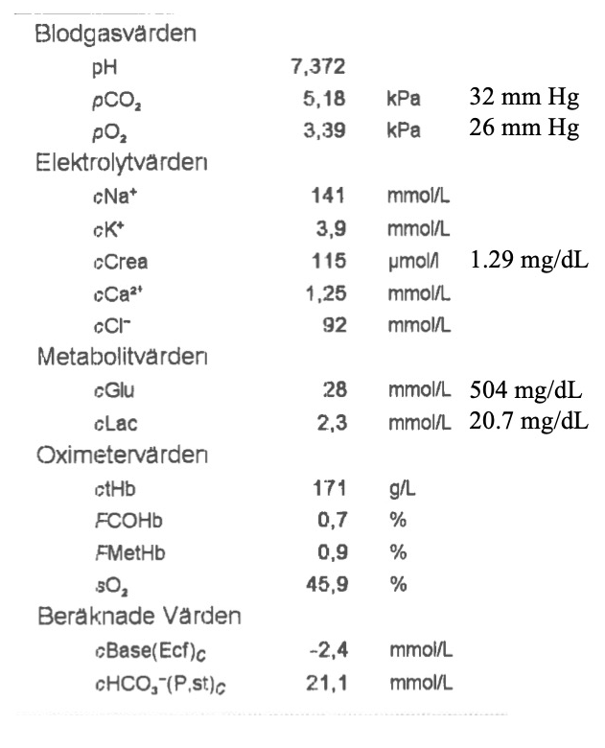
7.40 & 4.6 kPa / 27 mm Hg
7.40 & 5.8 kPa / 37 mm Hg
7.34 & 4.6 kPa / 27 mm Hg
7.34 & 5.8 kPa / 37 mm Hg

Slide 5
Arterial pH = venous pH + 0.03
Arterial pH = 7.37 + 0.03 = 7.40
kPa
Arterial pCO₂ = venous pCO₂ – 0.6
Arterial pCO₂ = 5.2 – 0.6 = 4.6
mm Hg
Arterial pCO₂ = venous pCO₂ – 5
Arterial pCO₂ = 32 – 5 = 27
Next Step

Slide 6
Metabolic acidosis
Metabolic alkalosis
Respiratory acidosis
Respiratory alkalosis
Other

Slide 7
The pH is normal so there is no “dominant disorder”
The pCO₂ is < 5.0 kPa / 37 mm Hg so there is a respiratory alkalosis
There must hence be a metabolic acidosis to result in a normal pH
Given that the pH is normal, there is no “compensation”
Next Step

Slide 8
- 3
4
14
24

Slide 9
(Na – Cl) = 141 – 92 = 49
Δ (Na – Cl) = 49 – 35 = 14
Hence the patient has either a metabolic alkalosis or a compensation for a chronic respiratory acidosis. Chronic respiratory acidosis unlikely given the low pCO₂.
Next Step

Slide 10
- 12
4
12
16

Slide 11
There are two ways to calculate the Δ AG:
  Δ AG = AG – 10
  Δ AG = Δ (Na – Cl) – SBE
Δ AG = 14 – (-2) = 16
Hence the patient has a HAGMA
Next Step

Slide 12
A 26-year-old man called the ambulance because he has been feeling unwell for the past four days.
The patient has type 1 diabetes mellitus.
What do you suspect?
Next Step

Slide 13
Resp Alkalosis
Hypoxemia
Drugs
Sepsis
Pain/anxiety
Met Alkalosis
D | Diuretics
R | RAS
I | Insuff arterial
V | Vomiting
E | Conn, Cushing
L | Licorice, Lax
< 5.0 / 35
> 3
pH
CO₂
∆ (Na - Cl)
∆ AG
> 3
HAGMA
K | Ketones
U | Uremia
L | Lactate
T | Toxins
Next Step

Slide 15
Next Step

Slide 16
Next Step

Slide 17
26-year-old man
Respiratory alkalosis: unclear etiology. An infection (sepsis, pneumonia) might be the trigger of the DKA
HAGMA: due to diabetic ketoacidosis. Clinically you would confirm the presence of ketones by measuring capillary ketones
Metabolic alkalosis: due to the diuretic effect of hyperglycemia and intravascular volume depletion
Treated as DKA
Next Case

Slide 18
Case 2: 63-year-old woman
Proceed

Slide 19
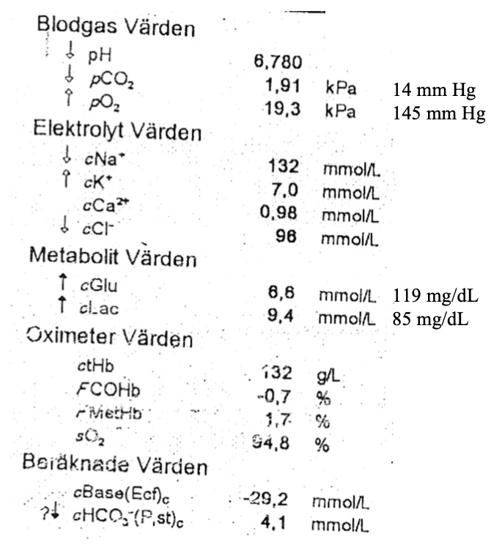
Metabolic acidosis
Metabolic alkalosis
Respiratory acidosis
Respiratory alkalosis
Other

Slide 20
The dominant disorder is a metabolic acidosis
Next Step

Slide 21
Yes
No. A respiratory acidosis is present
No. A respiratory alkalosis is present

Slide 22
Expected | kPa | mm Hg
∆pCO₂ | SBE x 0.1 | SBE x 1
∆pCO₂ | -2.9 | -29
pCO₂ | 5.3 – 2.9 = 2.4 | 40 – 29 = 11
Range | +/- 1 | +/- 5
Actual pCO₂ is 1.9 kPa / 14 mm Hg
The respiratory compensation is appropriate. There is no apparent respiratory disorder.
Next Step

Slide 23
- 5
1
5
9

Slide 24
(Na – Cl) = 132 – 96 = 36
Δ (Na – Cl) = 36 – 35 = 1
Hence the patient has neither a metabolic alkalosis nor a NAGMA
Next Step

Slide 25
5
10
15
30

Slide 26
There are two ways to calculate the Δ AG:
  Δ AG = AG – 10
  Δ AG = Δ (Na – Cl) – SBE
Δ AG = 11 – (-29) = 30
Hence the patient has a HAGMA
Next Step

Slide 27
A 63-year-old woman who was found unconscious is brought to the ED via ambulance.
The patient has previously suffered from alcohol over-consumption and she has had a gastric bypass.
A neighbour found the patient lying unconscious on the floor of her apartment. According to the neighbour, the patient was in her usual state of health yesterday.
Next Step

Slide 28
< 5.0 / 35
L-Lactate
L | Liver failure
A | Acc glycol
C | Circ failure
T | Thiamine
A | Anaerobic
T | Toxins
E | Ethylene G
S | Sepsis
pH
CO₂
∆ (Na - Cl)
∆ AG
> 3
HAGMA
K | Ketones
U | Uremia
L | Lactate
T | Toxins
Next Step

Slide 31
63-year-old woman
HAGMA: most likely caused by a toxin (toxic alcohol or salicylate poisoning)
Patient received dialysis to remove toxic metabolites of presumed methanol, ethylene glycol or salicylate poisoning.
Tests later revealed that the patient has overdosed on ethylene glycol. Note the hypocalcemia.
Next Case

Slide 32
Case 3: 82-year-old man
Proceed

Slide 33
Acid-Base
pH 7.37
pCO₂ 4.46 kPa 33 mm Hg
pO₂ 3.07 kPa 23 mm Hg
Base(Ecf)c -5.3 mmol/L
HCO₃⁻(P,st)c 19.1 mmol/L
Oximetry Values
sO₂ 32.3 %
ctHb 133 g/L
FMetHb 0.9 %
FCOHb 0.2 %
Electrolyte Values
Na⁺ 141 mmol/L
K⁺ 4.3 mmol/L
Ca²⁺ 1.11 mmol/L
Cl⁻ 116 mmol/L
Metabolite Values
Glucose 9.4 mmol/L 169 mg/dl
Lactate 2.7 mmol/L 24.3 mg/dl
Creatinine 209 μmol/L 2.35 mg/dl
Calculated Values
Anion Gap_{c} 5.6 mmol/L
7.34 & 3.9 kPa / 28 mm Hg
7.40 & 3.9 kPa / 28 mm Hg
7.34 & 4.7 kPa / 35 mm Hg
7.40 & 4.7 kPa / 35 mm Hg

Slide 34
Acid-Base
pH 7.37
pCO₂ 4.46 kPa 33 mm Hg
pO₂ 3.07 kPa 23 mm Hg
Base(Ecf)c -5.3 mmol/L
HCO₃⁻(P,st)c 19.1 mmol/L
Oximetry Values
sO₂ 32.3 %
ctHb 133 g/L
FMetHb 0.9 %
FCOHb 0.2 %
Electrolyte Values
Na⁺ 141 mmol/L
K⁺ 4.3 mmol/L
Ca²⁺ 1.11 mmol/L
Cl⁻ 116 mmol/L
Metabolite Values
Glucose 9.4 mmol/L 169 mg/dl
Lactate 2.7 mmol/L 24.3 mg/dl
Creatinine 209 μmol/L 2.35 mg/dl
Calculated Values
Anion Gap_{c} 5.6 mmol/L
Arterial pH = venous pH + 0.03
Arterial pH = 7.37 + 0.03 = 7.40
kPa
Arterial pCO₂ = venous pCO₂ – 0.6
Arterial pCO₂ = 4.5 – 0.6 = 3.9
mm Hg
Arterial pCO₂ = venous pCO₂ – 5
Arterial pCO₂ = 33 – 5 = 28
Next Step

Slide 35
Acid-Base
pH 7.37
pCO₂ 4.46 kPa 33 mm Hg
pO₂ 3.07 kPa 23 mm Hg
Base(Ecf)c -5.3 mmol/L
HCO₃⁻(P,st)c 19.1 mmol/L
Oximetry Values
sO₂ 32.3 %
ctHb 133 g/L
FMetHb 0.9 %
FCOHb 0.2 %
Electrolyte Values
Na⁺ 141 mmol/L
K⁺ 4.3 mmol/L
Ca²⁺ 1.11 mmol/L
Cl⁻ 116 mmol/L
Metabolite Values
Glucose 9.4 mmol/L 169 mg/dl
Lactate 2.7 mmol/L 24.3 mg/dl
Creatinine 209 μmol/L 2.35 mg/dl
Calculated Values
Anion Gap_{c} 5.6 mmol/L
Metabolic acidosis
Metabolic alkalosis
Respiratory acidosis
Respiratory alkalosis
Other

Slide 36
The pH is normal so there is no “dominant disorder”
The pCO₂ is < 5.0 kPa / 37 mm Hg so there is a respiratory alkalosis
There must hence be a metabolic acidosis to result in a normal pH
Given that the pH is normal, there is no “compensation”
Next Step

Slide 37
Acid-Base
pH 7.37
pCO₂ 4.46 kPa 33 mm Hg
pO₂ 3.07 kPa 23 mm Hg
Base(Ecf)c -5.3 mmol/L
HCO₃⁻(P,st)c 19.1 mmol/L
Oximetry Values
sO₂ 32.3 %
ctHb 133 g/L
FMetHb 0.9 %
FCOHb 0.2 %
Electrolyte Values
Na⁺ 141 mmol/L
K⁺ 4.3 mmol/L
Ca²⁺ 1.11 mmol/L
Cl⁻ 116 mmol/L
Metabolite Values
Glucose 9.4 mmol/L 169 mg/dl
Lactate 2.7 mmol/L 24.3 mg/dl
Creatinine 209 μmol/L 2.35 mg/dl
Calculated Values
Anion Gap_{c} 5.6 mmol/L
- 10
- 5
5
10

Slide 38
Acid-Base
pH 7.37
pCO₂ 4.46 kPa 33 mm Hg
pO₂ 3.07 kPa 23 mm Hg
Base(Ecf)c -5.3 mmol/L
HCO₃⁻(P,st)c 19.1 mmol/L
Oximetry Values
sO₂ 32.3 %
ctHb 133 g/L
FMetHb 0.9 %
FCOHb 0.2 %
Electrolyte Values
Na⁺ 141 mmol/L
K⁺ 4.3 mmol/L
Ca²⁺ 1.11 mmol/L
Cl⁻ 116 mmol/L
Metabolite Values
Glucose 9.4 mmol/L 169 mg/dl
Lactate 2.7 mmol/L 24.3 mg/dl
Creatinine 209 μmol/L 2.35 mg/dl
Calculated Values
Anion Gap_{c} 5.6 mmol/L
(Na – Cl) = 141 – 116 = 25
Δ (Na – Cl) = 25 – 35 = -10
Hence the patient has a NAGMA
Next Step

Slide 39
Acid-Base
pH 7.37
pCO₂ 4.46 kPa 33 mm Hg
pO₂ 3.07 kPa 23 mm Hg
Base(Ecf)c -5.3 mmol/L
HCO₃⁻(P,st)c 19.1 mmol/L
Oximetry Values
sO₂ 32.3 %
ctHb 133 g/L
FMetHb 0.9 %
FCOHb 0.2 %
Electrolyte Values
Na⁺ 141 mmol/L
K⁺ 4.3 mmol/L
Ca²⁺ 1.11 mmol/L
Cl⁻ 116 mmol/L
Metabolite Values
Glucose 9.4 mmol/L 169 mg/dl
Lactate 2.7 mmol/L 24.3 mg/dl
Creatinine 209 μmol/L 2.35 mg/dl
Calculated Values
Anion Gap_{c} 5.6 mmol/L
- 4
0
4
8

Slide 40
Acid-Base
pH 7.37
pCO₂ 4.46 kPa 33 mm Hg
pO₂ 3.07 kPa 23 mm Hg
Base(Ecf)c -5.3 mmol/L
HCO₃⁻(P,st)c 19.1 mmol/L
Oximetry Values
sO₂ 32.3 %
ctHb 133 g/L
FMetHb 0.9 %
FCOHb 0.2 %
Electrolyte Values
Na⁺ 141 mmol/L
K⁺ 4.3 mmol/L
Ca²⁺ 1.11 mmol/L
Cl⁻ 116 mmol/L
Metabolite Values
Glucose 9.4 mmol/L 169 mg/dl
Lactate 2.7 mmol/L 24.3 mg/dl
Creatinine 209 μmol/L 2.35 mg/dl
Calculated Values
Anion Gap_{c} 5.6 mmol/L
There are two ways to calculate the Δ AG:
  Δ AG = AG – 10
  Δ AG = Δ (Na – Cl) – SBE
Δ AG = 6 – 10 = -4
Hence the patient has a low AG
Next Step

Slide 41
Acid-Base
pH 7.37
pCO₂ 4.46 kPa 33 mm Hg
pO₂ 3.07 kPa 23 mm Hg
Base(Ecf)c -5.3 mmol/L
HCO₃⁻(P,st)c 19.1 mmol/L
Oximetry Values
sO₂ 32.3 %
ctHb 133 g/L
FMetHb 0.9 %
FCOHb 0.2 %
Electrolyte Values
Na⁺ 141 mmol/L
K⁺ 4.3 mmol/L
Ca²⁺ 1.11 mmol/L
Cl⁻ 116 mmol/L
Metabolite Values
Glucose 9.4 mmol/L 169 mg/dl
Lactate 2.7 mmol/L 24.3 mg/dl
Creatinine 209 μmol/L 2.35 mg/dl
Calculated Values
Anion Gap_{c} 5.6 mmol/L
An 82-year-old man presents because of vomiting and diarrhea
He has malignant melanoma with metastases to the liver, lung, adrenal glands, bone and brain. 10 days ago, he was treated with checkpoint inhibitor (Ipilimumab-Nivolumab). Developed vomiting and diarrhea three days ago.
What do you suspect?
Next Step

Slide 42
Resp Alkalosis
Hypoxemia
Drugs
Sepsis
Pain/anxiety
Low Anion Gap
L | Li, Low Albumin
I | Iodide
M | Myeloma
B | Bromide
S | Salicylates
< 5.0 / 35
< -3
pH
CO₂
∆ (Na - Cl)
∆ AG
< -3
NAGMA
C | Chloride
R | RTA, r. failure
A | Addison, Acet.
P | Poop & pee
Next Step

Slide 43
Acid-Base
pH 7.37
pCO₂ 4.46 kPa 33 mm Hg
pO₂ 3.07 kPa 23 mm Hg
Base(Ecf)c -5.3 mmol/L
HCO₃⁻(P,st)c 19.1 mmol/L
Oximetry Values
sO₂ 32.3 %
ctHb 133 g/L
FMetHb 0.9 %
FCOHb 0.2 %
Electrolyte Values
Na⁺ 141 mmol/L
K⁺ 4.3 mmol/L
Ca²⁺ 1.11 mmol/L
Cl⁻ 116 mmol/L
Metabolite Values
Glucose 9.4 mmol/L 169 mg/dl
Lactate 2.7 mmol/L 24.3 mg/dl
Creatinine 209 μmol/L 2.35 mg/dl
Calculated Values
Anion Gap_{c} 5.6 mmol/L

Slide 44
Acid-Base
pH 7.37
pCO₂ 4.46 kPa 33 mm Hg
pO₂ 3.07 kPa 23 mm Hg
Base(Ecf)c -5.3 mmol/L
HCO₃⁻(P,st)c 19.1 mmol/L
Oximetry Values
sO₂ 32.3 %
ctHb 133 g/L
FMetHb 0.9 %
FCOHb 0.2 %
Electrolyte Values
Na⁺ 141 mmol/L
K⁺ 4.3 mmol/L
Ca²⁺ 1.11 mmol/L
Cl⁻ 116 mmol/L
Metabolite Values
Glucose 9.4 mmol/L 169 mg/dl
Lactate 2.7 mmol/L 24.3 mg/dl
Creatinine 209 μmol/L 2.35 mg/dl
Calculated Values
Anion Gap_{c} 5.6 mmol/L

Slide 45
Acid-Base
pH 7.37
pCO₂ 4.46 kPa 33 mm Hg
pO₂ 3.07 kPa 23 mm Hg
Base(Ecf)c -5.3 mmol/L
HCO₃⁻(P,st)c 19.1 mmol/L
Oximetry Values
sO₂ 32.3 %
ctHb 133 g/L
FMetHb 0.9 %
FCOHb 0.2 %
Electrolyte Values
Na⁺ 141 mmol/L
K⁺ 4.3 mmol/L
Ca²⁺ 1.11 mmol/L
Cl⁻ 116 mmol/L
Metabolite Values
Glucose 9.4 mmol/L 169 mg/dl
Lactate 2.7 mmol/L 24.3 mg/dl
Creatinine 209 μmol/L 2.35 mg/dl
Calculated Values
Anion Gap_{c} 5.6 mmol/L

Slide 46
82-year-old man
Respiratory alkalosis: unclear etiology.
NAGMA: due to immune checkpoint inhibitor (ICI)-induced colitis resulting in diarrhea.
Low anion gap: due to hypoalbuminemia (albumin 28 g/L).
Treated with Cortison and Infliximab. Follow-up gastroscopy suggestive of immune-therapy related gastritis and duodenitis.
Next Case

Slide 47
Case 4: 54-year-old man
Proceed

Slide 48
Metabolic acidosis
Metabolic alkalosis
Respiratory acidosis
Respiratory alkalosis
Other

Slide 49
The dominant disorder is a metabolic acidosis
Next Step

Slide 50
Yes
No. A respiratory acidosis is present
No. A respiratory alkalosis is present

Slide 51
Expected | kPa | mm Hg
∆pCO₂ | SBE x 0.1 | SBE x 1
∆pCO₂ | -0.8 | -8
pCO₂ | 5.3 – 0.8 = 4.5 | 40 – 8 = 32
Range | +/- 1 | +/- 5
Actual pCO₂ is 5.3 kPa / 40 mm Hg
Borderline respiratory acidosis
Next Step

Slide 52
- 12
4
12
16

Slide 53
(Na – Cl) = 123 – 107 = 16
Δ (Na – Cl) = 16 – 35 = -19
Hence the patient has a NAGMA
Next Step

Slide 54
- 11
4
12
16

Slide 55
There are two ways to calculate the Δ AG:
  Δ AG = AG – 10
  Δ AG = Δ (Na – Cl) – SBE
Δ AG = -19 – (-8) = -11
Hence the patient has a Low Anion Gap
Next Step

Slide 56
A 54-year-old man is found unconscious lying on the floor of his apartment by his relatives.
He suffers from severe depression, for which he takes amitriptyline, lithium and a benzodiazepine.
What do you suspect?
Next Step

Slide 57
Low Anion Gap
L | Li, Low Albumin
I | Iodide
M | Myeloma
B | Bromide
S | Salicylates
< 5.0 / 35
< -3
pH
CO₂
∆ (Na - Cl)
∆ AG
> 5.7 / 45
< -3
Resp Acidosis
↓ CNS Drive
↓ Suction
Airway obstr
Alveoli
NAGMA
C | Chloride
R | RTA, r. failure
A | Addison, Acet.
P | Poop & pee
Next Step

Slide 61
54-year-old man
Respiratory acidosis: presumbly because of poisoning and decreased respiratory drive
NAGMA: lithium toxicity decreases the Na-Cl gap according to AI but I don’t understand the explanation provided
Low AG: the AG is remarkably low (- 11 mmol/L). This cannot be accounted for by low albumin. Presumed to be because of lithium overdose.
The measured lithium was around 11.9 mmol/L (therapeutic range 0.4 - 0.9 mmol/L)
Next Case

Slide 62
Case 5: 21-month-old boy
Proceed

Slide 63
Acid-Base
pH 7.33
pCO₂ 2.4 kPa 18 mm Hg
pO₂ 4.7 kPa 35 mm Hg
Base(Ecf)c -13.6 mmol/L
HCO₃⁻ 10 mmol/L
Oximetry Values
ctHb 118 g/L
Electrolyte Values
Na⁺ 139 mmol/L
K⁺ 2.9 mmol/L
Ca²⁺ 1.22 mmol/L
Cl⁻ 105 mmol/L
Metabolite Values
Glucose 9.4 mmol/L 170 mg/dl
Lactate 1.6 mmol/L 14.4 mg/dl
Creatinine 37 μmol/L 0.42 mg/dl
Calculated Values
Anion Gap_{c} 24 mmol/L
7.30 & 1.8 kPa / 13 mm Hg
7.30 & 3.0 kPa / 23 mm Hg
7.36 & 1.8 kPa / 13 mm Hg
7.36 & 3.0 kPa / 23 mm Hg

Slide 64
Arterial pH = venous pH + 0.03
Arterial pH = 7.33 + 0.03 = 7.36
kPa
Arterial pCO₂ = venous pCO₂ – 0.6
Arterial pCO₂ = 2.4 – 0.6 = 1.8
mm Hg
Arterial pCO₂ = venous pCO₂ – 5
Arterial pCO₂ = 18 – 5 = 13
Acid-Base
pH 7.33
pCO₂ 2.4 kPa 18 mm Hg
pO₂ 4.7 kPa 35 mm Hg
Base(Ecf)c -13.6 mmol/L
HCO₃⁻ 10 mmol/L
Oximetry Values
ctHb 118 g/L
Electrolyte Values
Na⁺ 139 mmol/L
K⁺ 2.9 mmol/L
Ca²⁺ 1.22 mmol/L
Cl⁻ 105 mmol/L
Metabolite Values
Glucose 9.4 mmol/L 170 mg/dl
Lactate 1.6 mmol/L 14.4 mg/dl
Creatinine 37 μmol/L 0.42 mg/dl
Calculated Values
Anion Gap_{c} 24 mmol/L
Next Step

Slide 65
Acid-Base
pH 7.33
pCO₂ 2.4 kPa 18 mm Hg
pO₂ 4.7 kPa 35 mm Hg
Base(Ecf)c -13.6 mmol/L
HCO₃⁻ 10 mmol/L
Oximetry Values
ctHb 118 g/L
Electrolyte Values
Na⁺ 139 mmol/L
K⁺ 2.9 mmol/L
Ca²⁺ 1.22 mmol/L
Cl⁻ 105 mmol/L
Metabolite Values
Glucose 9.4 mmol/L 170 mg/dl
Lactate 1.6 mmol/L 14.4 mg/dl
Creatinine 37 μmol/L 0.42 mg/dl
Calculated Values
Anion Gap_{c} 24 mmol/L
Metabolic acidosis
Metabolic alkalosis
Respiratory acidosis
Respiratory alkalosis
Other

Slide 66
The dominant disorder is a metabolic acidosis
Next Step

Slide 67
Acid-Base
pH 7.33
pCO₂ 2.4 kPa 18 mm Hg
pO₂ 4.7 kPa 35 mm Hg
Base(Ecf)c -13.6 mmol/L
HCO₃⁻ 10 mmol/L
Oximetry Values
ctHb 118 g/L
Electrolyte Values
Na⁺ 139 mmol/L
K⁺ 2.9 mmol/L
Ca²⁺ 1.22 mmol/L
Cl⁻ 105 mmol/L
Metabolite Values
Glucose 9.4 mmol/L 170 mg/dl
Lactate 1.6 mmol/L 14.4 mg/dl
Creatinine 37 μmol/L 0.42 mg/dl
Calculated Values
Anion Gap_{c} 24 mmol/L
Yes
No. A respiratory acidosis is present
No. A respiratory alkalosis is present

Slide 68
Acid-Base
pH 7.33
pCO₂ 2.4 kPa 18 mm Hg
pO₂ 4.7 kPa 35 mm Hg
Base(Ecf)c -13.6 mmol/L
HCO₃⁻ 10 mmol/L
Oximetry Values
ctHb 118 g/L
Electrolyte Values
Na⁺ 139 mmol/L
K⁺ 2.9 mmol/L
Ca²⁺ 1.22 mmol/L
Cl⁻ 105 mmol/L
Metabolite Values
Glucose 9.4 mmol/L 170 mg/dl
Lactate 1.6 mmol/L 14.4 mg/dl
Creatinine 37 μmol/L 0.42 mg/dl
Calculated Values
Anion Gap_{c} 24 mmol/L
Expected | kPa | mm Hg
∆pCO₂ | SBE x 0.1 | SBE x 1
∆pCO₂ | -1.4 | -14
pCO₂ | 5.3 – 1.4 = 3.9 | 40 – 14 = 26
Range | +/- 1 | +/- 5
Actual pCO₂ is 1.8 kPa / 13 mm Hg
Hence the patient also has a respiratory alkalosis
Next Step

Slide 69
Acid-Base
pH 7.33
pCO₂ 2.4 kPa 18 mm Hg
pO₂ 4.7 kPa 35 mm Hg
Base(Ecf)c -13.6 mmol/L
HCO₃⁻ 10 mmol/L
Oximetry Values
ctHb 118 g/L
Electrolyte Values
Na⁺ 139 mmol/L
K⁺ 2.9 mmol/L
Ca²⁺ 1.22 mmol/L
Cl⁻ 105 mmol/L
Metabolite Values
Glucose 9.4 mmol/L 170 mg/dl
Lactate 1.6 mmol/L 14.4 mg/dl
Creatinine 37 μmol/L 0.42 mg/dl
Calculated Values
Anion Gap_{c} 24 mmol/L
-2
-1
1
3

Slide 70
Acid-Base
pH 7.33
pCO₂ 2.4 kPa 18 mm Hg
pO₂ 4.7 kPa 35 mm Hg
Base(Ecf)c -13.6 mmol/L
HCO₃⁻ 10 mmol/L
Oximetry Values
ctHb 118 g/L
Electrolyte Values
Na⁺ 139 mmol/L
K⁺ 2.9 mmol/L
Ca²⁺ 1.22 mmol/L
Cl⁻ 105 mmol/L
Metabolite Values
Glucose 9.4 mmol/L 170 mg/dl
Lactate 1.6 mmol/L 14.4 mg/dl
Creatinine 37 μmol/L 0.42 mg/dl
Calculated Values
Anion Gap_{c} 24 mmol/L
(Na – Cl) = 139 – 105 = 34
Δ (Na – Cl) = 34 – 35 = -1
Hence the patient has neither a metabolic alkalosis nor a NAGMA
Next Step

Slide 71
Acid-Base
pH 7.33
pCO₂ 2.4 kPa 18 mm Hg
pO₂ 4.7 kPa 35 mm Hg
Base(Ecf)c -13.6 mmol/L
HCO₃⁻ 10 mmol/L
Oximetry Values
ctHb 118 g/L
Electrolyte Values
Na⁺ 139 mmol/L
K⁺ 2.9 mmol/L
Ca²⁺ 1.22 mmol/L
Cl⁻ 105 mmol/L
Metabolite Values
Glucose 9.4 mmol/L 170 mg/dl
Lactate 1.6 mmol/L 14.4 mg/dl
Creatinine 37 μmol/L 0.42 mg/dl
Calculated Values
Anion Gap_{c} 24 mmol/L
18
16
14
12

Slide 72
Acid-Base
pH 7.33
pCO₂ 2.4 kPa 18 mm Hg
pO₂ 4.7 kPa 35 mm Hg
Base(Ecf)c -13.6 mmol/L
HCO₃⁻ 10 mmol/L
Oximetry Values
ctHb 118 g/L
Electrolyte Values
Na⁺ 139 mmol/L
K⁺ 2.9 mmol/L
Ca²⁺ 1.22 mmol/L
Cl⁻ 105 mmol/L
Metabolite Values
Glucose 9.4 mmol/L 170 mg/dl
Lactate 1.6 mmol/L 14.4 mg/dl
Creatinine 37 μmol/L 0.42 mg/dl
Calculated Values
Anion Gap_{c} 24 mmol/L
There are two ways to calculate the Δ AG:
  Δ AG = AG – 10
  Δ AG = Δ (Na – Cl) – SBE
Δ AG = 24 – 10 = 14
Hence the patient has a HAGMA
Next Step

Slide 73
Acid-Base
pH 7.33
pCO₂ 2.4 kPa 18 mm Hg
pO₂ 4.7 kPa 35 mm Hg
Base(Ecf)c -13.6 mmol/L
HCO₃⁻ 10 mmol/L
Oximetry Values
ctHb 118 g/L
Electrolyte Values
Na⁺ 139 mmol/L
K⁺ 2.9 mmol/L
Ca²⁺ 1.22 mmol/L
Cl⁻ 105 mmol/L
Metabolite Values
Glucose 9.4 mmol/L 170 mg/dl
Lactate 1.6 mmol/L 14.4 mg/dl
Creatinine 37 μmol/L 0.42 mg/dl
Calculated Values
Anion Gap_{c} 24 mmol/L
A 21-month-old boy is being brought to the Emergency Department by ambulance because of lethargy, respiratory distress, and abdominal distension.
Yesterday morning, the boy started to vomit, had diarrhea and decreased oral intake. He was taken to the ED, diagnosed with gastroenteritis, given IV fluids and ondansetron, and then discharged.
Yesterday evening, he developed laboured breathing and somnolence. This morning, he was difficult to arouse and had frequent vomiting, prompting the parents to call an ambulance.
Next Step

Slide 74
Resp Alkalosis
Hypoxemia
Drugs
Sepsis
Pain/anxiety
< 5.0 / 35
< -3
pH
CO₂
∆ (Na - Cl)
∆ AG
> 3
HAGMA
K | Ketones
U | Uremia
L | Lactate
T | Toxins
Next Step

Slide 75
Acid-Base
pH 7.33
pCO₂ 2.4 kPa 18 mm Hg
pO₂ 4.7 kPa 35 mm Hg
Base(Ecf)c -13.6 mmol/L
HCO₃⁻ 10 mmol/L
Oximetry Values
ctHb 118 g/L
Electrolyte Values
Na⁺ 139 mmol/L
K⁺ 2.9 mmol/L
Ca²⁺ 1.22 mmol/L
Cl⁻ 105 mmol/L
Metabolite Values
Glucose 9.4 mmol/L 170 mg/dl
Lactate 1.6 mmol/L 14.4 mg/dl
Creatinine 37 μmol/L 0.42 mg/dl
Calculated Values
Anion Gap_{c} 24 mmol/L

Slide 76
Acid-Base
pH 7.33
pCO₂ 2.4 kPa 18 mm Hg
pO₂ 4.7 kPa 35 mm Hg
Base(Ecf)c -13.6 mmol/L
HCO₃⁻ 10 mmol/L
Oximetry Values
ctHb 118 g/L
Electrolyte Values
Na⁺ 139 mmol/L
K⁺ 2.9 mmol/L
Ca²⁺ 1.22 mmol/L
Cl⁻ 105 mmol/L
Metabolite Values
Glucose 9.4 mmol/L 170 mg/dl
Lactate 1.6 mmol/L 14.4 mg/dl
Creatinine 37 μmol/L 0.42 mg/dl
Calculated Values
Anion Gap_{c} 24 mmol/L

Slide 77
21-month-old body
The boy’s 4-year-old brother had given the patient tablets containing acetylsalicylic acid (aspirin, ASA).
Respiratory alkalosis: caused by acetylsalicylic poisoning
HAGMA: caused by acetylsalicylic poisoning
Acute management is alkalinization of the blood to ”trap” the acetylsalicylic acid in the blood and prevent it from entering the brain. Then consider whether dialysis is indicated.
Next Case

Slide 78
Case 6: 82-year-old man
Proceed

Slide 79
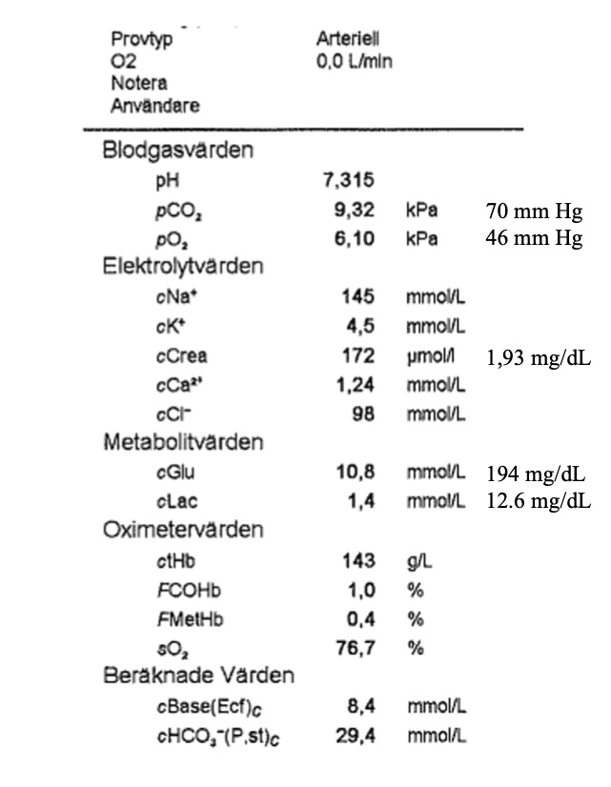
Metabolic acidosis
Metabolic alkalosis
Respiratory acidosis
Respiratory alkalosis
Other

Slide 80
The dominant disorder is a respiratory acidosis
Next Step

Slide 81
Acute
Chronic

Slide 82
If acute: expected SBE = 0
If chronic: expected SBE is
  3 x ∆pCO₂ in kPa
  1/3 x ∆pCO₂ in mm Hg
Actual SBE = 8
Suggests that the respiratory disorder is more likely chronic
∆pCO₂ | 4 kPa | 30 mm Hg
Expected SBE | 12 | 10
Next Step

Slide 83
- 12
4
12
16

Slide 84
(Na – Cl) = 145 – 98 = 47
Δ (Na – Cl) = 47 – 35 = 12
Hence the patient has either a metabolic alkalosis or a compensation for a chronic respiratory acidosis. Chronic respiratory acidosis is a plausible cause given the pCO₂.
Next Step

Slide 85
- 12
4
12
16

Slide 86
There are two ways to calculate the Δ AG:
  Δ AG = AG – 10
  Δ AG = Δ (Na – Cl) – SBE
Δ AG = 12 – 8 = 4
Hence the patient has a HAGMA
Next Step

Slide 87
An 80-year-old man has been brought to the ED by ambulance because he is no longer able to function at home.
No other information is currently available.
What do you interpret the blood gas?
Next Step

Slide 88
Met Alkalosis
D | Diuretics
R | RAS
I | Insuff arterial
V | Vomiting
E | Conn, Cushing
L | Licorice, Lax
< 5.0 / 35
> 3
pH
CO₂
∆ (Na - Cl)
∆ AG
> 5.7 / 45
> 3
Resp Acidosis
↓ CNS Drive
↓ Suction
Airway obstr
Alveoli
HAGMA
K | Ketones
U | Uremia
L | Lactate
T | Toxins
Next Step

Slide 91
82-year-old man
Respiratory acidosis: presumed COPD.
Δ (Na-Cl): the elevated Δ (Na-Cl) was interpreted as a metabolic compensation for chronic hypoventilation
HAGMA: presumed to be due to fasting (starvation) ketoacidosis. The creatinine level does not suggest a sufficiently severe renal failure to account for the unmeasured anions.
Treated as a COPD exacerbation.
Next Case

Slide 92
Case 7: 57-year-old woman
Proceed

Slide 93
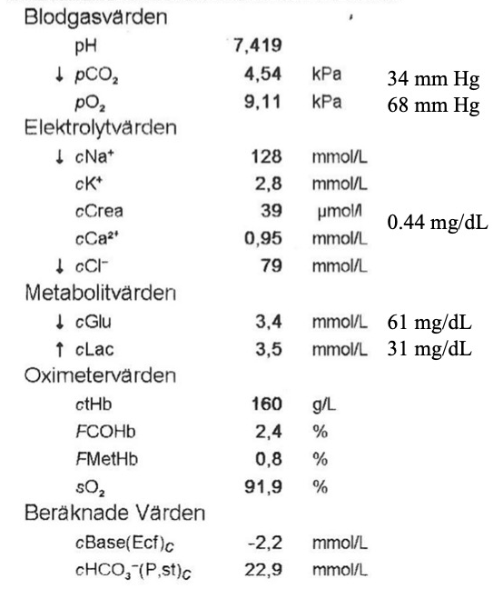
Metabolic acidosis
Metabolic alkalosis
Respiratory acidosis
Respiratory alkalosis
Other

Slide 94
The pH is normal so there is no “dominant disorder”
The pCO₂ is < 5.0 kPa / 37 mm Hg so there is a respiratory alkalosis
There must hence be a metabolic acidosis to result in a normal pH
Given that the pH is normal, there is no “compensation”
Next Step

Slide 95
- 12
4
12
14

Slide 96
(Na – Cl) = 128 – 79 = 49
Δ (Na – Cl) = 49 – 35 = 14
Hence the patient has either a metabolic alkalosis (or a compensation for a chronic respiratory acidosis but this is unlikely given the low pCO₂)
Next Step

Slide 97
-12
4
12
16

Slide 98
There are two ways to calculate the Δ AG:
  Δ AG = AG – 10
  Δ AG = Δ (Na – Cl) – SBE
Δ AG = 14 – (-2) = 16
Hence the patient has a HAGMA
Next Step

Slide 99
A 57-year-old woman is transported to the ED via ambulance. She has presumably been physically abused by her boyfriend.
According to the patient’s journal, she suffers from chronic alcohol abuse. She is awake and in no apparent distress. She responds appropriately to your questions but appears to be inebriated.
How do you explain the blood gas results?
Next Step

Slide 100
Resp Alkalosis
Hypoxemia
Drugs
Sepsis
Pain/anxiety
Met Alkalosis
D | Diuretics
R | RAS
I | Insuff arterial
V | Vomiting
E | Conn, Cushing
L | Licorice, Lax
< 5.0 / 35
> 3
L-Lactate
L | Liver failure
A | Acc glycol
C | Circ failure
T | Thiamine
A | Anaerobic
T | Toxins
E | Ethylene G
S | Sepsis
pH
CO₂
∆ (Na - Cl)
∆ AG
> 3
HAGMA
K | Ketones
U | Uremia
L | Lactate
T | Toxins
Next Step

Slide 104
Next Step

Slide 105
57-year-old woman
Respiratory alkalosis: unclear etiology. Stress?
Metabolic alkalosis: diuretic effect of ethanol? Intravascular volume depletion?
HAGMA: lactate accounts for only part of the delta AG. Alcohol ketoacidosis? The lactate itself could be the result of accelerated glycolysis, thiamine deficiency, ethanol
The patient was given thiamine and crystalloids and admitted to correct electrolyte disturbances. Ketones were elevated.
Next Case

Slide 106
Case 8: 54-year-old man
Proceed

Slide 107
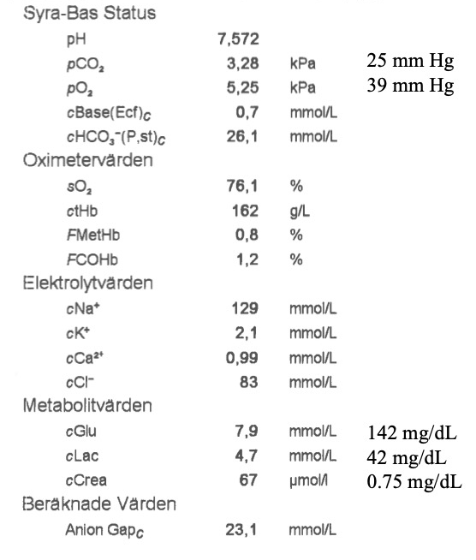
7.54 & 2.7 kPa / 20 mm Hg
7.54 & 3.9 kPa / 30 mm Hg
7.60 & 2.7 kPa / 20 mm Hg
7.60 & 3.9 kPa / 30 mm Hg

Slide 108
Arterial pH = venous pH + 0.03
Arterial pH = 7.57 + 0.03 = 7.60
kPa
Arterial pCO₂ = venous pCO₂ – 0.6
Arterial pCO₂ = 3.3 – 0.6 = 2.7
mm Hg
Arterial pCO₂ = venous pCO₂ – 5
Arterial pCO₂ = 25 – 5 = 20
Next Step

Slide 109
Metabolic acidosis
Metabolic alkalosis
Respiratory acidosis
Respiratory alkalosis
Other

Slide 110
The dominant disorder is a respiratory alkalosis
Next Step

Slide 111
Acute
Chronic

Slide 112
If acute: expected SBE = 0
If chronic: expected SBE is
  3 x ∆pCO₂ in kPa
  1/3 x ∆pCO₂ in mm Hg
Actual SBE = 0
Hence acute respiratory disorder
∆pCO₂ | 2.6 kPa | 20 mm Hg
Expected SBE | 7.8 | 7
Next Step

Slide 113
-12
4
11
16

Slide 114
(Na – Cl) = 129 – 83 = 46
Δ (Na – Cl) = 46 – 35 = 11
Hence the patient has a metabolic alkalosis
Next Step

Slide 115
-12
4
13
16

Slide 116
There are two ways to calculate the Δ AG:
  Δ AG = AG – 10
  Δ AG = Δ (Na – Cl) – SBE
Δ AG = 23 – 10 = 13
Hence the patient has a HAGMA
Next Step

Slide 117
A 54-year-old man presents to the ED because of accentuation of his panic attacks, vomiting, inability to eat/drink/sleep, reported weight loss of 15 kg.
Background: anxiety disorder, episodic alcohol over-consumption.
What do you suspect?
Next Step

Slide 118
Resp Alkalosis
Hypoxemia
Drugs
Sepsis
Pain/anxiety
Met Alkalosis
D | Diuretics
R | RAS
I | Insuff arterial
V | Vomiting
E | Conn, Cushing
L | Licorice, Lax
< 5.0 / 35
> 3
L-Lactate
L | Liver failure
A | Acc glycol
C | Circ failure
T | Thiamine
A | Anaerobic
T | Toxins
E | Ethylene G
S | Sepsis
pH
CO₂
∆ (Na - Cl)
∆ AG
> 3
HAGMA
K | Ketones
U | Uremia
L | Lactate
T | Toxins
Next Step

Slide 123
54-year-old man
Respiratory alkalosis: anxiety?
Metabolic alkalosis: vomiting? Intravascular volume depletion?
HAGMA: lactate accounts for part of the delta AG. Ketoacidosis from starvation/ethanol? Lactate from accelerated glycolysis/ethanol?
Treated in the ED with benzo PO, thiamine and NaCl 1000 ml with 40 mmol KCl and 20 mmol MgSO4 IV
Next Case

Slide 124
Case 9: 46-year-old man
Proceed

Slide 125
Acid-Base
pH 7.37
pCO₂ 3.0 kPa 22.5 mm Hg
pO₂ 8.2 kPa 61.5 mm Hg
Base(Ecf)c -11.5 mmol/L
HCO₃⁻(P,st)c 16 mmol/L
Oximetry Values
sO₂ 91 %
ctHb 163 g/L
FMetHb 1.1 %
FCOHb 1.1 %
Electrolyte Values
Na⁺ 136 mmol/L
K⁺ 8.5 mmol/L
Ca²⁺ 1.04 mmol/L
Cl⁻ 116 mmol/L
Metabolite Values
Glucose 6.7 mmol/L 120 mg/dl
Lactate 2.5 mmol/L 22.5 mg/dl
Creatinine 145 μmol/L 1.63 mg/dl
Calculated Values
Anion Gap_{c} 8 mmol/L
Metabolic acidosis
Metabolic alkalosis
Respiratory acidosis
Respiratory alkalosis
Other

Slide 126
The dominant disorder is a metabolic acidosis
Next Step

Slide 127
Acid-Base
pH 7.37
pCO₂ 3.0 kPa 22.5 mm Hg
pO₂ 8.2 kPa 61.5 mm Hg
Base(Ecf)c -11.5 mmol/L
HCO₃⁻(P,st)c 16 mmol/L
Oximetry Values
sO₂ 91 %
ctHb 163 g/L
FMetHb 1.1 %
FCOHb 1.1 %
Electrolyte Values
Na⁺ 136 mmol/L
K⁺ 8.5 mmol/L
Ca²⁺ 1.04 mmol/L
Cl⁻ 116 mmol/L
Metabolite Values
Glucose 6.7 mmol/L 120 mg/dl
Lactate 2.5 mmol/L 22.5 mg/dl
Creatinine 145 μmol/L 1.63 mg/dl
Calculated Values
Anion Gap_{c} 8 mmol/L
Yes
No. A respiratory acidosis is present
No. A respiratory alkalosis is present

Slide 128
Acid-Base
pH 7.37
pCO₂ 3.0 kPa 22.5 mm Hg
pO₂ 8.2 kPa 61.5 mm Hg
Base(Ecf)c -11.5 mmol/L
HCO₃⁻(P,st)c 16 mmol/L
Oximetry Values
sO₂ 91 %
ctHb 163 g/L
FMetHb 1.1 %
FCOHb 1.1 %
Electrolyte Values
Na⁺ 136 mmol/L
K⁺ 8.5 mmol/L
Ca²⁺ 1.04 mmol/L
Cl⁻ 116 mmol/L
Metabolite Values
Glucose 6.7 mmol/L 120 mg/dl
Lactate 2.5 mmol/L 22.5 mg/dl
Creatinine 145 μmol/L 1.63 mg/dl
Calculated Values
Anion Gap_{c} 8 mmol/L
Expected | kPa | mm Hg
∆pCO₂ | SBE x 0.1 | SBE x 1
∆pCO₂ | -1.2 | -12
pCO₂ | 5.3 – 1.2 = 4.1 | 40 – 12 = 28
Range | +/- 1 | +/- 5
Actual pCO₂ is 3.0 kPa / 23 mm Hg
There is a respiratory alkalosis
Next Step

Slide 129
Acid-Base
pH 7.37
pCO₂ 3.0 kPa 22.5 mm Hg
pO₂ 8.2 kPa 61.5 mm Hg
Base(Ecf)c -11.5 mmol/L
HCO₃⁻(P,st)c 16 mmol/L
Oximetry Values
sO₂ 91 %
ctHb 163 g/L
FMetHb 1.1 %
FCOHb 1.1 %
Electrolyte Values
Na⁺ 136 mmol/L
K⁺ 8.5 mmol/L
Ca²⁺ 1.04 mmol/L
Cl⁻ 116 mmol/L
Metabolite Values
Glucose 6.7 mmol/L 120 mg/dl
Lactate 2.5 mmol/L 22.5 mg/dl
Creatinine 145 μmol/L 1.63 mg/dl
Calculated Values
Anion Gap_{c} 8 mmol/L
-15
-10
10
15

Slide 130
Acid-Base
pH 7.37
pCO₂ 3.0 kPa 22.5 mm Hg
pO₂ 8.2 kPa 61.5 mm Hg
Base(Ecf)c -11.5 mmol/L
HCO₃⁻(P,st)c 16 mmol/L
Oximetry Values
sO₂ 91 %
ctHb 163 g/L
FMetHb 1.1 %
FCOHb 1.1 %
Electrolyte Values
Na⁺ 136 mmol/L
K⁺ 8.5 mmol/L
Ca²⁺ 1.04 mmol/L
Cl⁻ 116 mmol/L
Metabolite Values
Glucose 6.7 mmol/L 120 mg/dl
Lactate 2.5 mmol/L 22.5 mg/dl
Creatinine 145 μmol/L 1.63 mg/dl
Calculated Values
Anion Gap_{c} 8 mmol/L
(Na – Cl) = 136 – 116 = 20
Δ (Na – Cl) = 20 – 35 = -15
Hence the patient has a NAGMA
Next Step

Slide 131
Acid-Base
pH 7.37
pCO₂ 3.0 kPa 22.5 mm Hg
pO₂ 8.2 kPa 61.5 mm Hg
Base(Ecf)c -11.5 mmol/L
HCO₃⁻(P,st)c 16 mmol/L
Oximetry Values
sO₂ 91 %
ctHb 163 g/L
FMetHb 1.1 %
FCOHb 1.1 %
Electrolyte Values
Na⁺ 136 mmol/L
K⁺ 8.5 mmol/L
Ca²⁺ 1.04 mmol/L
Cl⁻ 116 mmol/L
Metabolite Values
Glucose 6.7 mmol/L 120 mg/dl
Lactate 2.5 mmol/L 22.5 mg/dl
Creatinine 145 μmol/L 1.63 mg/dl
Calculated Values
Anion Gap_{c} 8 mmol/L
-2
4
12
16

Slide 132
Acid-Base
pH 7.37
pCO₂ 3.0 kPa 22.5 mm Hg
pO₂ 8.2 kPa 61.5 mm Hg
Base(Ecf)c -11.5 mmol/L
HCO₃⁻(P,st)c 16 mmol/L
Oximetry Values
sO₂ 91 %
ctHb 163 g/L
FMetHb 1.1 %
FCOHb 1.1 %
Electrolyte Values
Na⁺ 136 mmol/L
K⁺ 8.5 mmol/L
Ca²⁺ 1.04 mmol/L
Cl⁻ 116 mmol/L
Metabolite Values
Glucose 6.7 mmol/L 120 mg/dl
Lactate 2.5 mmol/L 22.5 mg/dl
Creatinine 145 μmol/L 1.63 mg/dl
Calculated Values
Anion Gap_{c} 8 mmol/L
There are two ways to calculate the Δ AG:
  Δ AG = AG – 10
  Δ AG = Δ (Na – Cl) – SBE
Δ AG = 8 – 10 = -2
Hence the patient has no HAGMA
Next Step

Slide 133
Acid-Base
pH 7.37
pCO₂ 3.0 kPa 22.5 mm Hg
pO₂ 8.2 kPa 61.5 mm Hg
Base(Ecf)c -11.5 mmol/L
HCO₃⁻(P,st)c 16 mmol/L
Oximetry Values
sO₂ 91 %
ctHb 163 g/L
FMetHb 1.1 %
FCOHb 1.1 %
Electrolyte Values
Na⁺ 136 mmol/L
K⁺ 8.5 mmol/L
Ca²⁺ 1.04 mmol/L
Cl⁻ 116 mmol/L
Metabolite Values
Glucose 6.7 mmol/L 120 mg/dl
Lactate 2.5 mmol/L 22.5 mg/dl
Creatinine 145 μmol/L 1.63 mg/dl
Calculated Values
Anion Gap_{c} 8 mmol/L
A 46-year-old man called the ambulance because of bilateral leg weakness.
The patient suffers from Crohns. He has undergone a hemicolectomy and rectum amputation and has a terminal ileostomy. Has developed liver cirrhosis as a complication of treatment with Azathioprine.
What do you suspect?
Next Step

Slide 134
Resp Alkalosis
Hypoxemia
Drugs
Sepsis
Pain/anxiety
< 5.0 / 35
pH
CO₂
∆ (Na - Cl)
∆ AG
< -3
NAGMA
C | Chloride
R | RTA, r. failure
A | Addison, Acet.
P | Poop & pee
Next Step

Slide 135
Acid-Base
pH 7.37
pCO₂ 3.0 kPa 22.5 mm Hg
pO₂ 8.2 kPa 61.5 mm Hg
Base(Ecf)c -11.5 mmol/L
HCO₃⁻(P,st)c 16 mmol/L
Oximetry Values
sO₂ 91 %
ctHb 163 g/L
FMetHb 1.1 %
FCOHb 1.1 %
Electrolyte Values
Na⁺ 136 mmol/L
K⁺ 8.5 mmol/L
Ca²⁺ 1.04 mmol/L
Cl⁻ 116 mmol/L
Metabolite Values
Glucose 6.7 mmol/L 120 mg/dl
Lactate 2.5 mmol/L 22.5 mg/dl
Creatinine 145 μmol/L 1.63 mg/dl
Calculated Values
Anion Gap_{c} 8 mmol/L

Slide 136
Acid-Base
pH 7.37
pCO₂ 3.0 kPa 22.5 mm Hg
pO₂ 8.2 kPa 61.5 mm Hg
Base(Ecf)c -11.5 mmol/L
HCO₃⁻(P,st)c 16 mmol/L
Oximetry Values
sO₂ 91 %
ctHb 163 g/L
FMetHb 1.1 %
FCOHb 1.1 %
Electrolyte Values
Na⁺ 136 mmol/L
K⁺ 8.5 mmol/L
Ca²⁺ 1.04 mmol/L
Cl⁻ 116 mmol/L
Metabolite Values
Glucose 6.7 mmol/L 120 mg/dl
Lactate 2.5 mmol/L 22.5 mg/dl
Creatinine 145 μmol/L 1.63 mg/dl
Calculated Values
Anion Gap_{c} 8 mmol/L

Slide 137
46-year-old man
Respiratory alkalosis: unclear etiology. Infection? Stress?
NAGMA: due to high flow through his ileostomy leading to an increased loss of Cl in relation to Na
Note: the delta AG is the summation of all ionic charges once the delta Na-Cl has been removed. In this case, the patient has a slightly elevated lactate that is presumably offset by a low albumin (patient’s albumin measured 2 weeks before admission and 2 weeks after admission was 34 g/L)
Next Case

Slide 138
Case 10: 60-year-old man
Proceed

Slide 139
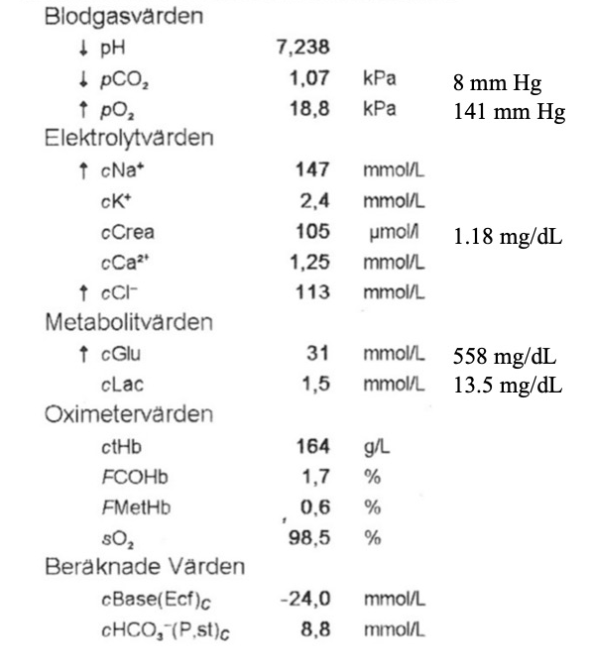
Metabolic acidosis
Metabolic alkalosis
Respiratory acidosis
Respiratory alkalosis
Other

Slide 140
The dominant disorder is a metabolic acidosis
Next Step

Slide 141
Yes
No. A respiratory acidosis is present
No. A respiratory alkalosis is present

Slide 142
Expected | kPa | mm Hg
∆pCO₂ | SBE x 0.1 | SBE x 1
∆pCO₂ | -2.4 | -24
pCO₂ | 5.3 – 2.4 = 2.9 | 40 – 24 = 16
Range | +/- 1 | +/- 5
Actual pCO₂ is 1.1 kPa / 8 mm Hg
Hence there is a respiratory alkalosis
Next Step

Slide 143
-12
4
-1
16

Slide 144
(Na – Cl) = 147 – 113 = 34
Δ (Na – Cl) = 35 – 35 = -1
Hence the patient has neither a metabolic alkalosis nor a NAGMA
Next Step

Slide 145
-12
4
12
23

Slide 146
There are two ways to calculate the Δ AG:
  Δ AG = AG – 10
  Δ AG = Δ (Na – Cl) – SBE
Δ AG = -1 – (-24) = 23
Hence the patient has a HAGMA
Next Step

Slide 147
A 60-year-old man is transported to the ED via ambulance because he can not longer function alone at home.
According to the available information, he has been feeling increasingly unwell during the past week.
What do you suspect?
Next Step

Slide 148
Resp Alkalosis
Hypoxemia
Drugs
Sepsis
Pain/anxiety
< 5.0 / 35
pH
CO₂
∆ (Na - Cl)
∆ AG
> 3
HAGMA
K | Ketones
U | Uremia
L | Lactate
T | Toxins
Next Step

Slide 151
60-year-old man
Respiratory alkalosis: the patient has a pronounced respiratory alkalosis that is not hypoxemia-driven. Gram-negative sepsis as a trigger for the DKA/HHS?
HAGMA: given the hyperglycemia, the normal lactate and the near-normal creatinine, DKA is the most likely explanation. The patient also has hyperosmolarity, i.e. a combination of DKA and HHS
Treated as DKA/HHS, first with crystalloids and replenishment of potassium before insulin therapy. Required admission to the ICU (presumed urosepsis).
Next Case

Slide 152
Case 11: 52-year-old man
Proceed

Slide 153
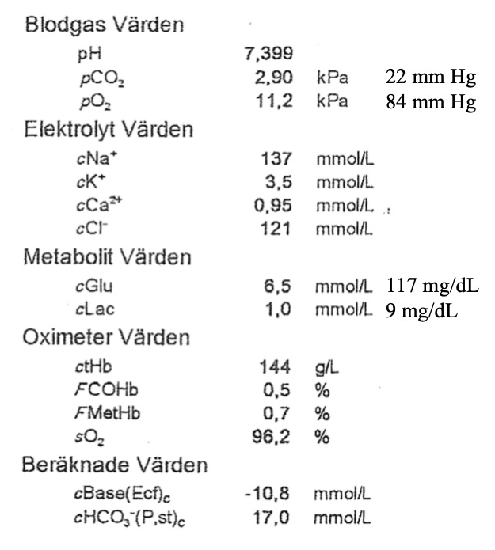
Metabolic acidosis
Metabolic alkalosis
Respiratory acidosis
Respiratory alkalosis
Other

Slide 154
The pH is normal so there is no “dominant disorder”
The pCO₂ is < 5.0 kPa / 37 mm Hg so there is a respiratory alkalosis
There must hence be a metabolic acidosis to result in a normal pH
Given that the pH is normal, there is no “compensation”
Next Step

Slide 155
-20
-19
-18
13

Slide 156
(Na – Cl) = 137 – 121 = 16
Δ (Na – Cl) = 16 – 35 = -19
Hence the patient has a NAGMA
Next Step

Slide 157
-8
-6
6
8

Slide 158
There are two ways to calculate the Δ AG:
  Δ AG = AG – 10
  Δ AG = Δ (Na – Cl) – SBE
Δ AG = -19 – (-11) = -8
Hence the patient has a Low AG
Next Step

Slide 159
A 52-year-old man is referred to the ED by primary care physician because the patient is short of breath and confused
On the referral note: “Pulmonary embolism? Serotonin syndrome? Other?”
What do you suspect?
Next Step

Slide 160
Resp Alkalosis
Hypoxemia
Drugs
Sepsis
Pain/anxiety
Low Anion Gap
L | Li, Low Albumin
I | Iodide
M | Myeloma
B | Bromide
S | Salicylates
< 5.0 / 35
< -3
pH
CO₂
∆ (Na - Cl)
∆ AG
< -3
> 3
NAGMA
C | Chloride
R | RTA, r. failure
A | Addison, Acet.
P | Poop & pee
Next Step

Slide 164
52-year-old man
Patient’s wife reports that her husband has been overconsuming Treo (acetylsalicylic acid + caffein) for headache
Respiratory alkalosis: presumably due to ASA stimulating the respiratory center
NAGMA: due to falsely elevated chloride value
Low AG: in the setting of an ASA poisoning, the radiometer can sometimes report falsely elevated chloride value. The patient’s actual chloride (measured in another way) was 102 mmol/L. Patient’s metabolic acidosis was actually a HAGMA from ASA.
Next Case

Slide 165
Case 12: 82-year-old woman
Proceed

Slide 166
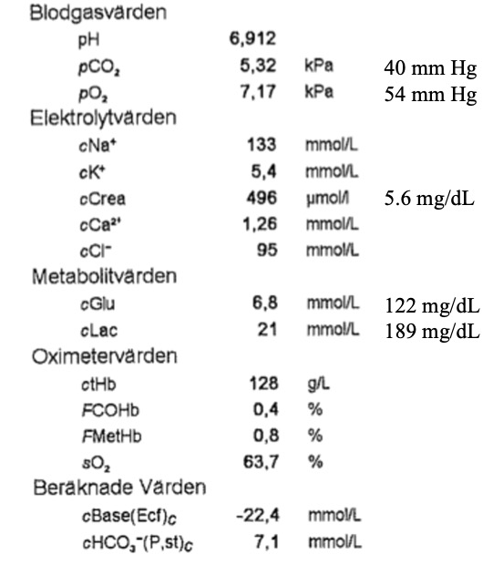
7.11 & 6.0 kPa / 45 mm Hg
7.21 & 5.9 kPa / 45 mm Hg
6.94 & 4.7 kPa / 35 mm Hg
6.94 & 6.0 kPa / 45 mm Hg

Slide 167
Arterial pH = venous pH + 0.03
Arterial pH = 6.91 + 0.03 = 6.94
kPa
Arterial pCO₂ = venous pCO₂ – 0.6
Arterial pCO₂ = 5.3 – 0.6 = 4.7
mm Hg
Arterial pCO₂ = venous pCO₂ – 5
Arterial pCO₂ = 40 – 5 = 35
Next Step

Slide 168
Metabolic acidosis
Metabolic alkalosis
Respiratory acidosis
Respiratory alkalosis
Other

Slide 169
The dominant disorder is a metabolic acidosis
Next Step

Slide 170
Yes
No. A respiratory acidosis is present
No. A respiratory alkalosis is present

Slide 171
Expected | kPa | mm Hg
∆pCO₂ | SBE x 0.1 | SBE x 1
∆pCO₂ | -2.2 | -22
pCO₂ | 5.3 – 2.2 = 3.1 | 40 – 22 = 28
Range | +/- 1 | +/- 5
Actual pCO₂ is 4.7 kPa / 35 mm Hg
Hence there is a respiratory acidosis
Next Step

Slide 172
-12
4
12
16

Slide 173
(Na – Cl) = 133 – 95 = 38
Δ (Na – Cl) = 38 – 35 = 3
Hence the patient has a borderline metabolic alkalosis
Next Step

Slide 174
-12
4
16
25

Slide 175
There are two ways to calculate the Δ AG:
  Δ AG = AG – 10
  Δ AG = Δ (Na – Cl) – SBE
Δ AG = 3 – (-22) = 25
Hence the patient has a HAGMA
Next Step

Slide 176
An 82-year-old woman presents to the ED because of abdominal pain
She has type 2 diabetes mellitus and takes metformin.
What do you suspect?
Next Step

Slide 177
L-Lactate
L | Liver failure
A | Acc glycol
C | Circ failure
T | Thiamine
A | Anaerobic
T | Toxins
E | Ethylene G
S | Sepsis
pH
CO₂
∆ (Na - Cl)
∆ AG
> 3
Resp Acidosis
↓ CNS Drive
↓ Suction
Airway obstr
Alveoli
NAGMA
C | Chloride
R | RTA, r. failure
A | Addison, Acet.
P | Poop & pee
HAGMA
K | Ketones
U | Uremia
L | Lactate
T | Toxins
Next Step

Slide 180
Next Step

Slide 181
82-year-old woman
Respiratory acidosis: unclear why the patient is not able to mount a better respiratory compensation. Decreased level of consciousness? Underlying lung disease?
HAGMA: due mainly to lactate. Perhaps some ketones as well? Or some sulphate and phosphate from renal failure?
Lactate: the lactate is profoundly elevated, yet the patient is not moribund according to available information. This suggests metformin toxicity, consistent with the elevated creatinine.
Next Case

Slide 182
Case #: X-year-old Y
Proceed

Slide 183
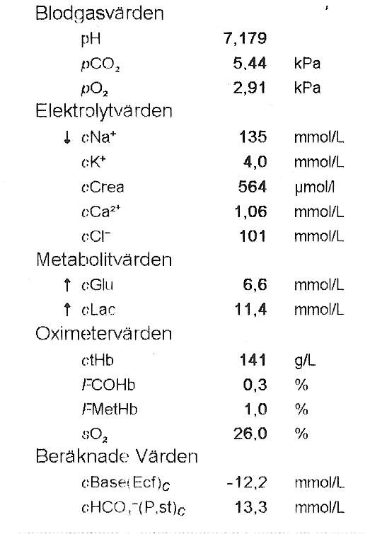
7.21 & 6.0 kPa / 45 mm Hg
7.21 & 6.0 kPa / 45 mm Hg
7.21 & 6.0 kPa / 45 mm Hg
7.21 & 6.0 kPa / 45 mm Hg

Slide 184
Arterial pH = venous pH + 0.03
Arterial pH = 7.37 + 0.03 = 7.40
kPa
Arterial pCO₂ = venous pCO₂ – 0.6
Arterial pCO₂ = 5.2 – 0.6 = 4.6
mm Hg
Arterial pCO₂ = venous pCO₂ – 5
Arterial pCO₂ = 32 – 5 = 27
Next Step

Slide 185
Metabolic acidosis
Metabolic alkalosis
Respiratory acidosis
Respiratory alkalosis
Other

Slide 186
The dominant disorder is a metabolic acidosis
Next Step

Slide 187
Yes
No. A respiratory acidosis is present
No. A respiratory alkalosis is present

Slide 188
Expected | kPa | mm Hg
∆pCO₂ | SBE x 0.1 | SBE x 1
∆pCO₂ | -2.9 | -29
pCO₂ | 5.3 – 2.9 = 2.4 | 40 – 29 = 11
Range | +/- 1 | +/- 5
Actual pCO₂ is 1.9 kPa / 14 mm Hg
Hence appropriate respiratory compensation
Next Step

Slide 189
Acute
Chronic

Slide 190
If acute: expected SBE = 0
If chronic: expected SBE is
  3 x ∆pCO₂ in kPa
  1/3 x ∆pCO₂ in mm Hg
Actual SBE = 0
Hence acute respiratory disorder
∆pCO₂ | 2.7 kPa | 20 mm Hg
Expected SBE | 8.1 | 7
Next Step

Slide 191
- 12
4
12
16

Slide 192
(Na – Cl) = 141 – 92 = 49
Δ (Na – Cl) = 49 – 35 = 14
Hence the patient has either a metabolic alkalosis or a compensation for a chronic respiratory acidosis
Next Step

Slide 193
- 12
4
12
16

Slide 194
There are two ways to calculate the Δ AG:
  Δ AG = AG – 10
  Δ AG = Δ (Na – Cl) – SBE
Δ AG = 14 – (-2) = 16
Hence the patient has a HAGMA
Next Step

Slide 195
An 82-year-old woman presents to the ED because of abdominal pain
She has type 2 diabetes mellitus and takes metformin.
What do you suspect?
Next Step

Slide 196
Resp Alkalosis
Hypoxemia
Drugs
Sepsis
Pain/anxiety
Met Alkalosis
D | Diuretics
R | RAS
I | Insuff arterial
V | Vomiting
E | Conn, Cushing
L | Licorice, Lax
Low Anion Gap
L | Li, Low Albumin
I | Iodide
M | Myeloma
B | Bromide
S | Salicylates
< 5.0 / 35
> 3
< -3
L-Lactate
L | Liver failure
A | Acc glycol
C | Circ failure
T | Thiamine
A | Anaerobic
T | Toxins
E | Ethylene G
S | Sepsis
pH
CO₂
∆ (Na - Cl)
∆ AG
> 5.7 / 45
< -3
> 3
Resp Acidosis
↓ CNS Drive
↓ Suction
Airway obstr
Alveoli
NAGMA
C | Chloride
R | RTA, r. failure
A | Addison, Acet.
P | Poop & pee
HAGMA
K | Ketones
U | Uremia
L | Lactate
T | Toxins
Next Step

Slide 197
Next Step

Slide 198
82-year-old woman
Respiratory alkalosis: unclear etiology. An infection (sepsis, pneumonia) might be the trigger of the DKA
HAGMA: due to diabetic ketoacidosis
Metabolic alkalosis: due to the diuretic effect of hyperglycemia and intravascular volume depletion
Treated as DKA
Next Case

