Slide 1
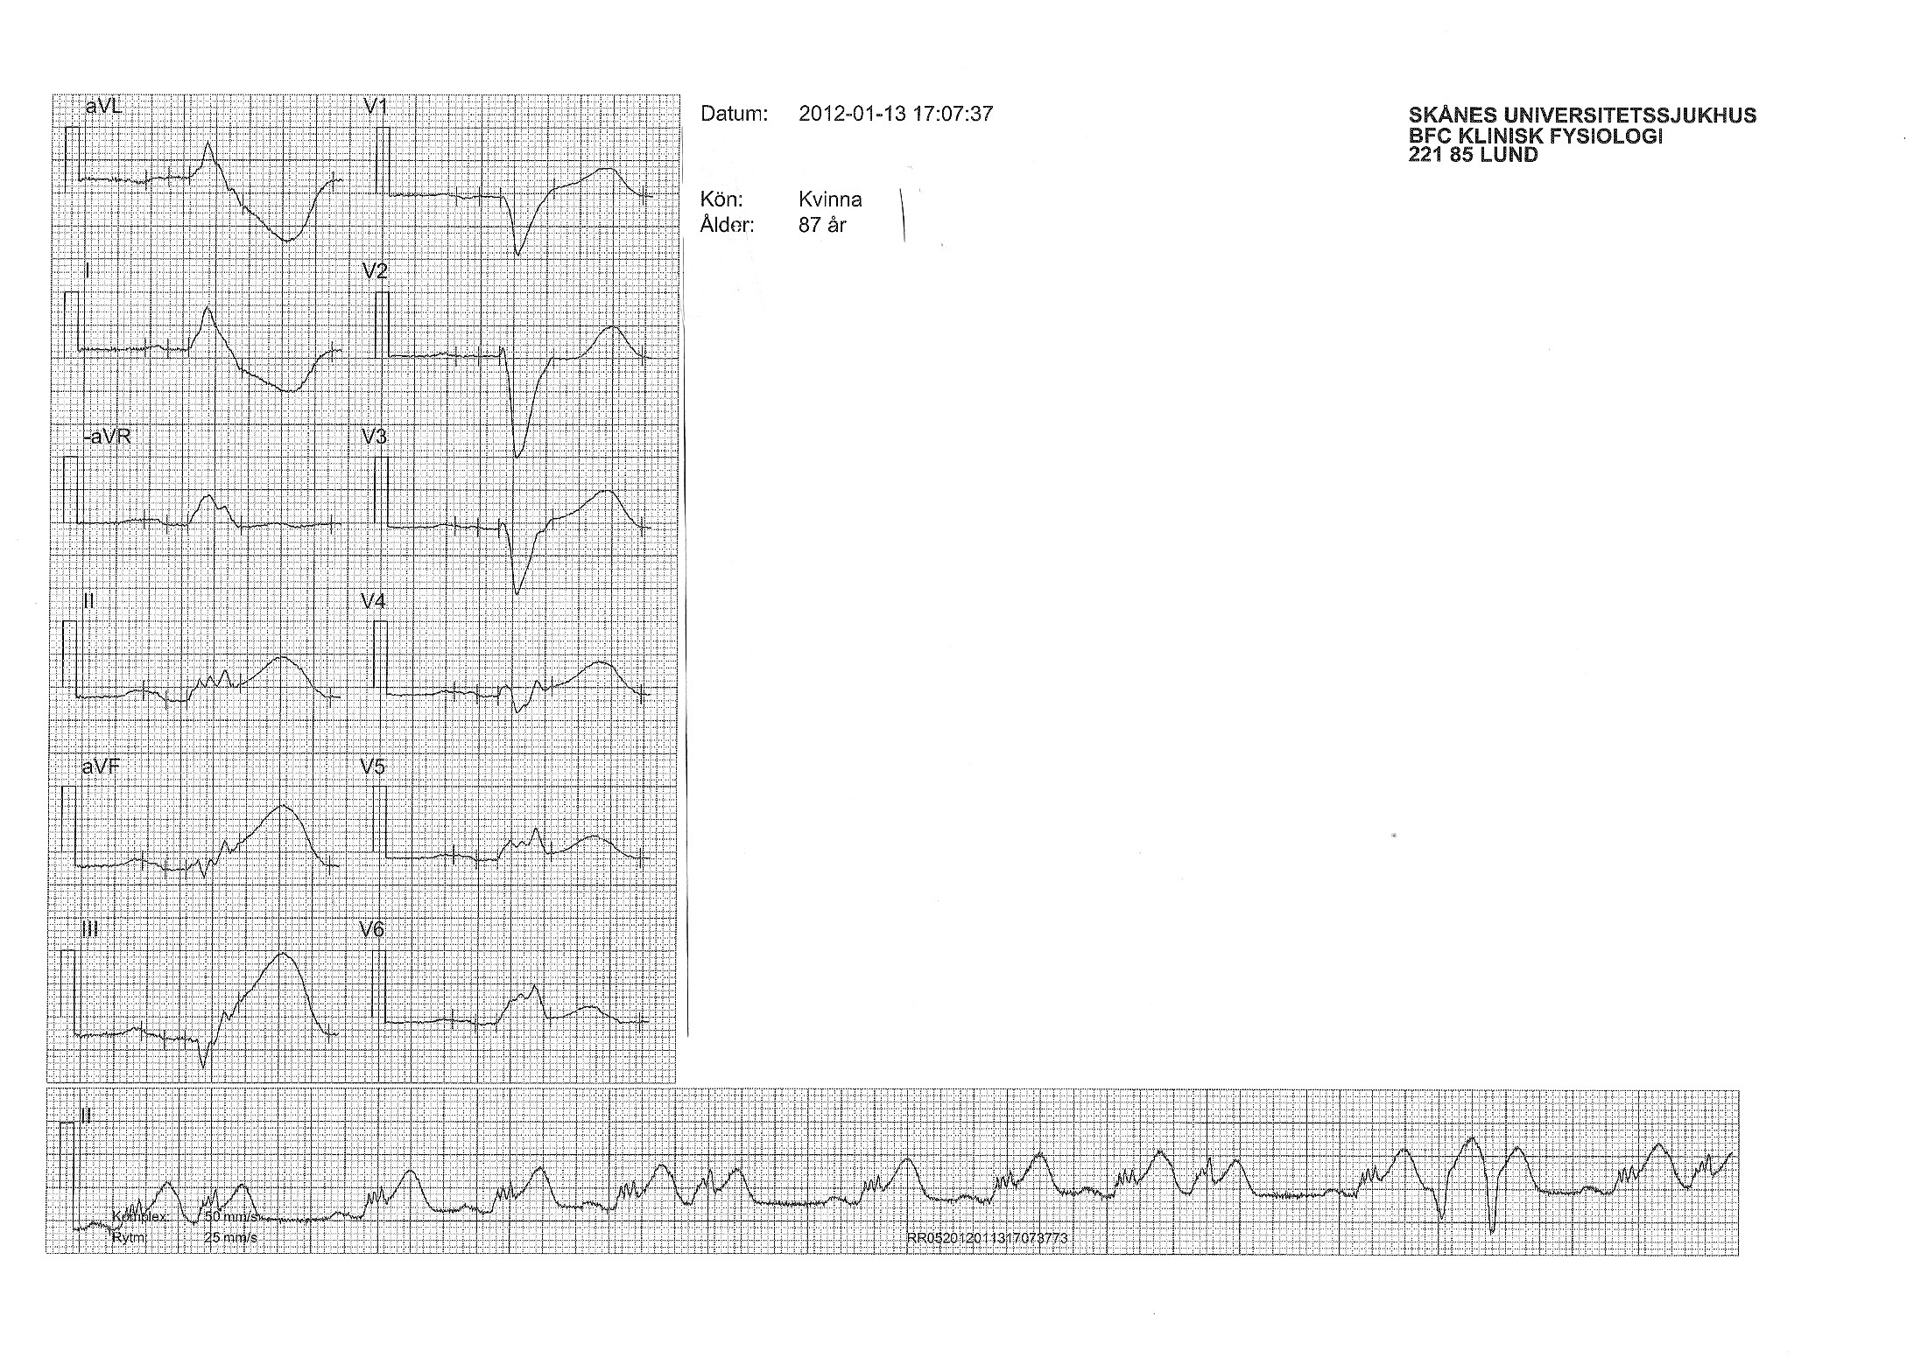
87-Year-Old Woman with Chest Pain
Notes:
87-year-old presents with chest pain
Paper speed for the complexes is 50 mm/sec
Paper speed for the rhythm strip is 25 mm/sec
The patient has LBBB.
The most obvious Sgarbossa criteria in lead II.
Also has a Barcelona in aVL
Unfortunately, a format of this EKG with a uniform paper speed of 25 mm/sec is not available.

Slide 2
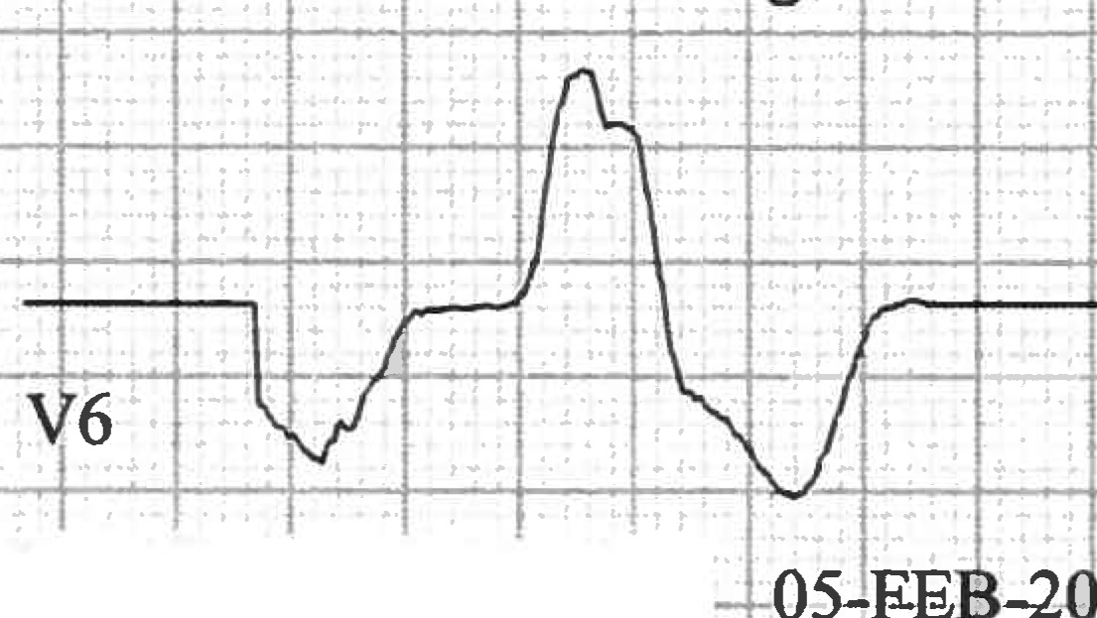
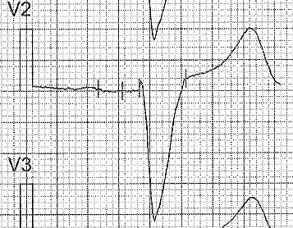
Discordance between QRS and ST is Normal with LBBB
Notes:
Normally in LBBB, QRS and ST go in opposite directions (“discordance”)

Slide 3
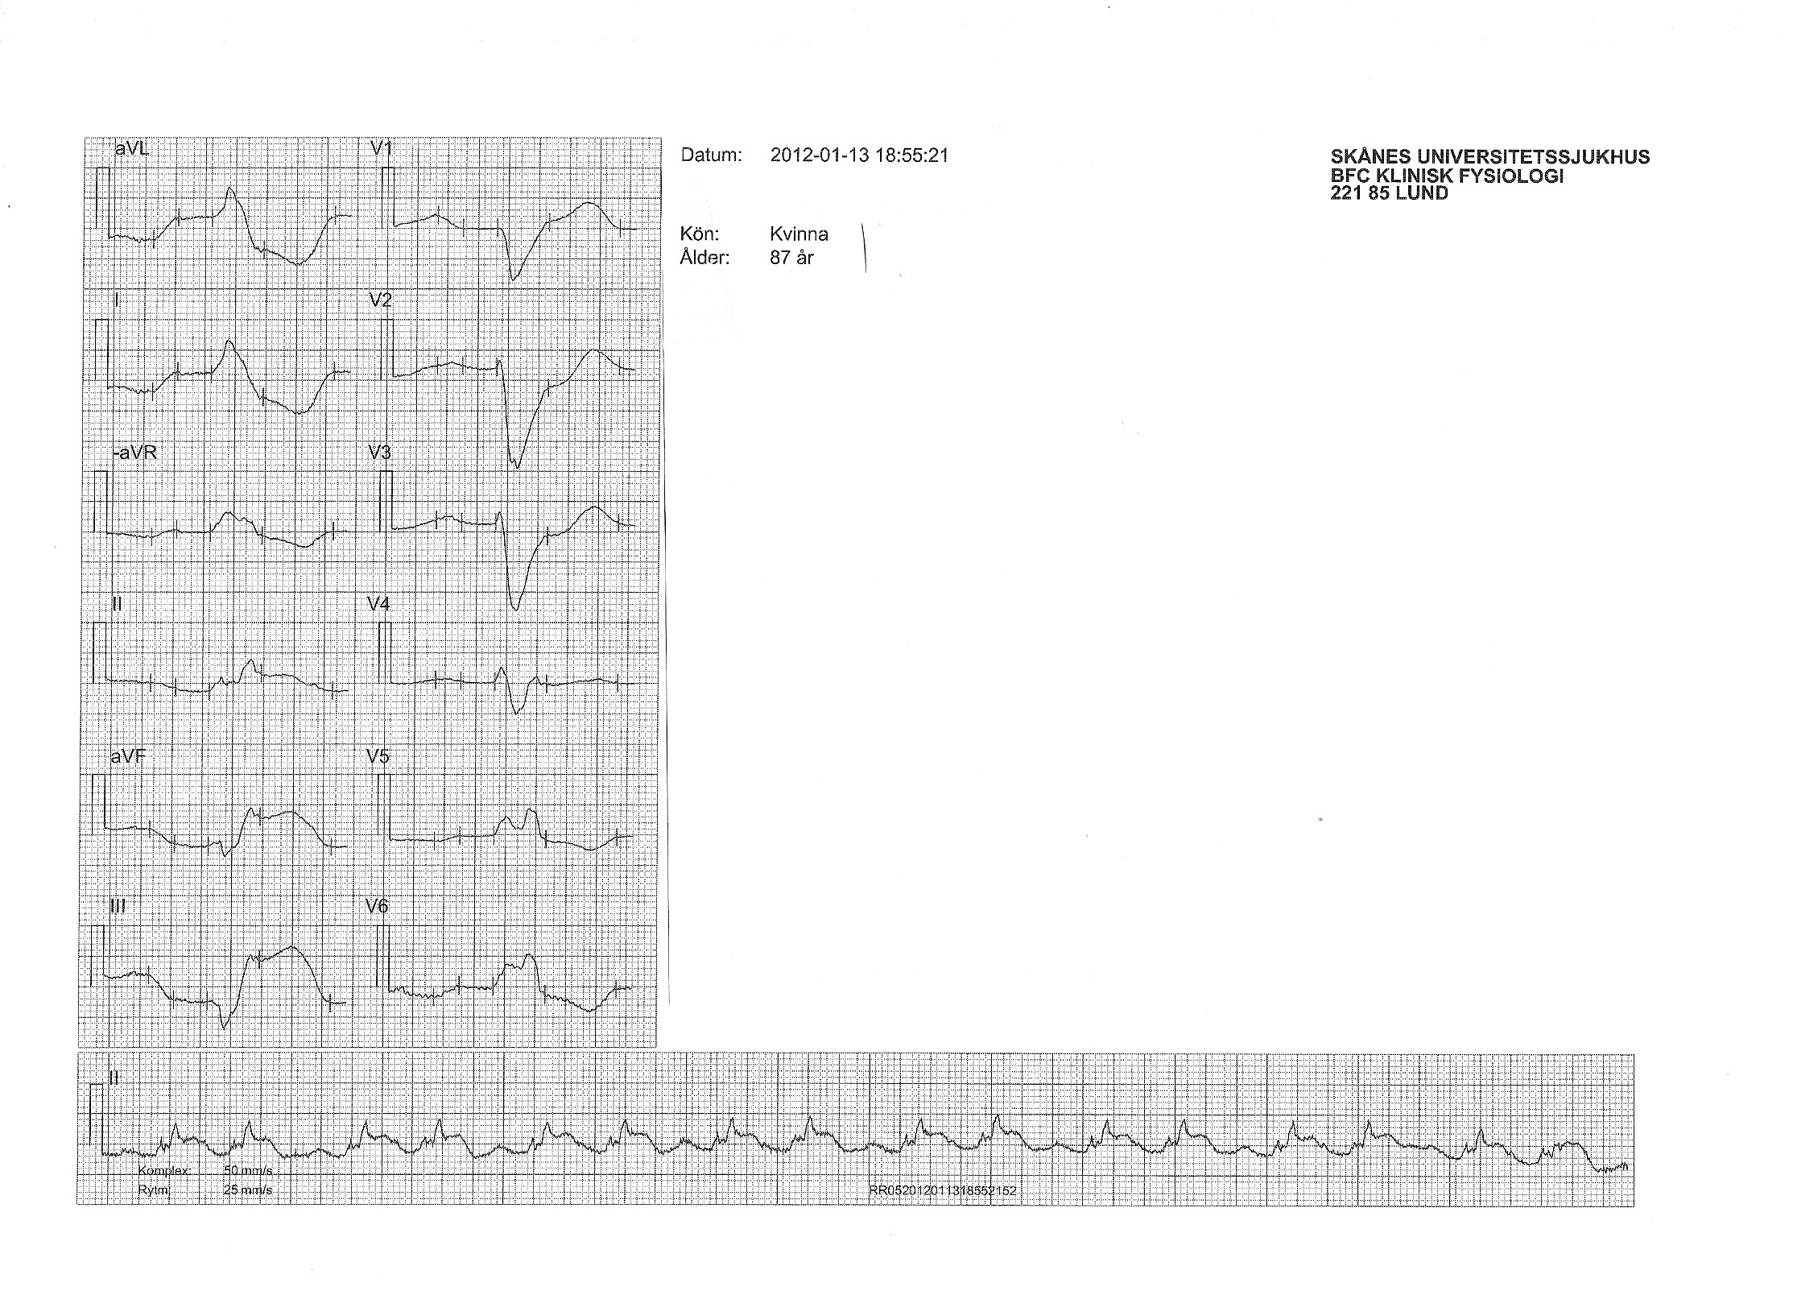
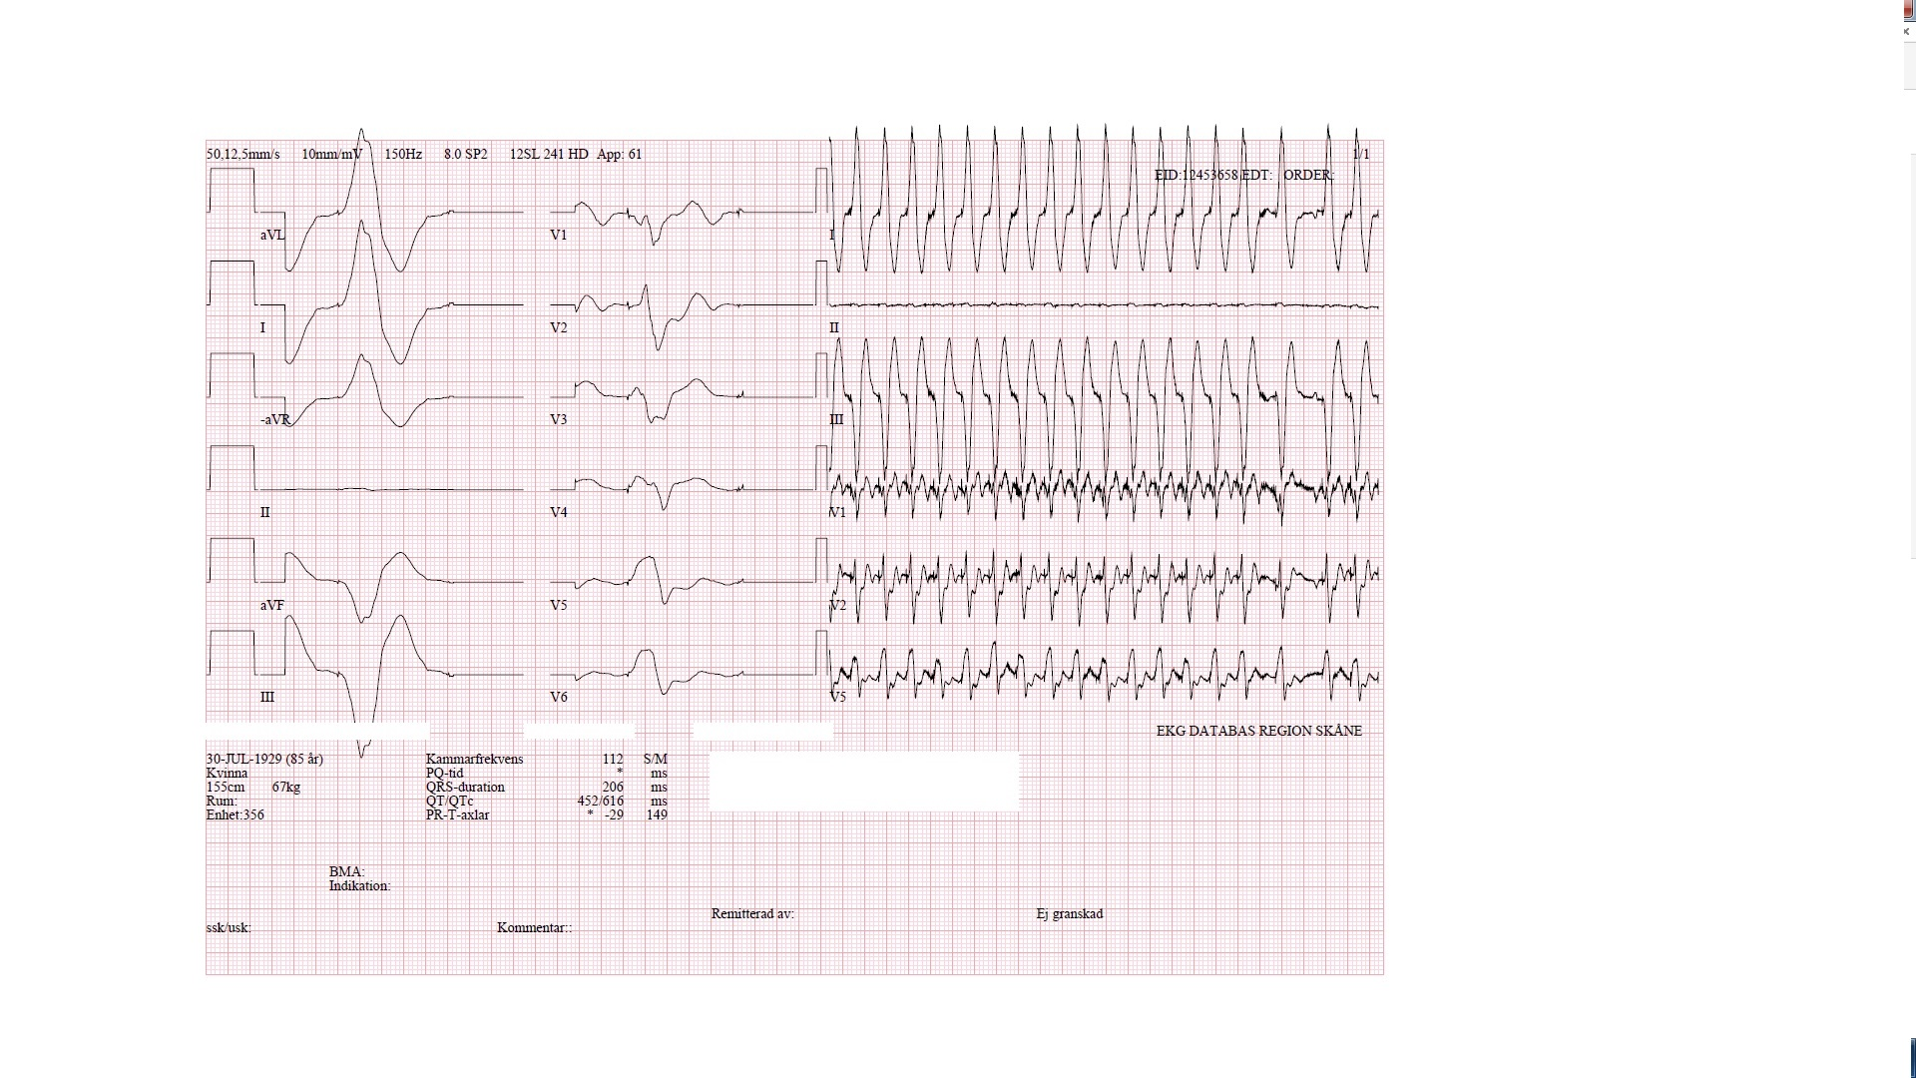
Modified Sgarbossa
Concordant ST elevation > 1 mm anywhere
Concordant ST depression > 1 mm in V1-V2-V3
Discordant ST elevation > 1 mm and > 25% S wave
Notes:
Concordant ST-elevation present in II, V5 and V6.
Discordant ST-elevation >25% of S wave in III

Slide 4
BARCELONA
ST deviation > 1 mm concordant with QRS (anywhere)
ST deviation > 1 mm discordant with QRS in leads with max R or S ≤ 6 mm*
*Note that this is not peak-to-peak QRS amplitude
Notes:
Concordant ST-elevation present in II, V5 and V6.
R wave in aVL = 6 mm and ST-depression > 1 mm
S wave in aVF and III < 6 mm and ST-elevation > 1 mm

Slide 5
EKG at 16:28
Notes:
Ambulance EKG at 16.28
Sgarbossa in II
Note the hyperacute T waves in the inferior leads

Slide 6
17:07
18:55
Notes:
Complexes: paper speed of 50 mm/sec
Rhythm: paper speed of 25 mm/sec
18:55: patient is crashing. Has all 3 modified Sgarbossa criteria
Taking to PCI, opened RCA. Cardiac arrest on angio table but survived.
Unfortunately, a version of this EKG with a uniform paper speed of 25 mm/sec is not available.

Slide 7
85-Year-Old Woman with Chest Pain
Notes:
EKG from Peter Sawatiuk: 85-year-old woman with tachypnea, desaturation, hypotension. TnT 4500 proBNP 6500.
Pacemaker and LBBB pattern.
Sgarbossa in V2 and III.

Slide 8
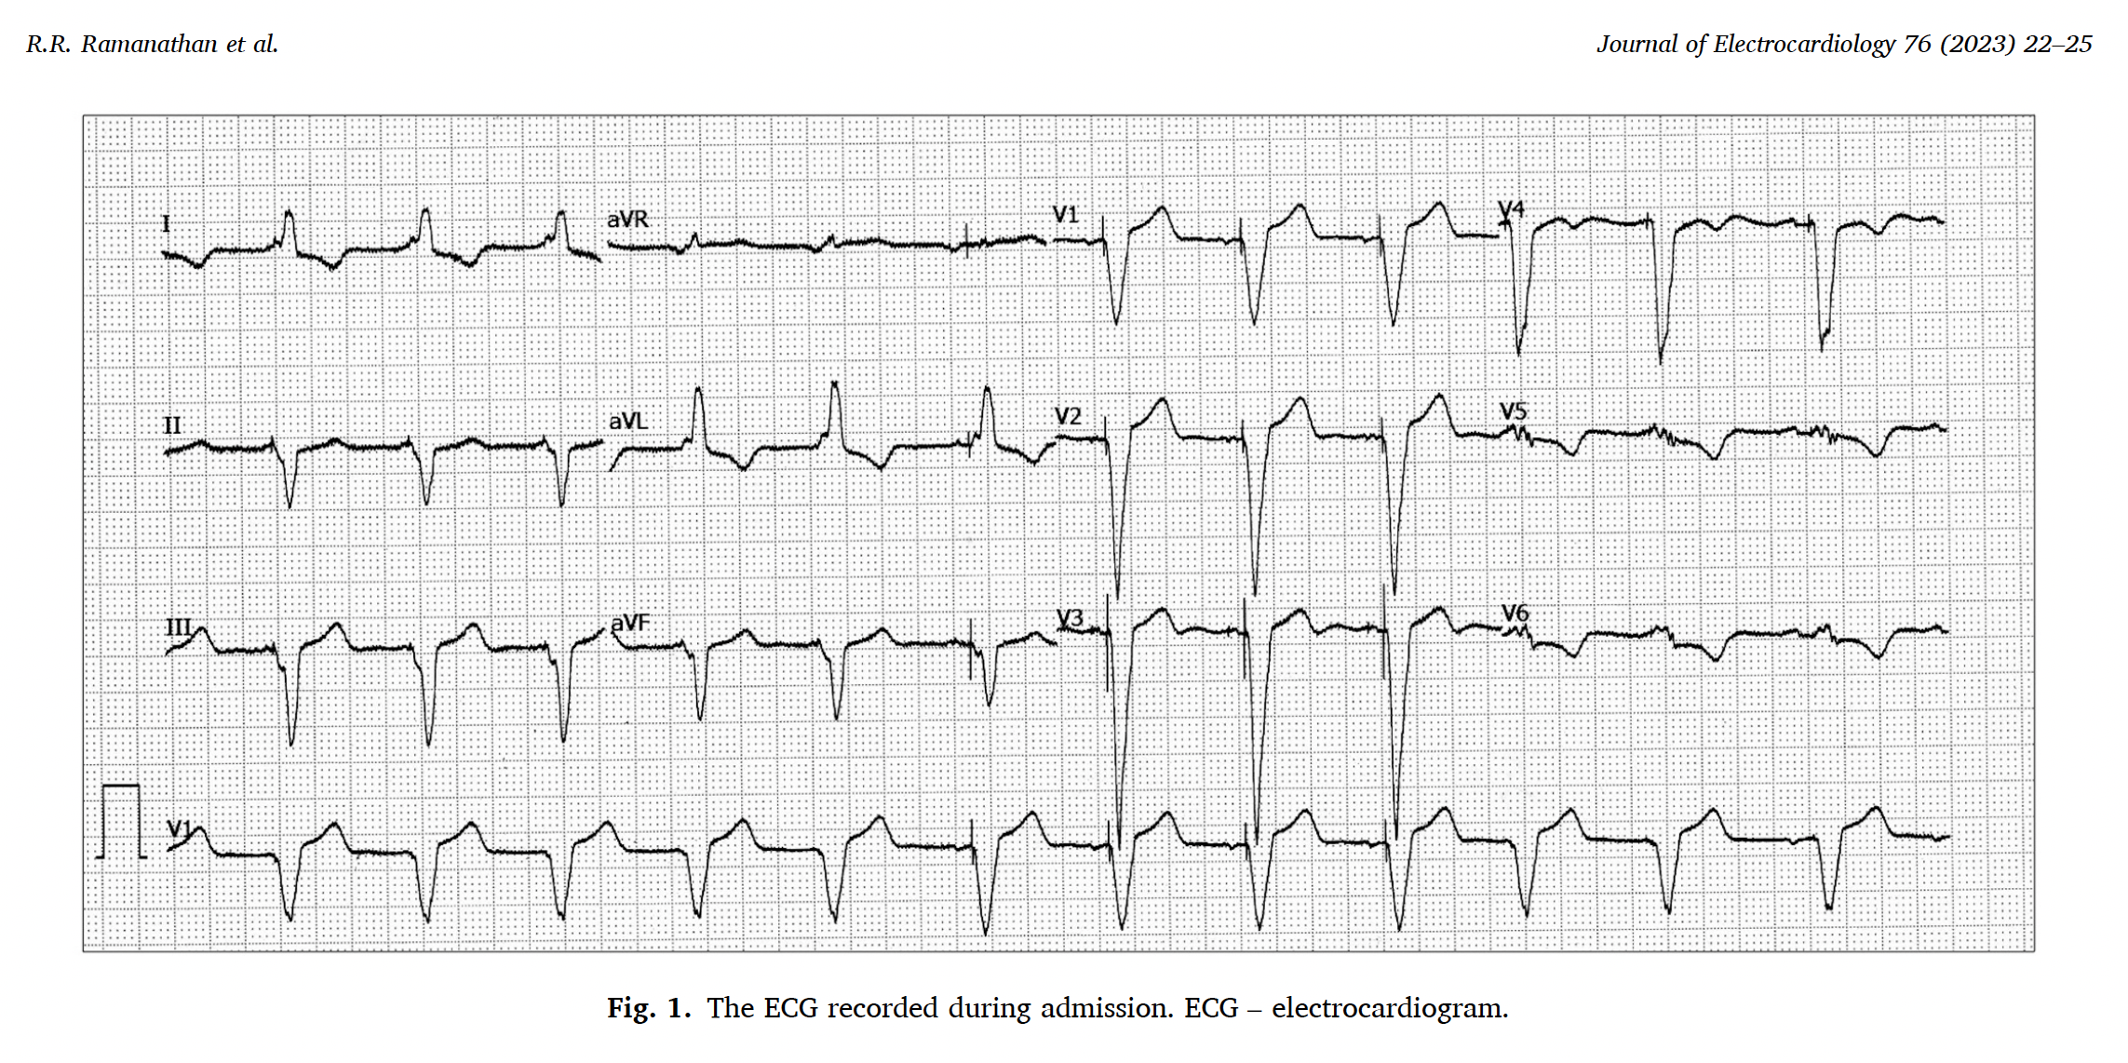

Slide 9
