Slide 1
T-Wave

Slide 2
Index
RV-Strain & -Injury
Wellen’s T-Waves
Cerebral T-Waves
Hyperacute T-Waves
De Winter Pattern
Hyperkalemia

Slide 3
RV-Strain & -Injury

Slide 4
45-year-old woman with chest pain on exertion
Notes:
Complexes: 50 mm/sec
Rhythm: 25 mm/sec
45-year-old woman presenting to the ED because of chest pain
The chest pain and shortness of breath started a couple of months ago and occur when she walks, never at rest.
The pain and shortness of breath have gotten gradually worse and she can now barely walk to the subway stop without have to take a break.

Slide 5
Negative T-waves V1-V4
Negative T-wave in III: PE
Positive T-wave in III: LAD
Kosuge. Eur Heart J Acute Cardiovasc Care 2012;1:349

Slide 6
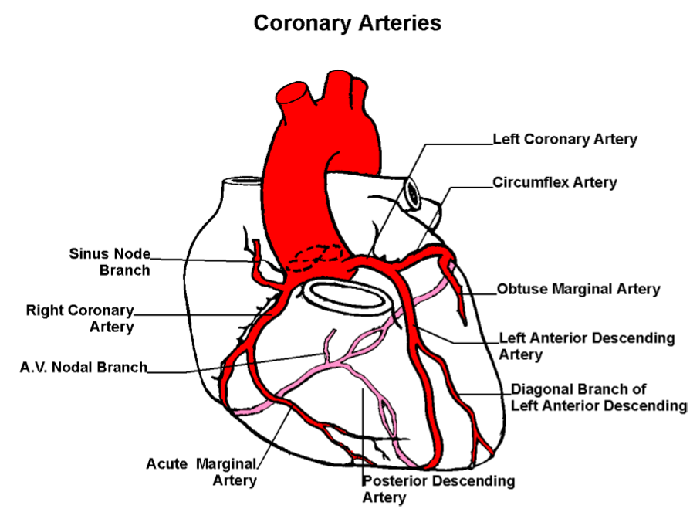
Notes:
If the negative T waves in V1-V4 were due to LAD pathology, you would not expect negative T wave in lead III (usually RCA).
Lead III points to the right. The RV is located under electrodes V1-V3. The combination of negative T waves in V1-V3 + III suggests RV strain.

Slide 7
CT pulmonary angiogram:
65% pulmonary embolism
Notes:
Complexes: 50 mm/sec
Rhythm: 25 mm/sec
45-year-old woman presenting to the ED because of chest pain
The chest pain and shortness of breath started a couple of months ago and occur when she walks, never at rest.
The pain and shortness of breath have gotten gradually worse and she can now barely walk to the subway stop without have to take a break.

Slide 8
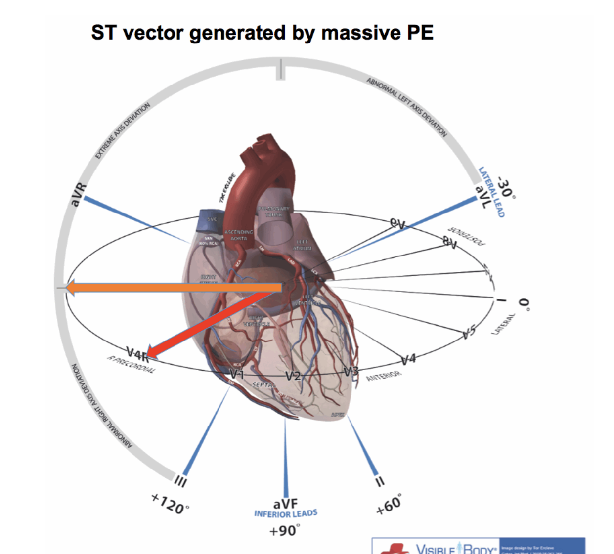
RV-Strain in PE
Chest leads:
Peak T-wave inversion in V1 + V2
Limb leads:
Peak T-wave inversion in III
https://emcrit.org/pulmcrit/two-ekg-patterns-of-pulmonary-embolism

Slide 9
RV-Injury in PE
Ischemia sufficient to cause STE & reciprocal STD
Chest leads:
STE V1-V2
STD V4-V6
Limb leads:
STE III
STD I - aVL
https://emcrit.org/pulmcrit/two-ekg-patterns-of-pulmonary-embolism

Slide 10
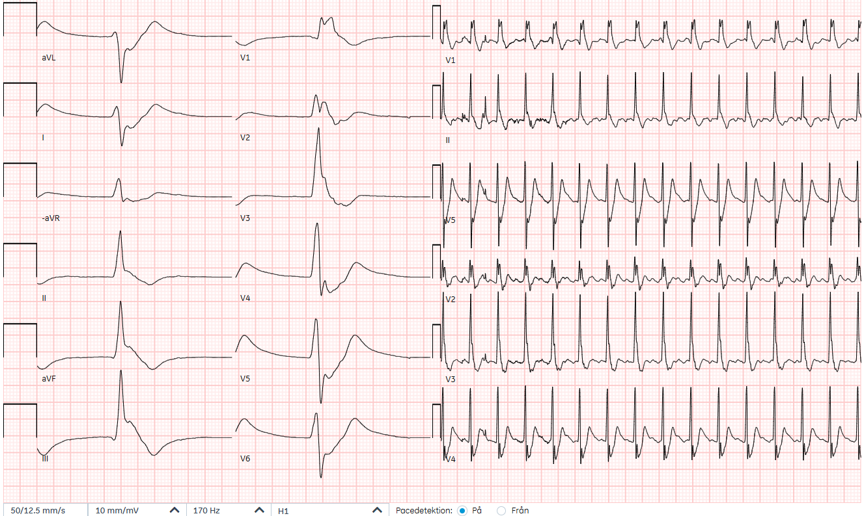
81-year-old man with cardiac arrest
Notes:
Source: 440324-251104-KE (Ystad)

Slide 11
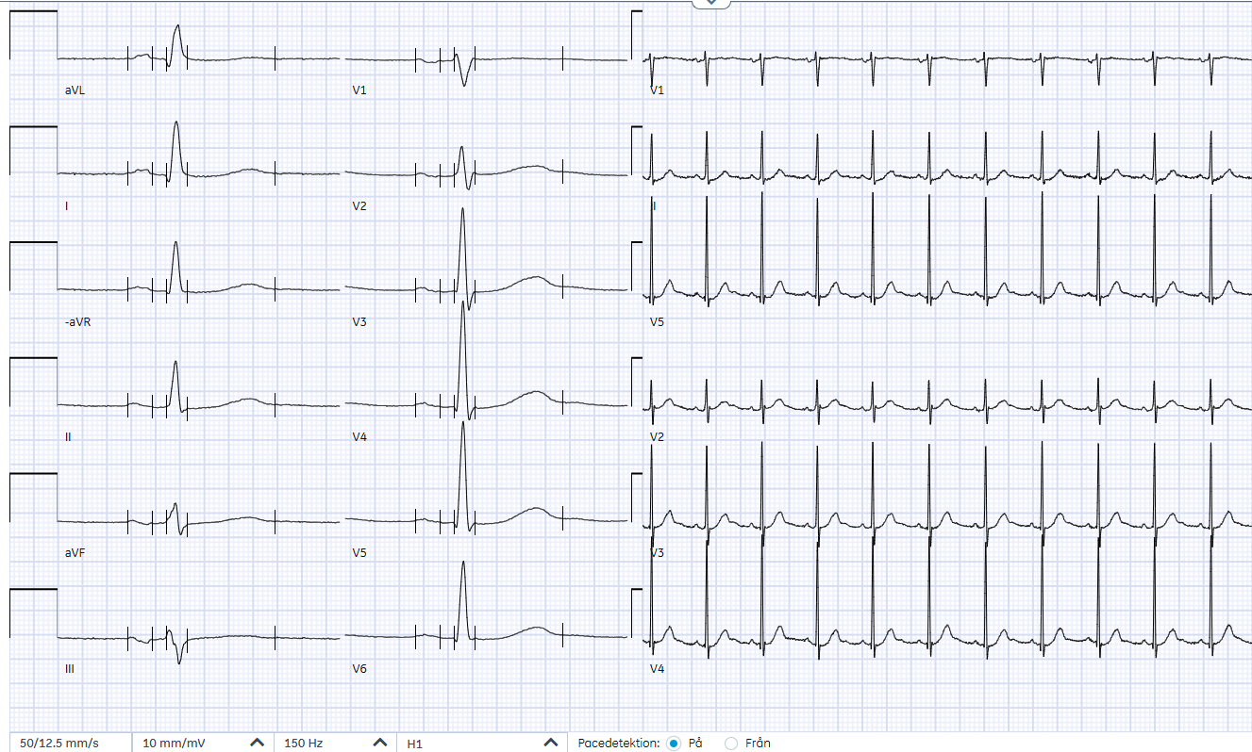
Prior EKG
Notes:
Provide if available for the most recent prior EKG.
Delete this slide if unavailable or irrelevant.

Slide 12
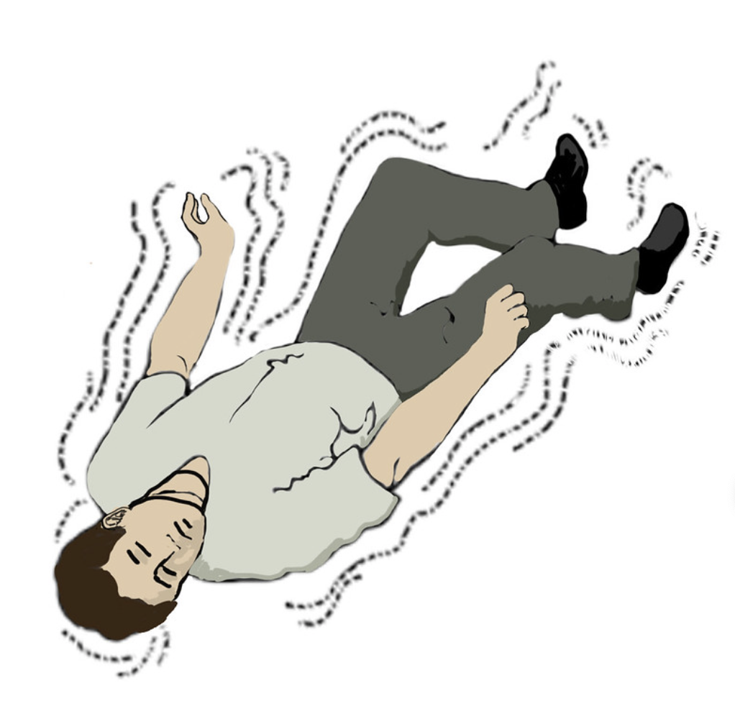

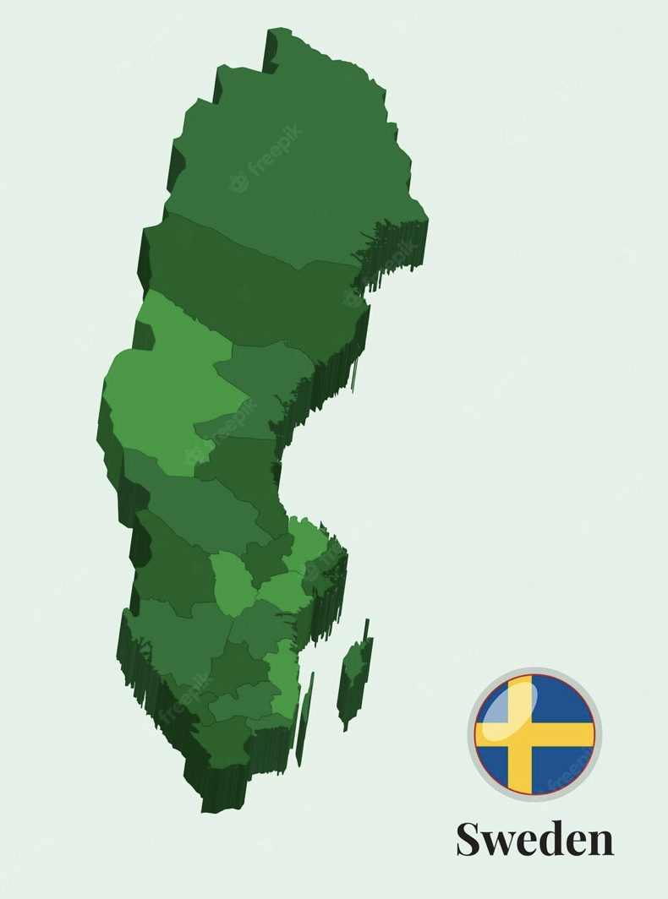




61-year-old man with seizure
-5 dagar
Notes:
Source: 580421-191229-TN
1-On holiday in Thailand. Drinks lots of alcohol. Wife upset. Promises to stop drinking upon return to Sweden
2-Flies back from Thailand 5 days ago. Felt like crap since then.
3-”Seizure” today, wife calls ambulance
4-”Seizure” again in the ED, neurologist administers 5 mg Diazepam IV

Slide 13
61-year-old man with seizure
Notes:
Source: 580421-191229-TN

Slide 14
RR 30 | SpO2 92%
HR 120 | BP 105/77
GCS 15 | Temp 36.8
A | Pulmonary embolism?
B | Alcohol withdrawal?
C | Ischemia-driven arrhythmia?
D | Hypertrophic cardiomyopathy?
Notes:
Initially suspected alcohol-withdrawal seizure. But:
1-Timing is wrong
2-Doesn’t explain the low SpO2
3-With alcohol withdrawal you wound expect high blood pressure
4-The EKG shows since of RV strain

Slide 15
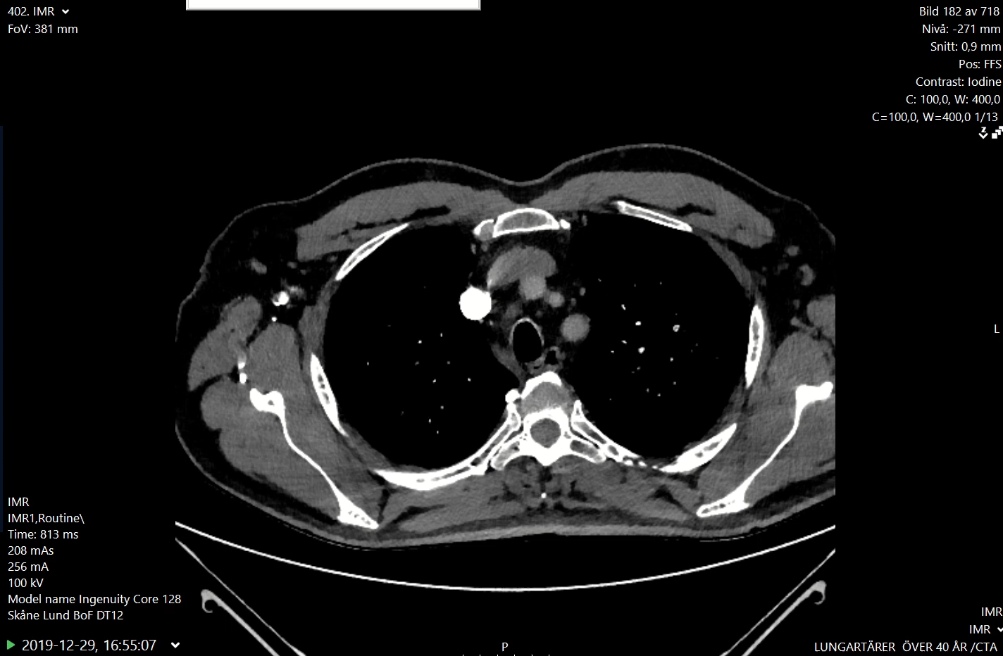
Notes:
Source: 580421-191229-TN
Massive PE, presumably got his DVT during flight home. Thrombolysis. Discharged with additional diagnosis of alcohol-induced hepatitis.

Slide 16
Course
Treated with rt-Pa
Discharged on Xarelto

Slide 17
Wellen’s T-Waves

Slide 18
76-year-old man with chest pain
Notes:
Source: 431227-201221-BG
Here the negative T waves are not limited to V1-V4, not max in V1-V2.
The T wave in III is negative but there is not this gradient where the T wave becomes increasingly negative as the vector progresses from II through aVF to III.

Slide 19
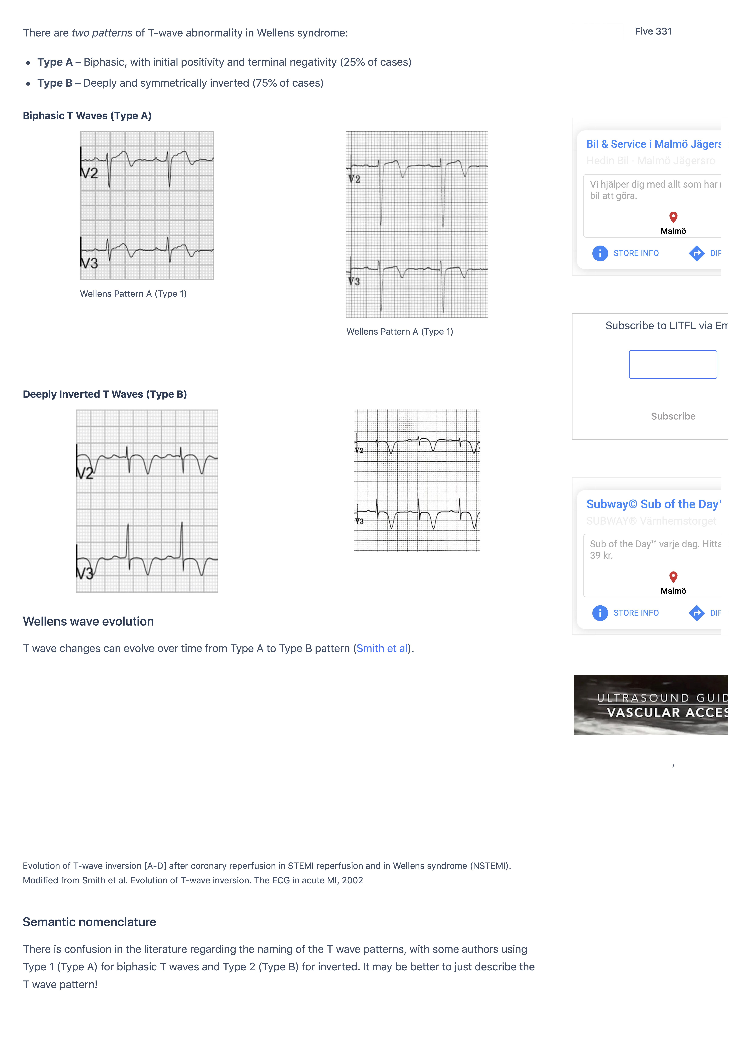
Wellen’s T-Waves
lifeinthefastlane
Notes:
Wellen’s T wave suggests critical LAD stenosis

Slide 20
Course
Cardiology resident suspects PE, refers patient to ED
In ED, given ASA 300 mg + Heparin 5000 E
After contact with cardiologist, acute CT (no PE)
Angio: severe stenosis LAD/D1 and 80% stenosis Cx
PCI LAD/D1 and Cx

Slide 21
Cerebral T-Waves

Slide 22
81-year-old woman with altered mental status
Vomited, trouble understanding words, unable to move left arm

Slide 23
Cerebral T-Waves

Slide 24
Hyperacute T-Waves

Slide 25
54-year-old man with chest pain EKG 06:57
Notes:
Source: 660431-210103-JP

Slide 26
54-year-old man with chest pain EKG 08:13
Notes:
Source: 660431-210103-JP
in acute coronary occlusion:
1-The first sign on EKG is QT prolongation (https://pubmed.ncbi.nlm.nih.gov/17394962/)
2-Then come the hyperacute T-waves
3-Then come the ST-elevations

Slide 27
Hyperacute T-Wave
Wide base
Round peak
Large in relation to preceding QRS-complex
Regional

Slide 28
Course
ASA 500 mg PO in ambulance
Heparin 5000 E IV in ED
Coronary angio: LAD stenosis right after D2
PCI mid-LAD

Slide 29
De Winter Pattern

Slide 30
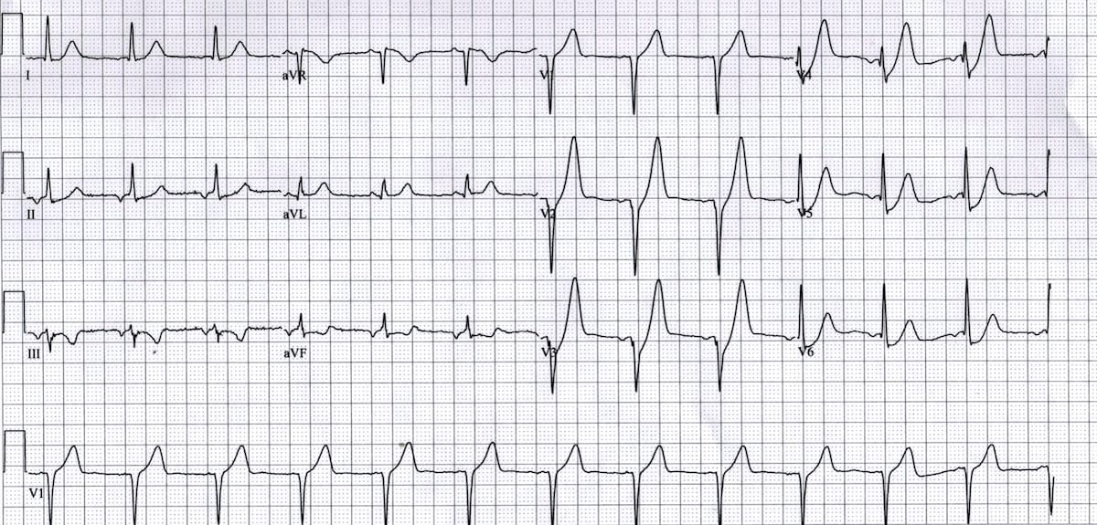
48-year-old man with chest pain
Notes:
Från Nikolas Sbyrakis
Previously healthy, no regular medications, no allergies. Smoker 30-pack-years.
Sudden onset severe chest pain 2 hours ago, associated pallor and diaphoresis
RR 20/min, SpO₂ 97%, HR 77/min, BP 148/94 mmHg, T 36ºC
ECG done at triage
Example of De Winter Pattern

Slide 31
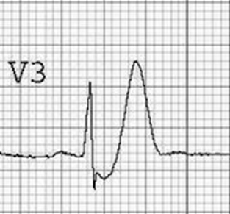
De Winter ECG Pattern
V2-V6
Peaked, symmetric T wave
Ascending limb of T wave starts below the isoelectric baseline
ST-segment depression > 1 mm
Hyperacute T-wave variant
Suggests acute LAD occlusion

Slide 32
Hyperkalemia

Slide 33
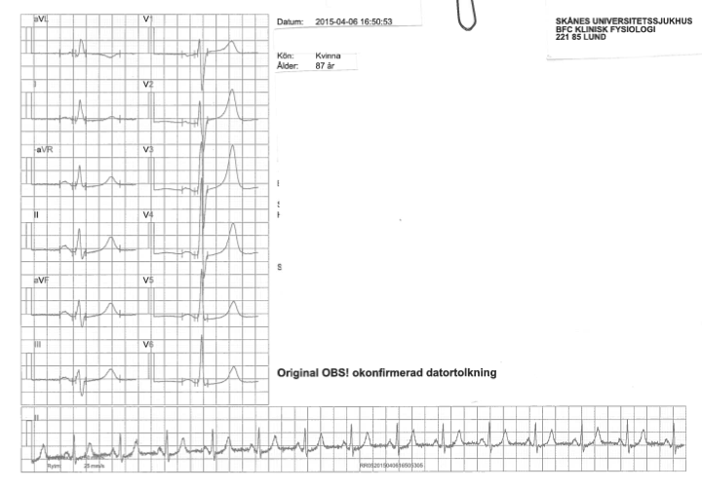
87-year-old woman who is unwell
Hyperkalemia
Notes:
Source: 271219-150406-TL
Patient with prior heart attack, stroke, epilepsi
Sent to the ED because of decreased level of functioning, decreased appetite, increased frequency of absence episodes
Complexes: paper speed 50 mm/sec
Rhythm: paper speed 25 mm/sec
Unfortunately, no uniform paper speed 25 mm/sec available

Slide 34
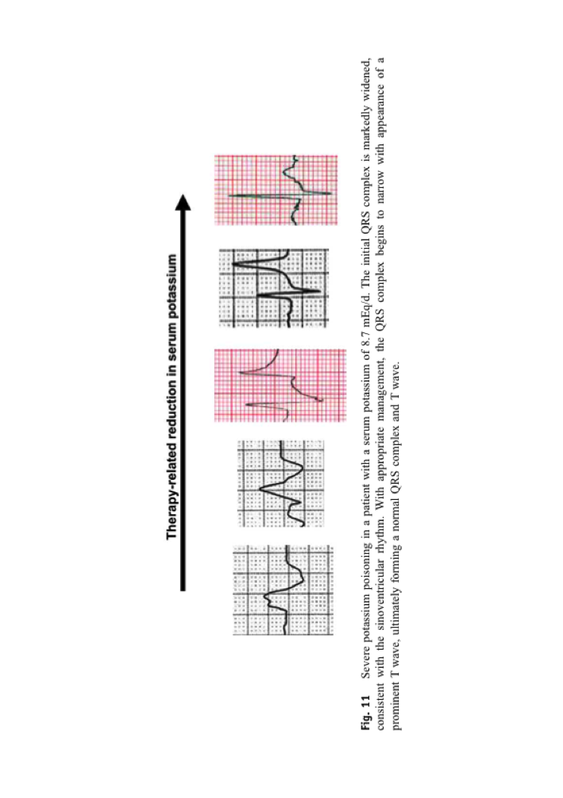
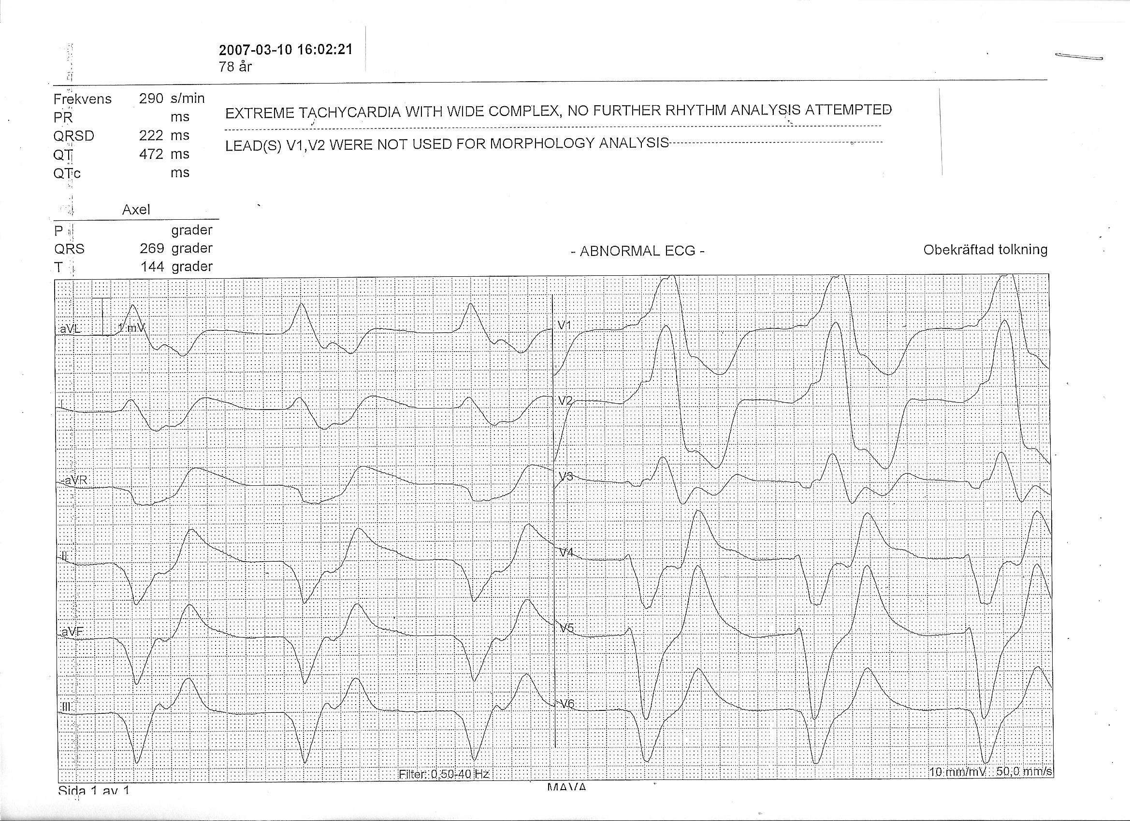
Hyperkalemia
Peaked T-waves:
Tall, narrow, symmetrical, most prominent in precordial leads
Not as regional as hyperacute T-waves, no STD as in De Winter
Increasing hyperkalemia:
T-wave peaking; P-wave flattening; PR-prolongation; QRS-widening
Notes:
As the potassium rises:
1-The T wave peaks
2-Then the EKG is drawn out length wise: the PQ gets longer and the P wave disappears; the QRS gets wide.

