Slide 1
ST-Segment

Slide 2
Index
STEMI
OMI
STE III + STD aVL
Aslanger
STE aVL + STD III = South African Flag
STE V1 + STD V6 = Precordial Swirl
Posterior OMI
LMCA or Multivessel Occlusion
Pericarditis
Hyperkalemia
Digoxin Effect

Slide 3
STEMI

Slide 4
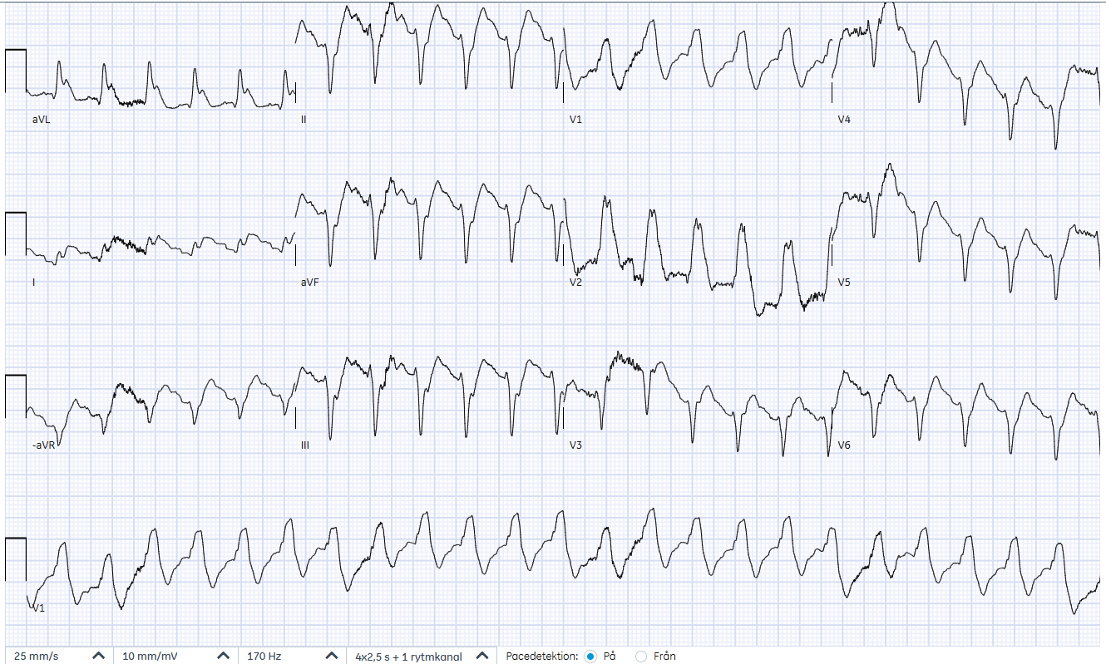
51-year-old man, chest pain then arrest
Notes:
EKG at 18:23 showing VT (in cardiac arrest)

Slide 5
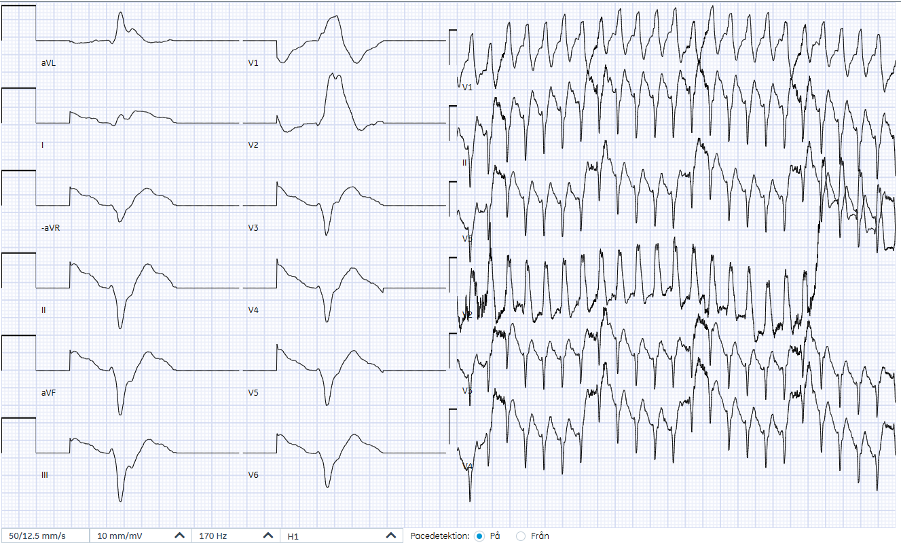
51-year-old man with chest pain
Notes:
EKG at 18:23 showing VT (in cardiac arrest)

Slide 6
51-year-old man with ROSC
Notes:
Source: 721114-240603-LCWK
EKG 18:34 upon arrival in ED ROSC

Slide 7
51-year-old man with chest pain
Chest pain then cardiac arrest
Healthy, no medications, works for the post office
Chest pain onset in the afternoon, planning to come to ED Witnessed cardiac arrest, bystander CPR 18:04 First rhythm VT/VF, def x 3, ROSC after 8 min Arrives in ED 18:35. SpO2 82% on 15 L/min, pink sputum, looks up but confused, agitated. LM ok, LAD prox occlusion, RCA dominant Stent LAD. Echo several days later EF 30-35%. Discharged after 11 days.
Notes:
Source: 430232-251121-ILL
“i anslutning till hjärtat, liten mjukdelsökning i höger förmak.”

Slide 8
Systematic EKG Interpretation
O | Rate | 110 bpm
 | Regularity | Regular
P | P-waves | LAE
 | PR-segments | Normal
Q | Q-waves | Q in II, pathological
 | QRS-complexes | Narrow
R | Axis | Leftward
 | R-waves | Very poor R-wave progression
S | S-waves | No signs of LVH
 | ST-segments | STE V1, V2, aVL, I. STD inferior + V6
T | T-waves | Neg in I + aVL
 | QT-interval | Around 300 msec
+ | Other findings
 | Summary | Sinus rhythm. STEMI proximal LAD occlusion
Notes:
The coronary artery occlusion is most likely located in the proximal left anterior descending (LAD) coronary artery. The American Heart Association, American College of Cardiology Foundation, and Heart Rhythm Society recommend that ST-segment elevation in leads I, aVL, V1, and V2 (with especially high elevation in V2), along with reciprocal ST-segment depression in the inferior leads and V6, indicates extensive anterior and anterobasal ischemia due to occlusion of the proximal LAD, typically above the first septal and diagonal branches.^{[1]} This pattern reflects involvement of the basal anterior wall, lateral wall, and interventricular septum, with the ST-segment vector directed superiorly and to the left.
Recent case series and ECG pattern analyses have described the "South African flag sign," characterized by prominent ST elevation in V2, I, and aVL with reciprocal changes in the inferior leads, as a marker of high lateral myocardial infarction due to occlusion of the first diagonal (D1) branch of the LAD. However, when ST elevation is present in both V1 and V2, with widespread reciprocal depression, the culprit is more likely a proximal LAD occlusion above the first septal and diagonal branches, rather than an isolated D1 lesion.

Slide 9
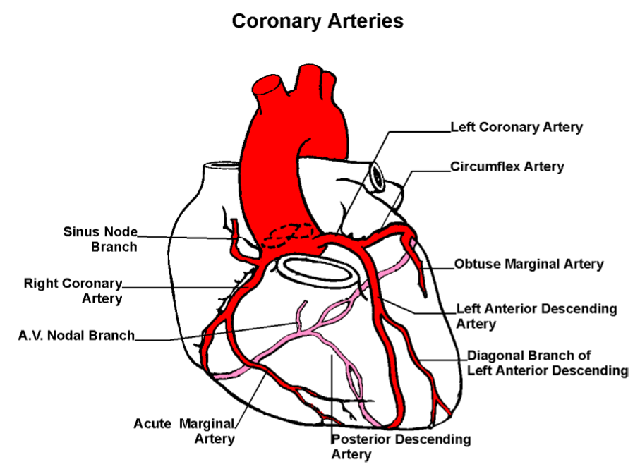
Notes:
The patient likely has an RCA occlusion proximal to the A.V. Nodal Branch (since the patient has third degree AV block)

Slide 10
Course
Goes into cardiac arrest prior to arrival of prehospital personnel
Initial rhythm VT/VF
Defibrillated 3 times
ECMO called to ED prior to patient’s arrival
On arrival asystole

Slide 11
ST-Elevation Myocardial Infarction
V2-V3 | New ST-elevation at the J-point in 2 contiguous leads: ≥ 2.5 mm in men < 40 years-old ≥ 2.0 mm in required in men ≥ 40 years-old ≥ 1.5 mm in women regardless of age
V7-V9 | New ST-elevation at the J-point in 2 contiguous leads in the presence of ST-depression in V1-V3, especially when the terminal T-wave is positive: ≥ 1.0 mm in V7-V9 in men < 40 years-old ≥ 0.5 mm in V7-V9 in men ≥ 40 years-old and in women
All other leads (incl. V4R) | New ST-elevation at the J-point in 2 contiguous leads: ≥ 1.0 mm
Thygesen 2018. 4th Universal Definition of Myocardial Infarction
Notes:
Traditionally, acute coronary occlusion is identified by looking for ST-elevation in contiguous leads.

Slide 12
OMI

Slide 13
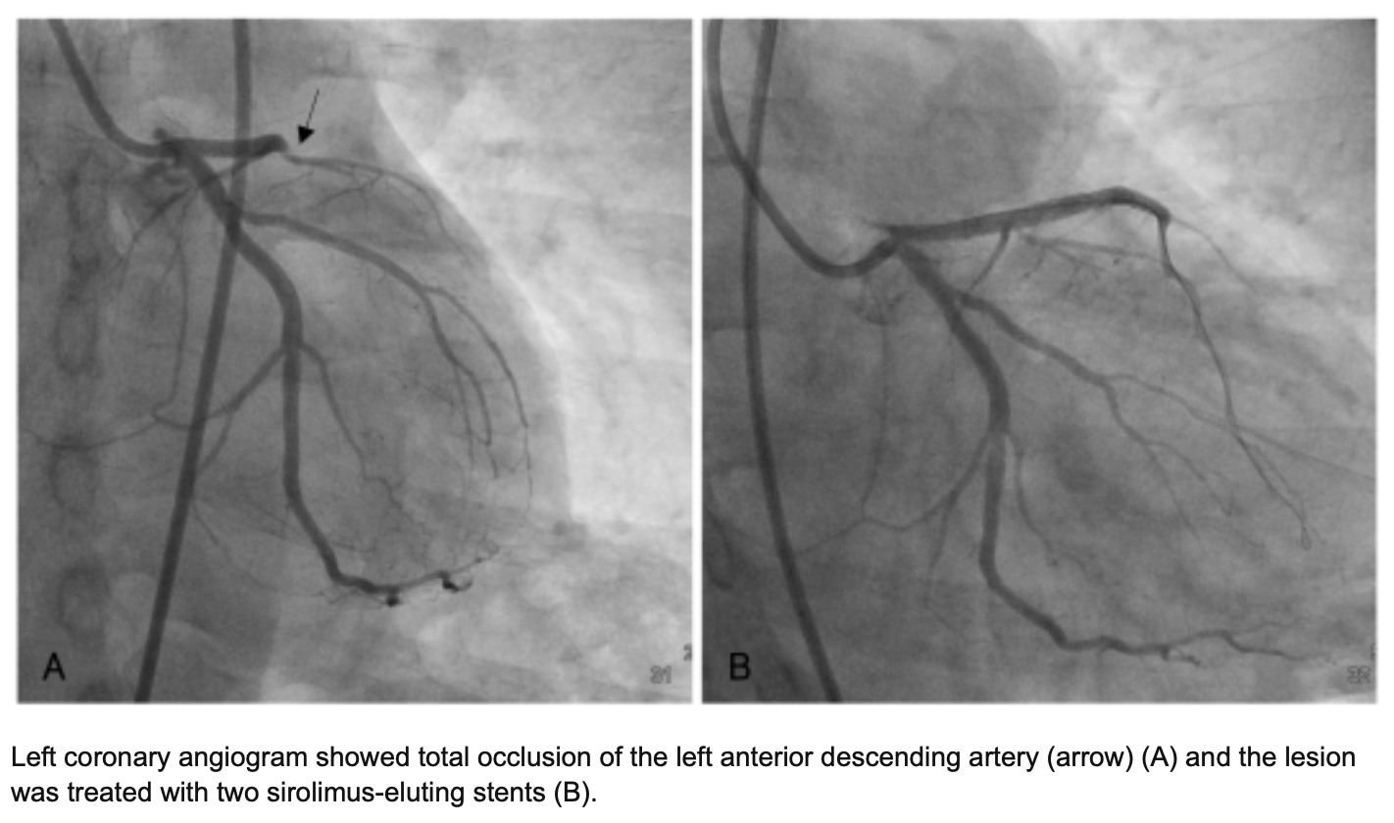
Occlusion Myocardial Infarction
Imminent risk for myocardial death without urgent reperfusion
Notes:
When a patient presents with chest pain from cardiac ischemia, the initial goal is to identify patients with acute coronary occlusion that benefit from immediate revascualization (without waiting for the results of cardiac enzyme tests)

Slide 14


STEMI
+
_
OMI
+
_
STEMI-criteria are 25% false negative
STEMI-criteria are 25% false positive
Aslanger Turk Kardiyol Dern Ars 2021;49(6):488
Notes:
But STEMI-criteria are 25% false positive and 25% false negative for ACO.
The point of promoting the “OMI” terminology is to highlight the fact that the STEMI-criteria are 25% false positive and 25% false negative, and to learn addditional EKG criteria to reduce these false assessments.

Slide 15
STE III + STD aVL

Slide 16
68-year-old woman with chest pain
Notes:
550117-230204-CH
Note how there now is ST-elevation in lead III and reciprocal ST-depression in aVL.
The paper speed on the right is 12.5 mm/sec. So heart rate is 150/4 = 38 bpm

Slide 17
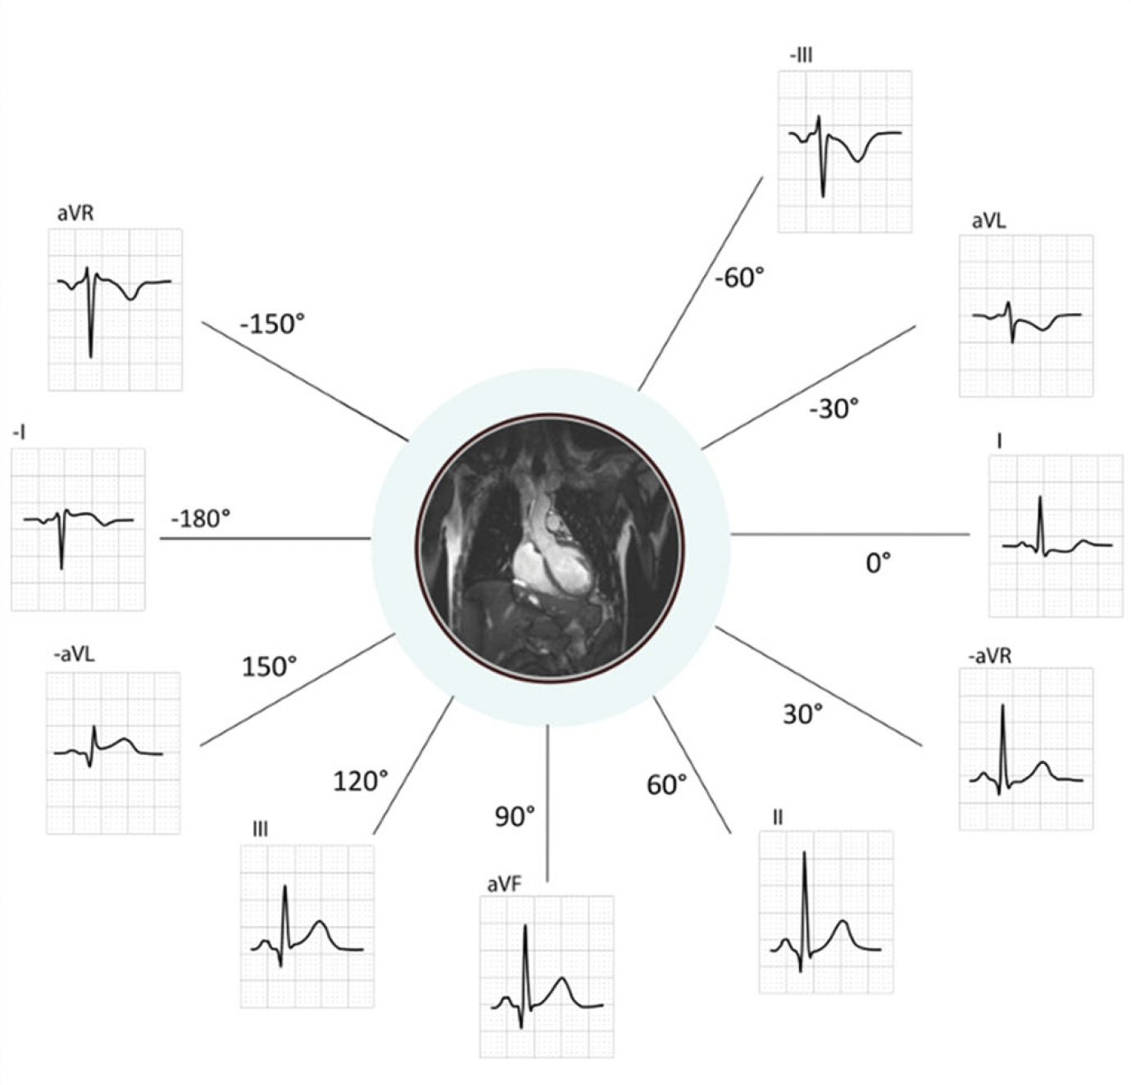
STE III + STD in aVL
Corresponds to ST-elevation in two consecutive leads: III + -aVL
Lindow Scand Cardiovasc J 2021;55:145

Slide 18
Course
4 minutes after ambulance arrival, patient becomes unconscious, snoring breathing. Short compressions and patient wakes up. Treated with 5000 U Heparin and ASA 500 mg. Atropine 0.5 mg IV without effect.
Isoprenalin high dose and repeated doses Atropin IV without effect. Transvenous pacemaker via right jugular vein. Angio:
LM ua
LAD: significant stenosis middle section
Cx: ua
RCA: proximally occluded
PCI to RCA with good effect. Recovers hemodynamically, stable sinus rhythm with frequency around 70. PM on demand with frequency 60.

Slide 19
72-year-old man who fainted
End of QRS
SBP 85 mm Hg
SpO2 88% on room air
Notes:
Same EKG, different format

Slide 20
72-Year-Old Man who Fainted

Slide 22
Notes:
So the main diagnoses to consider are PE and myocardial ischemia

Slide 23
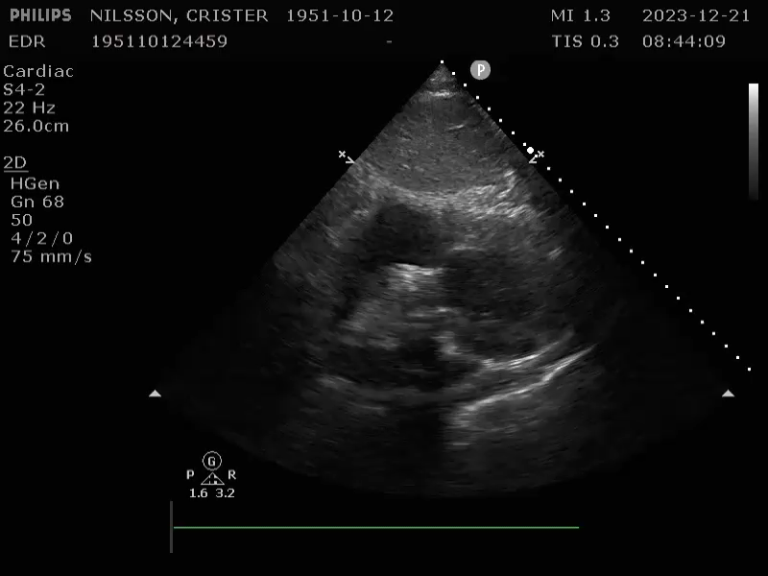
Notes:
SCLAX. No RV dilation

Slide 24
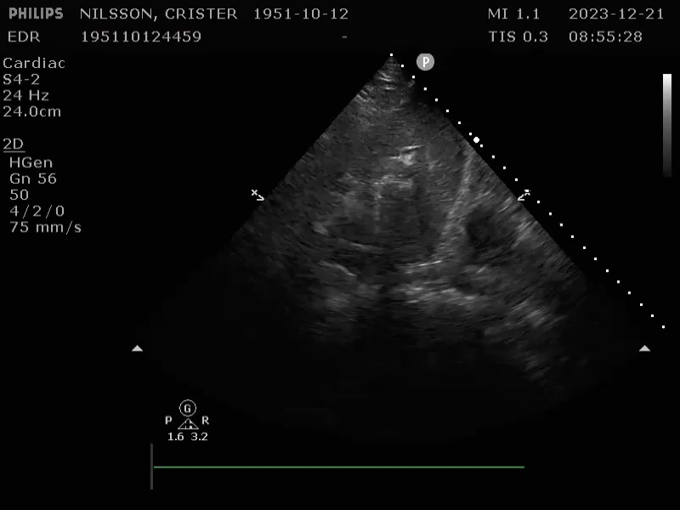
Notes:
IVC not big fat and juicy

Slide 25
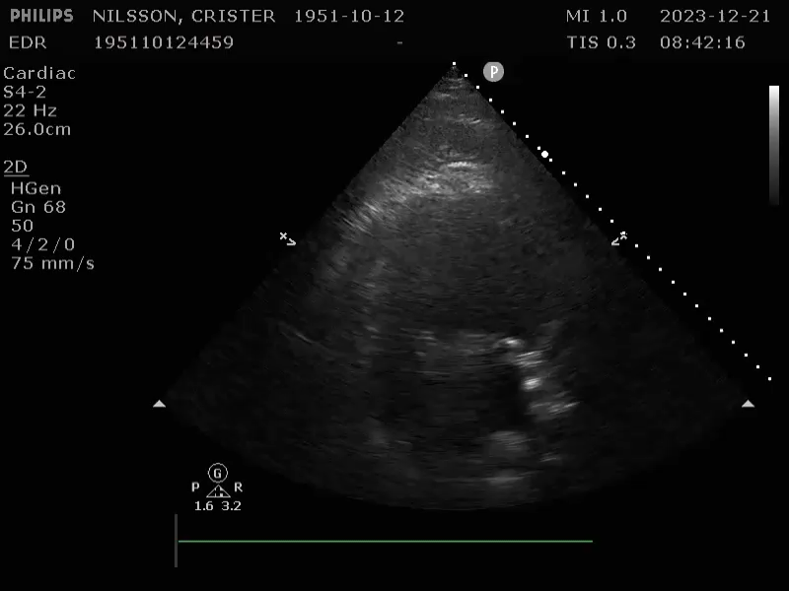
Notes:
A4C. No septum deviation into the LV. Free wall of RV is moving. So no evidence of massive PE.

Slide 26
Course
OMI vs Massive PE
Massive PE deemed less likely based on ultrasound findings
CT head + CT pulm angio: no bleed, no PE
Coronary angio: previous vein graft between M2 and D acutely occluded
PCI to vein graft, discharged 4 days later on DAPT

Slide 27
STE aVL + STD III High-Lateral MI South African Flag

Slide 28
65-year-old woman with chest pain

Slide 29
STE aVL + STD in III
Corresponds to ST-elevation in two consecutive leads: aVL + -III
Lindow Scand Cardiovasc J 2021;55:145

Slide 30
Course
CCU-physician refers to this as NSTEMI but takes patient to cath lab.
90% stenosis in LADs D1, other vessels patent.

Slide 31
High-lateral MI from occlusion of D1 or OM
Notes:
OM: The obtuse marginal artery (OMA), also known as the left marginal branch, is a branch of the circumflex artery that supplies blood to the lateral wall of the left ventricle.
There are usually 2, sometimes three obtuse marginal arteries. Here on this diagram M1 and M2 depict two obtuse marginal arteries.

Slide 32
STE V1 + STD V6 Precordial Swirl

Slide 33
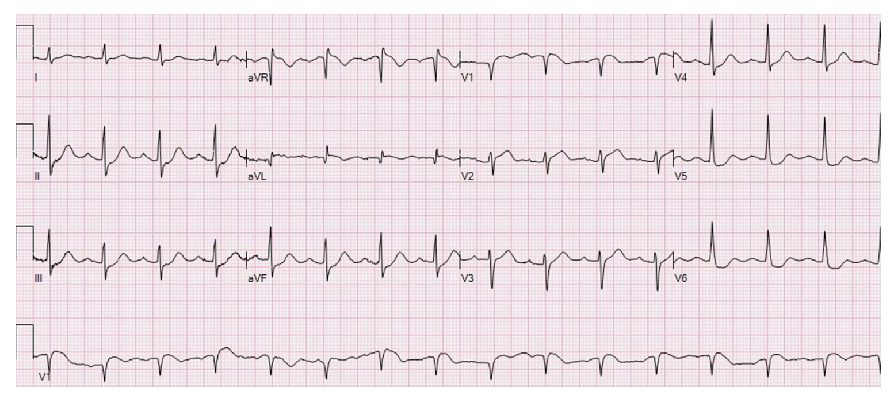

Slide 34
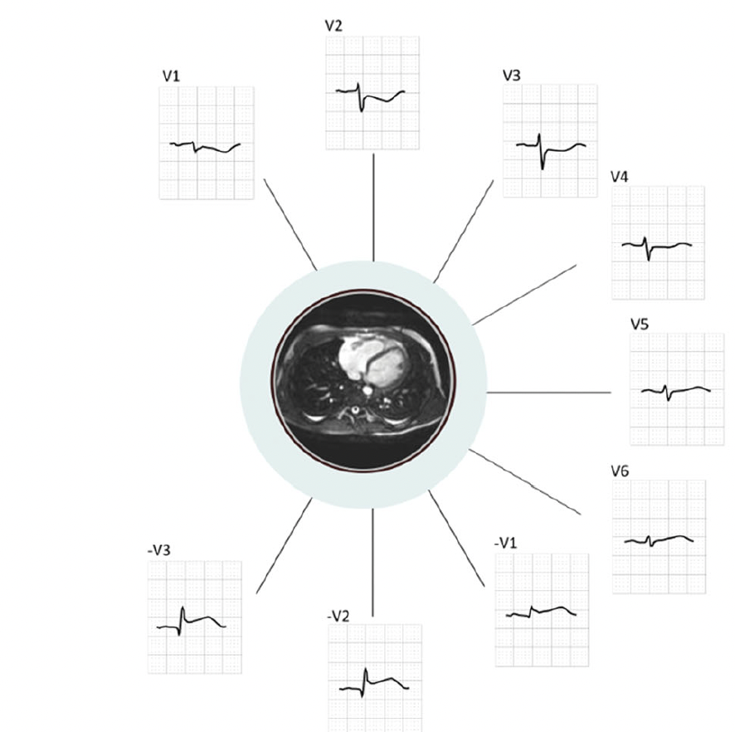
STE V1 + STD in V6
Corresponds to ST-elevation in two consecutive leads: V1 + -V6
Lindow Scand Cardiovasc J 2021;55:145

Slide 35
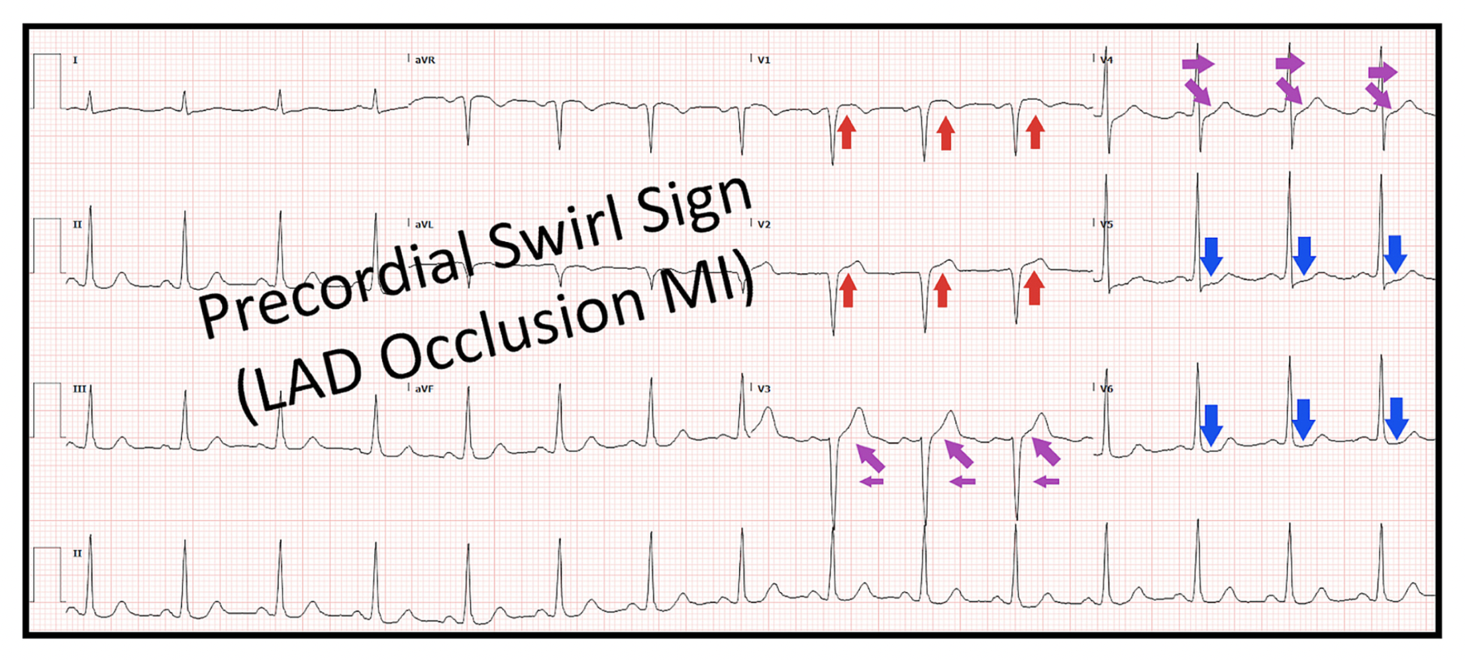
Goss Journal of Electrocardiology 2025;91:153931
Notes:
SP 92% for OMI if:
1-Narrow QRS with no LVH
2-STE V1 and/or V2
3-STD V5 and/or V6
83% had LAD occlusion

Slide 36
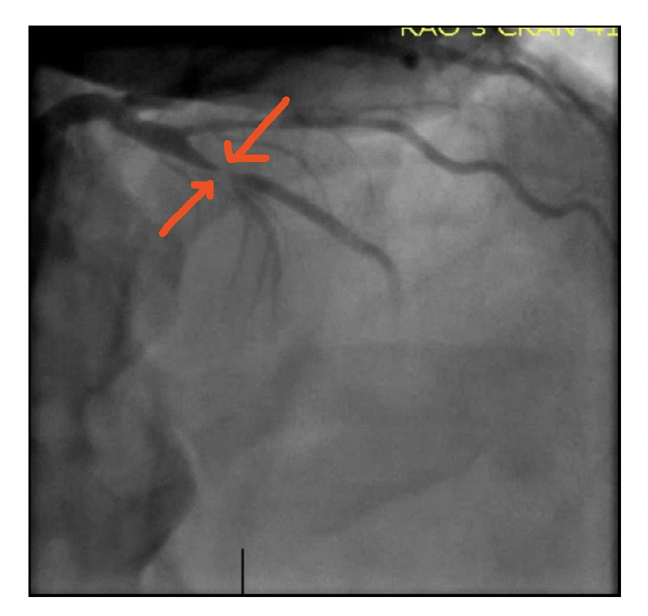
Precordial Swirl
Specificity 92% for OMI if:
1-Narrow QRS with no LVH
2-STE V1 and/or V2
3-STD V5 and/or V6
83% had LAD occlusion
Notes:
Specificity 92%

Slide 37
Posterior OMI

Slide 38
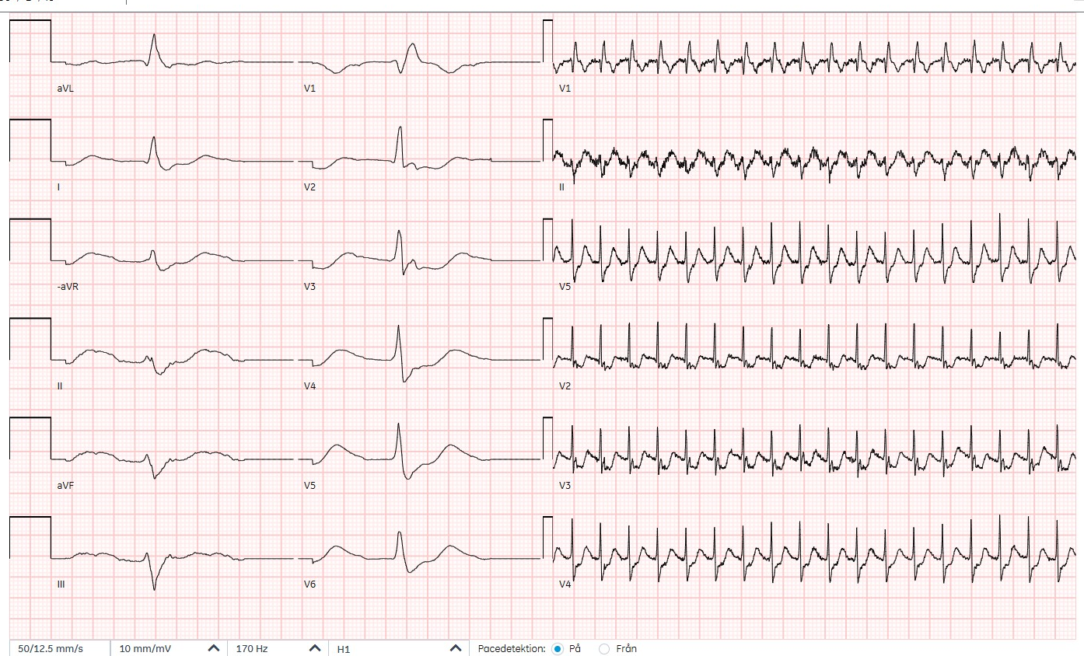
83-year-old man with chest pain
Notes:
SOURCE: 410618-250221 (HSB)-LET
This was interpreted as a posterior OMI in the setting of a RBBB
Max findings in V3-V4
Horizontal ST depression
Positive T waves
R>S in lead V2 (but you would expect that from RBBB?)

Slide 39
STD V1-V4
Corresponds to STE in consecutive leads V7-V9
Lindow Scand Cardiovasc J 2021;55:145

Slide 40
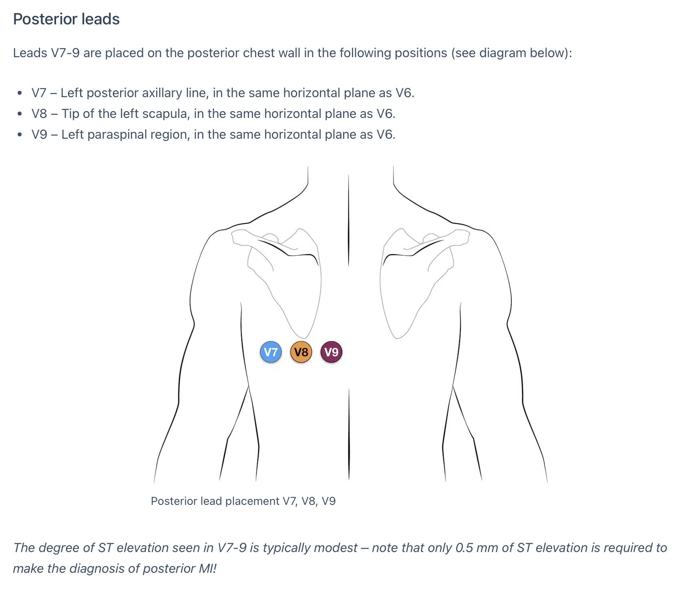
https://litfl.com/posterior-myocardial-infarction-ecg-library/
Notes:
Ideally, you would want to have posterior leads which would show you the ST-elevation

Slide 41
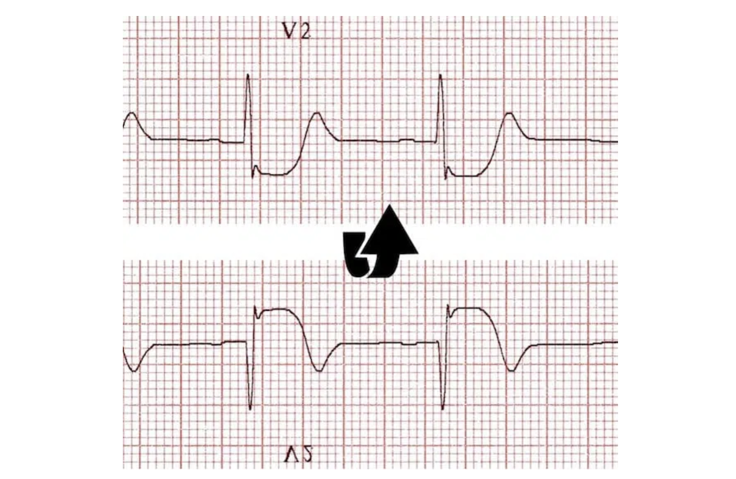
https://litfl.com/posterior-myocardial-infarction-ecg-library/
Notes:
And you can think of the findings in V2 as the reciprocal findings from ST-elevation in –V2 = V8

Slide 42
Posterior OMI
Max findings V1-V4
Horizontal STD
Upright T-waves
Usually accompanies inferior or lateral OMI
Isolated posterior OMI in 5% of infarcts (often missed)
Notes:
ST-depression maximal in V5-V6 suggests subendocardial ischemia instead

Slide 43
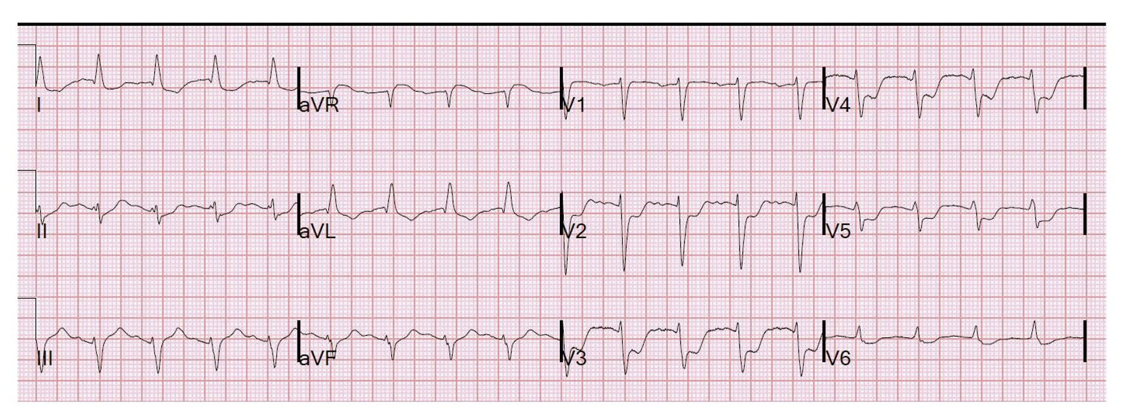
Posterior OMI
Maximal findings V1-V4
Horizontal ST-depression
Upright T-waves
Miranda Can J Cardiol 2018;34:132

Slide 44
Posterolateral OMI
Posterior OMI
Max findings V1-V4
Horizontal ST-depression
Upright T-waves
R/S > 1 in V2
Notes:
Source: 511116-090714-IJG
57-year-old woman

Slide 45
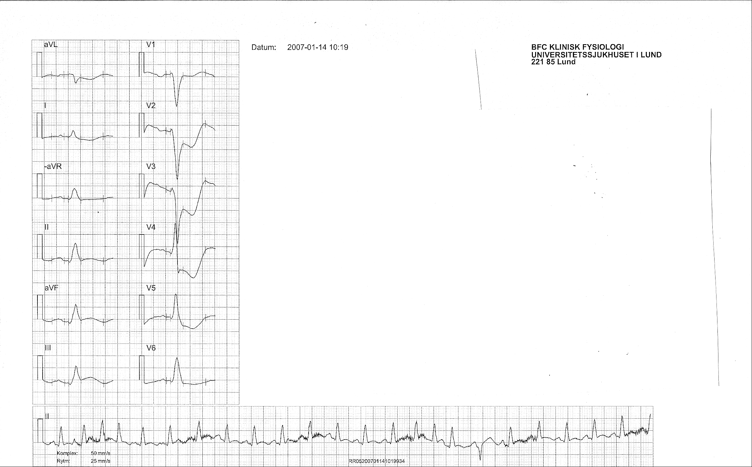
Inferoposterior OMI
Posterior OMI
Max findings V1-V4
Horizontal ST-depression
Upright T-waves
Notes:
Here you can see the ST-elevation in III and ST-depression in aVL
The changes in V2-V4 are not exactly how posterior MI are described in LIFTL but the T waves are upright. Likely an infero-posterior STEMI.

Slide 46
LMCA or Multivessel Occlusion

Slide 47
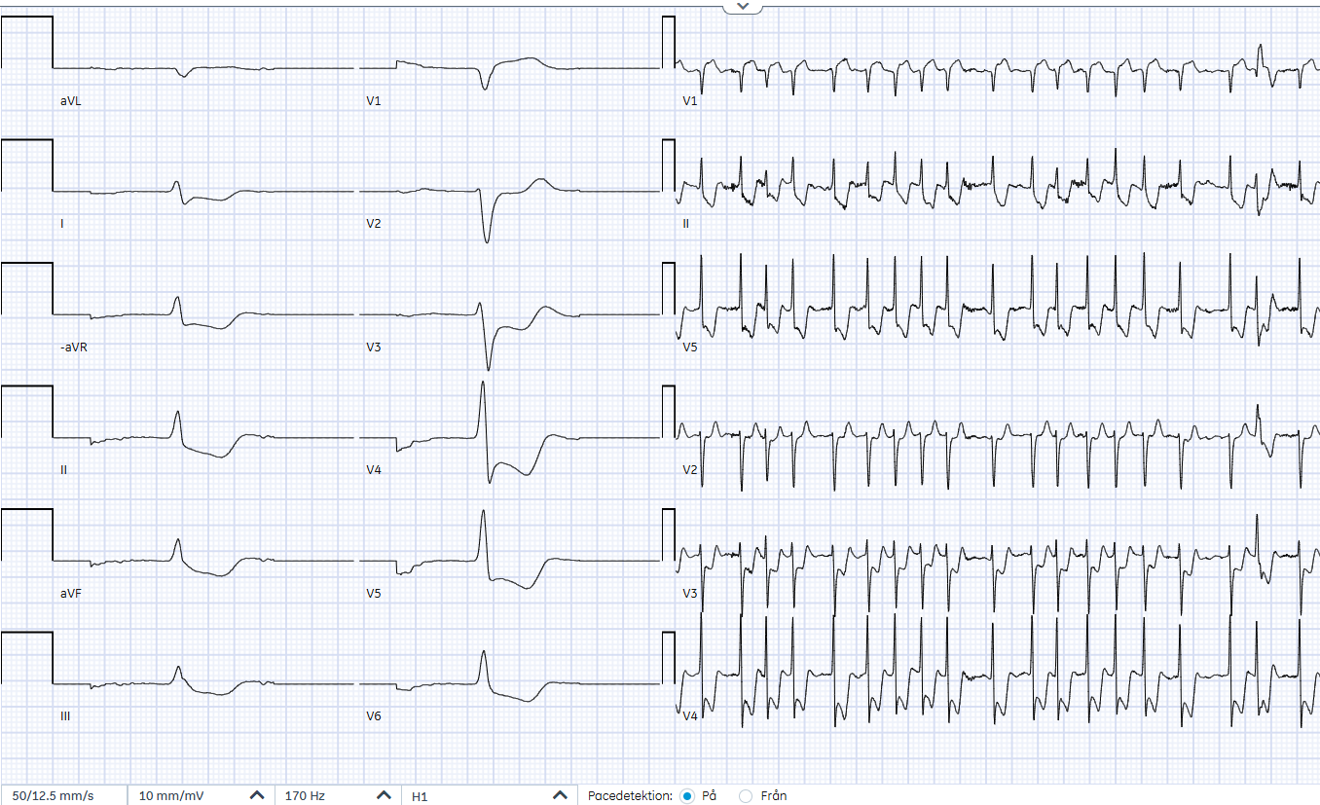
79-year-old man with chest pain
Notes:
Source: 460713-251107-PA

Slide 48
LMCA or Multivessel
Diffuse STD in –aVR, II, aVF, III, V4-V6
STE in V1 sometimes
Widespread STD reflects global subendocardial ischemia
Notes:
LMCA = Left Main Coronary Artery

Slide 49
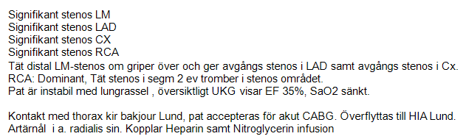
79-year-old man with chest pain
Notes:
Source: 460713-251107-PA

Slide 50
Pericarditis

Slide 51
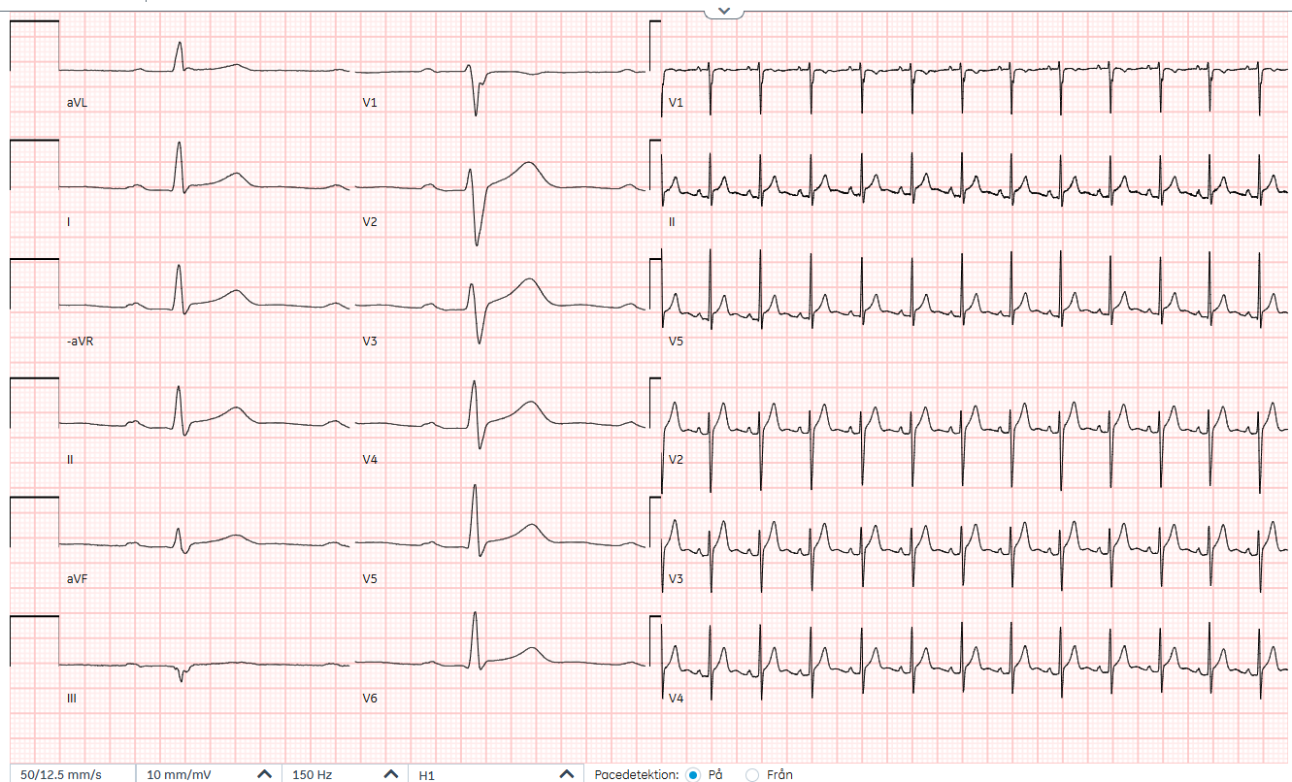
Current EKG 250621 15:25

Slide 52
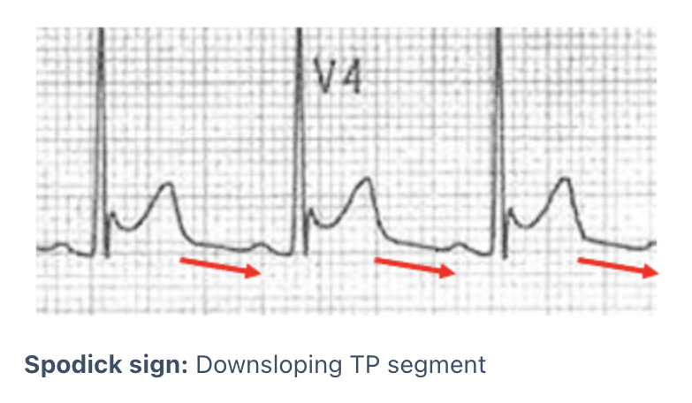
Pericarditis
STE: diffuse, concave upward
STE / T ≥ 0.25 in V6 distinguishes pericarditis from BER
PR-segment depression
Downsloping TP-segment: 30% pericarditis, 5% OMI
https://litfl.com/spodick-sign/
Notes:
LMCA = Left Main Coronary Artery

Slide 53
Notes:
Chest pain 25-year-old perimyocarditis

Slide 55
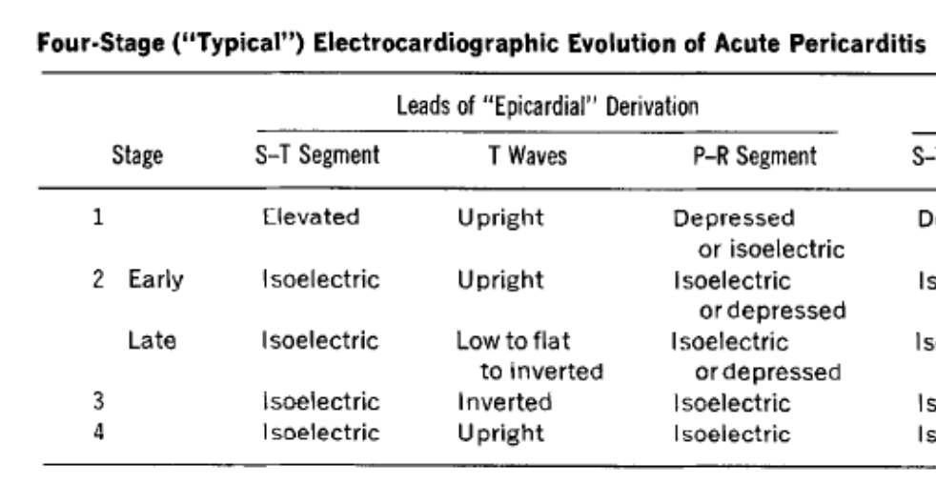
https://litfl.com/spodick-sign/

Slide 56
Hyperkalemia

Slide 57
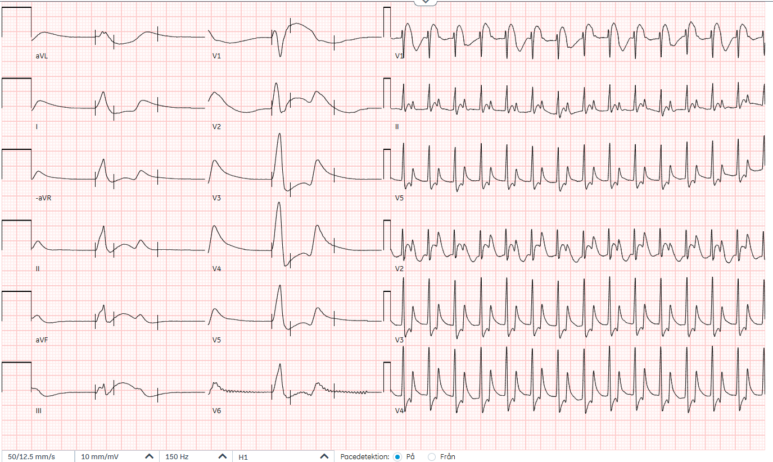
Current EKG 250831 20:02
Notes:
SOURCE: 790110-250831-FE
The Classic EKG display consists of:
1-A paper speed of 25 mm/sec
2-The original leads I, II, and III arranged in a column
3-The augmented leads aVR, aVL and aVF arranged in a column
4-A rhythm strip
Record the date and time when the EKG was taken
If no EKG was taken, delete this slide

Slide 58
Bedside Blood Tests 250831 19:00
Acid-Base
pH 7.37
pCO₂ 3.0 kPa 22.5 mm Hg
pO₂ 8.2 kPa 61.5 mm Hg
Base(Ecf)c -11.5 mmol/L
HCO₃⁻(P,st)c 16 mmol/L
Oximetry Values
sO₂ 91 %
ctHb 163 g/L
FMetHb 1.1 %
FCOHb 1.1 %
Electrolyte Values
Na⁺ 136 mmol/L
K⁺ 8.5 mmol/L
Ca²⁺ 1.04 mmol/L
Cl⁻ 116 mmol/L
Metabolite Values
Glucose 6.7 mmol/L 120 mg/dl
Lactate 2.5 mmol/L 22.5 mg/dl
Creatinine 145 μmol/L 1.63 mg/dl
Calculated Values
Anion Gap_{c} 8 mmol/L
Arterial
Room Air
Notes:
Most emergency departments have point-of-care blood analysis machine. If this was used for the patient (and is relevant to the case), fill in the values in this slide.
Fill in the date and time when the test was taken, whether it was venous or arterial blood, and whether the patient was receiving supplemental oxygen.
Please fill in pO2, pCO3, glucose, lactate and creatinine in both SI and non-SI units so that colleagues throughout Europe can have the values in the units they are used to working with. Use the following conversion factors:
pO2: kPa x 7.5 = mm Hg
pCO2: kPa x 7.5 = mm Hg
Glucose: mmol/L x 18 = mg/dL
Lactate: mmol/L x 9 = mg/dL
Creatinine: μmol/L : 88.89 = mg/dL

Slide 59
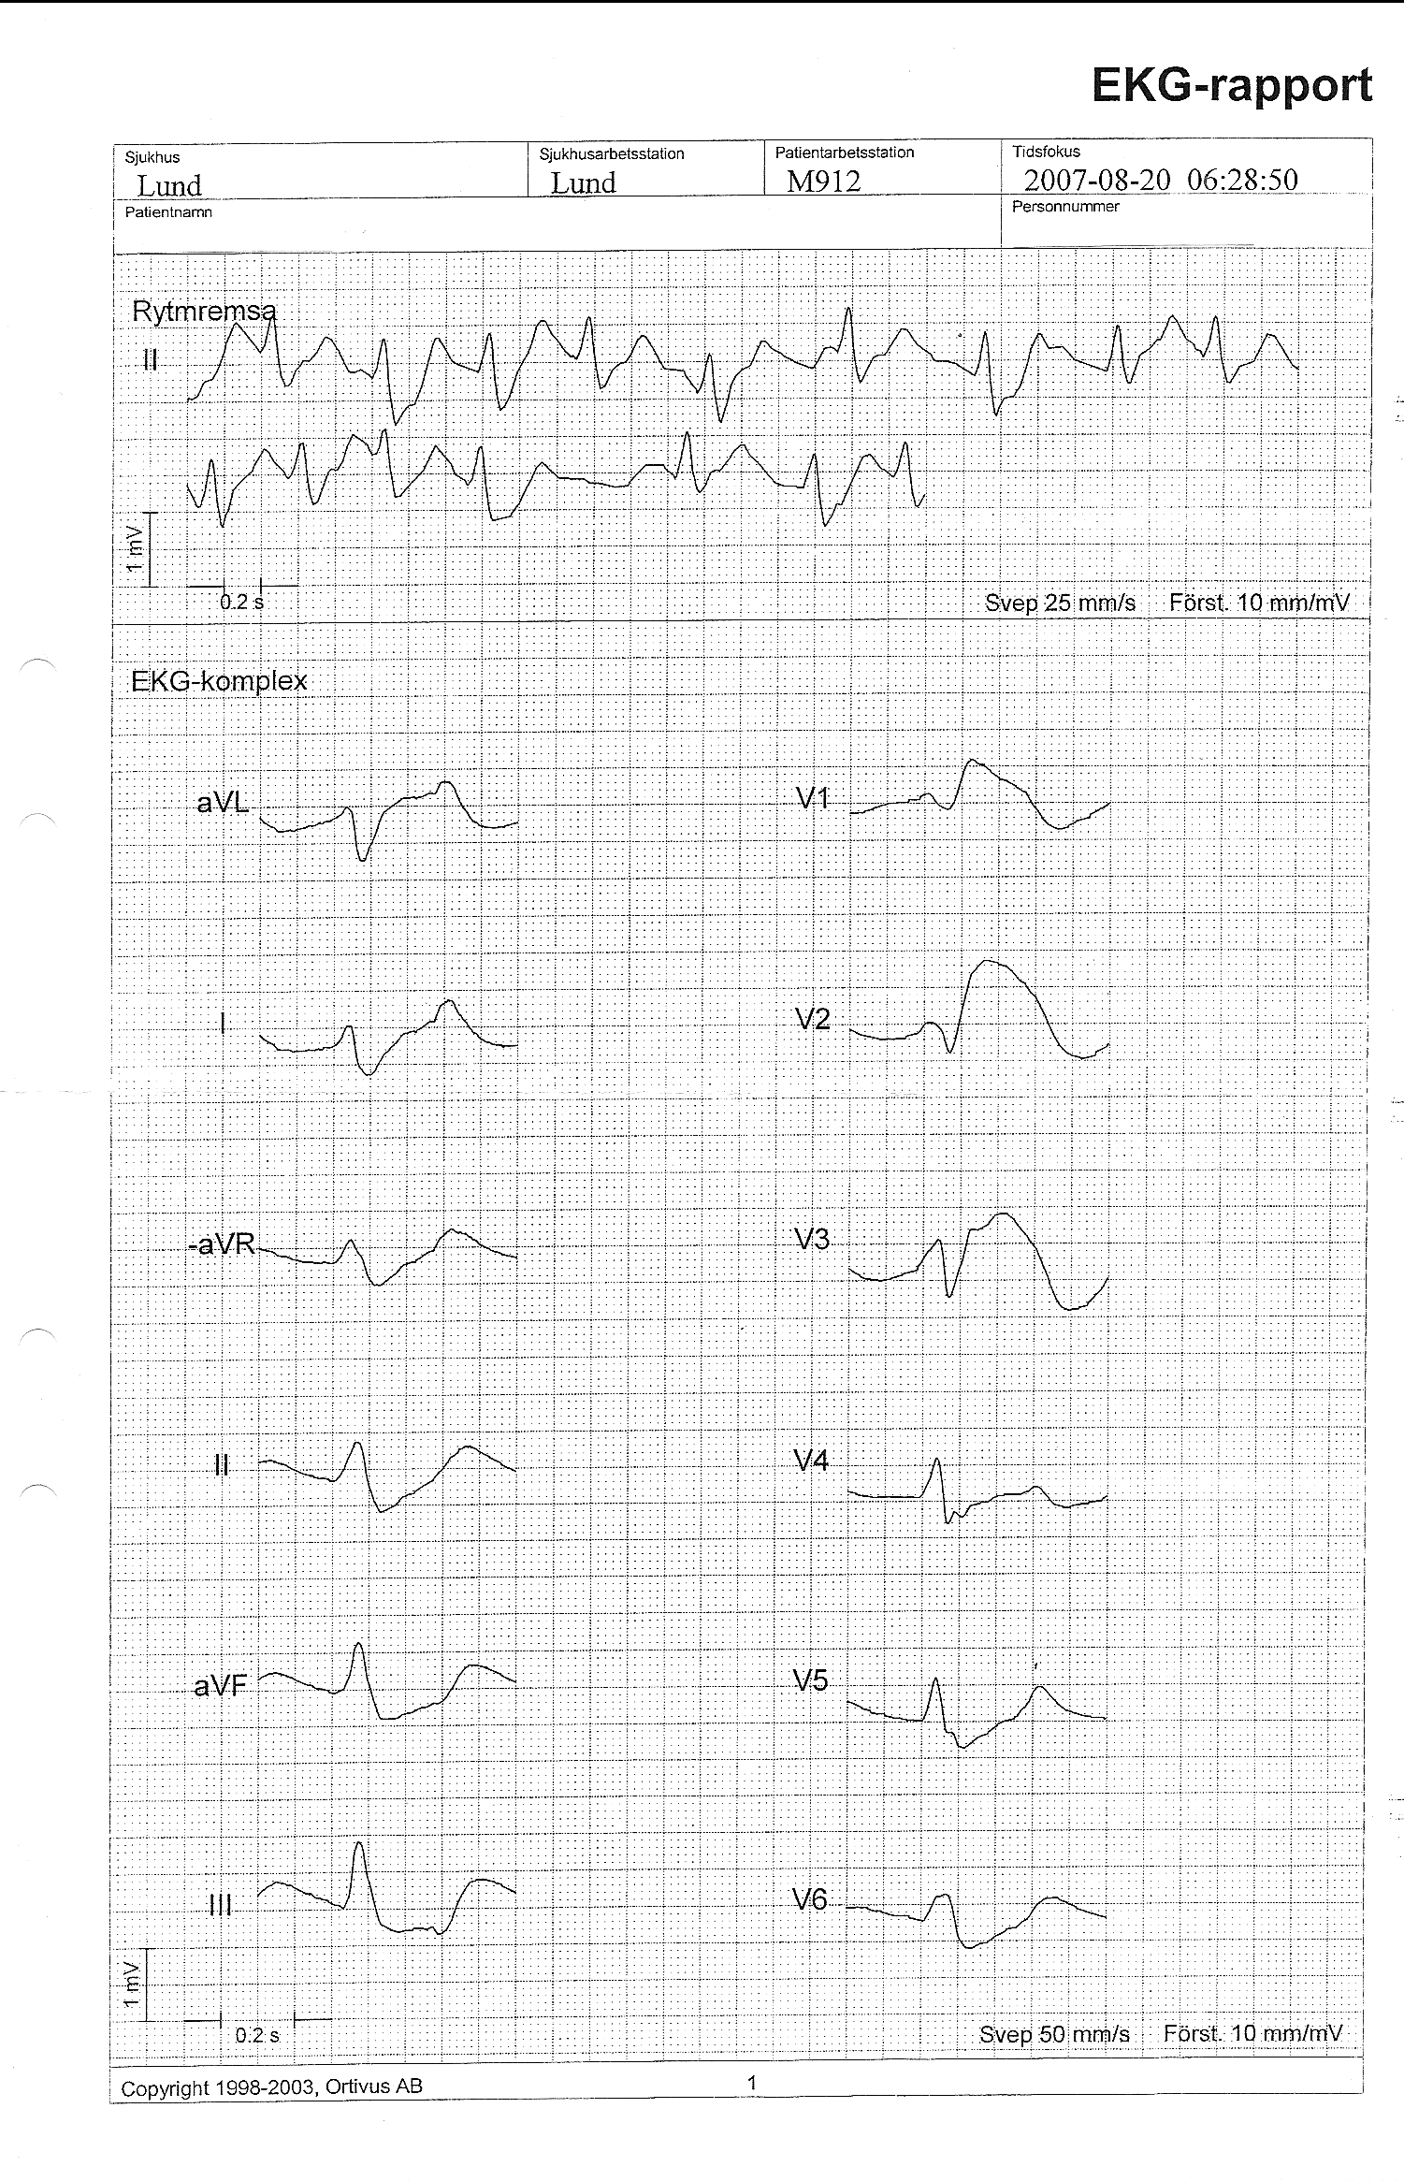
Pseudoinfarct pattern can be a manifestation of hyperkalemia
Notes:
In hyperkalemia, you can even get ST-elevation that looks like the STEMI. But the clue here is that the QRS complexes are really wide.
This patient has atrial fibrillation and wide QRS complexes that were due to hyperkalemia. The EKG was initially interpreted as STEMI.

Slide 60
Digoxin Effect

Slide 61
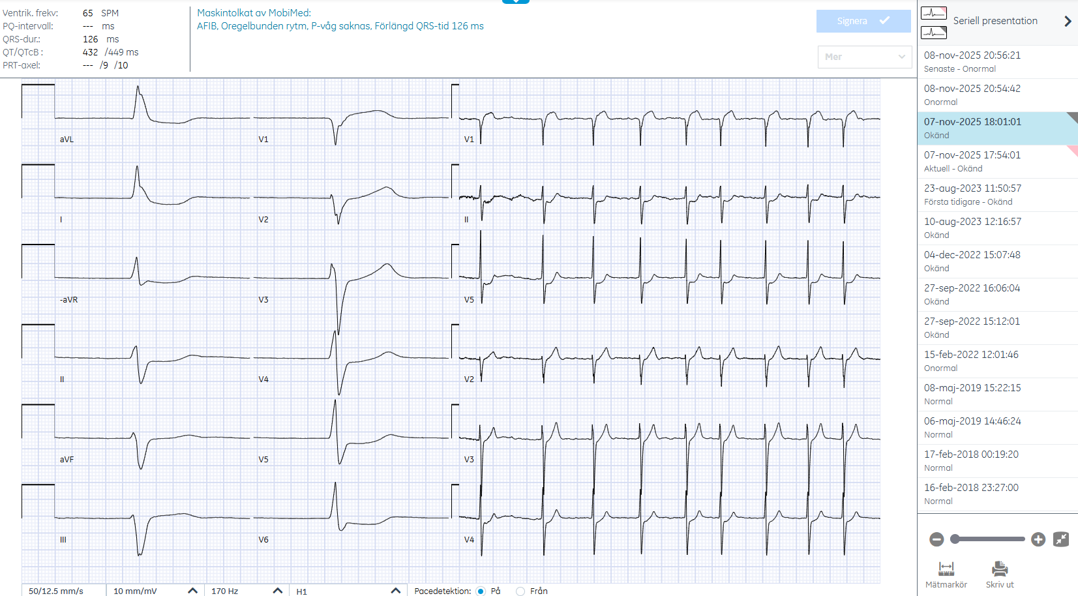
Current EKG 251107 18:01
Notes:
SOURCE: 530614-251107-AM
Digoxin level 2.1 nmol/L
Kreatinin 240 (prior kreatinin 60)

Slide 62
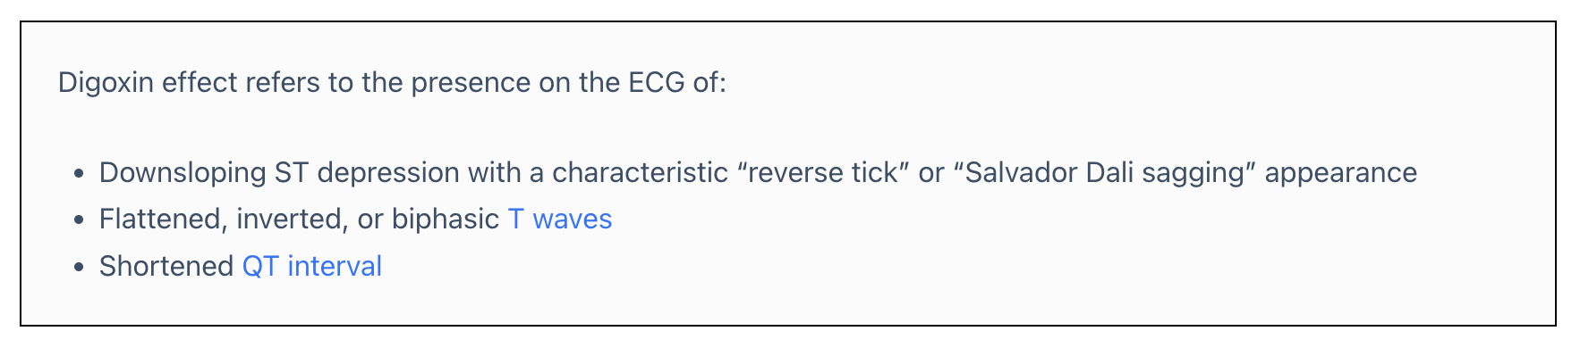
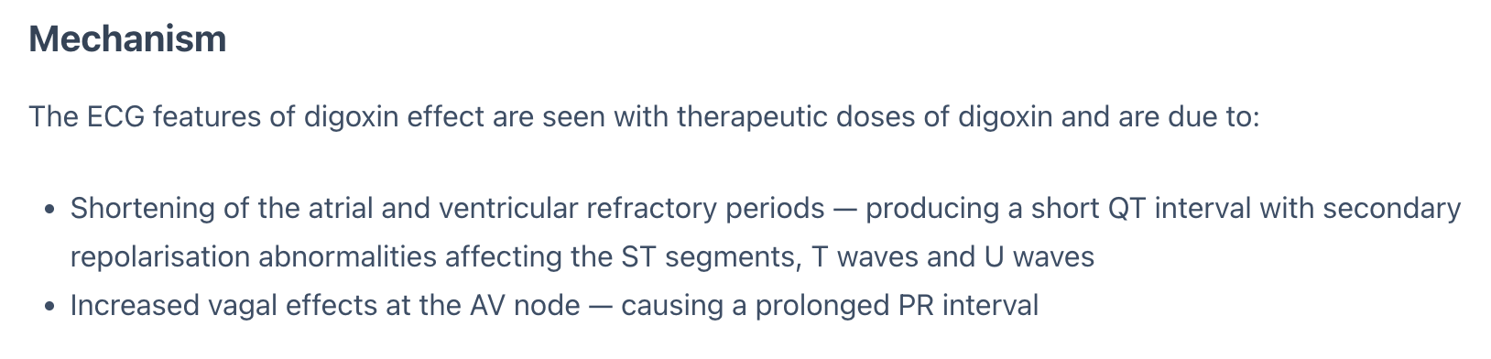
Digoxin Effect
https://litfl.com/digoxin-effect-ecg-library/

Slide 63
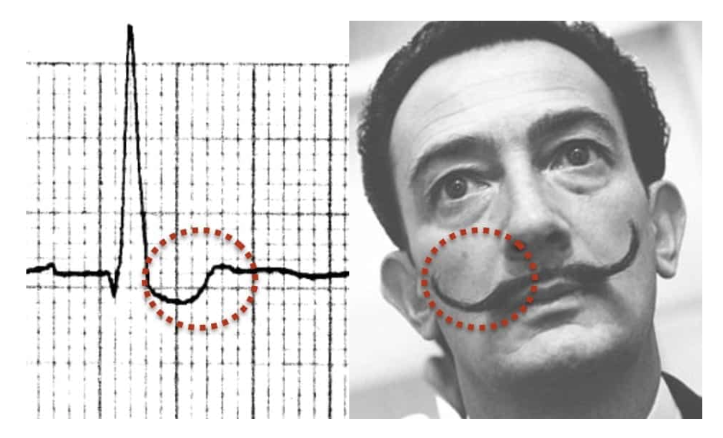
https://litfl.com/digoxin-effect-ecg-library/

