Slide 1
QRS-Complex

Slide 2
Index
Hyperkalemia
Sodium Channel Poisoning
Shark Fin Sign
Osborn Wave

Slide 3
Hyperkalemia

Slide 4
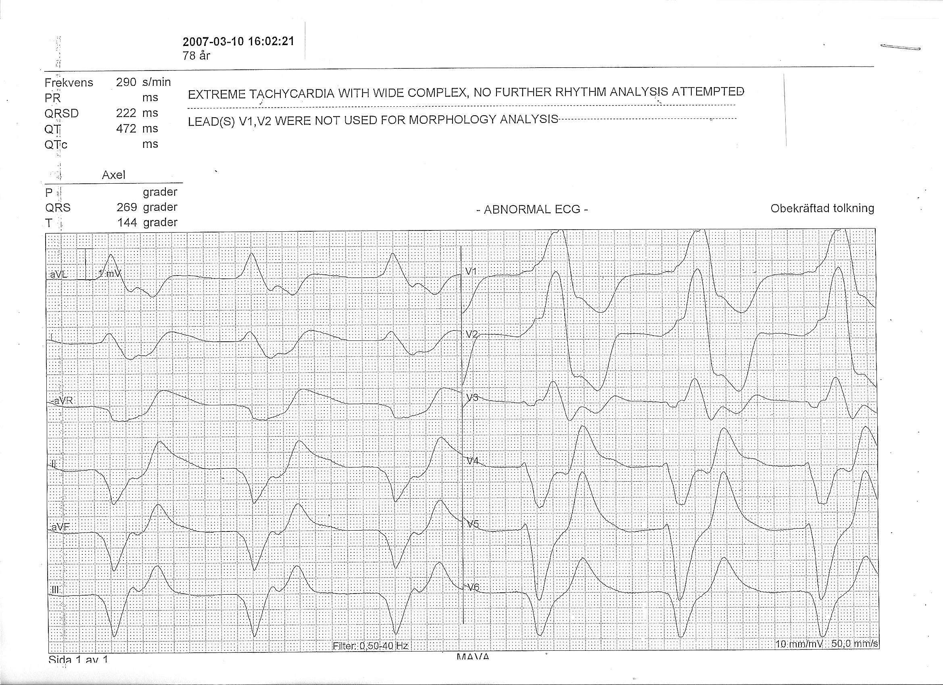
78-year-old man with leg weakness
Notes:
The paper speed here is 50 mm/sec. What is the rate? 600/9 boxes = 70 bpm.
Why does the computer interprete the frequency as 290 bpm? Probably fooled by inflection points occurring every second box in lead III for example.
What is most weird about this EKG? The bredth of the QRS. If really really wide, think Hyper K and Na-channel blockade.

Slide 5
This 78-year-old man who presented because of leg weakness had heart failure and kidney failure
He was taking Spironolactone and an angiotensin II antagonist. He was prescribed Trimethoprim-Sulfamethoxazole for suspected UTI one week prior to presentation
Trimethoprim blocks the collecting tubule sodium channel (an action similar to that induced by the potassium-sparing diuretic amiloride)
The patient’s potassium was 8.3 mmol/L

Slide 6
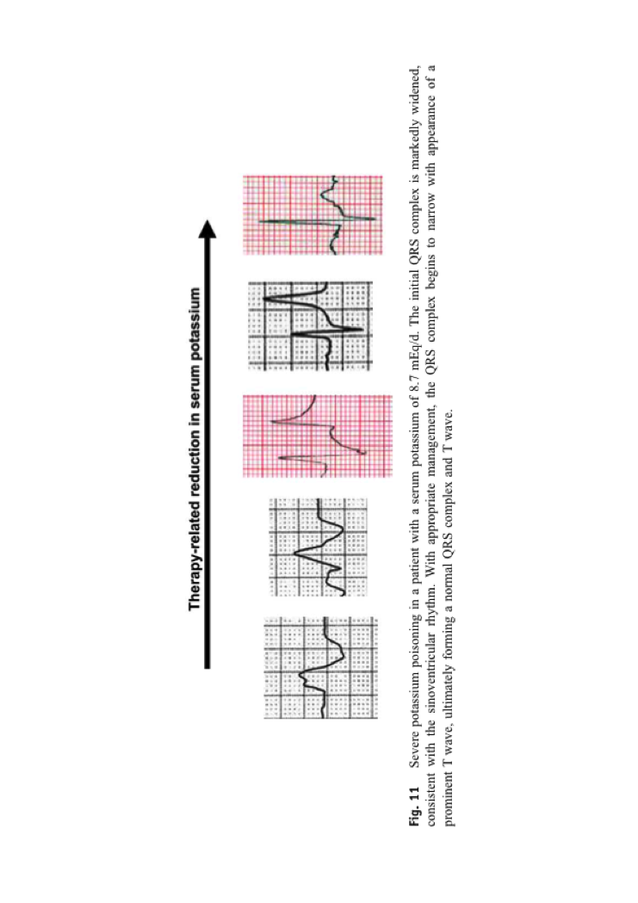
Hyperkalemia
Increasing hyperkalemia:
T-wave peaking; P-wave flattening; PR-prolongation; QRS-widening
Notes:
As the potassium rises:
1-The T wave peaks
2-Then the EKG is drawn out length wise: the PQ gets longer and the P wave disappears; the QRS gets wide.

Slide 7
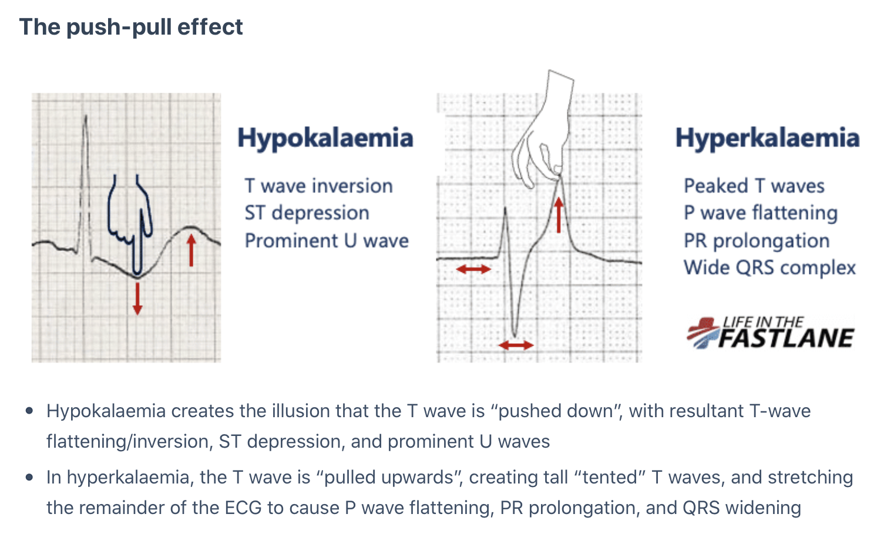
https://litfl.com/hypokalaemia-ecg-library/
Notes:
Note the mnemonic:
Push effect for hypokalemia
Pull effect for hyperkalemia

Slide 8
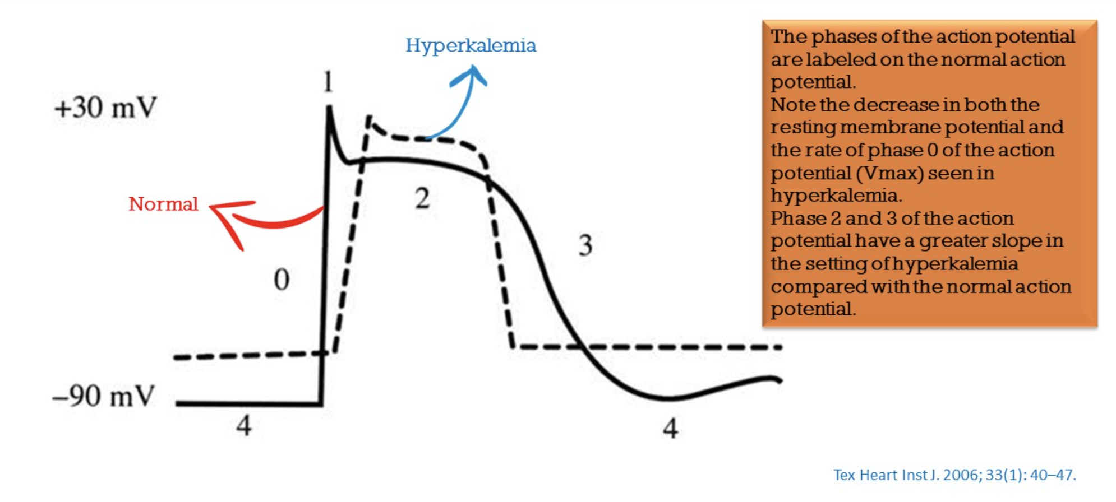
Notes:
In hyperkalemia, the resting membrane potential is not as negative. Phase I is prolonged. This corresponds to the QRS-complex on the EKG.

Slide 9
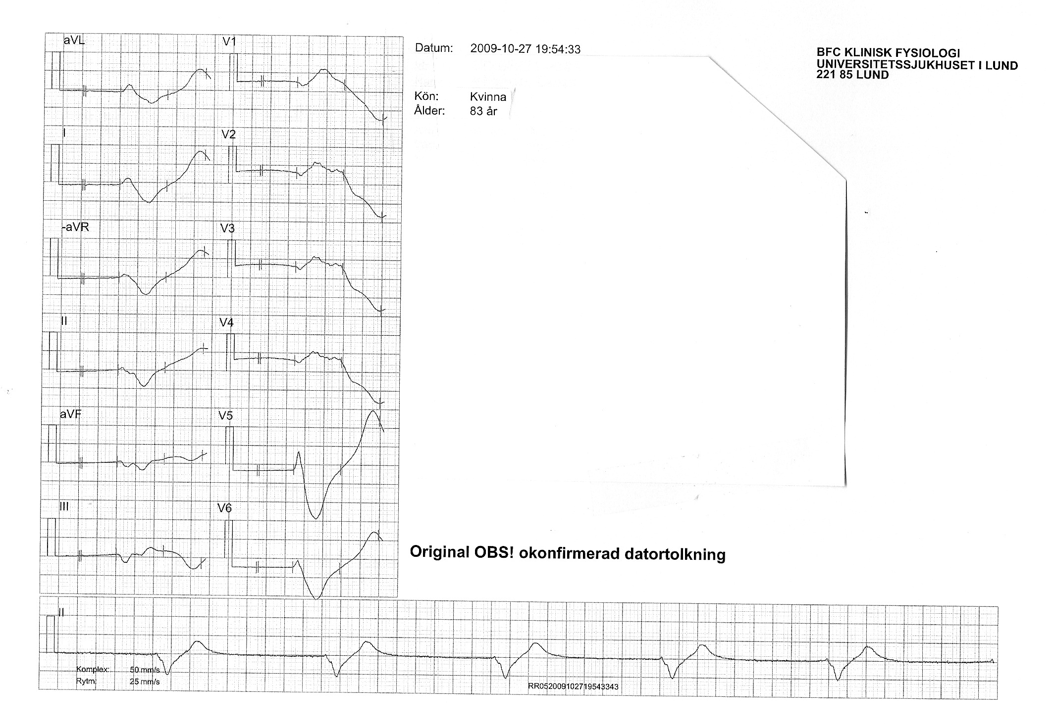
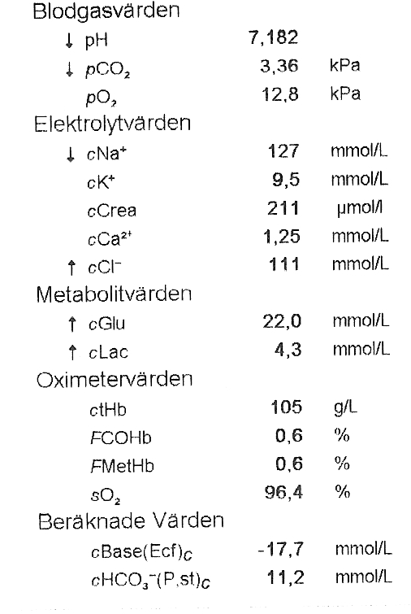
83-year-old woman with decreased level of consciousness
Notes:
Source: 260226-091027-DN
The paper speed showing the complexes is 50 mm/sec
The paper speed of the rhythm strip at the bottom of the EKG is 25 mm /sec. The QRS complexes are 250 msec wide.
The heart rate is 300/9 = 34.

Slide 10
Sodium Channel Poisoning

Slide 11
56-year-old man with suspected poisoning
Notes:
Same EKG, papper speed 50 mm /sec to the left and 12.5 mm/sec to the right.

Slide 12
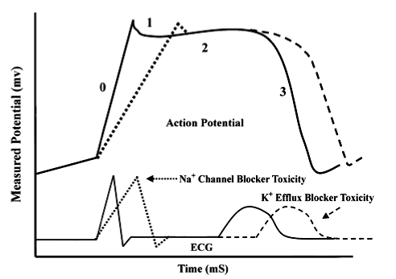
Sodium Channel Blockade
Holstege Am J Emerg Med 2005:23:171
Notes:
The pathophysiology is somewhat similar to that of hypekalemia, with a slow upslope of phase 0 due to Na channel blockade.
But the treatment is different. The initial drug of choice is NaHCO3.

Slide 13
Shark Fin Sign

Slide 14
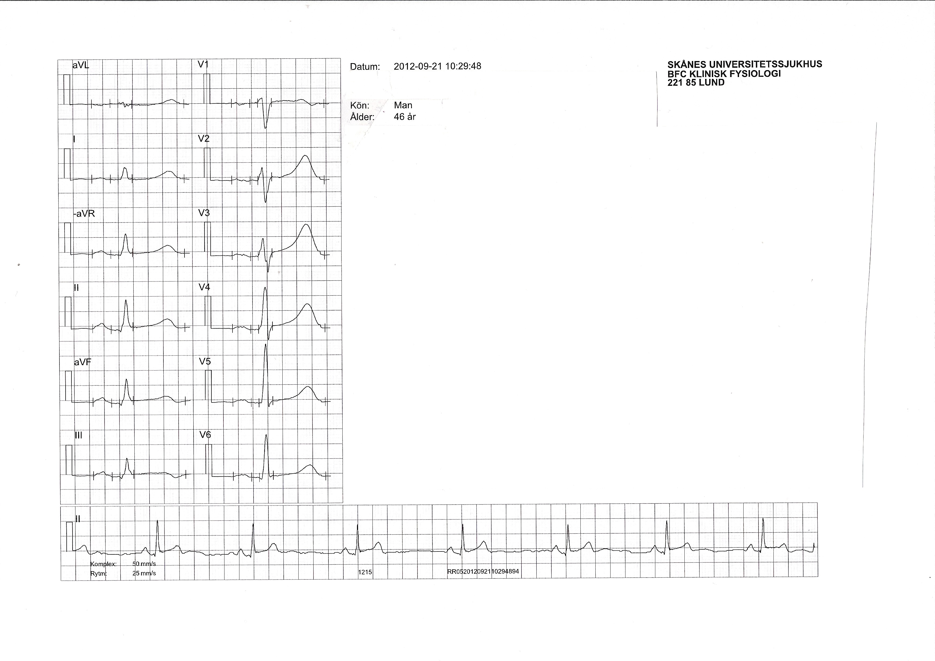
46-Year-Old Man with Chest Pain
Priority 2
ASA 300 mg
Clopidogrel 600 mg

Slide 15
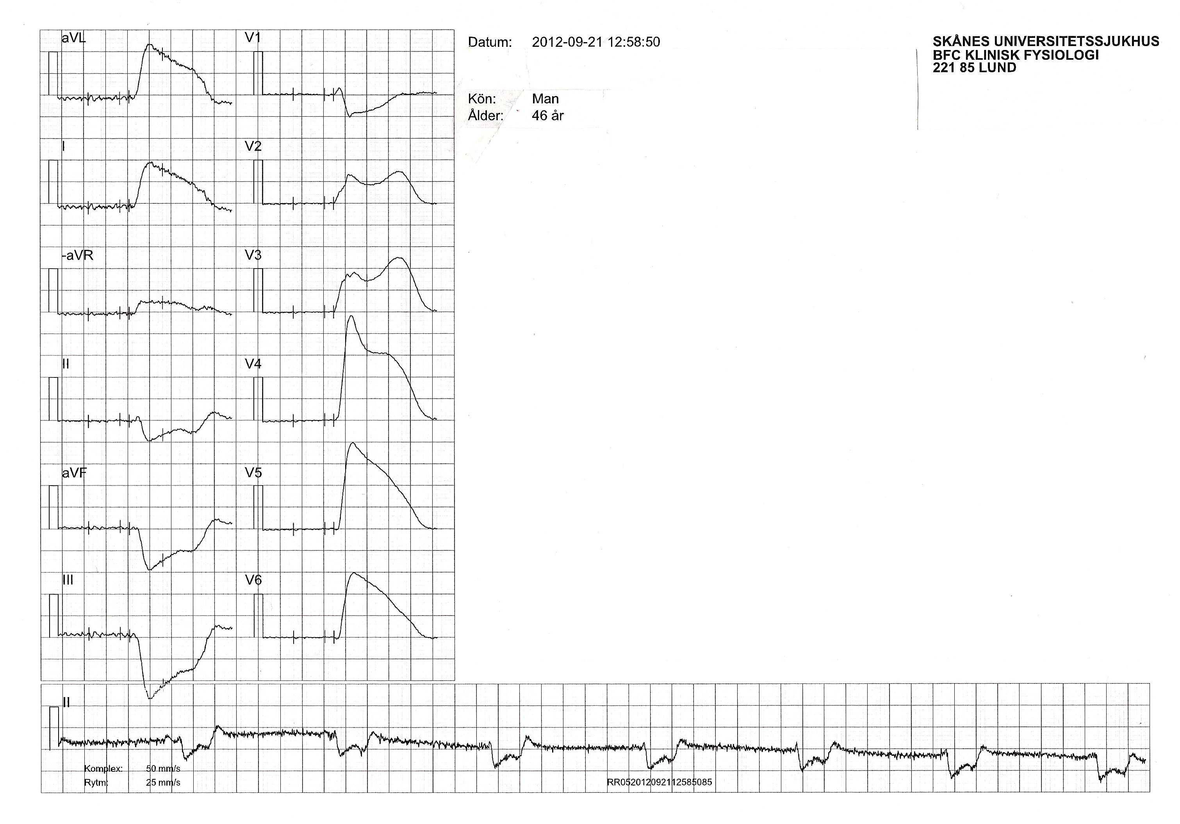
46-Year-Old Man with Chest Pain
Goes to the washroom, comes back completely grey, diaphoretic, severe chest pain.
Notes:
Paper speed for the complexes is 50 mm/sec.
Paper speed for rhythm strip 25 mm sec
Format with uniform paper speed 25 mm/sec not available.
So to see how the complexes would look like at 25 mm /sec, I “compressed” the complexes on the horizontal axis by 50%.
Type I in lead I
Type 2 in lead V4

Slide 16
Shark Fin
The QRS-ST-T can mimic wide QRS complex conditions such as:
VT if tachycardic
Hyperkalemia
TCA poisoning
Yet the wide “complex” is actually a merging of the QRS-complex with an ST-elevation.
This is a STEMI-OMI with increased risk for VF

Slide 17
Course
Överförs till akutrummet. Initialt kontaktbar, tappar därefter medvetande, hjärtstopp ca 13:30. Manuella kompressioner sedan LUCAS. Får VT/VF. Defibrilleras x 1 till sinusrytm, därefter åter VF/VF utan svar till defibrillering. Får sammanlagt Adrenalin 7 mg, Atropin 1 mg och 500 ml Tribonat. Även Cordarone.
Under pågående LUCAS behandling angiograferas patienten via femoralis. Stor tromb i huvudstammen som ockluderar LAD. Med aspirationskateter får man bort tromben och därmed stenosen, hazyness i ocklusionsområdet. Avstår från stent. Ingen bärande cirkulation trots öppet kärl. Hjärtat står helt stilla. Inget perikardexudat. Diskuterar ECMP med thoraxkirurg och anestesiolog som inte menar att det kommer att vara meningsfullt och avböjer. HLR i ca 60 min. Dödsförklaras 14:18.
Notes:
Cardiac arrest, LAD occlusion, unable to revascularize.

Slide 18
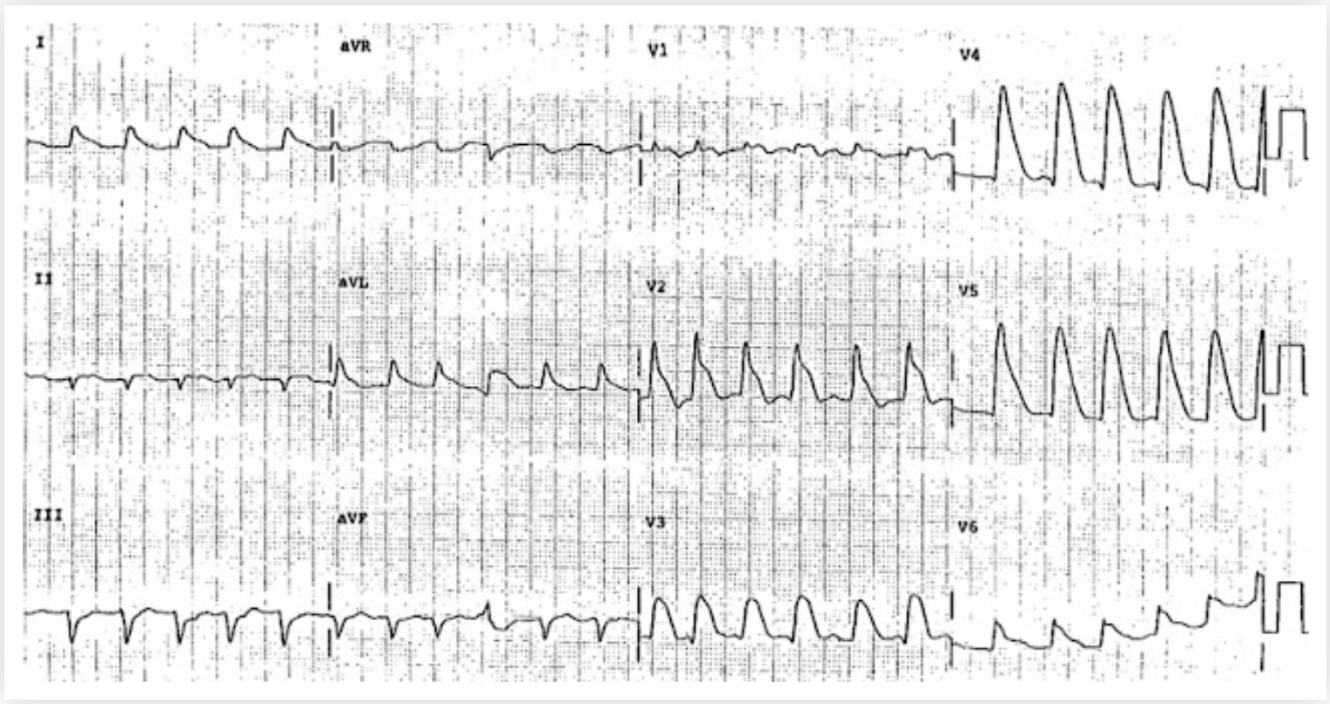
http://hqmeded-ecg.blogspot.com/2018/06/shark-fin-deadly-ecg-sign-that-you-must.html
Notes:
The paper speed is 25 mm/sec. The heart rate is slightly under 150 bpm.
What is going on here?
The complexes look like wide QRS complexes but they don’t have the same morphology as the QRS complexes in hyperkalemia and TCA poisoning.

Slide 19
Osborn Wave

Slide 20
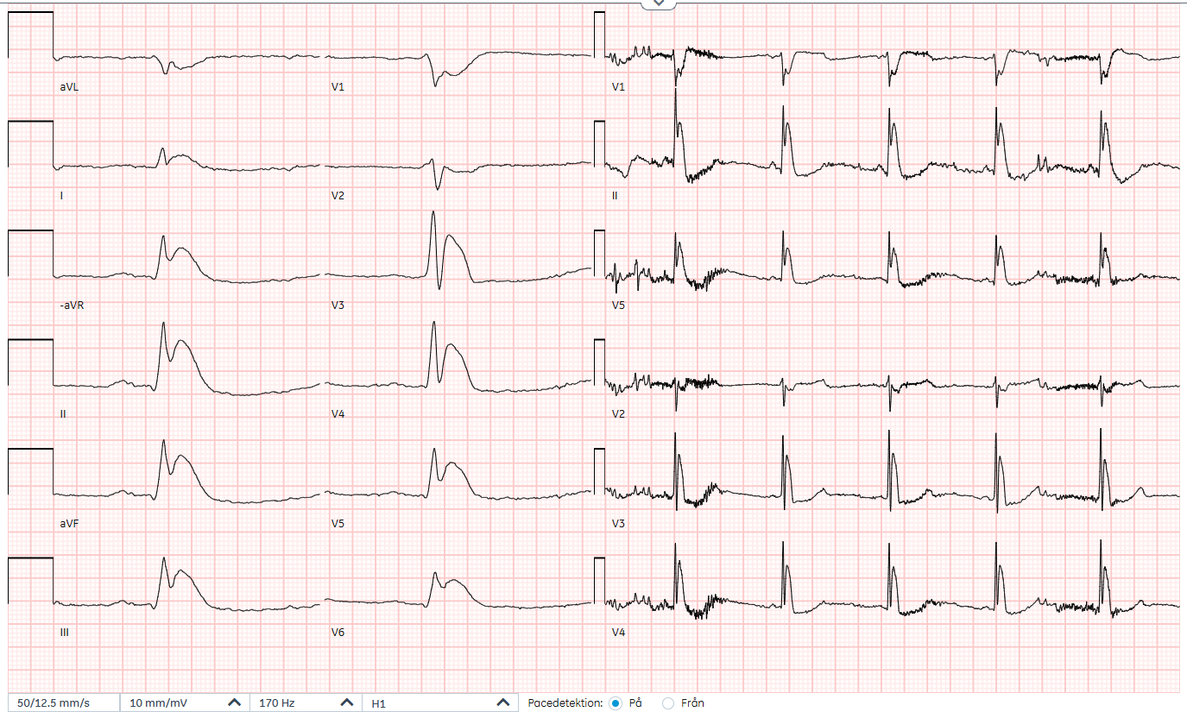
Current EKG 250101 12:30
Notes:
SOURCE: 761221-251019-IA

Slide 21
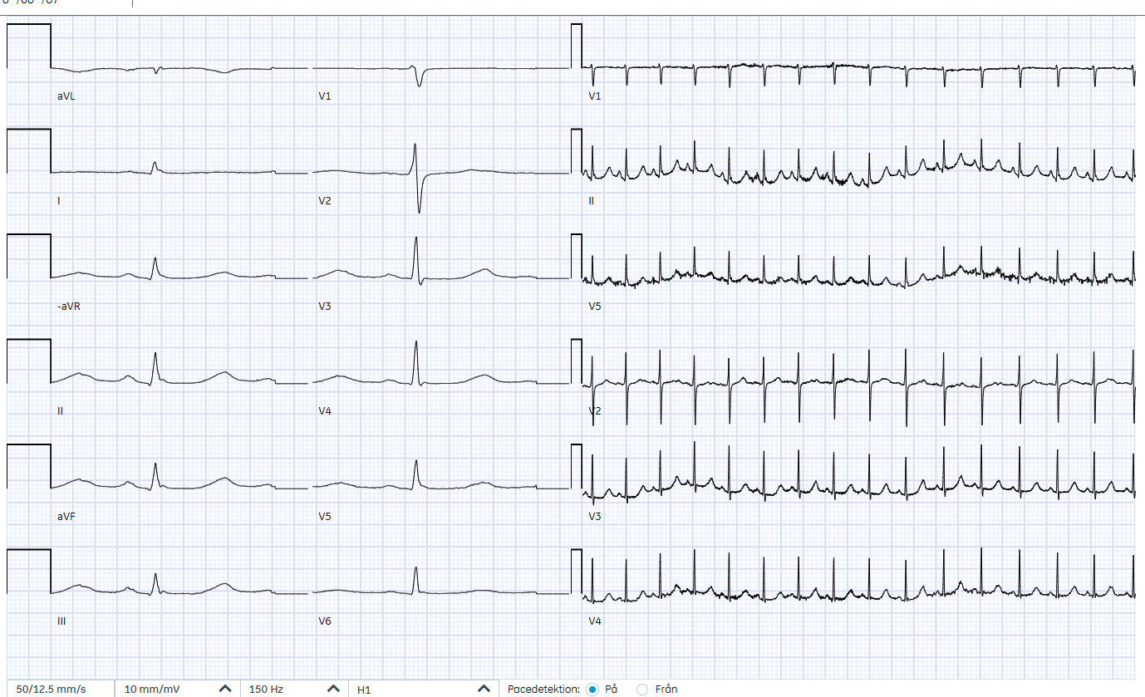
Subsequent EKG 240101 15:32
Notes:
SOURCE: 761221-251019-IA

Slide 22
Osborn Wave

