Slide 1
AV-Blocks

Slide 2
86-year-old woman with dizziness
Notes:
Source: 340835-201222-KP
What is the rhythm?
What is the difference between:
1-First degree AV block
2-Second degree AV block Mobitz type 1 (aka Wenckebach)
3-Second degree AV block Mobitz type 2
4-Third degree AV block?
Which ones have regular ventricular activity?

Slide 3
AV-Blocks
1st degree | PR > 0.2 sec, not true block, rather conduction delay
2nd degree | Occasional non-conducted P wave Mobitz type I (Wenckebach): PR prolongs prior to non-conduction. Pathology in AV-node Mobitz type II: PR does not prolong. Pathology in His-Purkinje system
3rd degree | AV-dissociation Junctional or ventricular escape rhythm
Notes:
Atropine should iimprove conduction through the AV-node. If atropine converts from 2:1 to 3:2, suggests type I
Carotid sinus massage worsens conduction through the AV-node. If CSM converst from 2:1 to high-degree AV-block (3:1, 4:1), suggest type I

Slide 4
Etiology of Conduction Blocks
Degenerative (50-67% of cases) | Fibrosis, sclerosis, calcification
Ischemia (2nd most common) | Ischemic heart disease, including acute myocardial infarction
Other | Drugs (e.g. beta-blockers), hyperkalemia Other (e.g. infections, amyloidosis . . .)
Notes:
Atropine should iimprove conduction through the AV-node. If atropine converts from 2:1 to 3:2, suggests type I
Carotid sinus massage worsens conduction through the AV-node. If CSM converst from 2:1 to high-degree AV-block (3:1, 4:1), suggest type I

Slide 5
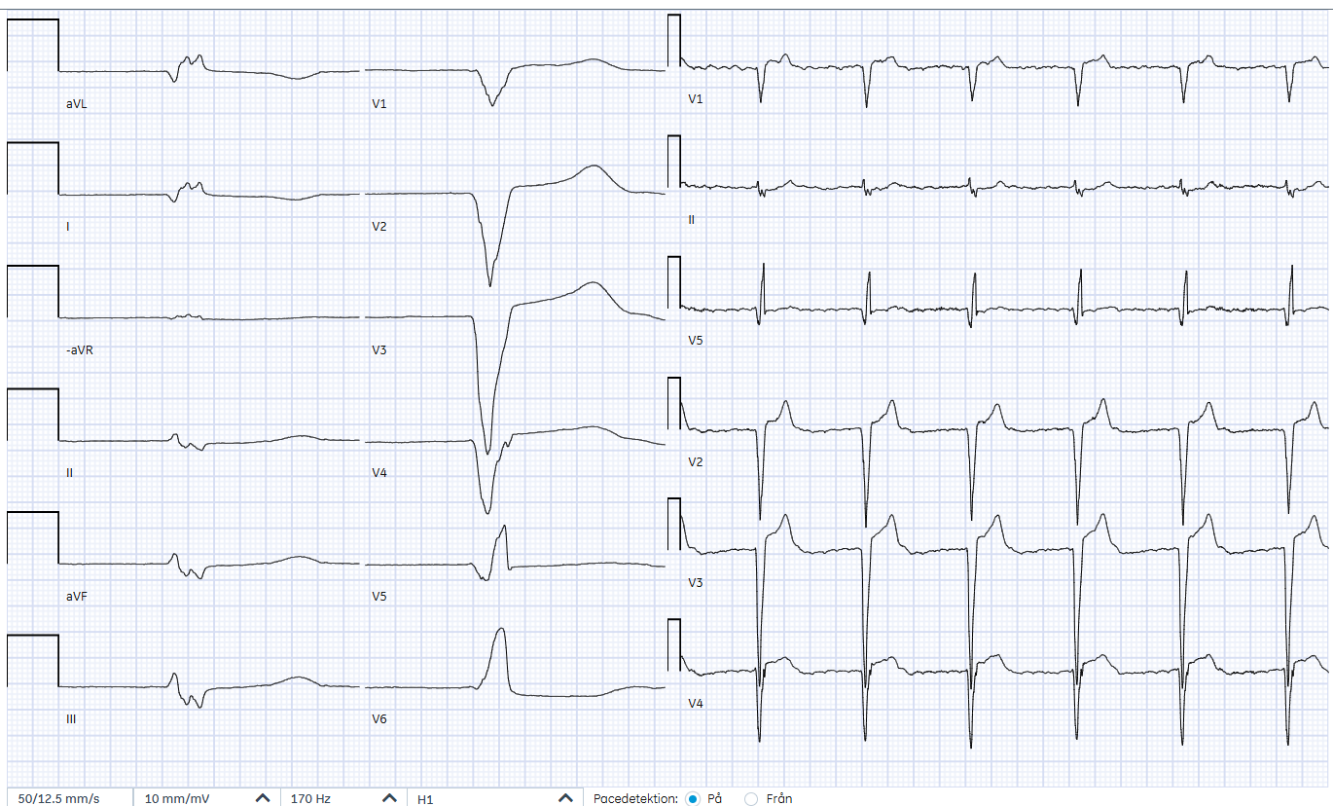
82-year-old man with abdominal pain
Notes:
SOURCE: 421206-250912-KS EKG 250912 02:03
heart rate 37 bpm.
No P-waves, atrial fibrillation
Heart rate is regular, suggests third degree AV-block

Slide 6
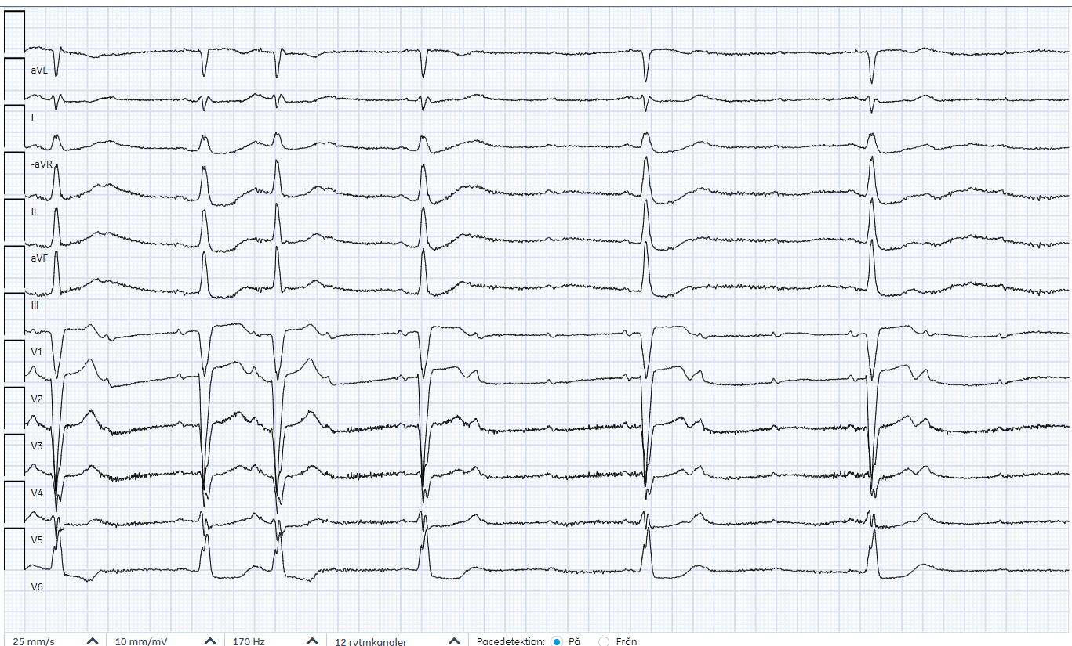
83-year-old man with dizziness
Notes:
Source: 420822-250915-SEF (Landskrona)
I think this is a high-degree AV-block (Mobitz II).

Slide 7
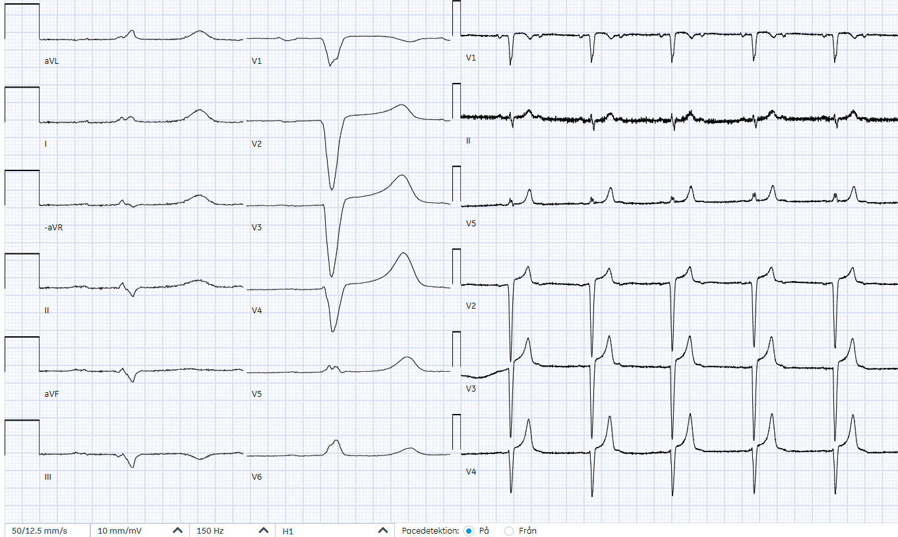
76-year-old man with weakness
Notes:
Source: 480923-250718-TP

Slide 8
2:1 AV-block
Cannot determine whether type I or type II
If measures that affect AV-node change the frequency of conduction, suggests type I
If atropine changes from 2:1 to 3:2, suggests type I
If carotid sinus massage changes from 2:1 to high-degree AV-block (3:1, 4:1), suggests type I
Notes:
Atropine should iimprove conduction through the AV-node. If atropine converts from 2:1 to 3:2, suggests type I
Carotid sinus massage worsens conduction through the AV-node. If CSM converst from 2:1 to high-degree AV-block (3:1, 4:1), suggest type I

Slide 9
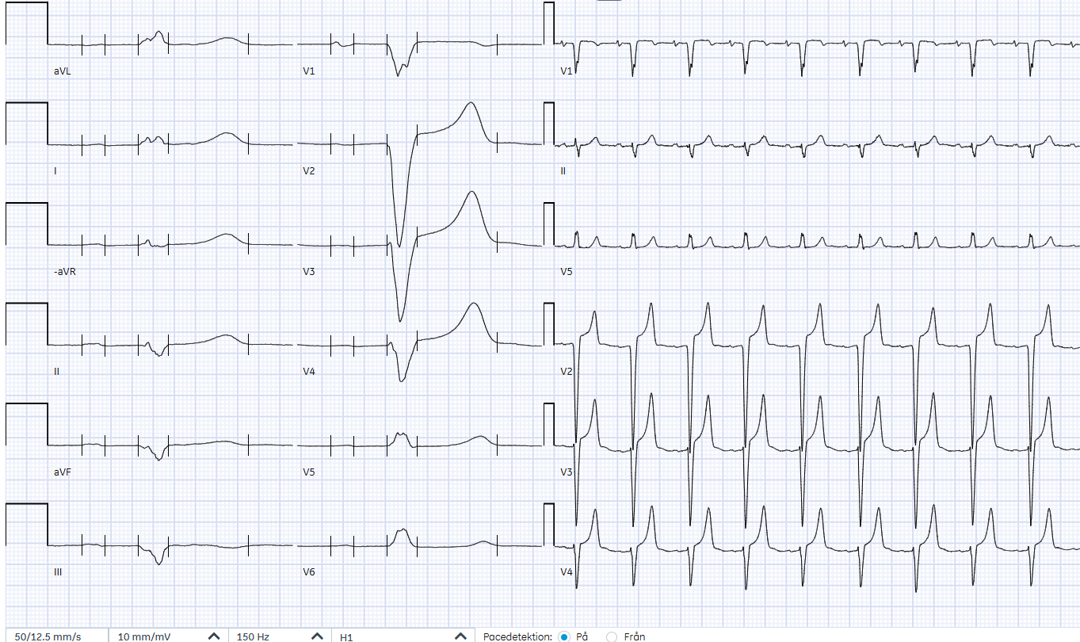
76-year-old man with weakness
Notes:
Source: 480923-250718-TP
This EKG is of the same patient, taken 250718 at 08:12
First degree AV block

Slide 10
45-Year-Old Woman with Poisoning
Reports ingesting 30 tablets of 180 mg Diltiazem (calcium channel blocker) with extended release two hours ago.

Slide 11
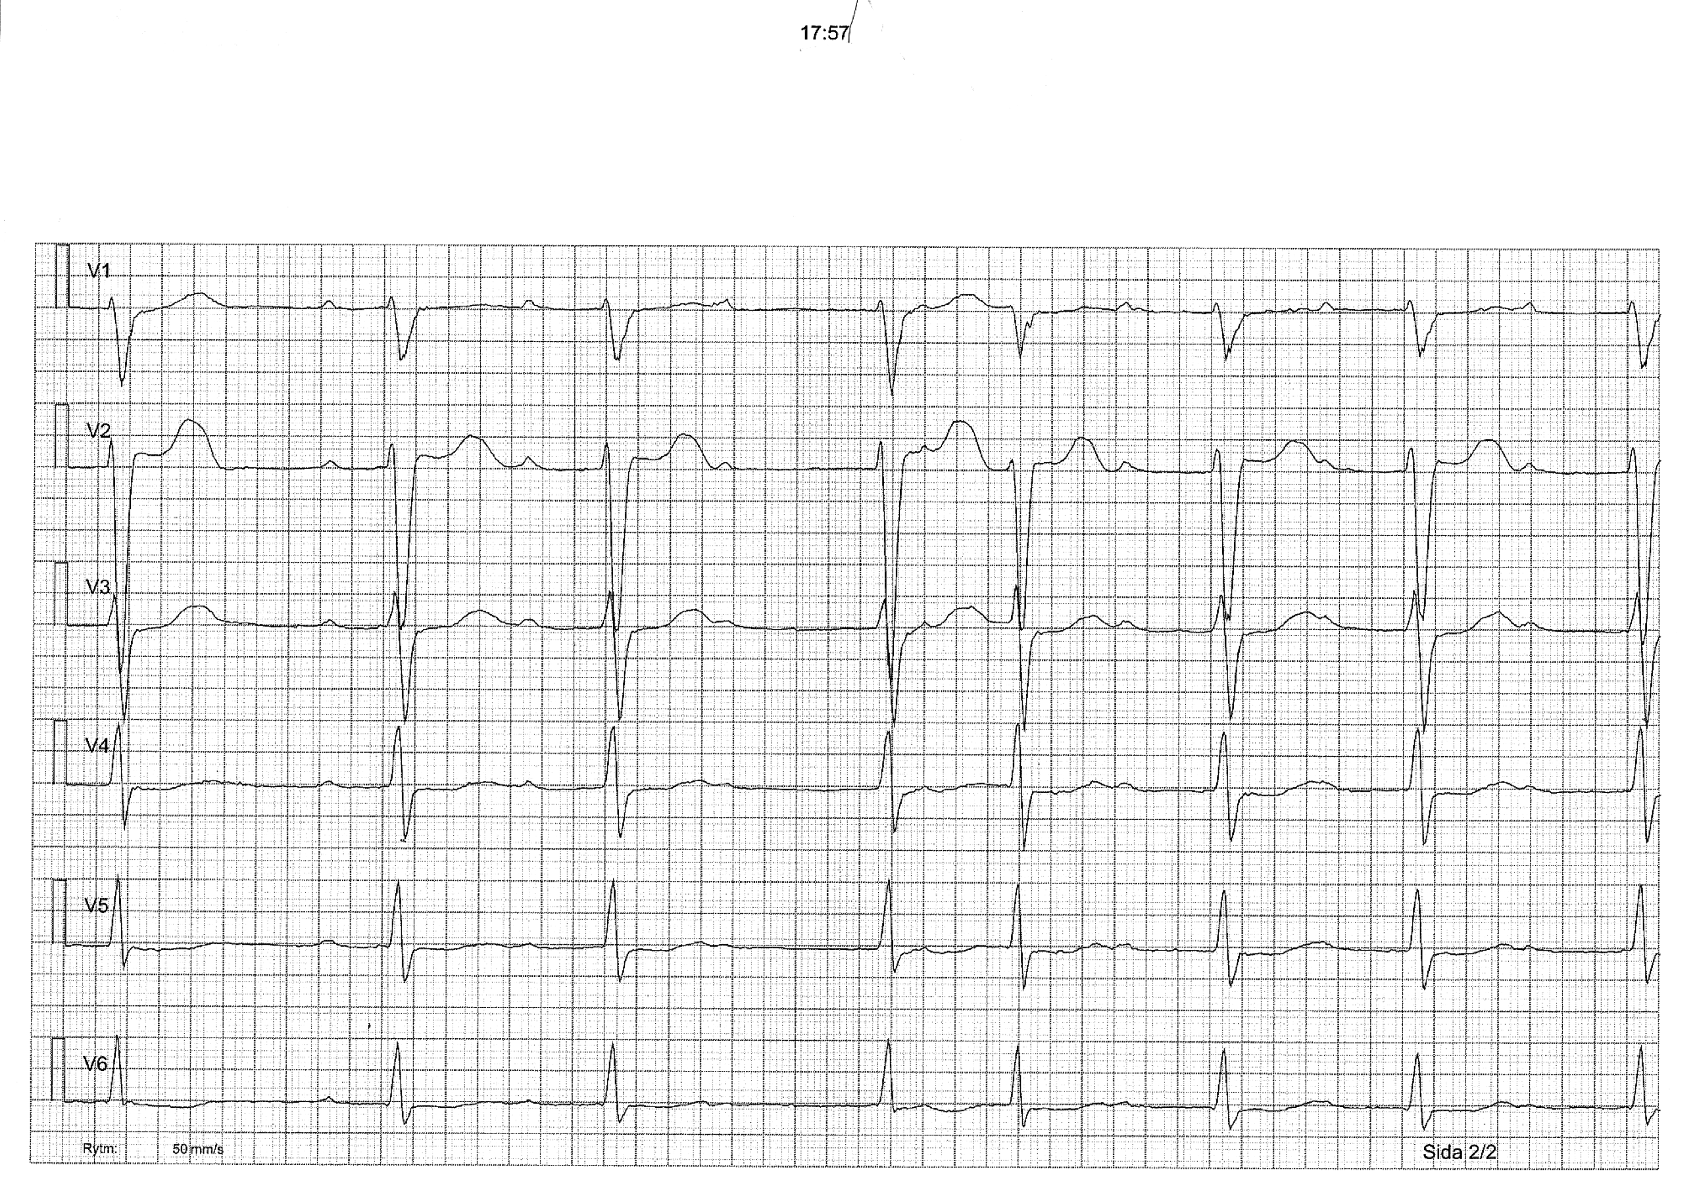
45-Year-Old Woman with Diltiazem Overdose
?
Notes:
Overdosed off Diltiazem, a calcium-channel blocker
The paper speed i 50 mm / sec but the EKG has been compressed by a factor of 2 to simulate a 25 mm/sec paper speed
This is probably a Wenckebach. The fourth QRS complex has a different morphology, perhaps an AV-nodal replacement origin?

Slide 12
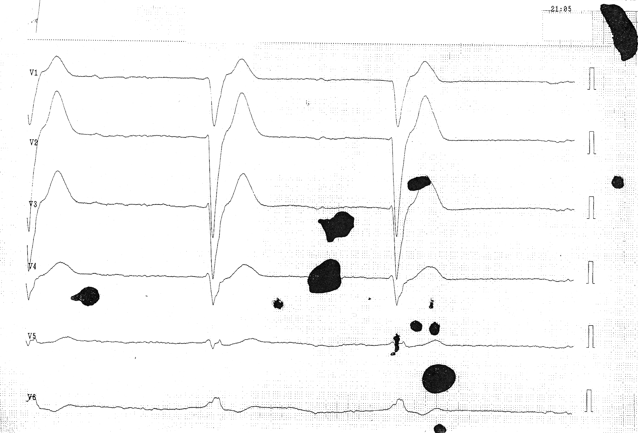
Notes:
Ventricular escape rhythm: no P waves, wide QRS complexes, HR 35 bpm

Slide 13
Course
The patient reported ingesting 30 tablets of Diltiazem with extended release two hours ago. The dose of each tablet was 180 mg, resulting in a total ingestion of 5.4 g.
The patient was transferred to the ICU and went into cardiac arrest despite max therapy with vasopressors, inotropes, transvenous pacemaker, Levosimendan

Slide 14
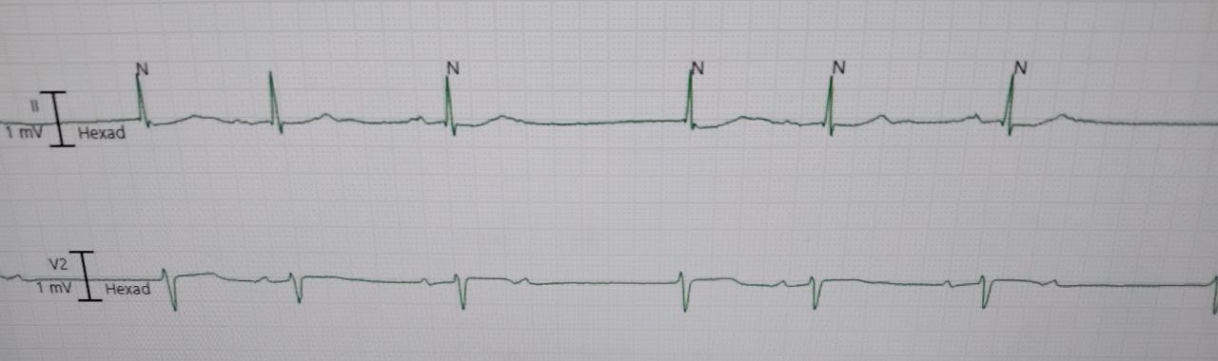
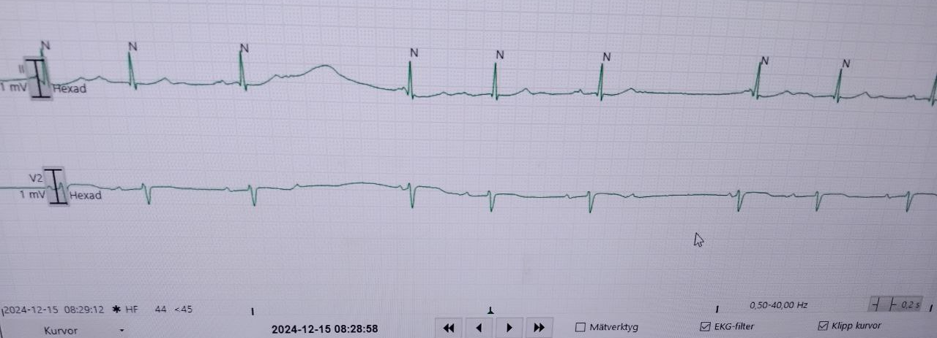
Notes:
501010-241215-RB
HIA jour said this is definitely NOT AV block 2, it is just blocked SVES because if you look at the P wave that is NOT followed by a QRS then you see that it comes much earlier than the other p waves.

Slide 15
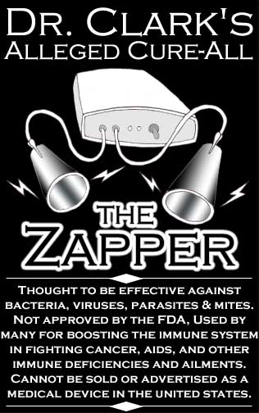

Slide 16
NEJM 2004;350:1688
Notes:
According to the article, the patient had “a dual chamber pacemaker, implanted because of intermittent, symptomatic, high-degree atrioventricular block.” I assume this was a DDD: dual chamber pacing, dual chamber sensing, both ability to trigger and inhibit.
The patient “presented with short episodes of dizziness and near-fainting. A detailed history revealed that the symptoms occurred exclusively during self-prescribed therapy with a Zapper device.”
Before start of Zapper therapy, you can see native P-waves and then a narrow QRS-complex that is triggered by the pacemaker. Initially, despite the interference generated by the Zapper, the pacemaker still senses the P-wave and the heart rate is stable around 100 bpm.

Slide 17
NEJM 2004;350:1688
Notes:
The text ”Beginning of undersensing” suggests that the pacemaker can no longer identify the P waves and hence trigger the ventricles. The heart rate is the same. So presumably, the P-waves are making it through to AV-node without help from the pacemaker.
In the article, the authors write that ”our patient used the Zapper and had symptomatic bradycardia
because of ventricular oversensing.” This suggests instead that the pacemaker thought that that wave forms generated by the Zapper were QRS-complexes and hence was “inhibited” and did not trigger the ventricles to contract.
On this EKG, it is unclear whether the pacemaker can sense the heart’s QRS-complexes or is oversensing the stimuli from the Zapper, because the heart rate is around 100 bpm, hence presumably above the threshold where the pacemaker would stimulate the ventricle.

Slide 18
NEJM 2004;350:1688
Notes:
Here you see the patient’s heart rate abruptly slow. The patient had intermittent AV-block. The AV-block has presumably suddenly kicked in.
The pacemaker is not doing anything. Hence here, the pacemaker is likely oversensing ventricular ”activity” and is inhibited.

Slide 19
91-Year-Old Man
Notes:
This patient was referred to the ED as new—onset atrial fibrillation
Computer agrees: “Förmaksflimmer” is Atrial fibrillation in Swedish.
But there is a regular 3-beat – pause – 3 beat – pause rhythm.

Slide 20
Notes:
The P waves (blue) appear at a regular rate of 170 beats/min. This might be an EAT (Ectopic Atrial Tachycardia).
The QRS complexes (red) follow three of the P waves with a progressively lower PR-interval, then there is a P wave that is not conducted. So second degree AV block type 1 (Wenckebach)

