Slide 1
Tachycardia

Slide 2
Index
Tachycardia: Regular + Wide
VT
SVT + bundle branch
SVT + hyperkalemia
Tachycardia: Irregular + Wide
AF + WPW
Ashman
TdP
Tachycardia: Regular + Narrow
Flutter
EAT

Slide 3
Tachycardia: Regular + Wide

Slide 4
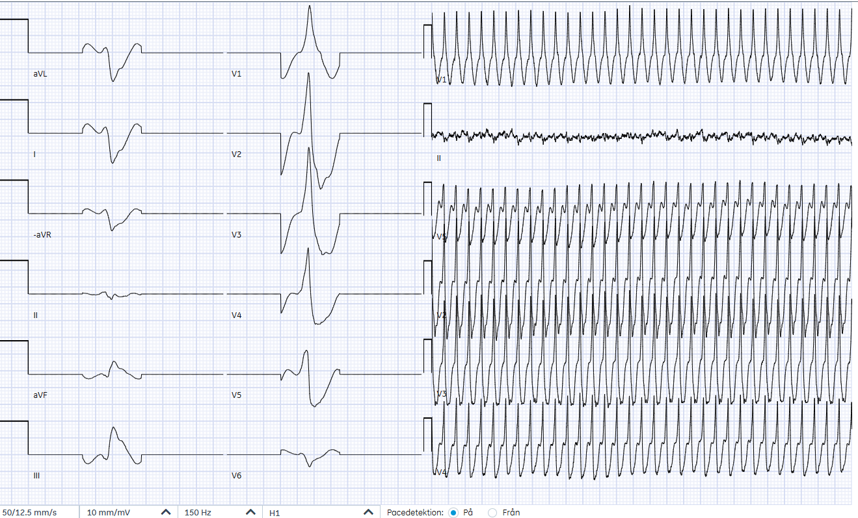
51-year-old who has fainted
Notes:
Source: 710430-221125-JB
This is the Cabrera format with QRS complexes displayed at 50 mm/sec and the rhythm at 12.5 mm/sec

Slide 5
51-year-old who has fainted
Notes:
The patient presented to triage with a heart rate of 200 and an SBP of 95, upon which he was “upgraded” to a priority 1 and brought into the resuscitation room.

Slide 6
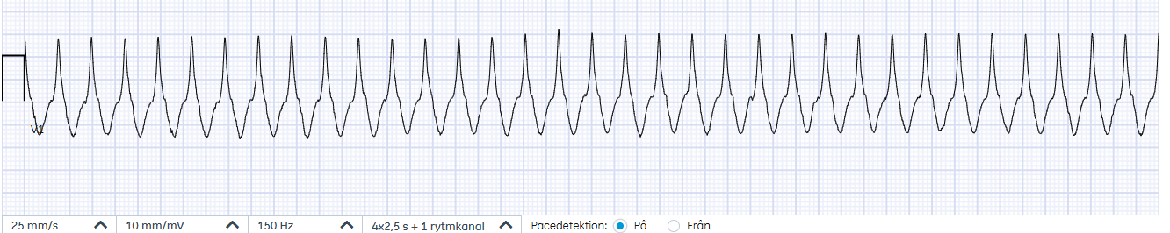
Differential of Tachycardia
 | Regular | Irregular
QRS < 120 msec
QRS > 120 msec
Notes:
So the patient is stable enough to spend some time trying to figure out the pathophysiology underlying the tachycardia.
Tachycardias can be categorized according to whether they are:
1-Regular or irregular
2-Narrow or wide QRS
This patient has a regular tachycardia with wide QRS complexes

Slide 7
Differential of Tachycardia
 | Regular | Irregular
QRS < 120 msec
QRS > 120 msec | VT SVT with bundle branch block bypass tract hyperkalemia N-channel blockade
Notes:
So the patient is stable enough to spend some time trying to figure out the pathophysiology underlying the tachycardia.
Tachycardias can be categorized according to whether they are:
1-Regular or irregular
2-Narrow or wide QRS
This patient has a regular tachycardia with wide QRS complexes

Slide 8
VT vs SVT
> 70% VT
> 85% if age > 35 years
> 90% VT if prior myocardial infarction
≈ 100% if VA-dissociation:
P waves not related to QRS complexes (slower)
Capture beats
Fusions beats
Notes:
So the question is whether he has VT or SVT with aberrancy.
Getting the diagnosis right is important because:
1-If VT, may need an ICD, and without ICD might die
2-If SVT, getting an unnecessary ICD is a pain
3-Good to determine the nature of the tachyarrhythmia while the patient has it. Can be difficult to know what it was after cardioversion.
The criteria that best reveals whether the patient has VT or SVT is VA-dissociation. The problem is that this is not always present.

Slide 9
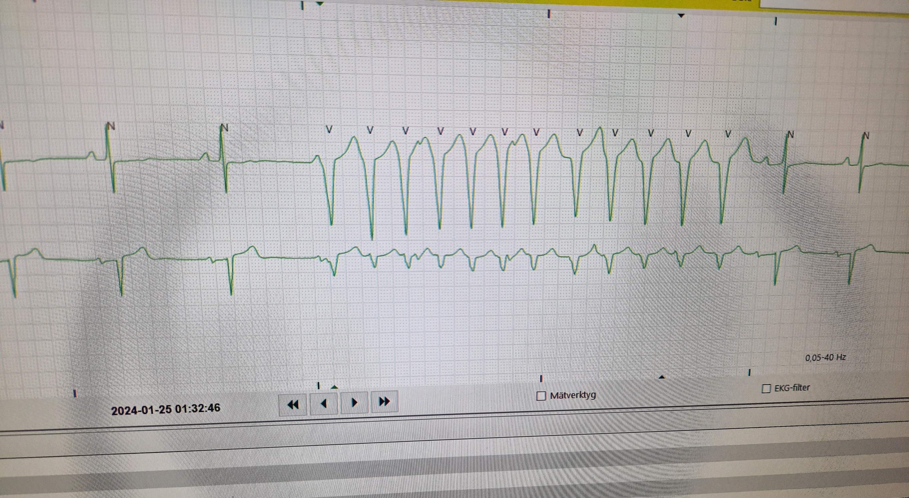
Atrial activation
Ventricular activation
VA-dissociation = VT (< 30 sec i.e. “non-sustained”)
Notes:
Non-sustained VT: < 30 seconds of duration

Slide 10
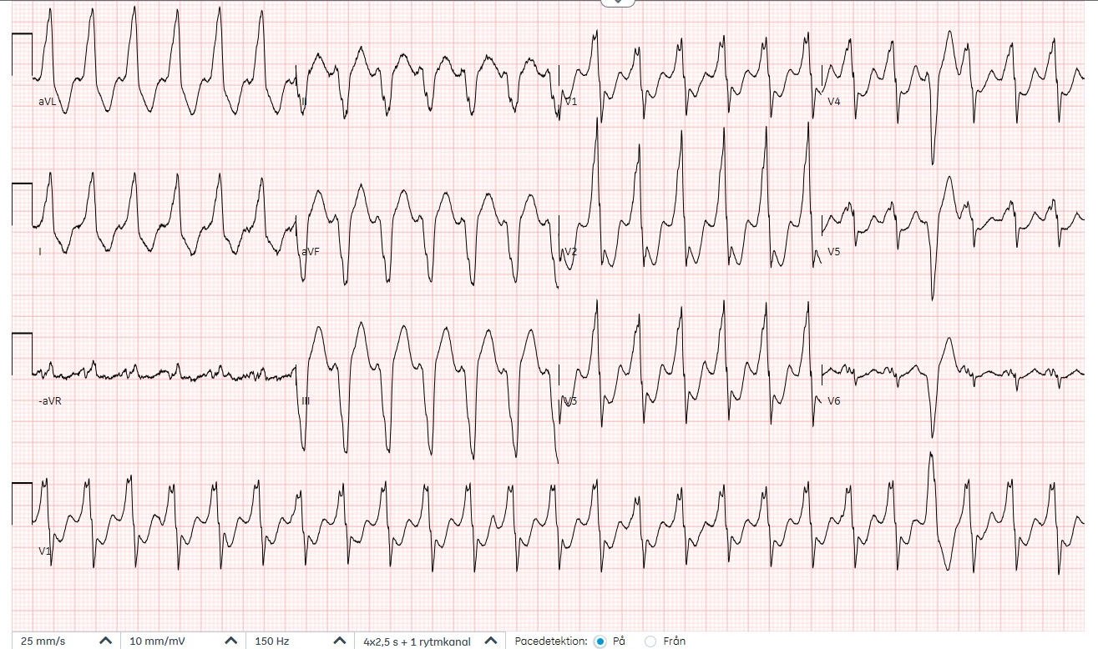
63-year-old man with chest pain
VA-dissociation = VT!
Fusion beat
Notes:
610225-250122-SS
I think this is a fusion beat, hence VA-dissocation, hence VT
E Early Wide: RS > 100 msec in V1
F Fragmentation: Josephson’s sign in V2?
Chronic ischemic heart disease. received ICD because of VT 2003 (this EKG is from 250122).
Presents with chest pain and episodes of VT. PCI to arteria epiploica. After that no further episodes of VT.

Slide 11
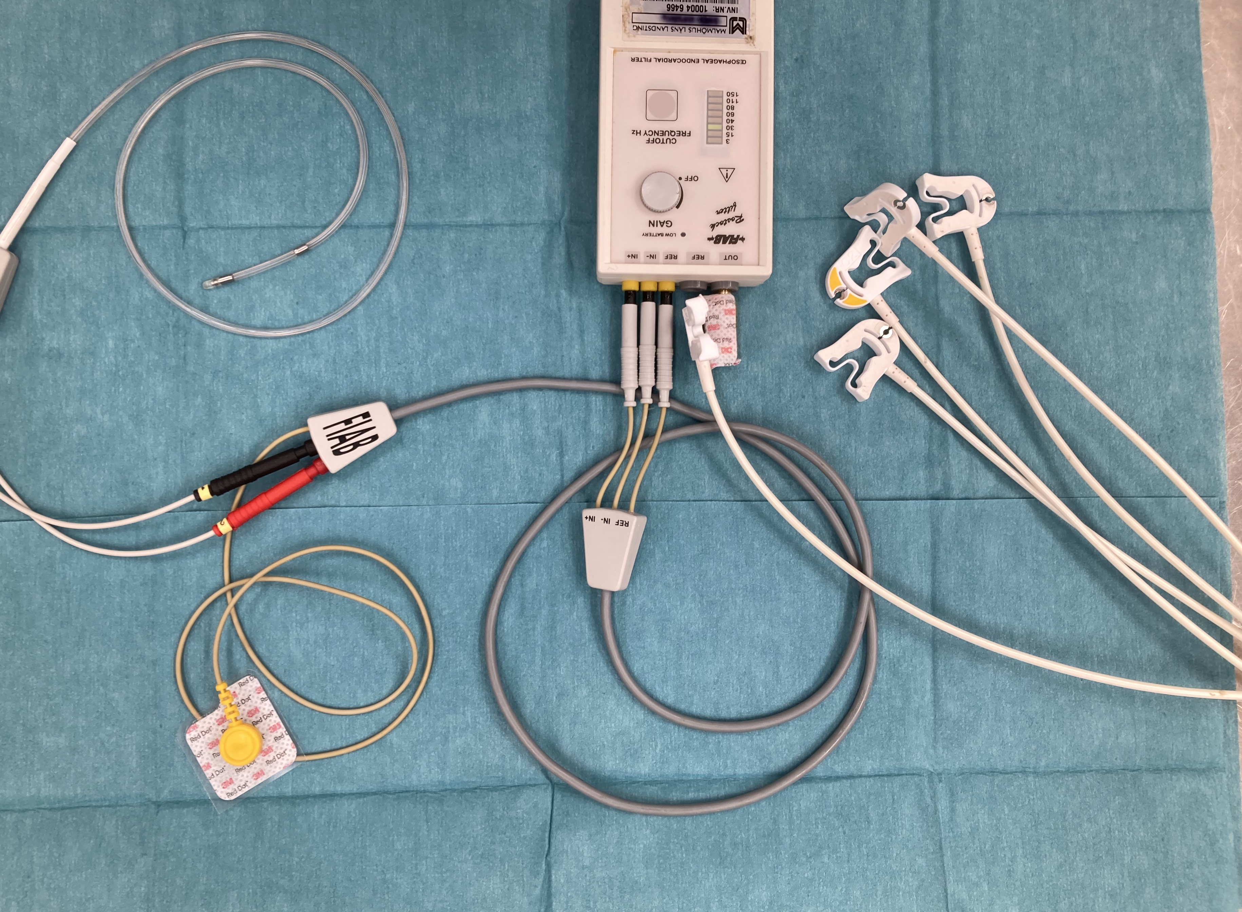
Notes:
Esophageal EKG is a relatively easy way to identify whether there is VA-dissociation.
Instead of the V4 signal coming from the chest wall, the signal comes from the esophagus.
The patient swallows an electrodes which is filtered through a “Rostock filter” and replaces the signal from the chest wall.

Slide 12
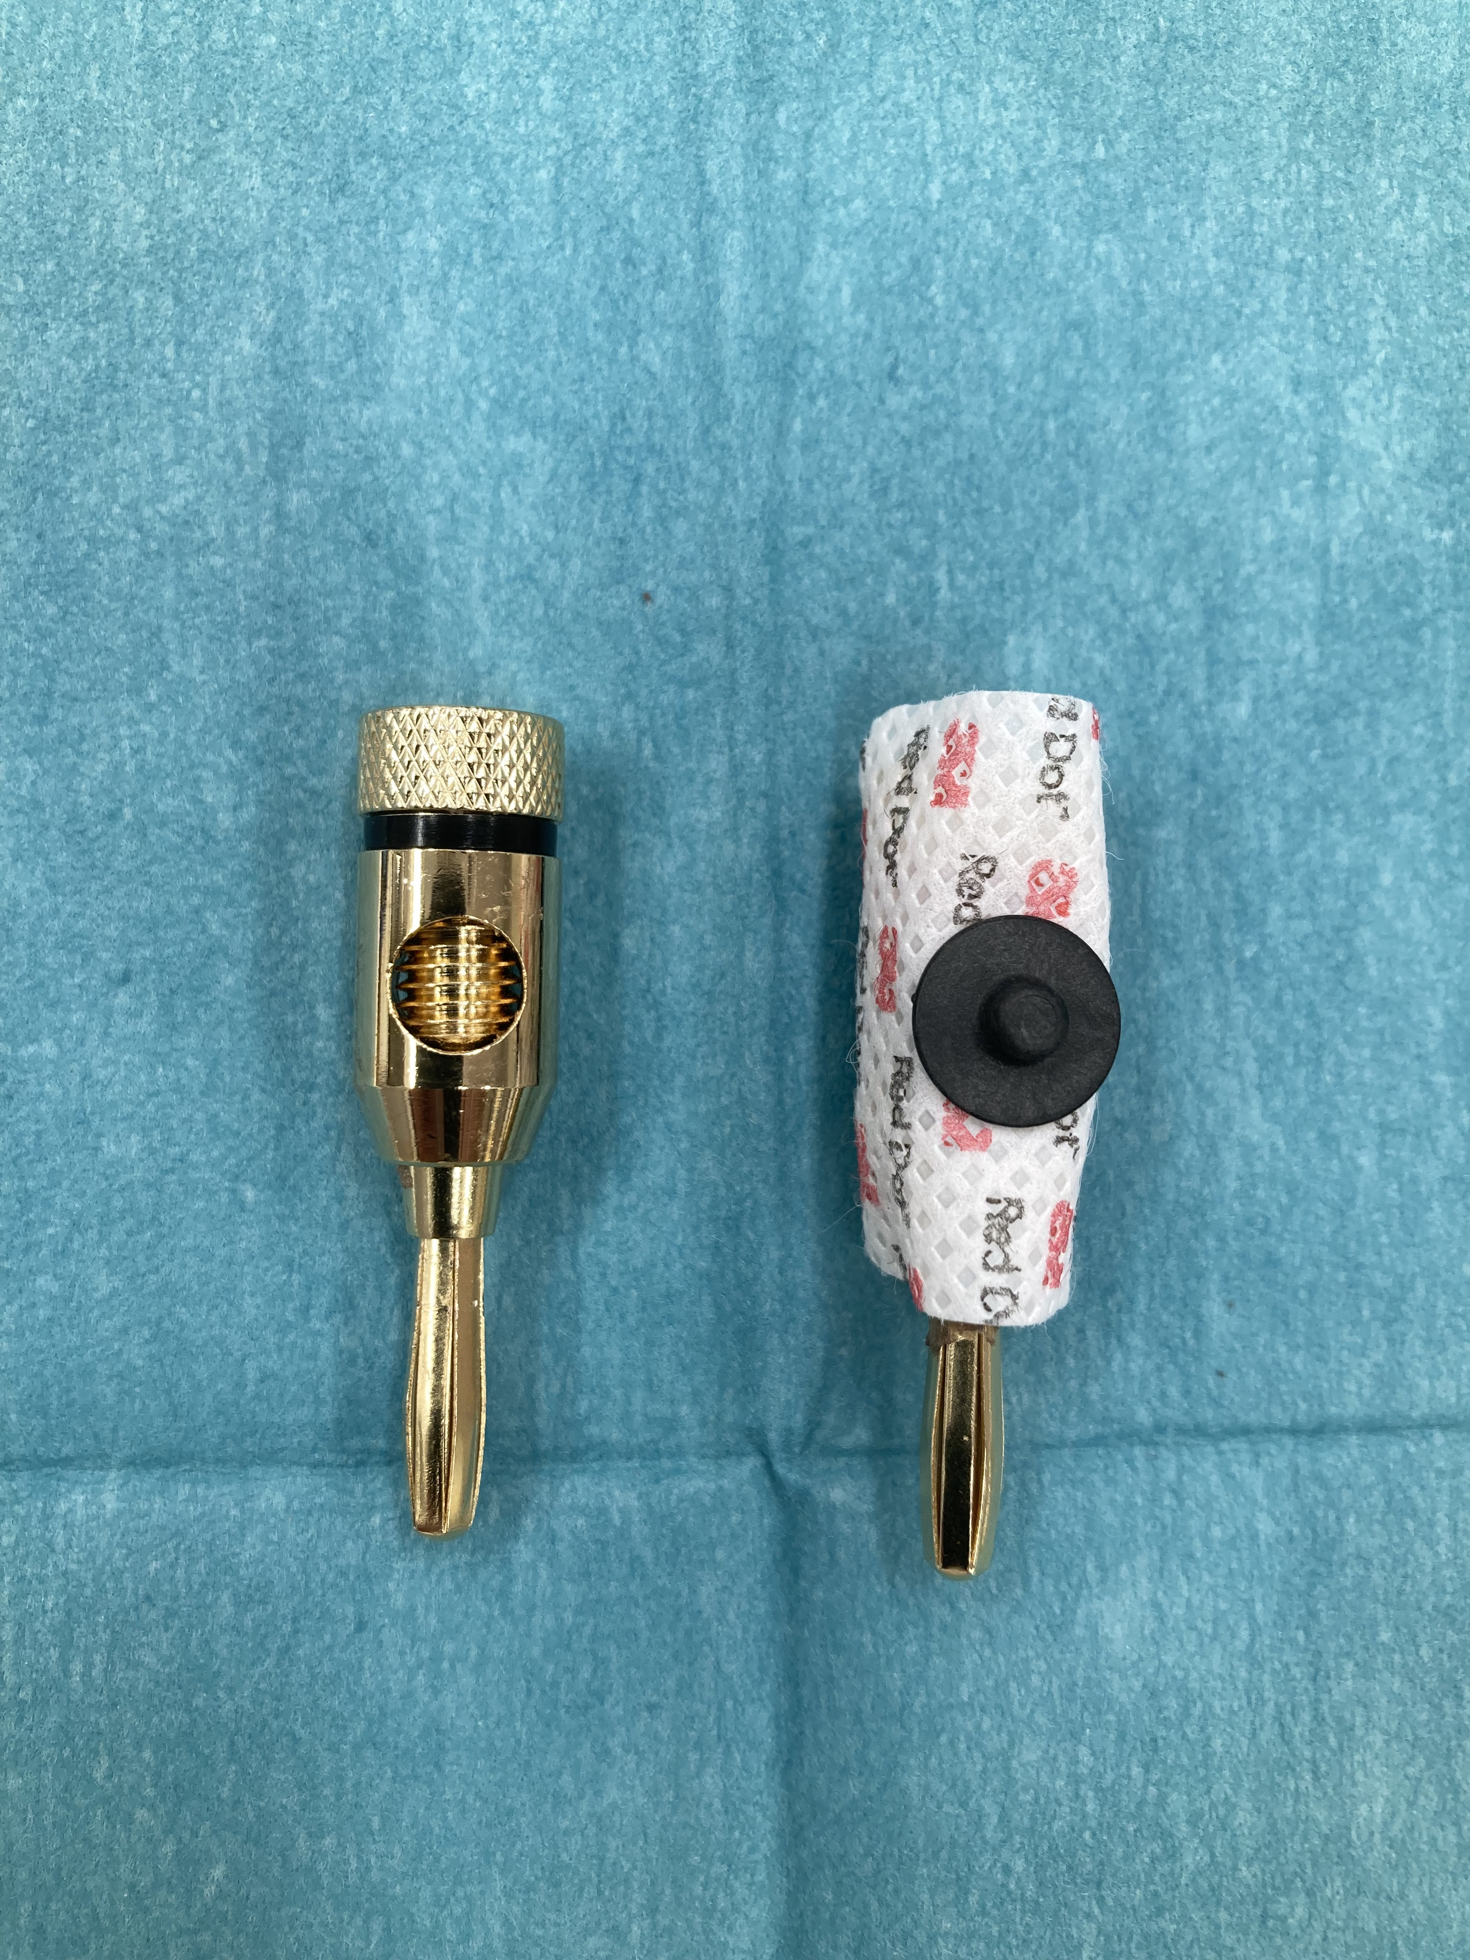
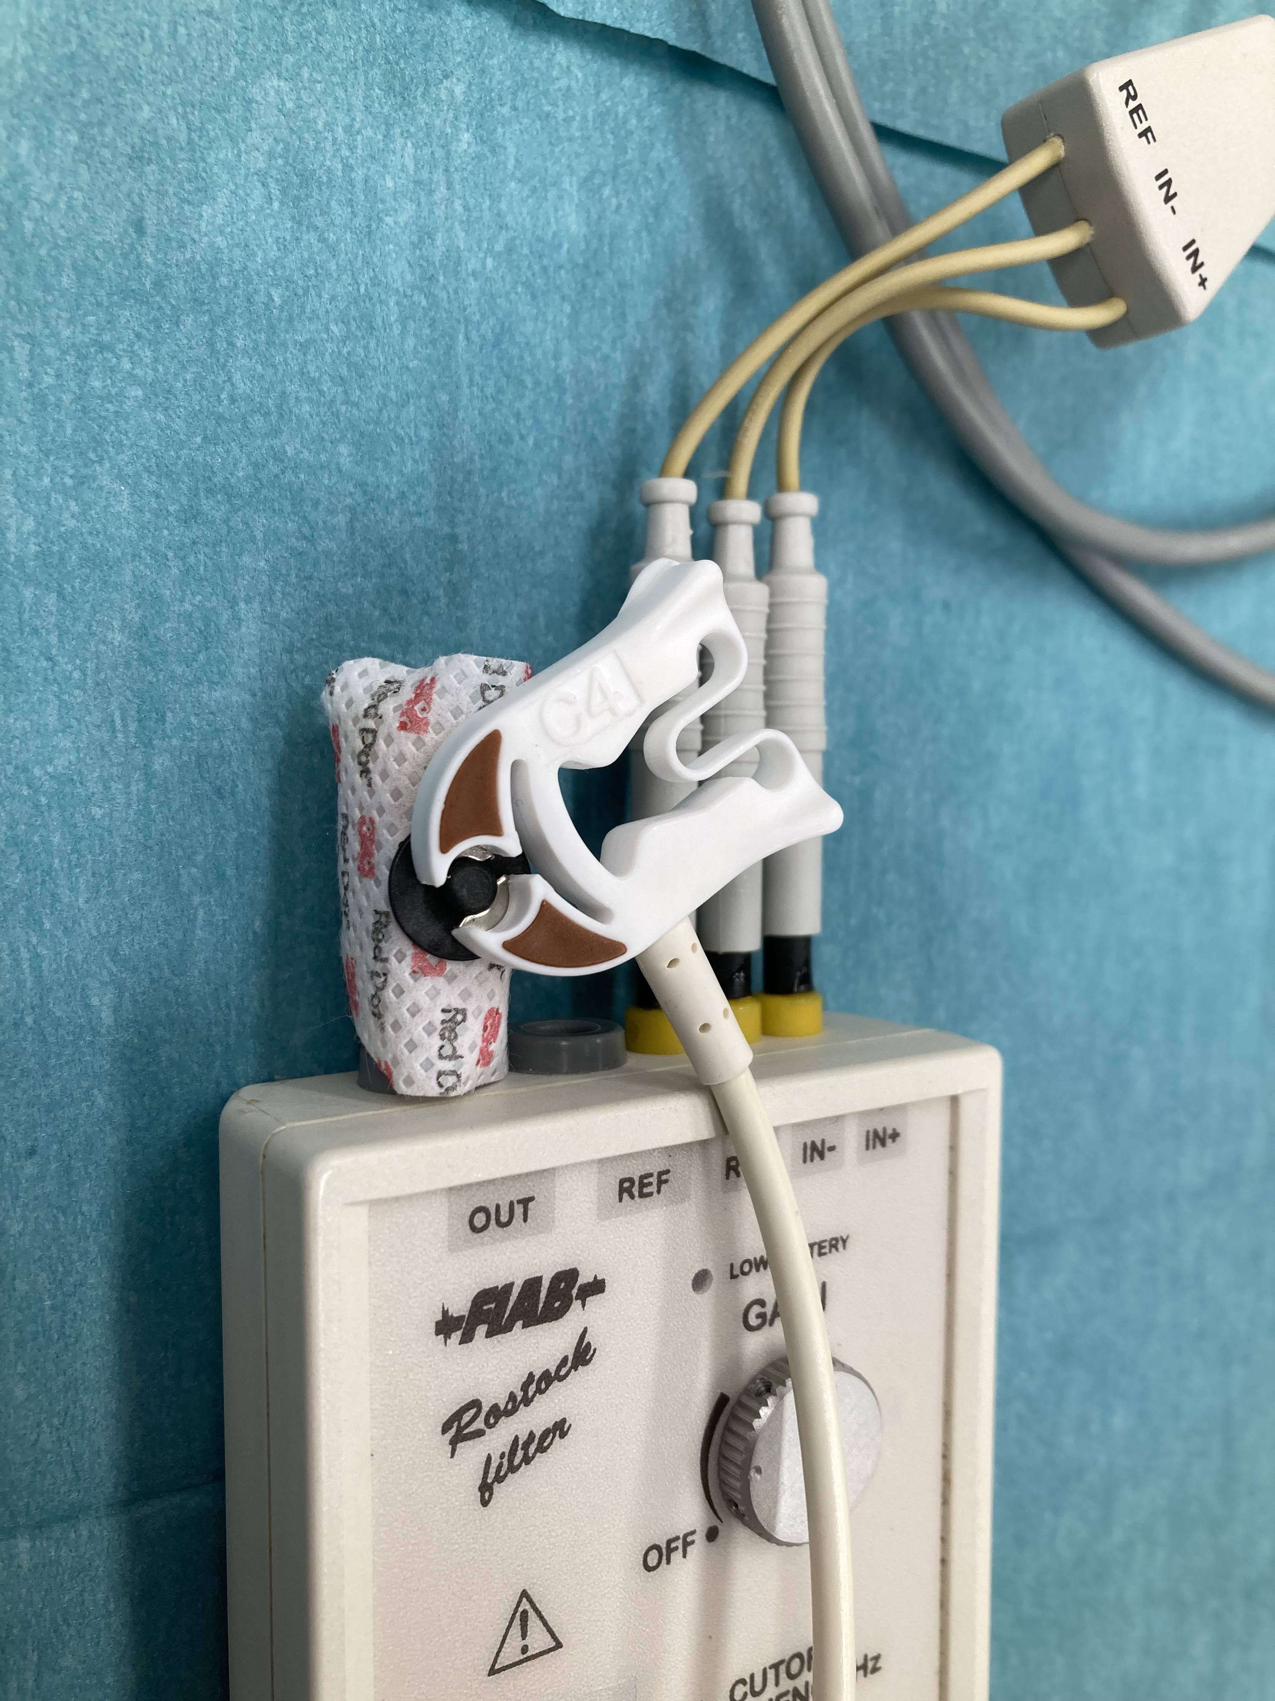
Esophageal EKG
Notes:
This shows how the output signal from the filter can be connected to the EKG machine via a normal usual skin electrode.

Slide 13
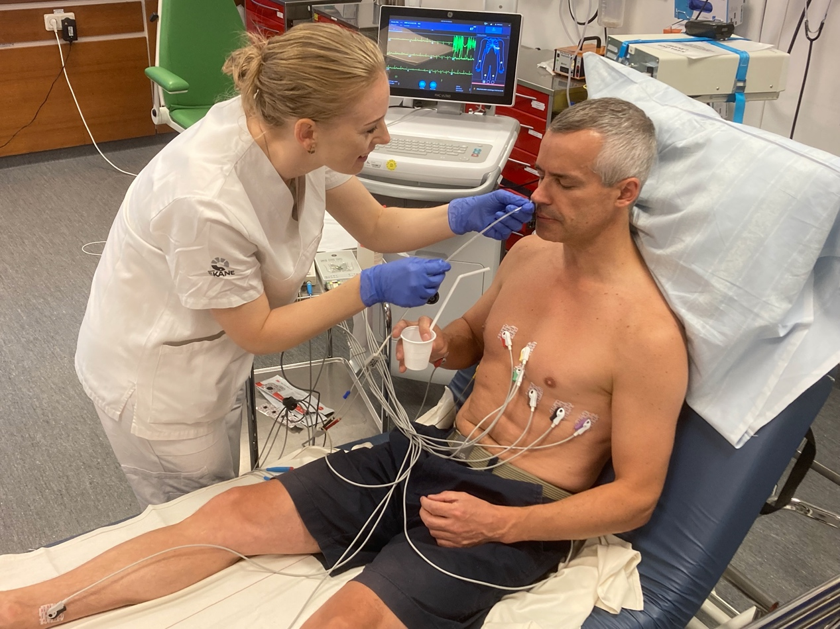
Notes:
The electrode is inserted like an NG-tube

Slide 14
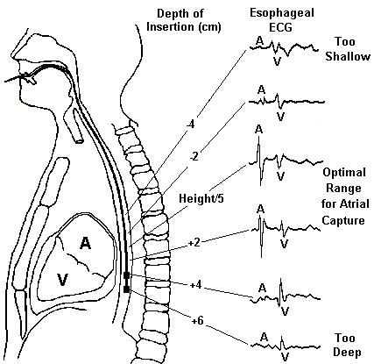
Notes:
You insert the E-EKG into the stomach and then slowly pull out the esophagus electrode until you get a good signal from the left atriium.

Slide 15
Ventricular activation
Atrial activation
VA-dissociation is present: VT!
Notes:
So the patient has VA-dissociation hence VT. Diagnosis established!
Paper speed of 50 mm/sec is recommended to make it easier to distinguish between A and V rates.

Slide 16
Management?
RR 26
SpO2 100%
HR 205 bpm
SBT 95 mm Hg
Refer to cardiology?
Pharmacological cardioversion?
Electrical cardioversion? PSA?
Notes:
What should we do now with the patient? Options are
1-electrical cardioversion
2-chemical cardioversion (Amiodarone infusion)
3-neither
We opted for electrical cardioversion with 2 mg Midazolam, 15 mg Esketamine and 200 J.

Slide 17
Course
PSA Midazolam 2 mg & Esketamine 15 mg
Electrical cardioversion 200 J x 1
Coronary angiography reveals a thrombus in the distal RCA with spontaneous revascualization
Ultrasound and MR reveal transmural infarct in the RCA distribution and EF of 40%
Receives ICD

Slide 18
28-year-old woman with palpitations
Notes:
Source: 940333-220721-ZN
Regular and wide QRS complexes

Slide 19
28-year-old woman with palpitations
Notes:
Source: 940333-220721-ZN
We had no prior EKG for this patient.
Tetralogy of Fallot (TOF) is a congenital birth defect of the heart that leads to cyanosis. It presents with the combination of four different heart defects and is the most common cause of blue baby syndrome. The four pathologies seen in this condition are:
1-Pulmonary infundibular stenosis
2-Right ventricular hypertrophy (RVH)
3-Overriding aorta
4-Ventricular septal defect (VSD)
Blue Baby Syndrome Blue Baby
TOF is the most common cause of blue baby syndrome in newborns. Babies are "blue" due to the cyanosis experienced in this heart disorder.
PROVe Acronym Prove-proof Stamp
The acronym “PROVe” can be used to help remember the four specific abnormalities generally associated with TOF: P for pulmonary infundibular stenosis, R for RVH, O for overriding aorta, V for VSD, and the “e” is silent without an associated pathology.
Pulmonary Infundibular Stenosis Lungs made of Stone
One of the tetralogies that can occur is pulmonary infundibular stenosis. Pulmonary infundibular stenosis is described as a narrowing of the right ventricular outflow tract. It occurs at the pulmonary valve, or just below at the infundibulum.
Right Ventricular Hypertrophy Right Vent Hiker-trophy
Due to the increased pressure and resistance of the right ventricular outflow tract, the right heart becomes pathologically hypertrophied. This RVH can cause the heart to be visualized as "boot-shaped."
Overriding Aorta Over-riding A-orca
In TOF, the aorta sits above the VSD, giving it biventricular access. This is problematic because deoxygenated blood from the right ventricle can then make its way into systemic blood flow.
Ventricular Septal Defect (VSD) Vase-hole-heart
Patients with TOF have a VSD which allows deoxygenated blood from the right ventricle to mix with oxygenated blood from the left ventricle. Because pulmonary stenosis causes right-sided outflow obstruction, blood is preferentially pushed toward the left side, and a right-to-left shunt is seen.

Slide 20
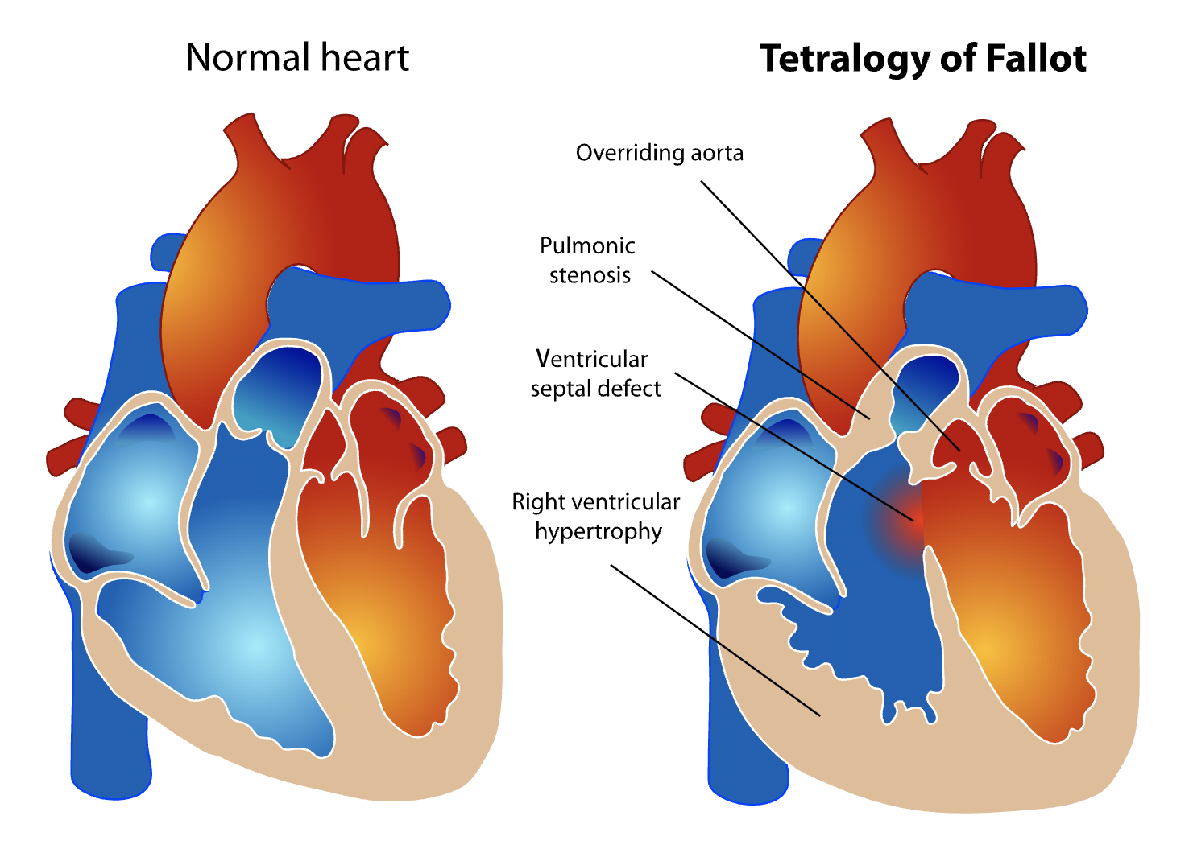

Slide 21
Ventricular activation
Atrial activation
No VA-dissociation
Notes:
Source: 940333-220721-ZN
She does not have VA-dissociation. There is a 1:1 relationship between atrial and ventricular activity.
So, this suggests SVT. In theory, this could also be VT with a 1:1 retrograde conduction through the AV-node.

Slide 22
During arrhythmia
After spontaneous
conversion to sinus rhythm
Notes:
Source: 940333-220721-ZN
What nails the diagnosis that this was an SVT is that the morphology of the QRS complexes during the tachycardia is the same as the morphology of the QRS complexes during sinus rhythm.
The patient probably had an AVNRT because she converted back to sinus after a maneuver (esophageal-EKG) that increases vagal tonus.

Slide 23
Course
Suspected supraventricular tachycardia (AVNRT?)
Spontaneous conversion to during esophagus-EKG
Cardiology recommended admisssion for eletrophysiological assessment but patient wanted to return to Serbia for her father's funeral
Taught how to perform the modified Valsalva maneuver, given 30 st Metoprolol à 25 mg
Provided with copies of the transthoracic and esophageal EKGs and recommendation to seek cardiologist in Serbia

Slide 24
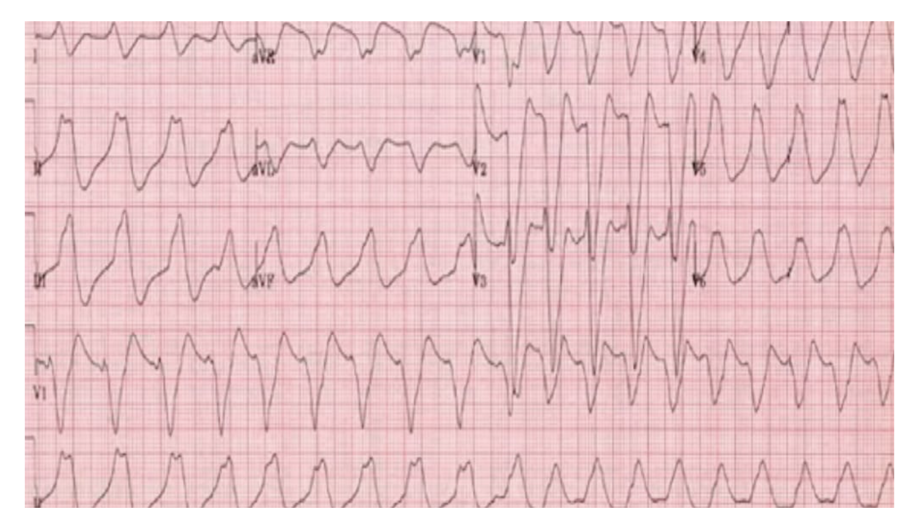
19-year-old woman, palpitations & unwell
Paper speed: 25 mm/sec
https://resus.com.au/diagnosing-ventricular-tachycardia-5-easy-steps/
Notes:
Avoiding giving antiarrhythmics if the heart rate is < 120 bpm. Consider hyperkalemia or Na-channel blockade. Given Amiodarone or Lidocaine can kill the patient in such a setting because the patient already has compromised Na-channel function.
According to info, BP 125/60.

Slide 25
Course
Suspected VT
Amiodarone
Asystole
Death
K 9.3
Hyperkalemia deactivates Na-channels
Amiodarone is a Na-channel blocker
Notes:
Dépret et al. Annals of Intensive Care 2019;1

Slide 26
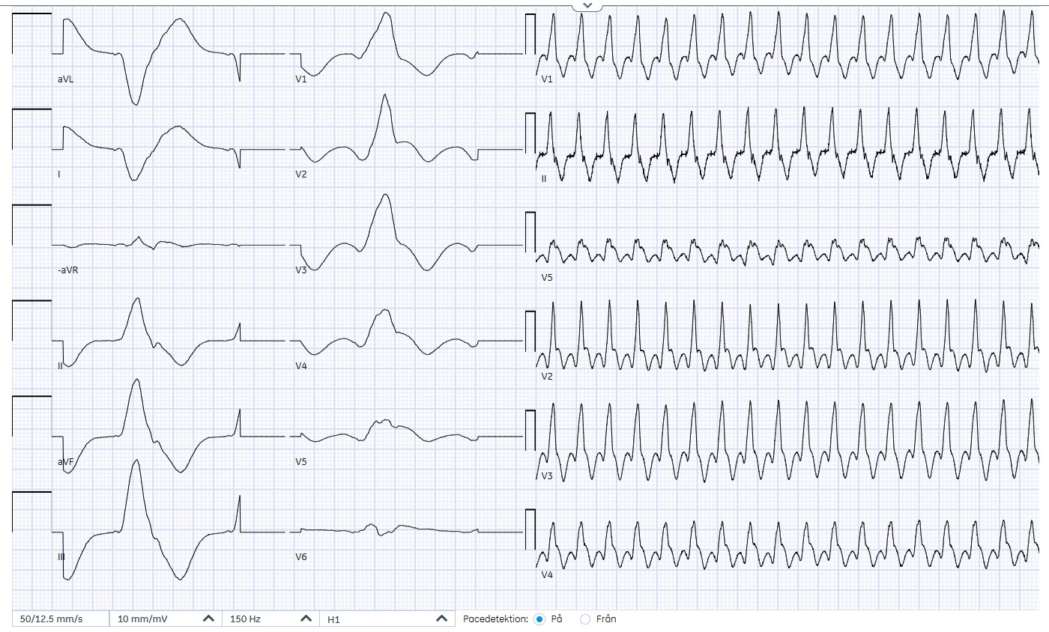
81-year-old woman feeling unwell
Notes:
SOURCE: 440210-250308-MS

Slide 27
81-year-old woman feeling unwell
Presents because of fatigue and dizziness
LVEF < 20%, CRT-D, type 2 DM, prior MI, COPD Admitted one week ago with VT, cardioverted, discharged yesterday
Today at 11:00 suddenly fatigue + dizzy SpO2 92% room air, RR 20, BT 87/50, HR 105, GCS 15
Notes:
SOURCE: 440210-250308-MS

Slide 28
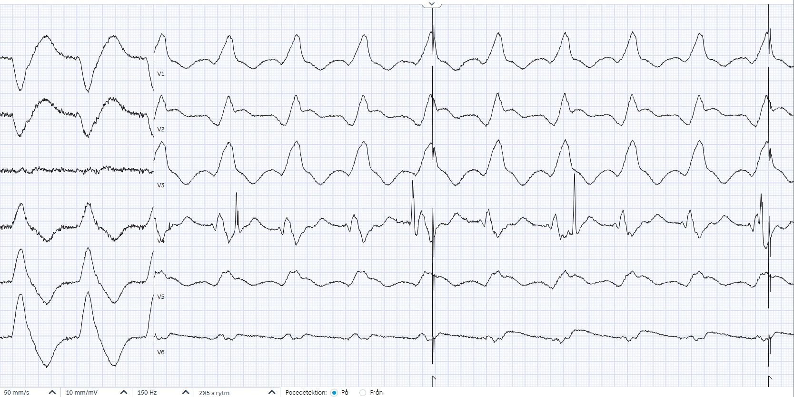
Esophagus-EKG
Ventricular activation
Atrial activation
VA-dissociation is present: VT!
Notes:
SOURCE: 440210-250308-MS
This patient had VT. Because of her underlying cardiomyopathy, the rate of the VT was below the threshold where her ICD would have cardioverted her.

Slide 29
Course
Suspected slow VT but different QRS complex compared to prior episode of VT
Hence E-EKG performed, which confirms VT
Given severely depressed LVEF and recent prior episode of VT, admission to CCU
Requires electrical cardioversion and new pacemaker settings

Slide 30
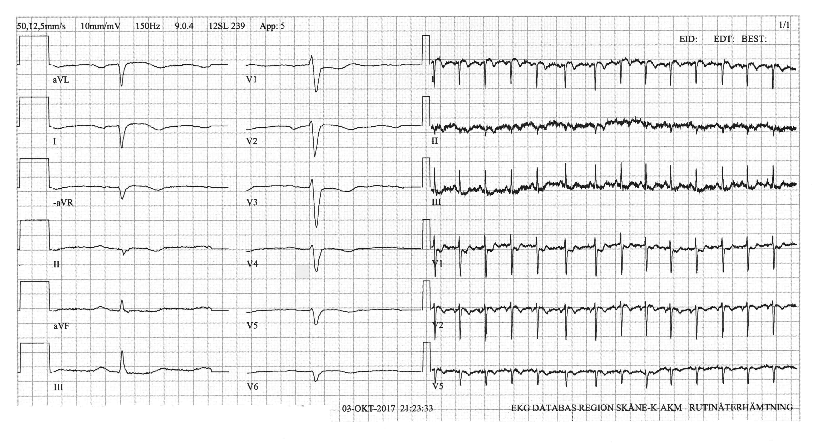
37-year-old man with chest pain EKG 21:23
Notes:
Source: 800107-(9)-171003-MNCO
This 37-year-old man presents with chest pain.
What do you think of the ST-segments and T waves in aVL, I, V1 and V2? Does it look ischemic?
What about the axis? It is Northwest! Has the nurse connected the electrodes correctly?

Slide 31
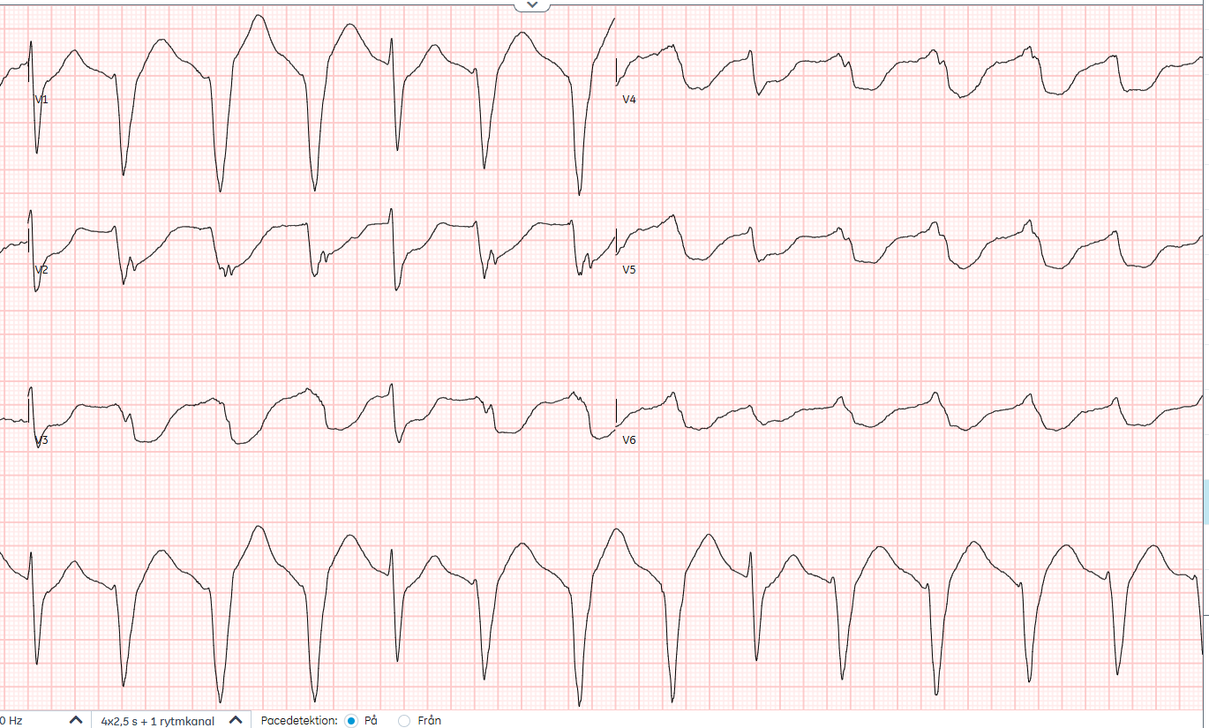
37-year-old man with chest pain EKG 22:24
Capture beat
VA-dissociation = VT!
Then cardiac arrest!

Slide 32
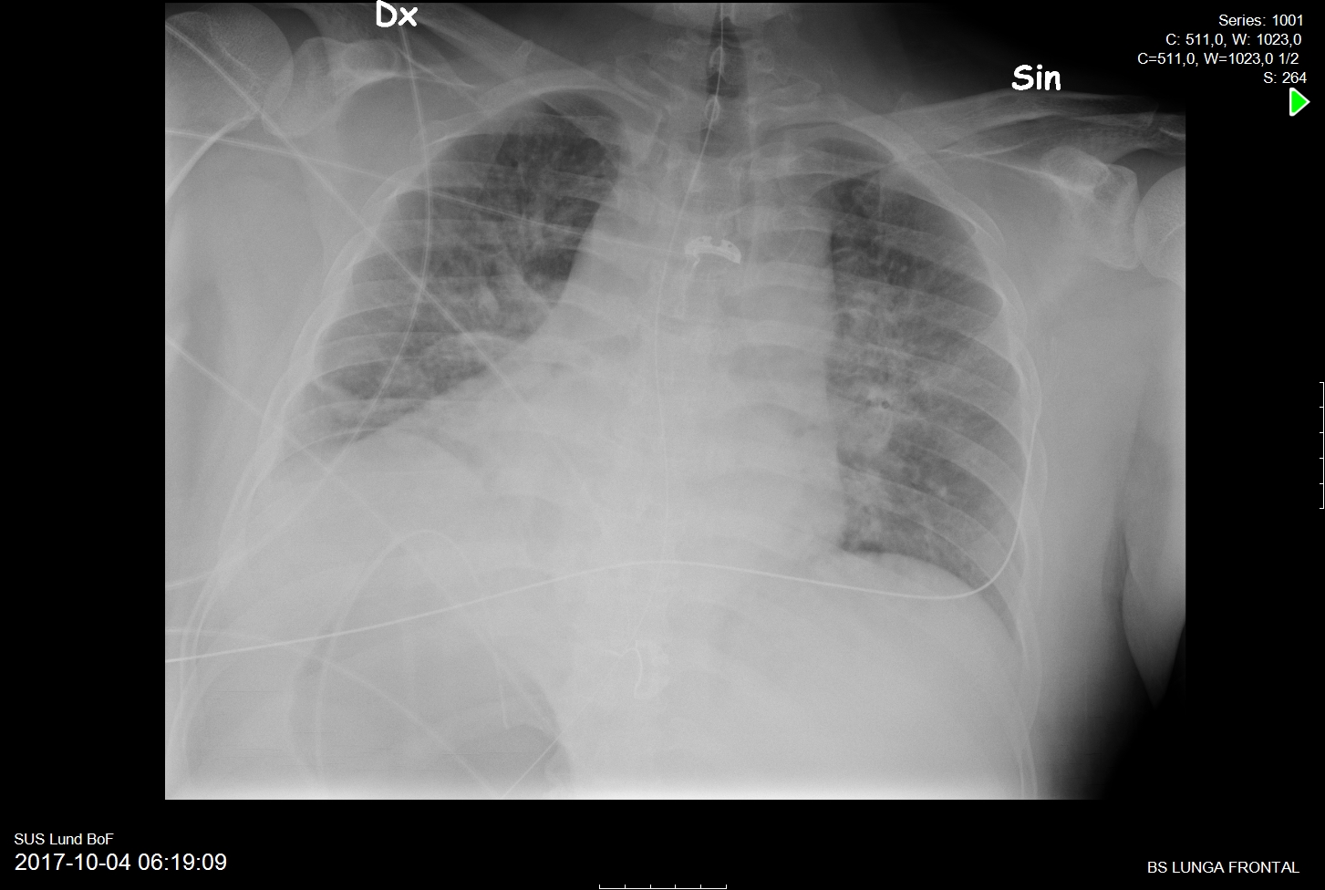

Slide 33
Presents several months later with abdominal pain in the left lower quadrant . . .
Notes:
Acute appendicitis

Slide 34
Tachycardia: Irregular + Wide

Slide 35
19-year-old with chest pain
Notes:
Source: 010422-200615-SG

Slide 36
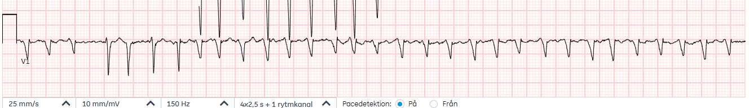
Differential of Tachycardia
 | Regular | Irregular
QRS < 120 msec
QRS > 120 msec
Notes:
So the patient is stable enough to spend some time trying to figure out the pathophysiology underlying the tachycardia.
Tachycardias can be categorized according to whether they are:
1-Regular or irregular
2-Narrow or wide QRS
This patient has a regular tachycardia with wide QRS complexes

Slide 37
Differential of Tachycardia
 | Regular | Irregular
QRS < 120 msec
QRS > 120 msec |  | VT (e.g. TdP) Atrial fibrillation with bundle branch block bypass tract hyperkalemia N-channel blockade
Notes:
So the patient is stable enough to spend some time trying to figure out the pathophysiology underlying the tachycardia.
Tachycardias can be categorized according to whether they are:
1-Regular or irregular
2-Narrow or wide QRS
This patient has a regular tachycardia with wide QRS complexes

Slide 38
19-year-old with chest pain
Narrow QRS beats
Rule-out BBB, hyper-K, Na-channel blockade
Notes:
Source: 010422-200615-SG

Slide 39
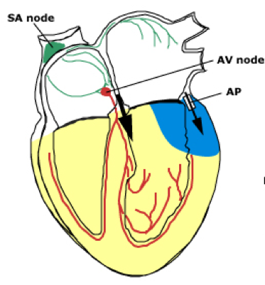

Slide 40
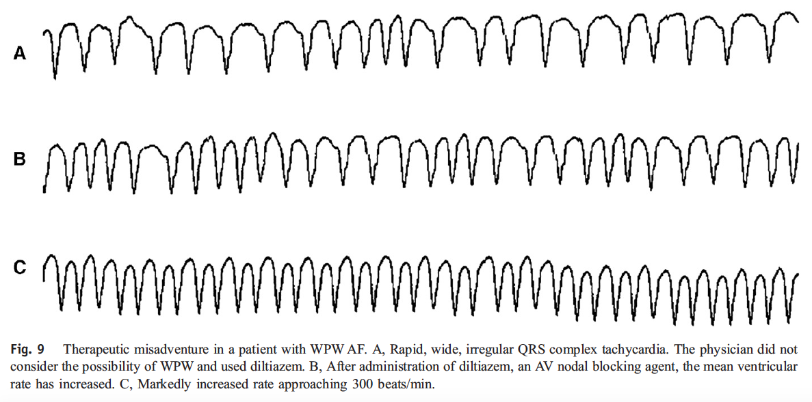
Atrial Fibrillation with Preexcitation
Fengler Am J Emerg Med 2007;25:576

Slide 41
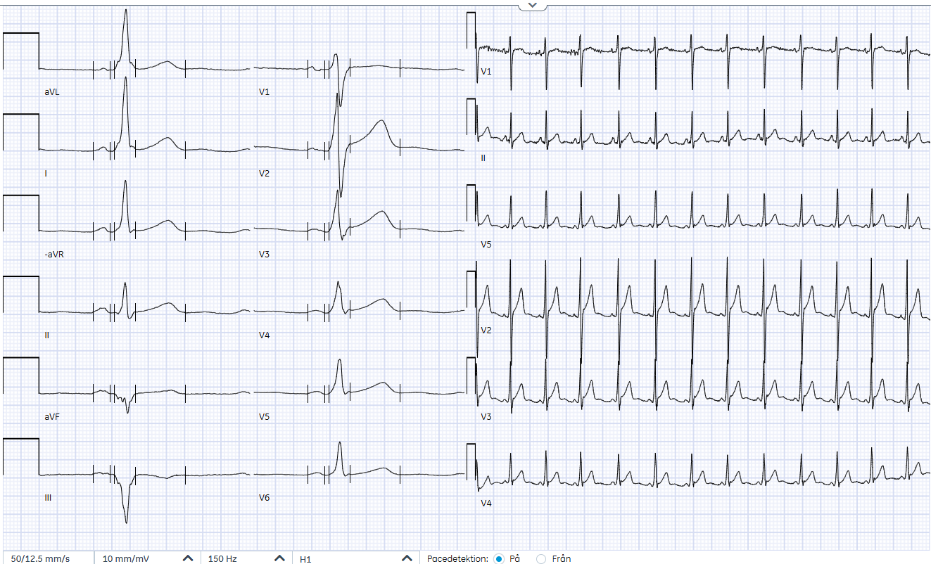
EKG 200618
Notes:
The delta wave is more obvious in this EKG taken three days later.

Slide 42
Course
The delta wave suggests a right posterior / posterolateral accessory bypass tract
But varying degrees of pre-excitation. During maximal pre-excitation, the EKG is more suggestive of a left-sided pathway
Unsuccessful ablation attempt. Treated with Sotalol for a couple of months. Requires a total of 3 ablations

Slide 43
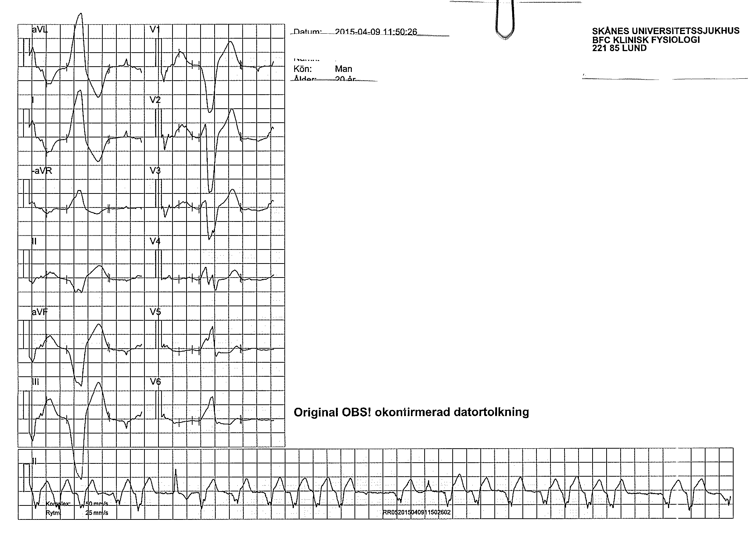
20-year-old with chest pain
Notes:
Source: 940923-150409-HA

Slide 44
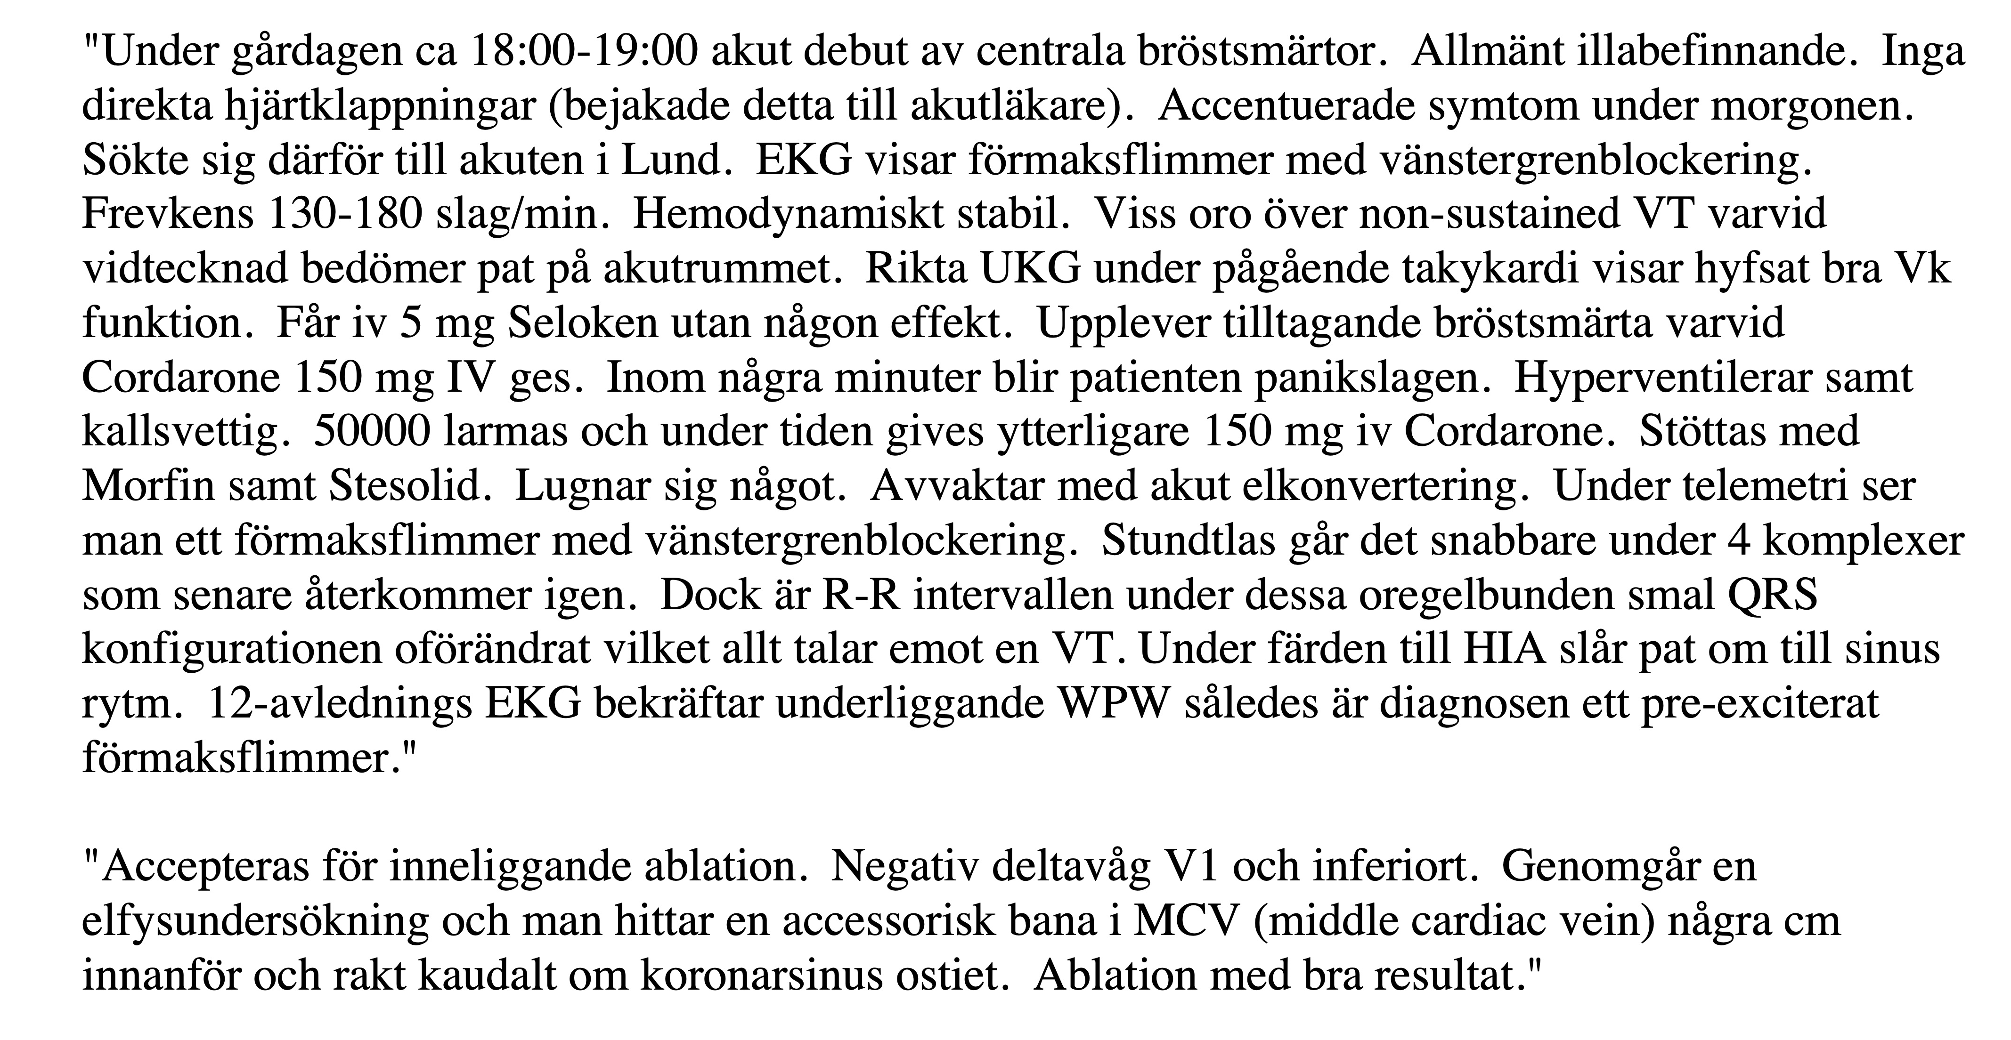
Förlopp

Slide 45
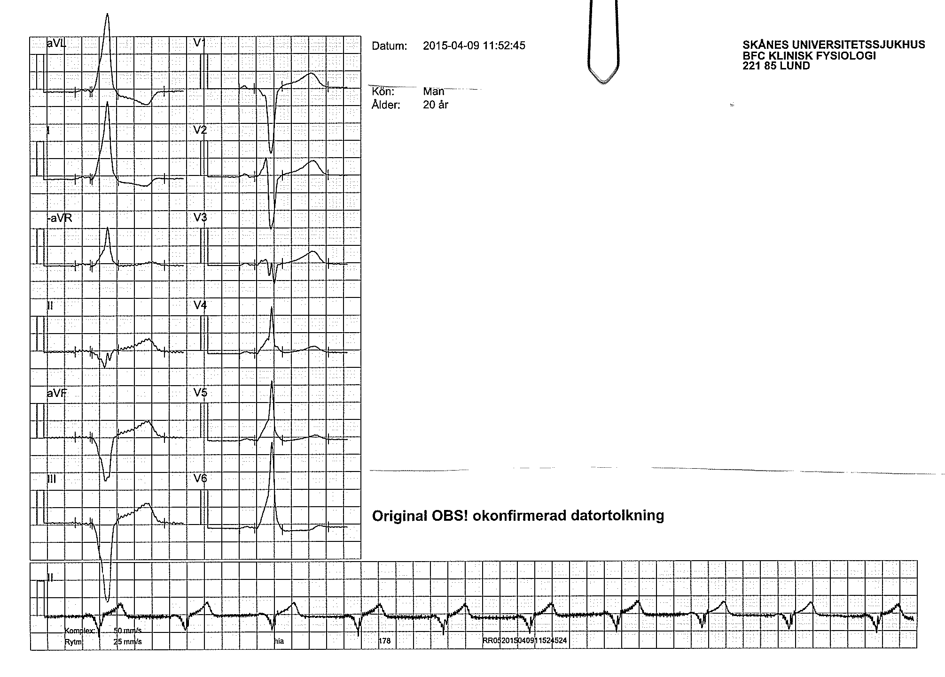
Spontaneous Conversion to Sinus Rhythm

Slide 46
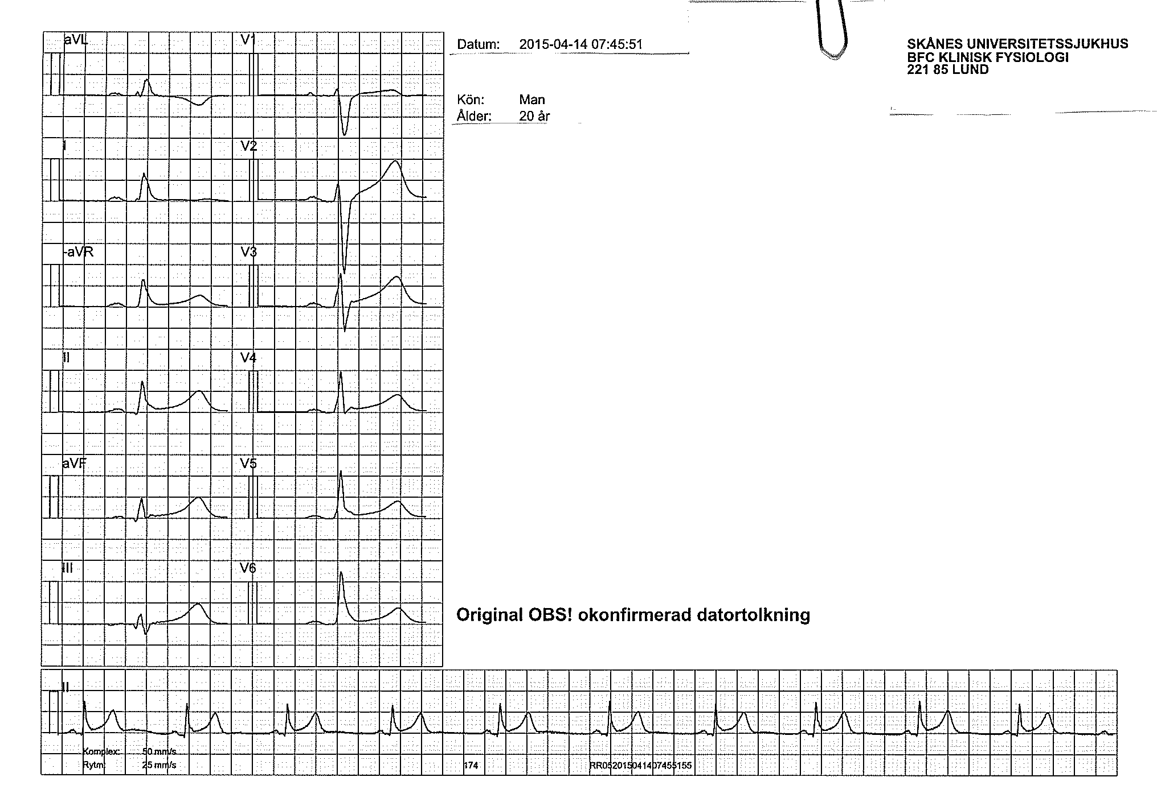
After ablation

Slide 47
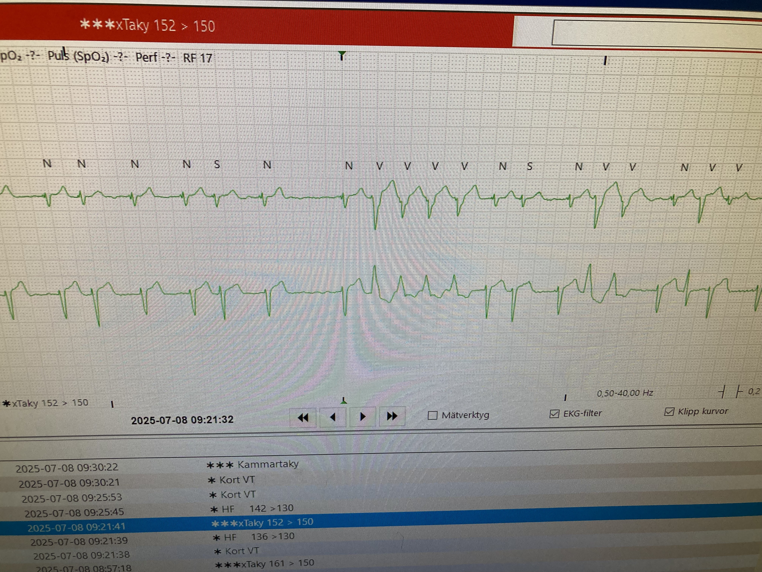
Notes:
SOURCE: 620408-250708-AB
Patient returned 250708 with palpitations

Slide 48
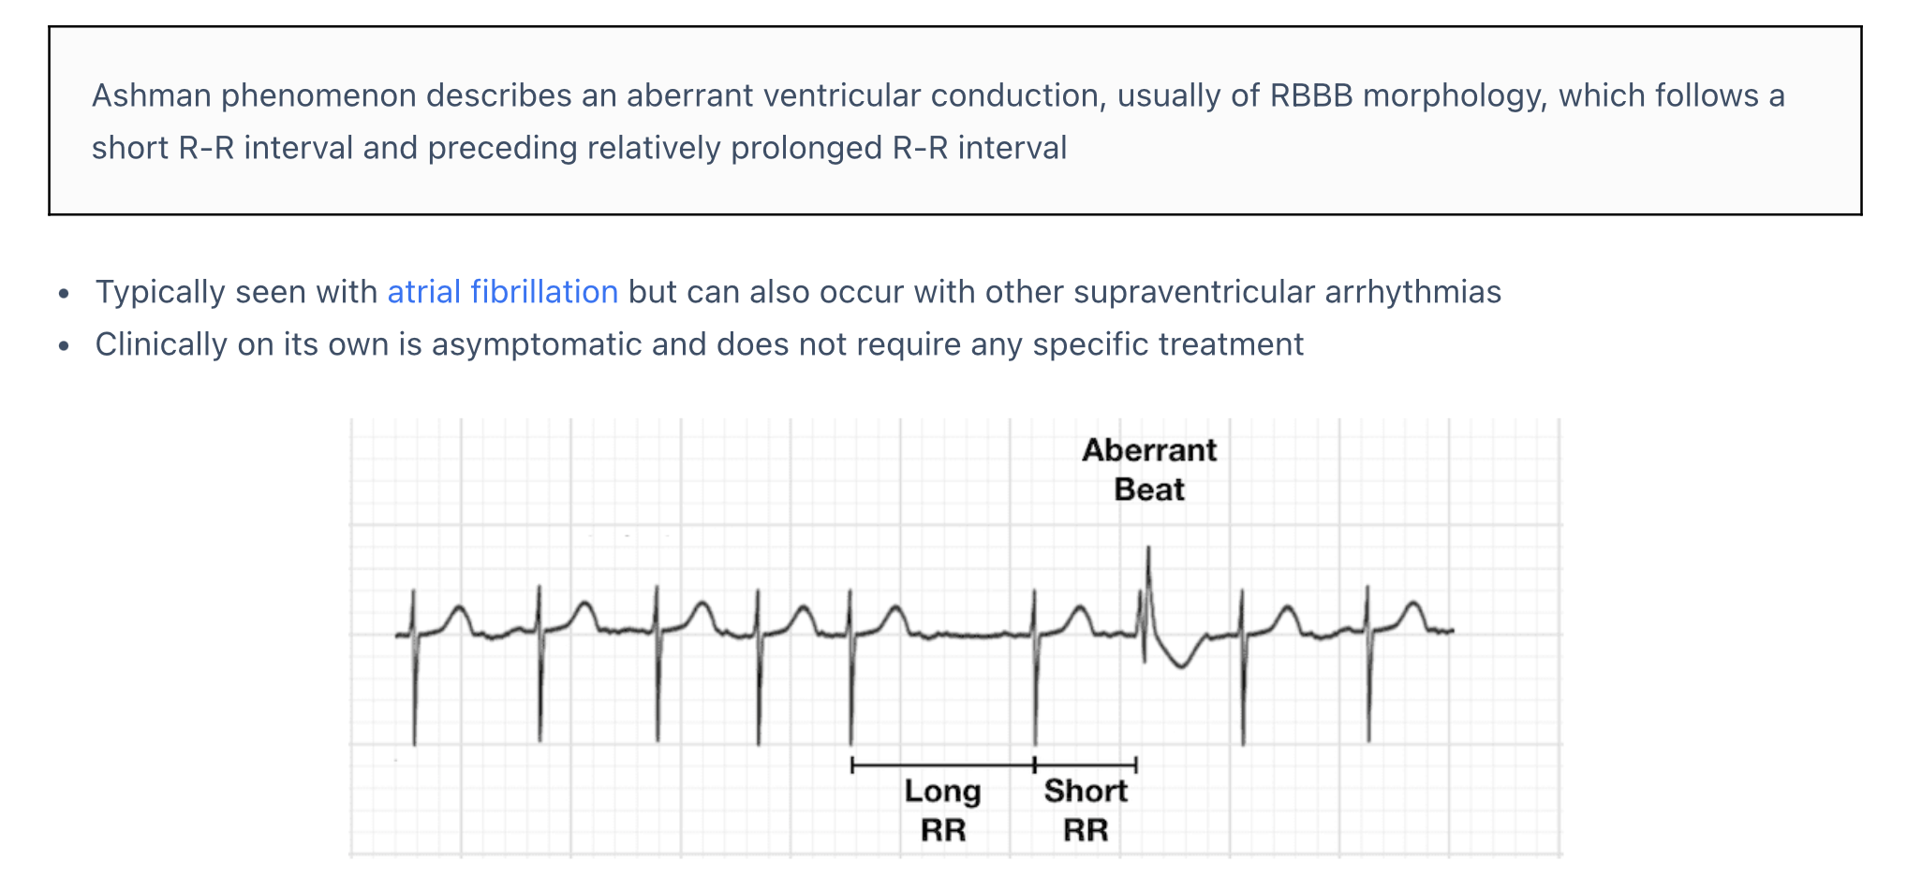
Ashman Phenomenon
https://litfl.com/ashman-phenomenon/
Notes:
Mnemonic. ”Long-Short-Wide”
Inspired by ”Ashman’s Beats – Long, Short, Weird” Emergency Physicians Monthly By SUSAN TORREY, MD ON AUGUST 4, 2017

Slide 49
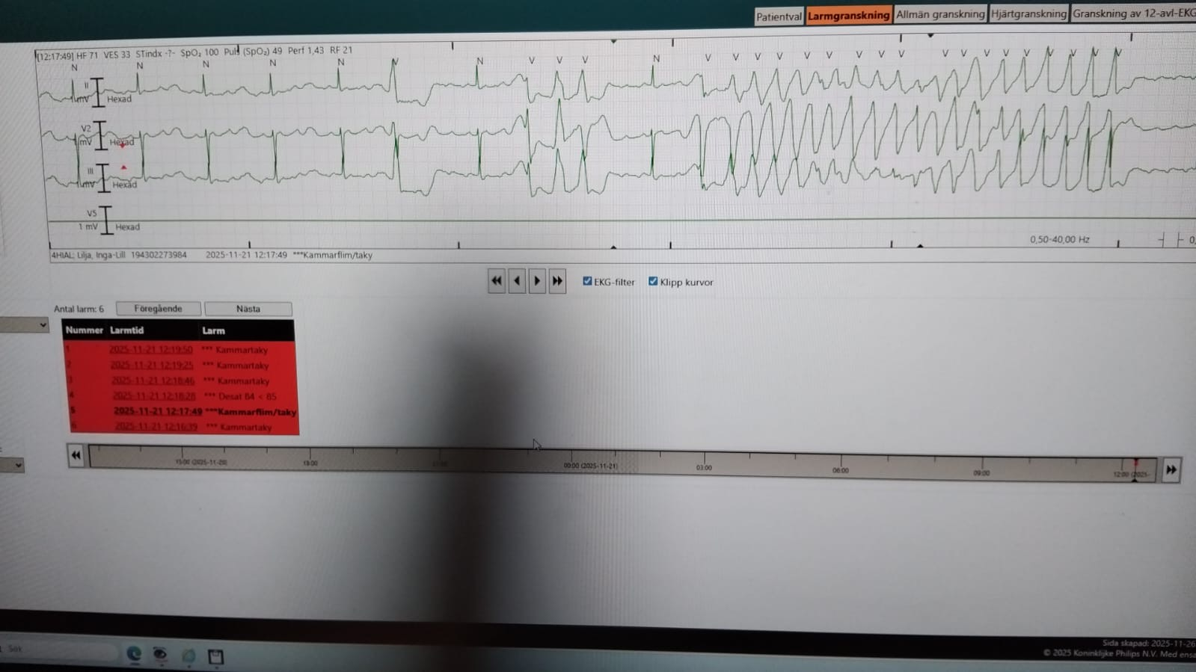
82-year-old woman with T-LOC
Notes:
Source: 430232-251121-ILL
Söker pga frånvaro episoder hemma
LIFTL argues to not include the U wave in measurement QT time if T and U separate.
So QT 450 msec with heart rate of 60 bpm
If you include the U wave, QT 620 msec.
Torsade de pointes is usually triggered by a ventricular extrasystole (premature ventricular contraction, PVC), particularly in the setting of a prolonged QT interval. The characteristic initiating sequence is a "short-long-short" pattern of R-R intervals, where a PVC (the "short") is followed by a compensatory pause (the "long"), and then another PVC that often falls on the preceding T wave (R-on-T phenomenon), precipitating the arrhythmia. This pause-dependent mechanism is well described in both congenital and acquired long QT syndromes and is a hallmark of torsade de pointes initiation.
If a premature ventricular contraction (PVC) falls on the U wave, particularly in the context of a prolonged QT interval, this is a highly arrhythmogenic event that can precipitate torsade de pointes. The U wave represents the terminal phase of ventricular repolarization, and a PVC occurring at this vulnerable period can trigger early afterdepolarizations, which are the electrophysiological substrate for torsade de pointes in both congenital and acquired long QT syndromes

Slide 50
Notes:
Source: 430232-251121-ILL
Söker pga frånvaro episoder hemma
LIFTL argues to not include the U wave in measurement QT time if T and U separate.
So QT 450 msec with heart rate of 60 bpm
If you include the U wave, QT 620 msec.
Torsade de pointes is usually triggered by a ventricular extrasystole (premature ventricular contraction, PVC), particularly in the setting of a prolonged QT interval. The characteristic initiating sequence is a "short-long-short" pattern of R-R intervals, where a PVC (the "short") is followed by a compensatory pause (the "long"), and then another PVC that often falls on the preceding T wave (R-on-T phenomenon), precipitating the arrhythmia. This pause-dependent mechanism is well described in both congenital and acquired long QT syndromes and is a hallmark of torsade de pointes initiation.
If a premature ventricular contraction (PVC) falls on the U wave, particularly in the context of a prolonged QT interval, this is a highly arrhythmogenic event that can precipitate torsade de pointes. The U wave represents the terminal phase of ventricular repolarization, and a PVC occurring at this vulnerable period can trigger early afterdepolarizations, which are the electrophysiological substrate for torsade de pointes in both congenital and acquired long QT syndromes

Slide 51
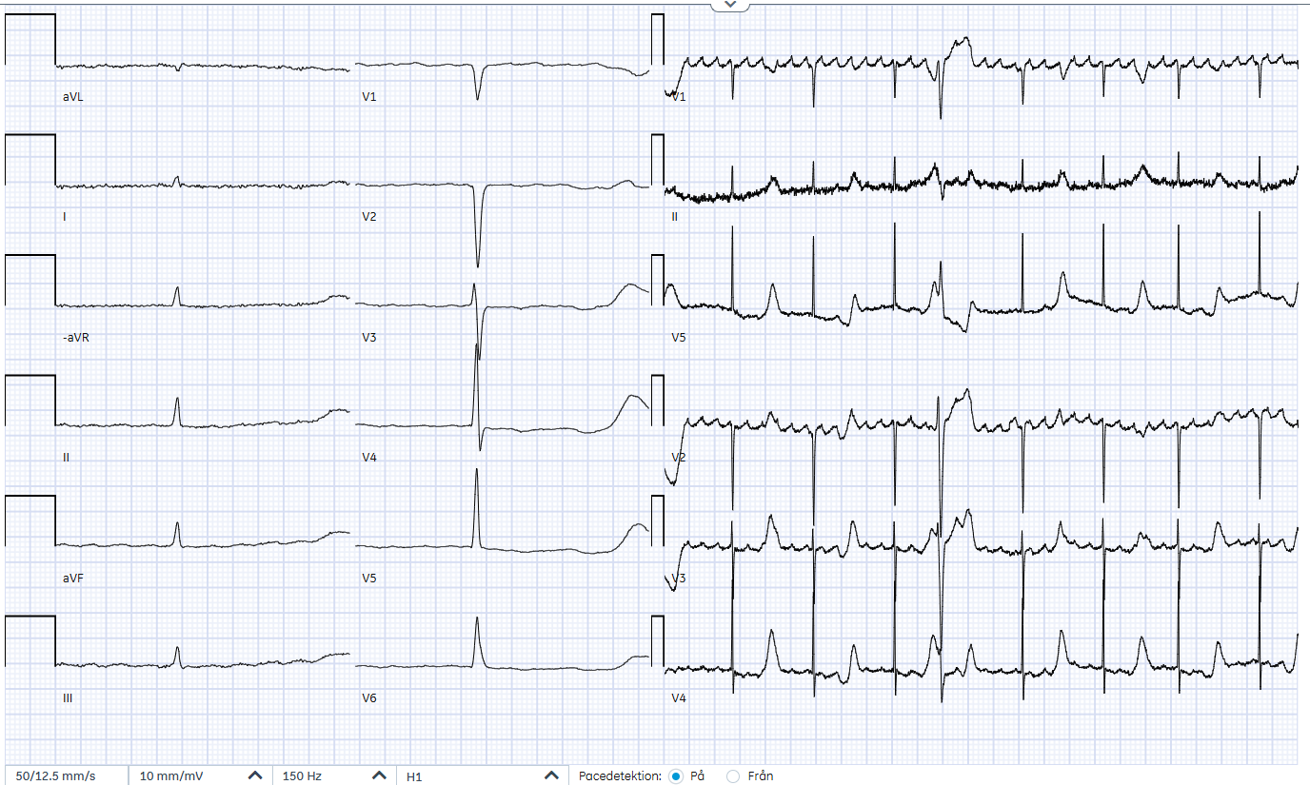
82-year-old woman with T-LOC
Notes:
Source: 430232-251121-ILL

Slide 52
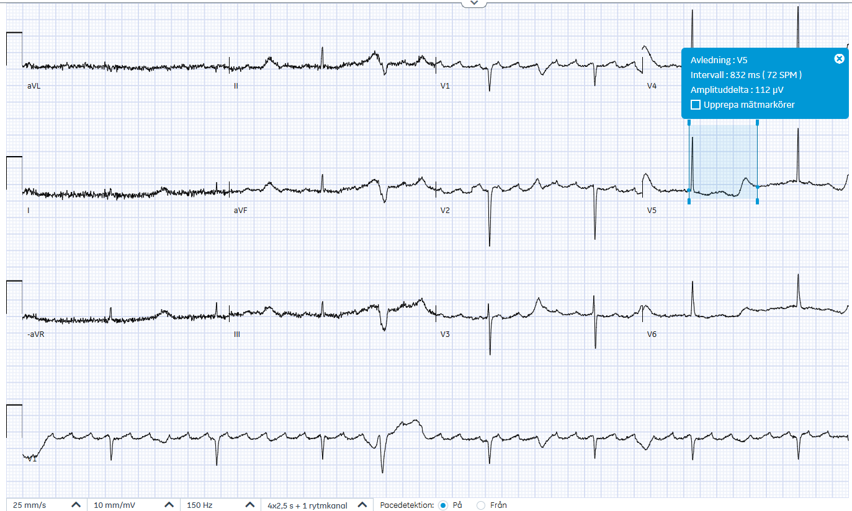
82-year-old woman with T-LOC
Notes:
Source: 430232-251121-ILL

Slide 53
82-year-old woman with T-LOC
Presents because of repeated episodes of “absence”
Generalized malignant melanoma, some beside the heart Pulmonary embolism (Klexane), microscopic colitis
Treated acutely with Magnesium 10 mmol and infusion with KCl. QTc > 600 msec. K 4.0 mmol/L, Ca ionized 1.17 mmol/L. Only medication that can prolong QT Loperamide that patient has been taking for several years (2 per day). Unclear whether this is the explanation for the patient’s prolonged QTc
Notes:
Source: 430232-251121-ILL
“i anslutning till hjärtat, liten mjukdelsökning i höger förmak.”

Slide 54
Tachycardia: Regular + Narrow

Slide 55
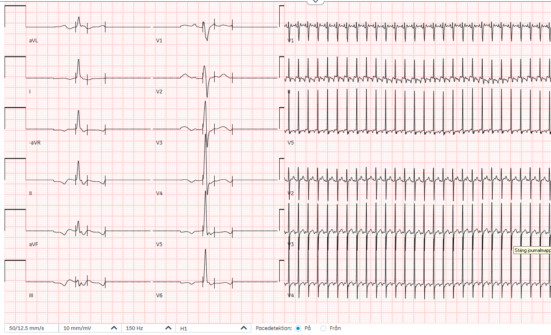
62-year-old woman with fever
Notes:
SOURCE: 630416-250624-AN

Slide 56
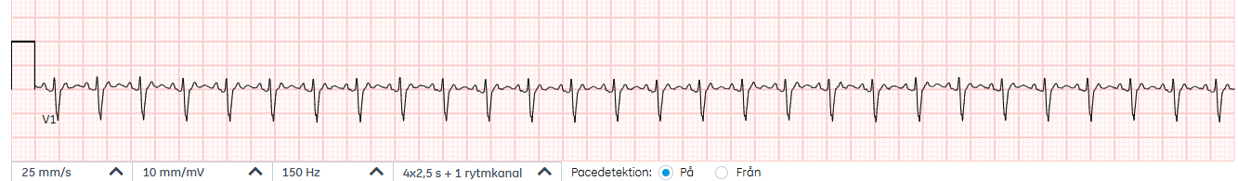
Differential of Tachycardia
 | Regular | Irregular
QRS < 120 msec
QRS > 120 msec
Notes:
So the patient is stable enough to spend some time trying to figure out the pathophysiology underlying the tachycardia.
Tachycardias can be categorized according to whether they are:
1-Regular or irregular
2-Narrow or wide QRS
This patient has a regular tachycardia with wide QRS complexes

Slide 57
Differential of Tachycardia
 | Regular | Irregular
QRS < 120 msec | ST Atrial flutter EAT = FAT AVNRT AVRT, orthodromic
QRS > 120 msec

Slide 58
Telemetry during adenosine
Atrial activation at 300 bpm
Notes:
Subsequent EKG 250624 12:37
1-The arrhythmia does not break despite adenosine. So not AVNRT or AVRT
2-The adenosine reveals atrial complexes going at a frequency of 300 bpm
So this suggests atrial flutter with 2:1 conduction.
EAT usually has a rate of 200 – 260 bpm.

Slide 59
Atrial Flutter
Usual atrial rate 300 bpm
Can be slower, e.g. if patient taking antiarrhythmic medications or previous ablation
The most common atrioventricular conduction ratio is 2-to-1

Slide 60
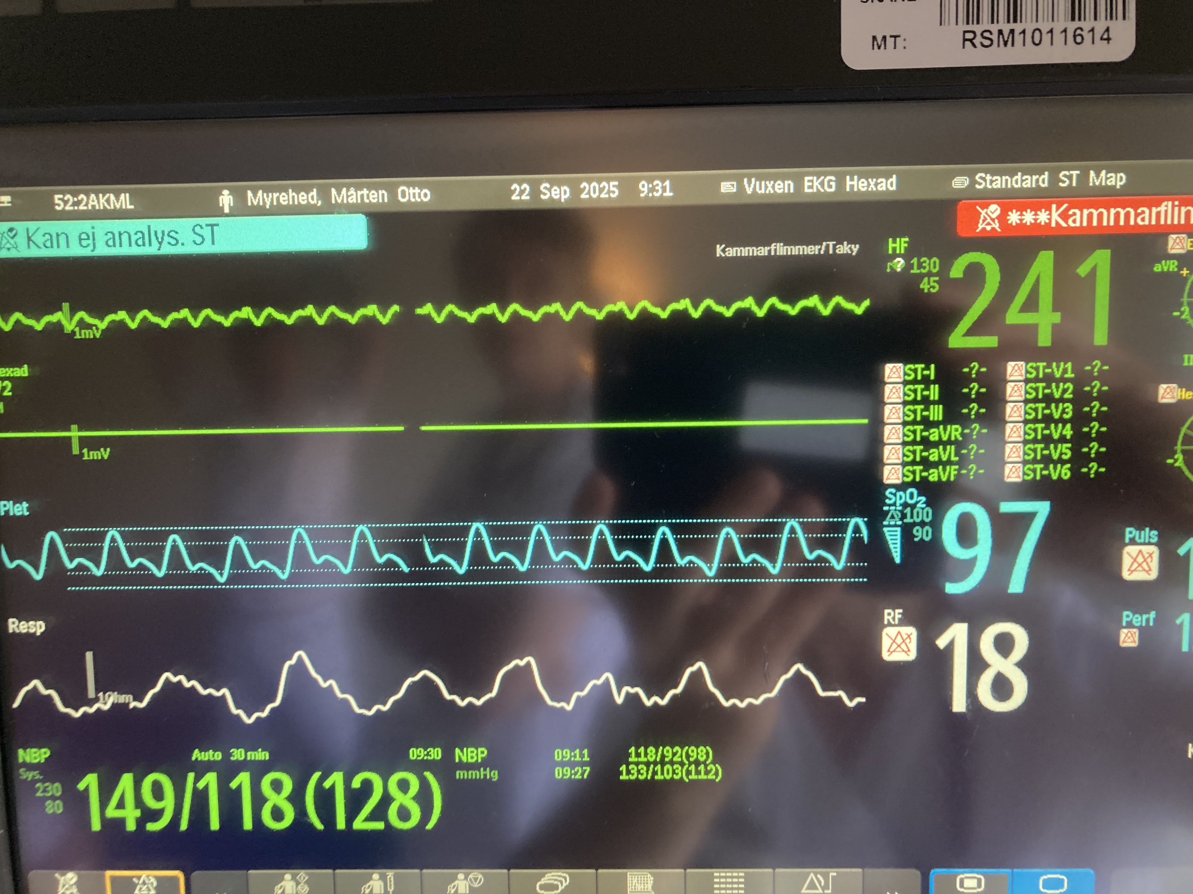
Notes:
250922. Called emergently by a resident to the bedside of this patient.
I had been told that he had 2:1 atrial flutter and had come to the ED to be cardioverted.
The monitor is picking up one each flutter wave and hence indicating a heart rate of 241.
Yet the pulse oximeter is only beating at half the speed.

Slide 61
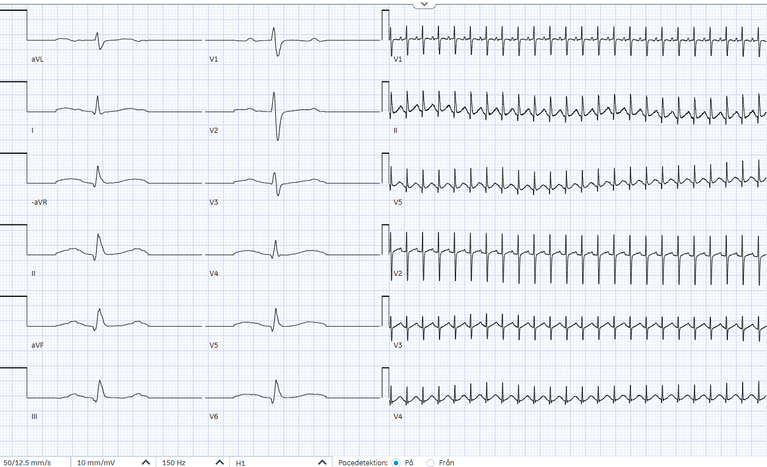
65-year-old woman with palpitations
Notes:
SOURCE: Source: 600122-250617-MN (not in patientliggare, was admitted to AVA)
EKG 250622 at 14:17
65-year old nursing assistant admitted to gynecology after having had surgery for cancer of the fallopian tubes, moved to ICU step-down unit because of episodes of palpitations, where the EKG showed a narrow regular tachycardia at a rate of 148 bpm. Blood pressure 94/71 during these episodes.
P-waves are visible. No evidence that this is 2:1 conducted atrial flutter (no “second” P-wave visible in V1).

Slide 62
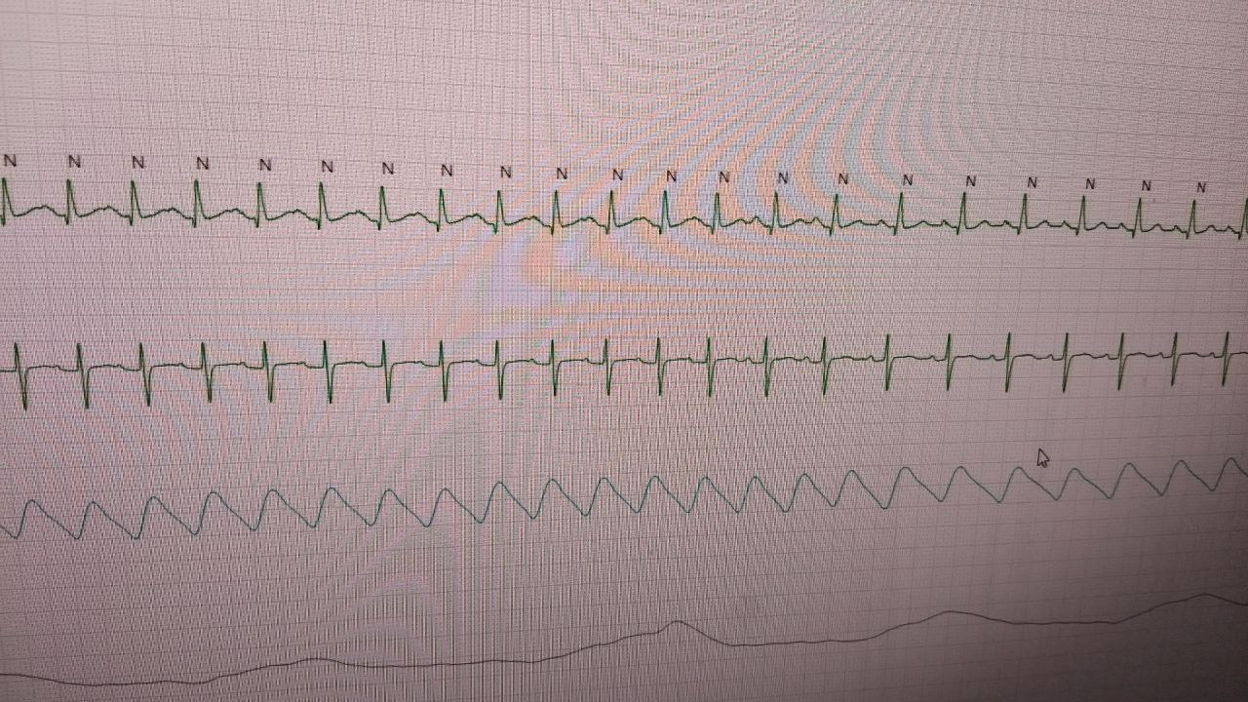
Telemetry 250623 21:38
Notes:
Source: 600122-250623-MN (not in patientliggare, was in AVA)
Telemetri
65-year old nursing assistant admitted to gynecology after having had surgery for cancer of the fallopian tubes, moved to ICU step-down unit because of episodes of palpitations, where the EKG showed a narrow regular tachycardia at a rate of 148 bpm. Blood pressure 94/71 during these episodes.
This rhythm stip shows a transition from a heart rate of approximately 140 bpm to 110 bpm. This is the “cold-down” period of the EAT.
The time between the Q and the P is longer than the time between the P and the following Q, so this is a long RP tachycardia arguing against AVNRT and orthodromic AVRT.

Slide 63
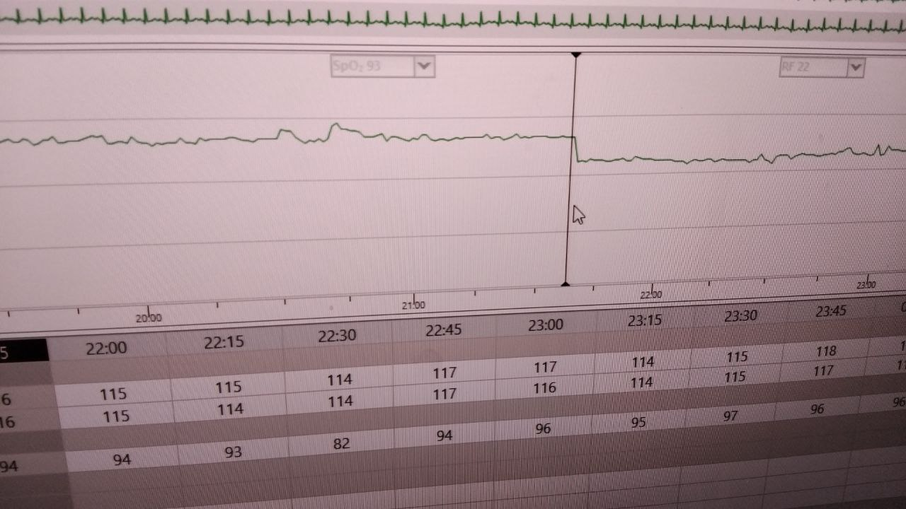
Telemetry 250623 21:38
Notes:
The heart rate trend curve shows a slight incline, indicating a cool-down phenomenon.

Slide 64
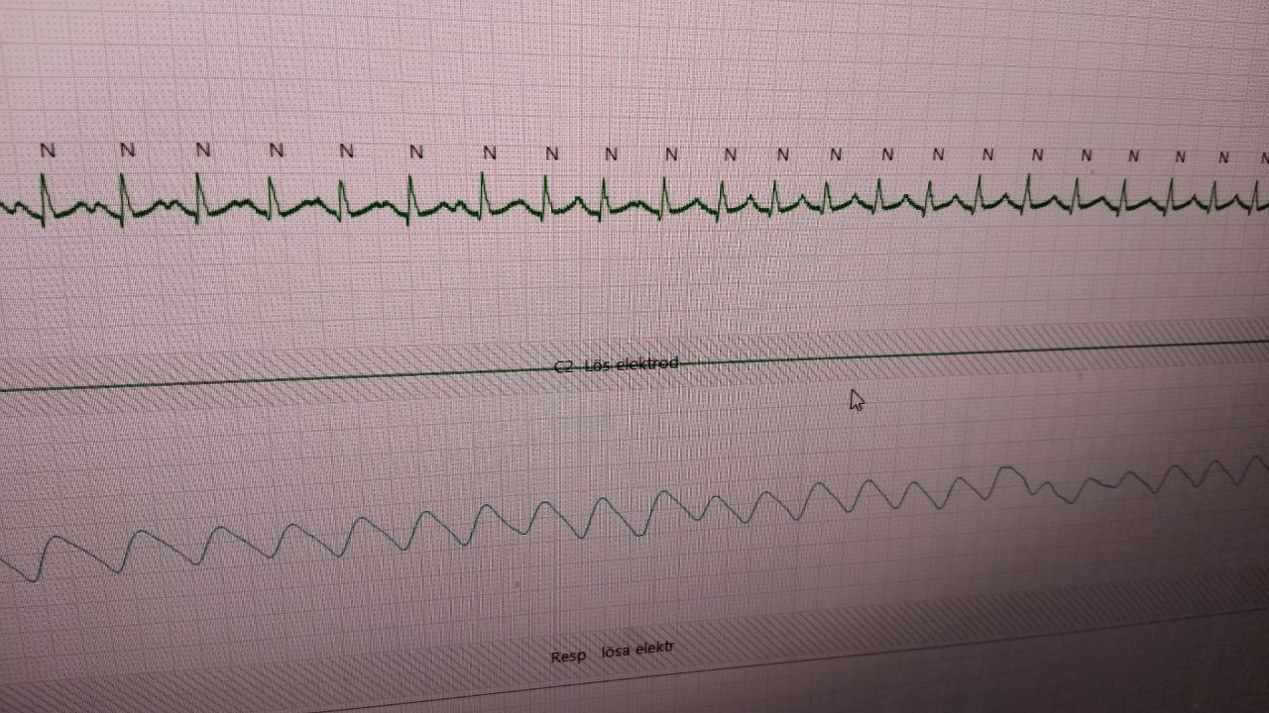
Telemetry 250624 05:22
Notes:
This strip capture a rapid transition from 120 bpm to 150 bpm, the “warm-up” period of EAT.

Slide 65
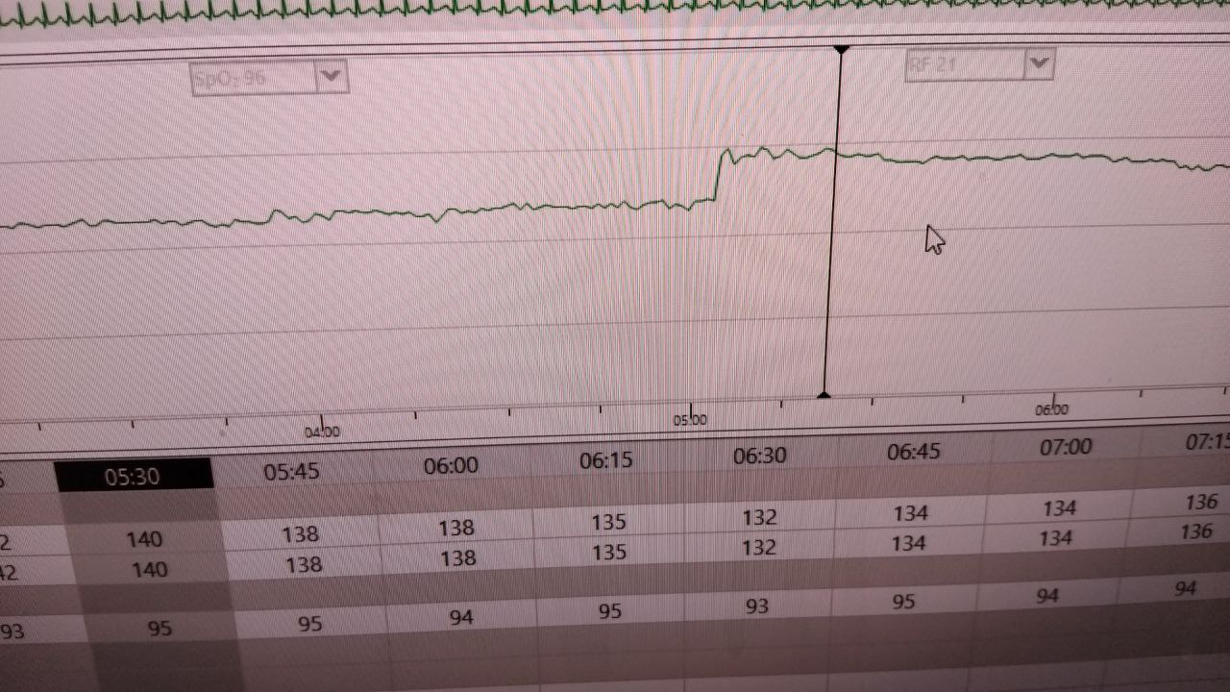
Telemetry 250624 05:22
Notes:
The heart rate trend shows a warm-up phemenon with rapid increase. Deemed to be an EAT by the cardiologist.
The patient was treated with metoprolol long-acting 50 mg BID

Slide 66
Ectopic Atrial Tachycardia
Heart rate 100-300 bpm, usually 200-260
Presence of irregularity at onset (“warm-up”) and termination (“cool-down”) is a hallmark of EAT
In contrast, abrupt onset and offset with reentrant arrhythmias such as AVNRT and AVRT

