Slide 1
EKG Interpretation

Slide 2
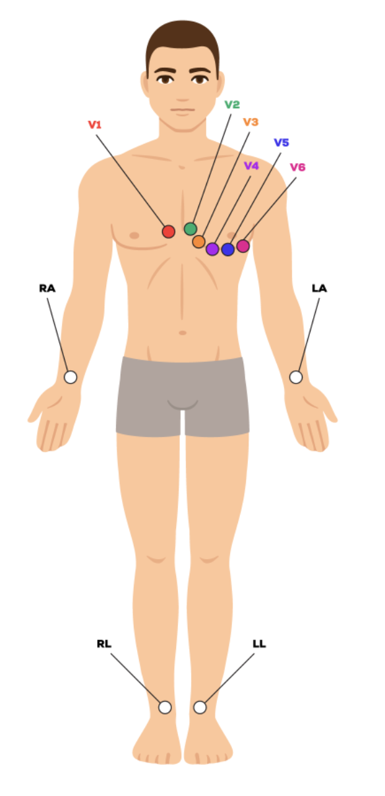
Electrode Placements
V1 | 4th ICS | Parasternal right
V2 | 4th ICS | Parasternal left
V3 | Between V2 and V4
V4 | 5th ICS | Mid-clavicular
V5 | 5th ICS | Anterior axillary line
V6 | 5th ICS | Mid axillary line
Notes:
https://www.cardiacdirect.com/12-lead-ecg-placement-guide/?srsltid=AfmBOopfRDWeU4UK5iki7xn69ju3AmL8vnHF7Cyopn7ajztucnLRxlP8

Slide 3
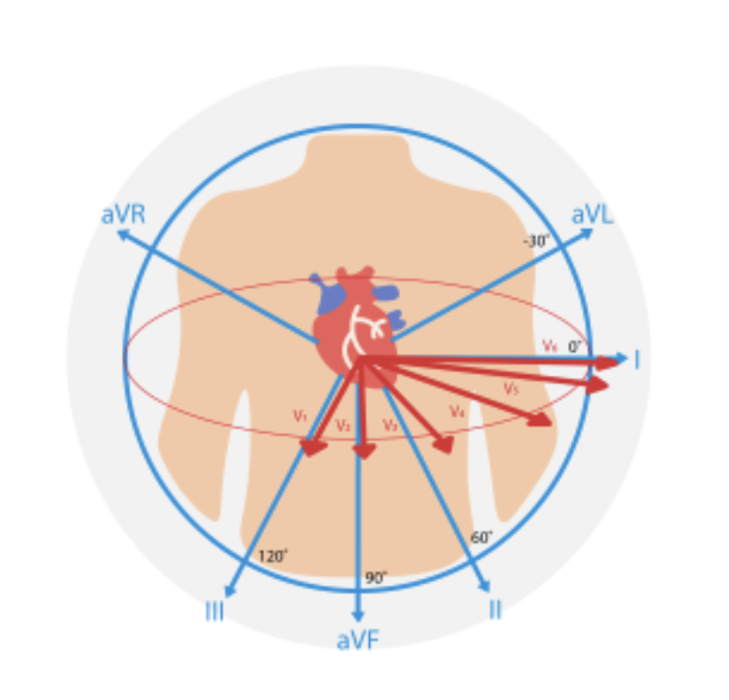
6 limb leads in the body’s coronal plane
6 chest leads in the body’s transverse plane
Lateral leads:
I, aVL, V5, V6
Septal leads:
V1, V2
Anterior leads:
V3, V4
Inferior leads:
II, III, aVF
Notes:
We use the differences in electrical charge between these electrodes to “generate” 12 leads.
https://www.cardiacdirect.com/12-lead-ecg-placement-guide/?srsltid=AfmBOopfRDWeU4UK5iki7xn69ju3AmL8vnHF7Cyopn7ajztucnLRxlP8

Slide 4
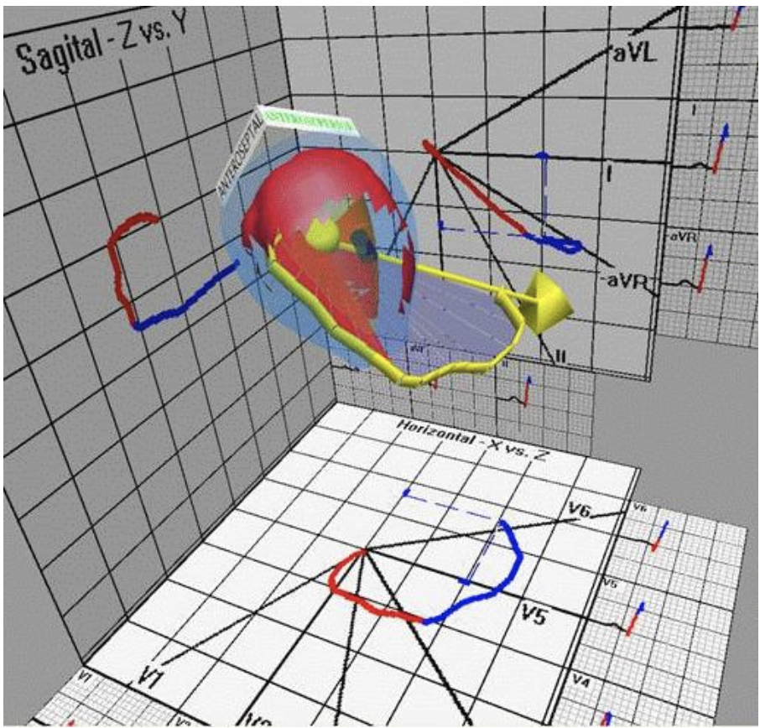
Notes:
We display the three dimensional change in electrical charge from the heart by “projecting” it onto these leads, in the transverse plane and the coronal plane
https://www.angelfire.com/ny3/ecgtech/looplead.html

Slide 5
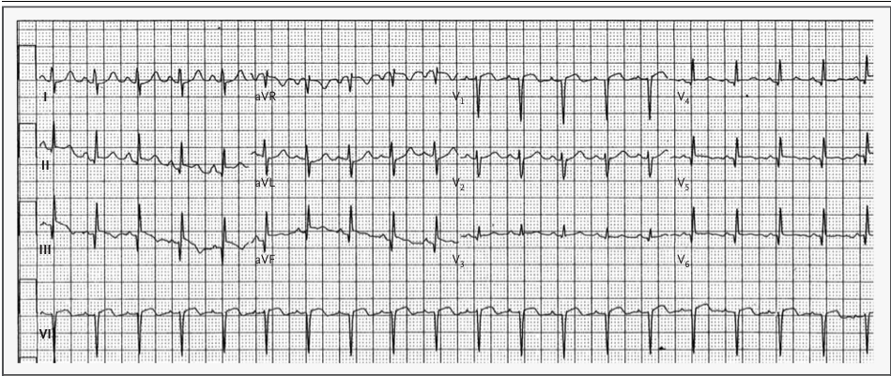
Classic Display
I | aVR | V1 | V4
II | aVL | V2 | V5
III | aVF | V3 | V6
Paper speed: 25 mm/sec. One rhythm strip

Slide 6
-aVR
Notes:
https://www.cardiacdirect.com/12-lead-ecg-placement-guide/?srsltid=AfmBOopfRDWeU4UK5iki7xn69ju3AmL8vnHF7Cyopn7ajztucnLRxlP8

Slide 7
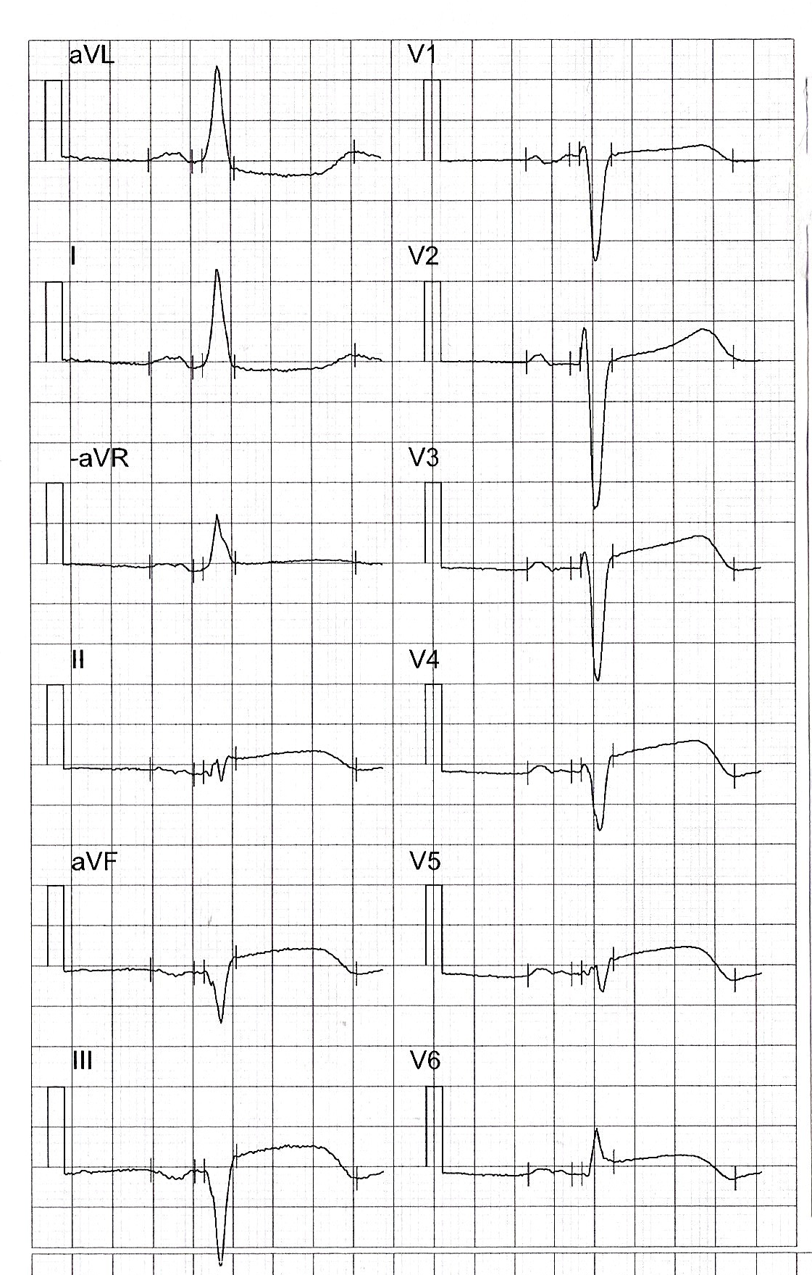
Cabrera Display
“LILAS”
Septal
aVL | V1
I | V2
-aVR | V3
II | V4
aVF | V5
III | V6
Lateral
Anterior
Inferior

Slide 8
Cabrera

Slide 9
Classic

Slide 10
Systematic EKG Interpretation
O | Rate
 | Regularity
P | P-waves
 | PR-segments
Q | Q-waves
 | QRS-complexes
R | Axis
 | R-waves
S | S-waves
 | ST-segments
T | T-waves
 | QT-interval
+ | Other findings
 | Summary | Rhythm +/- suspected conditions
Notes:
Rate in bpm:
1-If paper speed 25 mm/sec
300 / # of 5 mm squares between QRS-complexes
the typical length of the rhythm strip is 25 cm. If the paper speed is 25 mm/sec, the recording time is 10 seconds. So # of QRS-complexes on the rhythm strip x 6
2-If paper speed 50 mm/sec:
600 / # of 5 mm squares between QRS-complexes
with a rhythm strip length of 25 cm and a paper speed of 50 mm/sec, the recording time is 5 seconds. So # of QRS-complexes on the rhythm strip x 12

Slide 11
54-year-old woman with chest pain
Notes:
Source: 580718-121223-AB
This is a classic inferior STEMI with reciprocal ST-depression in aVL and I.
Note the heart rate of 50 bpm. The patient has third degree AV block due to AV-nodal ischemia. The QRS-complexes are narrow, this is a junctional escape rhythm.
Note the abrupt transition from the QRS-complex into the ST-segment in III. Amal Mattu calls this “check-mark” sign and it speaks for OMI.
Note the ST-elevation in V3. This is probably due to RV STEMI (the RV is located under the V3 electrode; we know this because the chamber closest to the probe when we do PLAX is the RV).

Slide 12
Systematic EKG Interpretation
O | Rate | 50 bpm
 | Regularity | QRS-complexes appear regularly
P | P-waves | Positive in II, no evidence of LAE or RAE
 | PR-segments | Not applicable given 3rd degree AV-block
Q | Q-waves | Pathological Q-wave in III
 | QRS-complexes | Narrow
R | Axis | Normal
 | R-waves | No signs of LVH
S | S-waves | No signs of LVH
 | ST-segments | STE III > II, STD aVL > I, STE V3 (+/- V1)
T | T-waves | Neg in I + aVL. “Hyperacute” in III?
 | QT-interval | Around 400 msec
+ | Other findings
 | Summary | 3rd degree AV-block, junctional espace rhythm Inferior + RV STEMI with junctional espace rhythm
Notes:
Comments regarding ”Pathological Q-wave in III”:
1-According to UpToDate 2025, there are no accepted criteria (duration, size) for pathological Q-waves, one needs to take the clinical context into account to interpret Q-waves (Bayes), and echo is the first line non-invasive way to assess unexpected Q-waves.
2-Fourth universal definition of myocardial infarction (2018): the section on Q-waves is actually about finding evidence of a prior MI including one that was silent/unrecognized. So unclear whether these criteria apply in the setting of an acute MI (as in this EKG).
3-If we do choose to apply these criteria, then this woman has:
a) Q-wave > 30 msec and > 1 mm in lead III
b) Q-wave > 30 msec and > 1 mm in lead aVF
So meets the criteria (two contiguous leads). Note that the R in aVL would be a pathological Q-wave in -aVL
4-If we choose to NOT use the fourth universal criteria: we still have a wide, deep and disproportionally big (> 25% of R wave) Q wave in an inferior lead in the setting of an inferior OMI where the pretest probability is that you have regional wall-motion abnormality. So in this context, the Q-wave is likely pathological (and due to an acute MI).

Slide 13
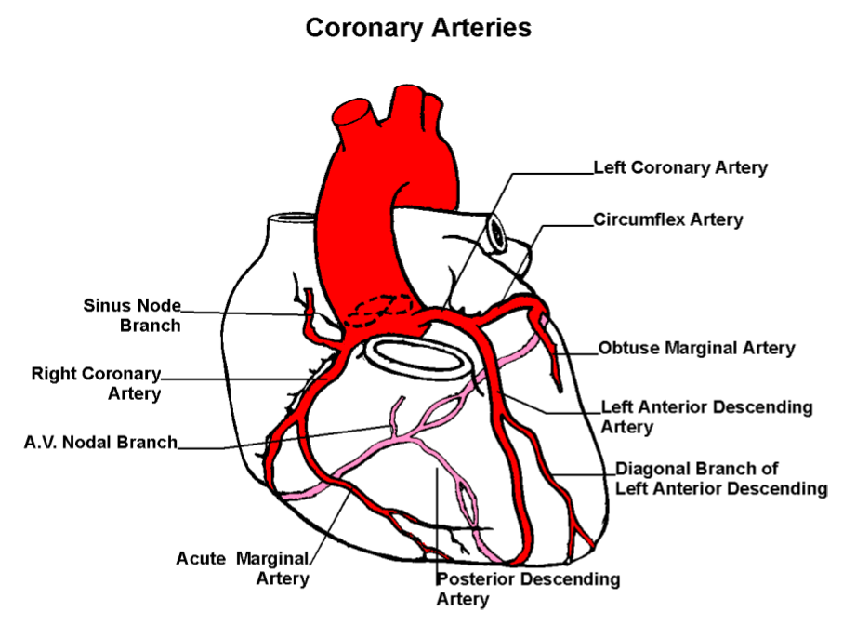
Notes:
The patient likely has an RCA occlusion proximal to the A.V. Nodal Branch (since the patient has third degree AV block)

Slide 14
V4R
V4R
Notes:
https://www.cardiacdirect.com/12-lead-ecg-placement-guide/?srsltid=AfmBOopfRDWeU4UK5iki7xn69ju3AmL8vnHF7Cyopn7ajztucnLRxlP8

Slide 15
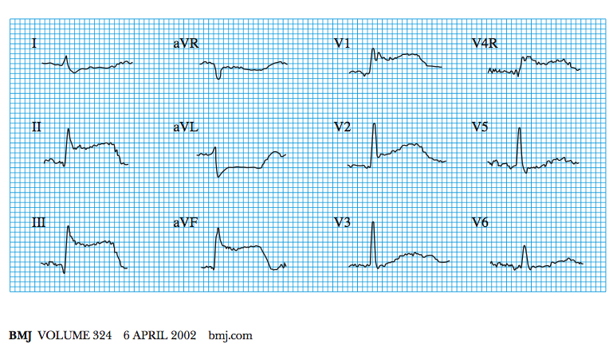
Acute inferior myocardial infarction
with associated right ventricular infarction
Notes:
To detect RV STEMI, place the V4 electrode on the mirror side, creating a V4R.

Slide 16
Course
LM unremarkable
LAD: atheroma but no significant stenosis
Septal collaterals to RPD
Cx: atheroma but no significant stenosis
RCA: dominant, proximally occluded
PCI to RCA

