Slide 1
Initialt omhändertagande vid omedelbar livshot

Slide 2
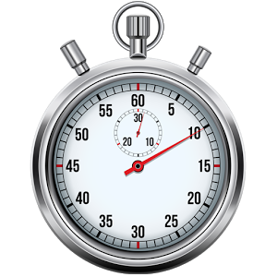
Omedelbar livshot
Svår ABC-problem:
Vissa nivå 1 traumalarm
Fåtal övriga prio 1 larm
Alla hjärtstopp
Notes:
Most priority 1 patients are fairly hemodynamically stable. But some priority one patients are really, really sick. These patients have an immediate threat to life. These patients fall into the following categories:
1-Cardiac arrest (in essence, these patients are already dead)
2-Trauma level 1
3-Upper airway obstruction
4-Really bad vitals; sometimes, you know from the vitals that this patient is going to need intubation and ICU care

Slide 3
F1 Pit Stop

Slide 4
Notes:
Ask the audience: “What do you see on this slide?”
The answer we’re fishing for is: large team where everyone knows his/her role and gets to work simultaneously the moment the car arrives.
For patients with immediate threat to life, minutes matter. The optimal strategy is to have lots of competent personnel with pre-assigned tasks, so that the patient is resuscitated as quickly as possible.

Slide 5
Sekventiell
Simultant
A
A
B
C
B
C
D
E
Notes:
This slide introduces a dichotomy between “Sequential Resuscitation” and “Simultaneous Resuscitation”
Sequential Resuscitation is carried out when:
1-The patient is actually not that critical; most priority one patients are not on death’s door when they arrive in the ED. It is OK to go sequentially from A through E and no large team of health care personnel is required. You can usually get by with one physician doing A-E at the bedside, one nurse putting in IVs and drawing blood tests and giving medications, and one nursing assistant measuring vitals, taking EKG, putting in Foley etc.
OR
2-When you have few personnel, you need to do things sequentially. Think about ATLS-courses where the scenario is always: “You are working in a rural hospital with few staff.” If you are one physician and one nurse, you can’t do everything at once, you have to do things sequentially and start with A.
Simultaneous Resuscitation is carried out when:
1-Patient is critical
AND
2-Sufficient personnel

Slide 6
Scribe
Ultra-
sound
Procus
Mon-itor
Leader
Airway
Airway cart
Vitals
Fluids
Def
CPR cart
PVC cart
Infuser

Slide 7
The Fall
Airway Fran
C Daryl
Anesthetic buddy Nurse Bronagh
Runner Nurse Ursula
Scribe Andrew
Tsar
https://www.youtube.com/watch?v=rUFRVEpvcA0
00:00 – 01:17 (drugs)
02:37 – 04:59 (sign-in/primary survey)
Notes:
So here is a suggestion for a generic simultaneous resuscitation. There are six key roles.
Four of these roles (Team-leader, Fluids, Vitals, Documentation) are present in both Sequential and Simultaneous resuscitations
There are two additional roles during Simultaneous Resuscitations:
1-Airway
2-Trunk

Slide 8
Airway
Restricts C-spine motion in trauma
Inspects oral cavity + head
Ventilates
EtCO₂
Intubates
Ultra-
sound
Mon-itor
ICU cart
Def
CPR cart
PVC cart
Infuser

Slide 9
Ultra-
sound
Mon-itor
Scribe
Crowd-control
Ambulance report
Time-keeper for rhythm-analysis
Phone calls
Checklists?
ICU cart
Def
CPR cart
PVC cart
Infuser

Slide 10
Vitals
Exposure (clips pants)
Attaches to monitor
EKG when not in cardiac arrest
Follows vitals, LOC, degree of pain
Assists Fluids & Procus
Ultra-
sound
Mon-itor
ICU cart
Def
CPR cart
PVC cart
Infuser

Slide 11
Fluids
Prepares rapid infuser
Inserts PVC or IO
Draws blood tests
Administers medications
Administers blood products
Ultra-
sound
Mon-itor
ICU cart
Def
CPR cart
PVC cart
Infuser

Slide 12
Ultra-
sound
Mon-itor
Procus
Pelvic binder on gurney?
Readies ultrasound + CVC-kit
PoCUS (+/- PoCUS pulse check)
Procedures?
Femoral vein: blood gas +/- CVC
ICU cart
Def
CPR cart
PVC cart
Infuser

Slide 13
Leader
Read medical record, Sign-In
ECMO? Child? Pregnant?
Assists Procus
Checklist key conditions/treatments
Flies ahead of the plane
Ultra-
sound
Mon-itor
ICU cart
Def
CPR cart
PVC cart
Infuser

Slide 14
Call-Response

Slide 15
Notes:
http://www.303rdbg.com/checklist-cockpit.html
Having a checklist is not enough to bridge the gap between knowledge and action. There also needs to be clear instructions for how the checklist is to be implemented.
So here we have a
1-read-do checklist
2-used by 2 people
3-Read aloud with a clear expected response
The key words are
1-Definite procedure (or protocol)
2-Active cooperation (involvement, engagement of the users)

Slide 17
Riktade åtgärder
Luftvägshinder | MaGill tång, intubation, coniotomi
Övertrycks PT | Öppen torakostomi
Perikardtamponad | Perikardiocentes, torakotomi
Massiv blödning | O- blod, tourniquet, kompression bukaorta, torakotomi
Massiv lungemboli | Actilys 50 mg bolus + Heparin 5000 enheter IV
Intoxikation | Narcanti, NaHCO3, Ca, Glucagon, Intralipid, ECMO
Hyperkalemi | Kalciumglukonat 10% 30 ml bolus
Hypocalcemi | Kalciumglukonat 10% 30 ml bolus
Myokardischemi | PCI, trombolys, ECMO
AV block III | Externpacing
Hypotermi | NaCl 42ºC intraperitonealt –pleuralt, ECMO, hjärt-lung
Hypovolemi | Ringer

Slide 18
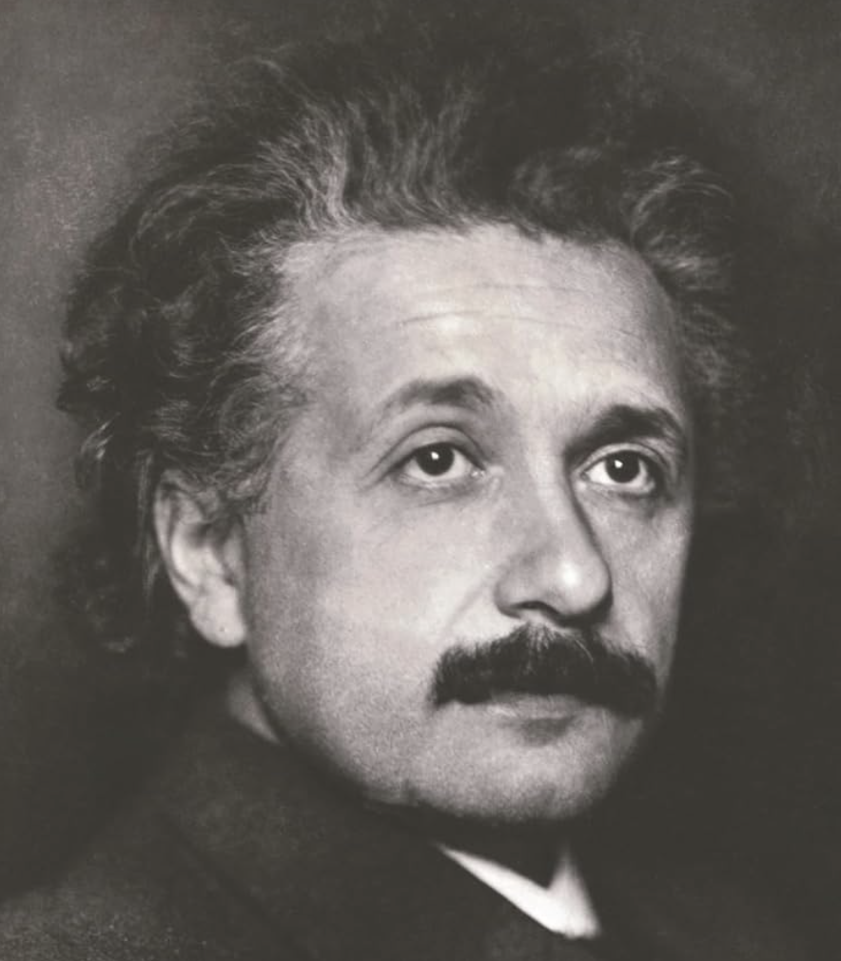
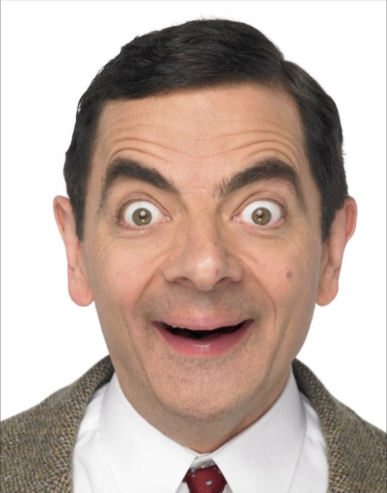
Hjärtstopp reversibla orsaker
 | 5H | 5T
A | Hypoxi
B |  | ÖvertryckspneumoT
C | Hypovolemi | Tamponad Lungemboli Myokardischemi
blodgas | Hyperkalemi Hypocalcemi Hypoglykemi
E | Hypotermi | Toxiner
Tänk diagnos
Hämta data
Hämta data
Tänk diagnos

Slide 19
Cardiac Arrest
Prioritize targeted measures over:
Chest compressions
Adrenalin IV
Examples:
Traumatic cardiac arrest
Hypoxic cardiac arrest
Notes:
In traumatic cardiac arrest, the most likely causes are hemorrhage, tension pneumothorax, tamponade. Prioritize:
1-Hemostasis
2-Giving blood
3-Bilateral thoracostomies
4-Ruling out tamponade
5-Consider thoracotomy
There seems to be no role for adrenalin IV. There seems to be no role for chest compressions if there is not preload. If preload is reestablished, then in theory chest compressions may have a role.
In hypoxic cardiac arrest (e.g. due to upper airway obstruction), prioritize bypassing the obstruction and ventilation over chest compressions and adrenalin.

Slide 20
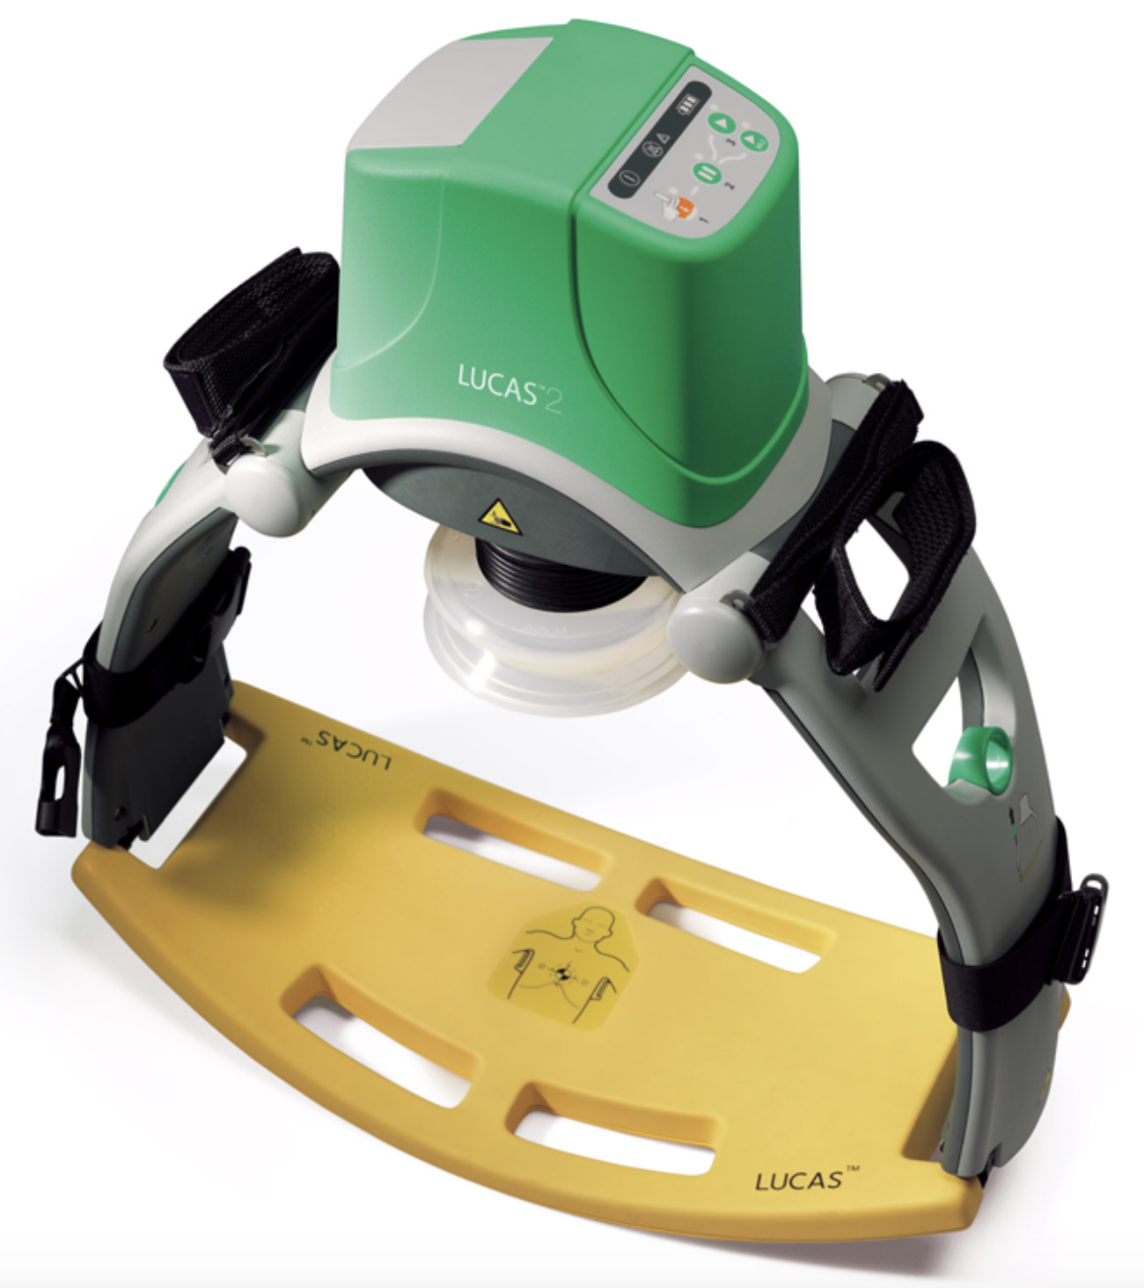
LUCAS
Frigör personal
Likvärdigt som manuell kompression gällande patientutfall
Koppling kan fördröja bröstkompressioner

Slide 21
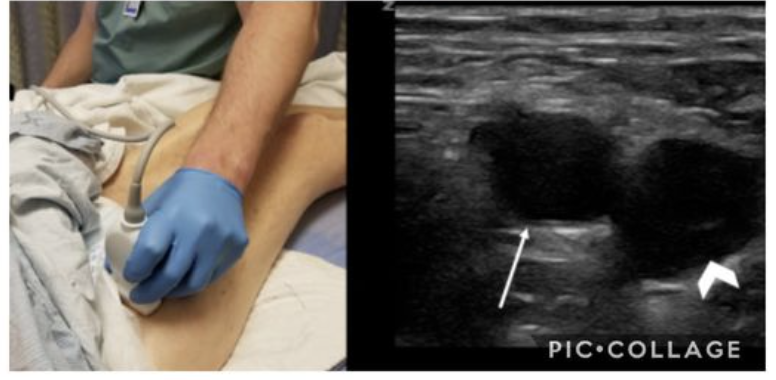
Ultraljud vena femoralis
Blodgas | CVK | DVT? | Pulse-Check

Slide 22
Vad bör hända vid rytmanalys?
Någon som är time-keeper
Någon som kollar rytm
Någon som kollar puls
Någon som gör ultraljud (?)

Slide 23
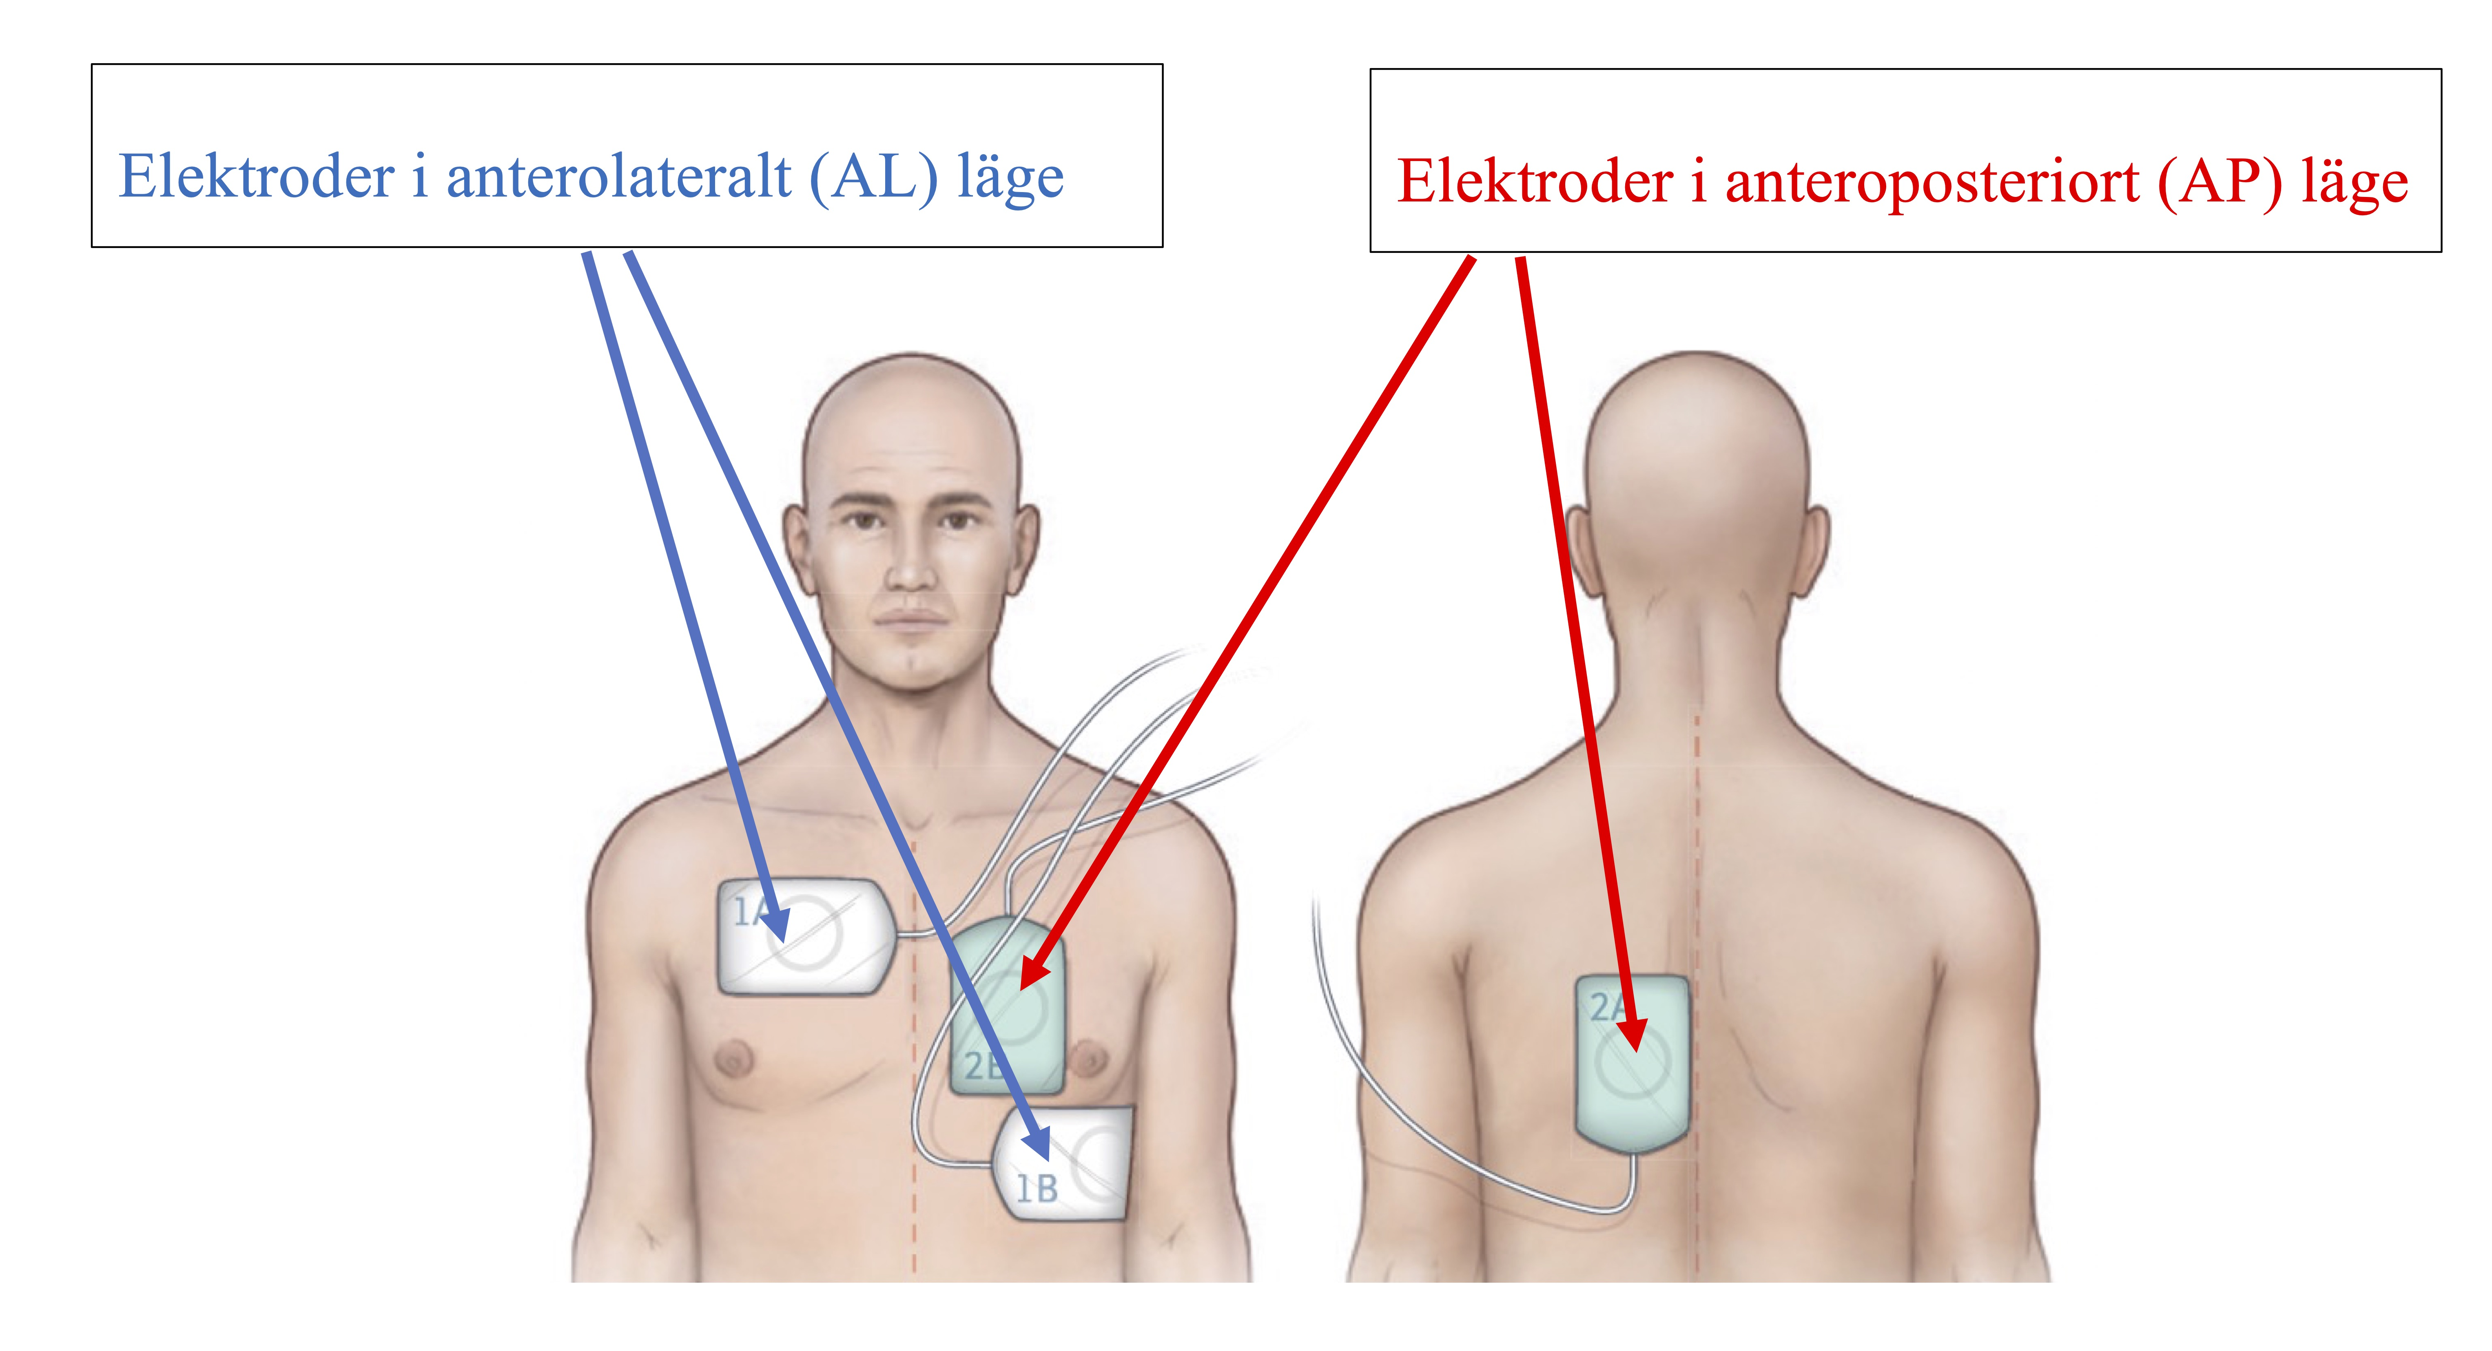
Dubbel-Def

Slide 24
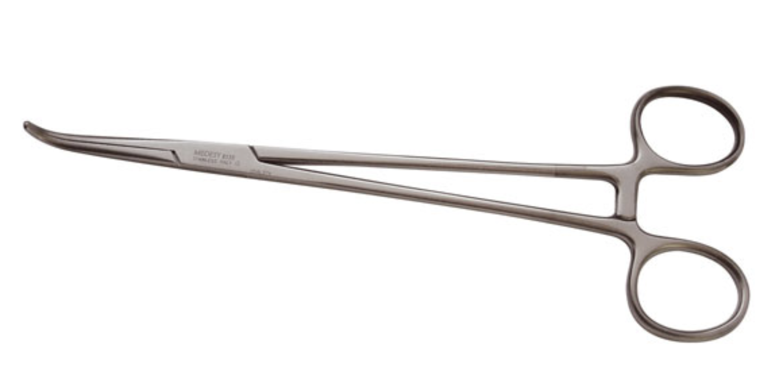
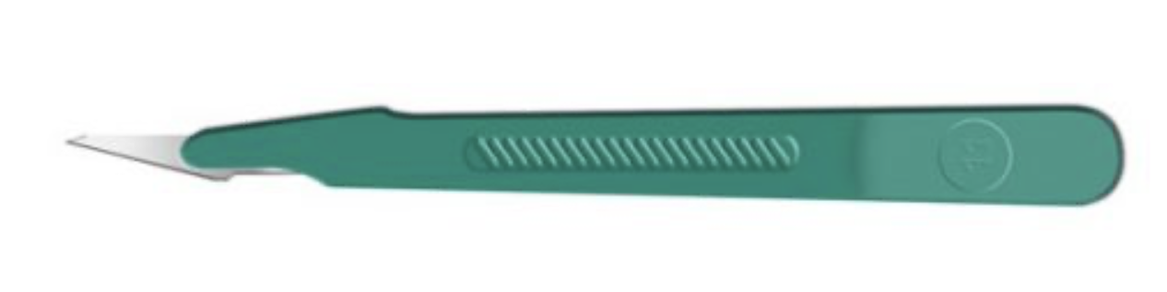
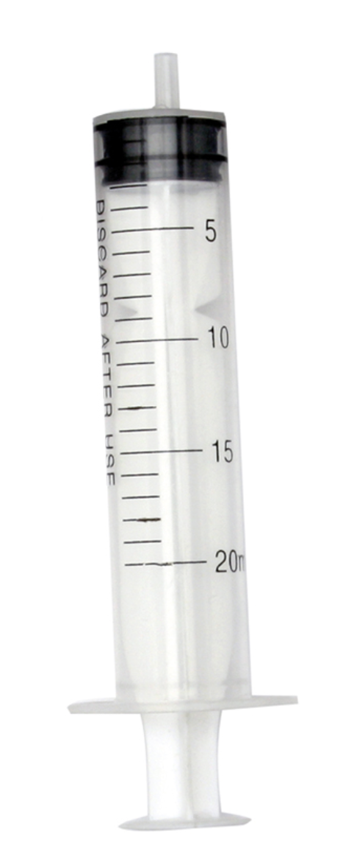

Torakostomi

Slide 25
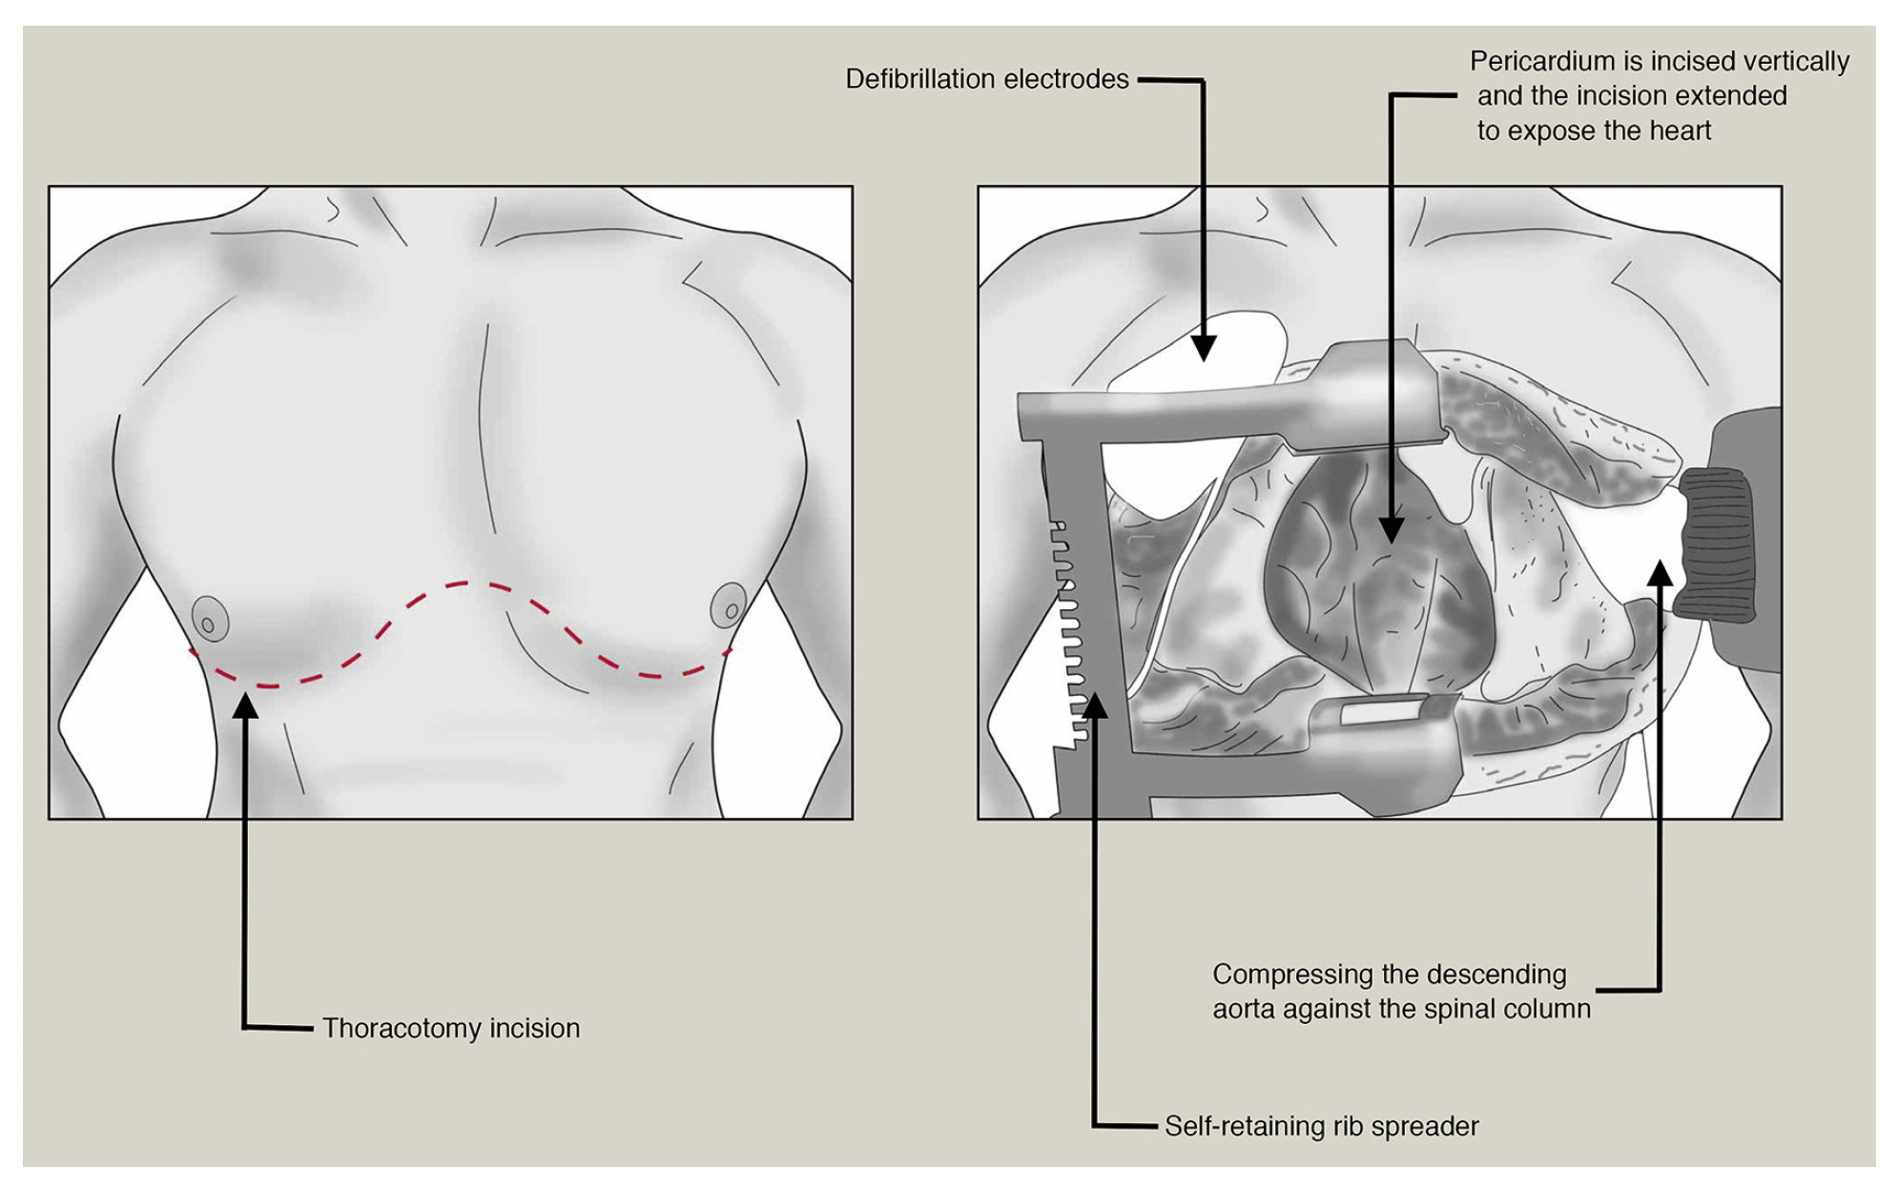
Torakotomi
Rhen Surgery 2018;36:424

Slide 26
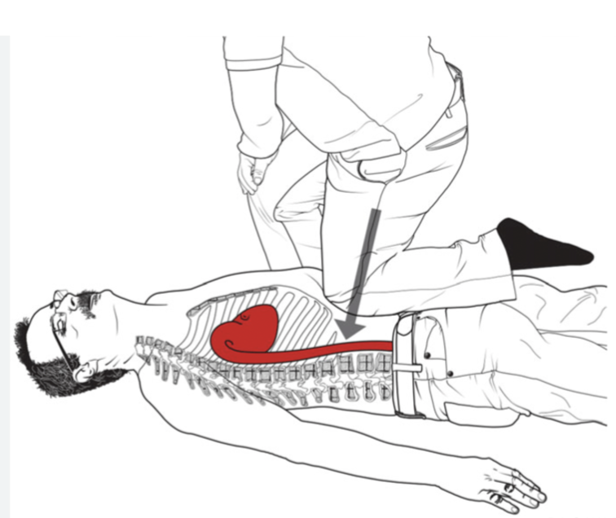
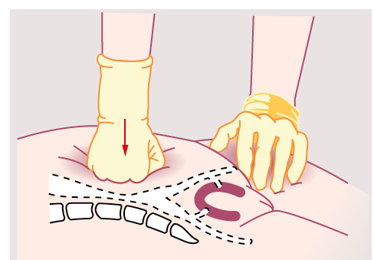
Extern kompression av bukaorta
“Knee-BOA”

Slide 27
REBOA

Slide 28
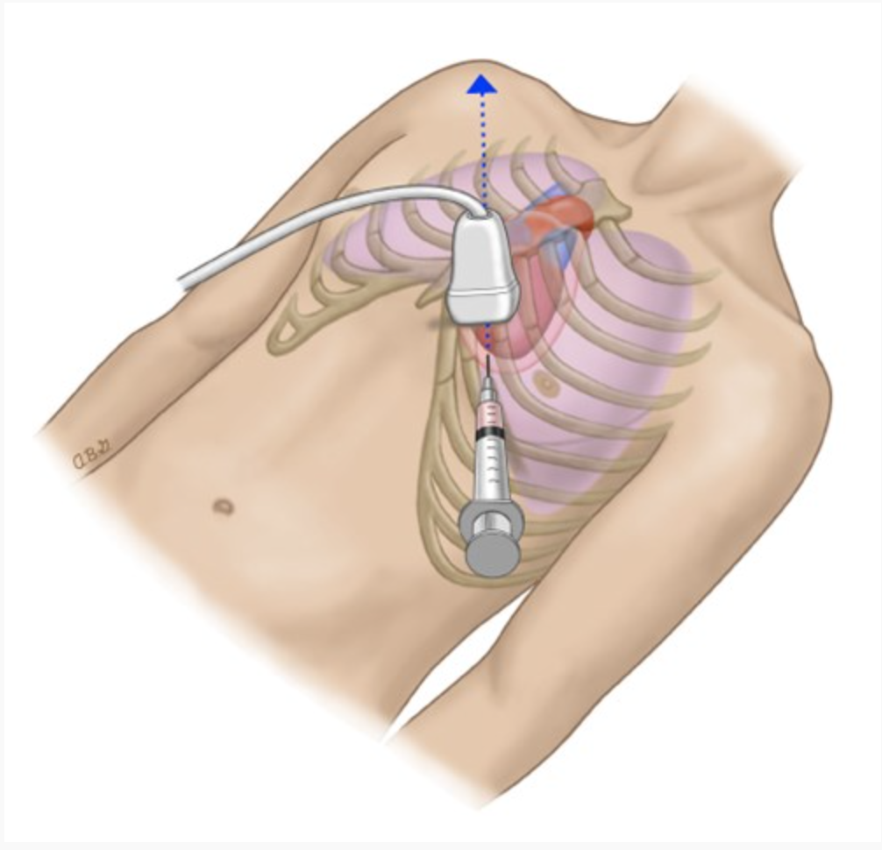
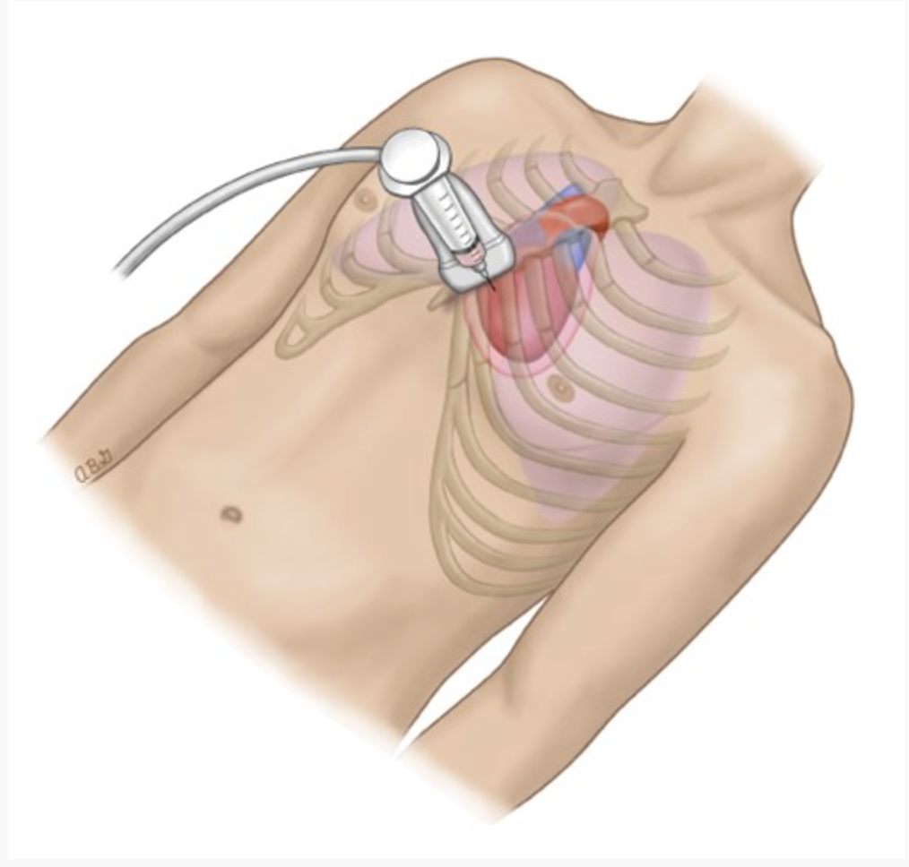
Perikardiocentes
Notes:
https://handbook.bcehs.ca/clinical-practice-guidelines/pr-clinical-procedure-guide/pr44-pericardiocentesis/

Slide 29
Perimortem sectio: för modern
Barn/placenta förbrukar O₂
Livmodern komprimerar IVC
Livmodern hindrar ventilation

Slide 30
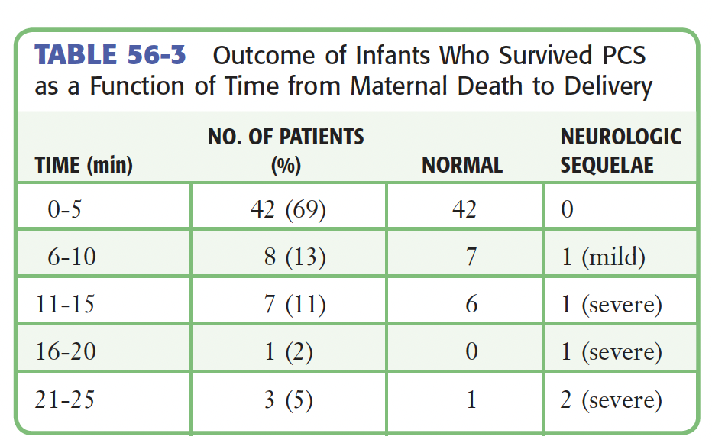
Perimortem sectio: för barnet
Roberts 6th ed

Slide 31
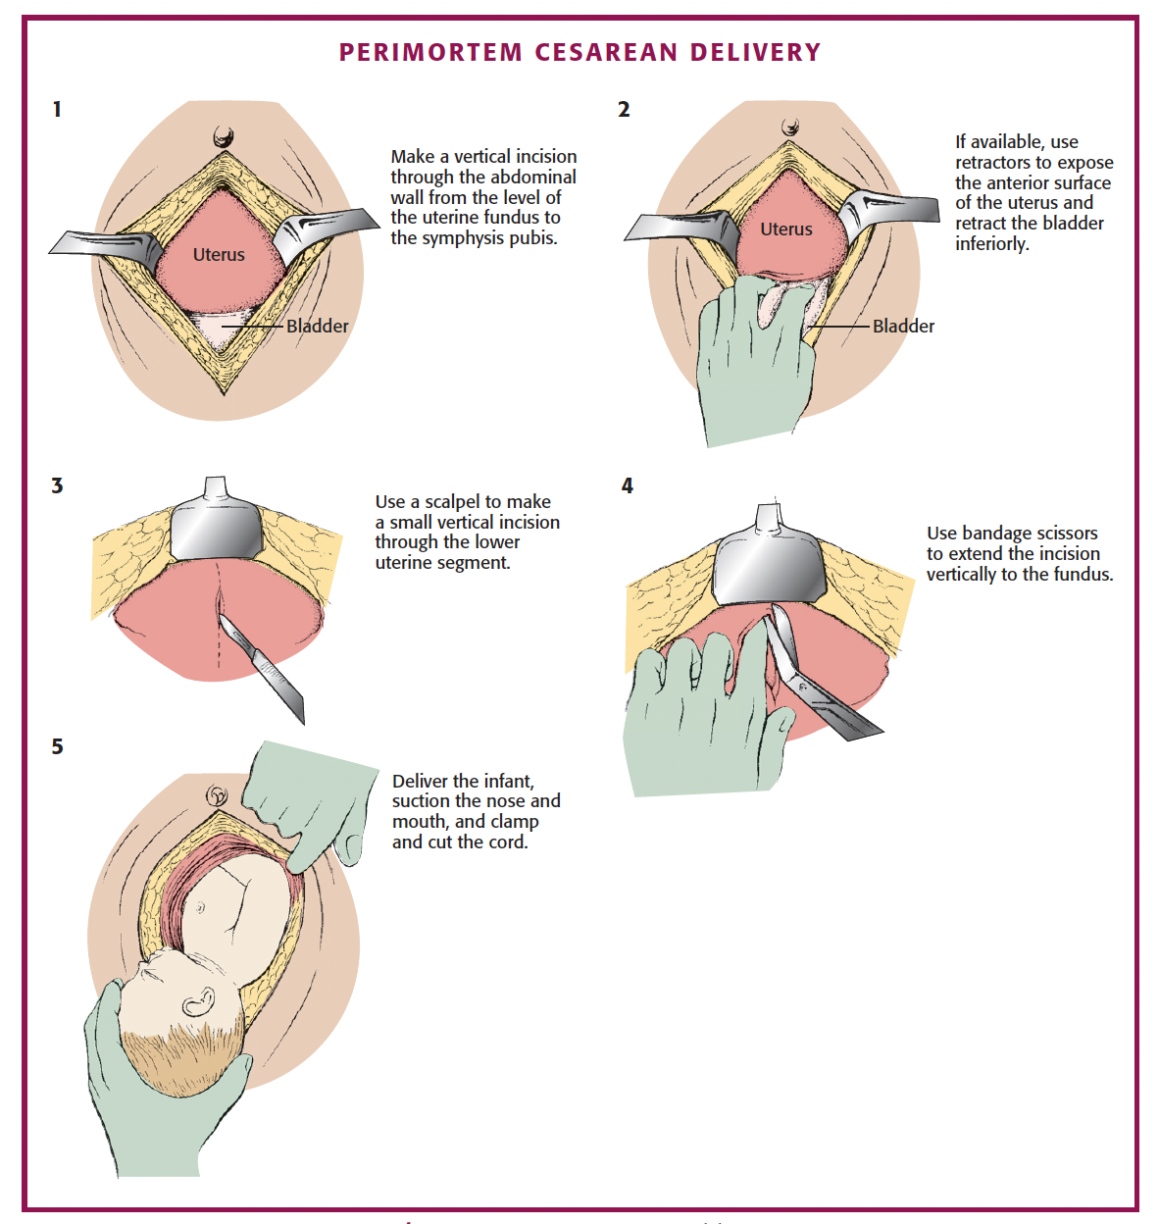
Perimortem sectio
Gravid > 20 veckor
Hjärtstopp > 1 min
Hjärtstopp < 15 min (?)
1-Navelsträng
2-Placenta
3-Packa

Slide 32
Hypothermia
< 30ºC
Def x 3 max
No meds
30-35ºC
Adrenalin Q 8 min
Warming Measures
NaCl 42ºC intraperitoneal/-pleural
ECMO
Cardiopulmonary bypass
Notes:
Rytm: VF / pulslös VT eller PEA / Asystole?
Återbörja direkt med basal HLR
HLR kan pågå under laddning av defibrillatorn
Adrenalin (1 mg vuxna, 10 ug/kg barn) direkt vid PEA / asystole, efter 3:e def vid VF/VT
Cordarone efter 3:e def (300 mg vuxna, 5 mg/kg barn)

