Slide 1
Initialt omhändertagande av svårt sjuka patienter

Slide 2
Generiskt förhållningssätt
1-Danger? | Säkerhet? Support? Stabilisering?
2-Data | Patientnära information
3-Diagnosis? | Tidskänsliga diagnoser?
4-Decisions | Utredningar/behandlingar?
5-Disposition | Muntlig/skriftlig kommunikation

Slide 3
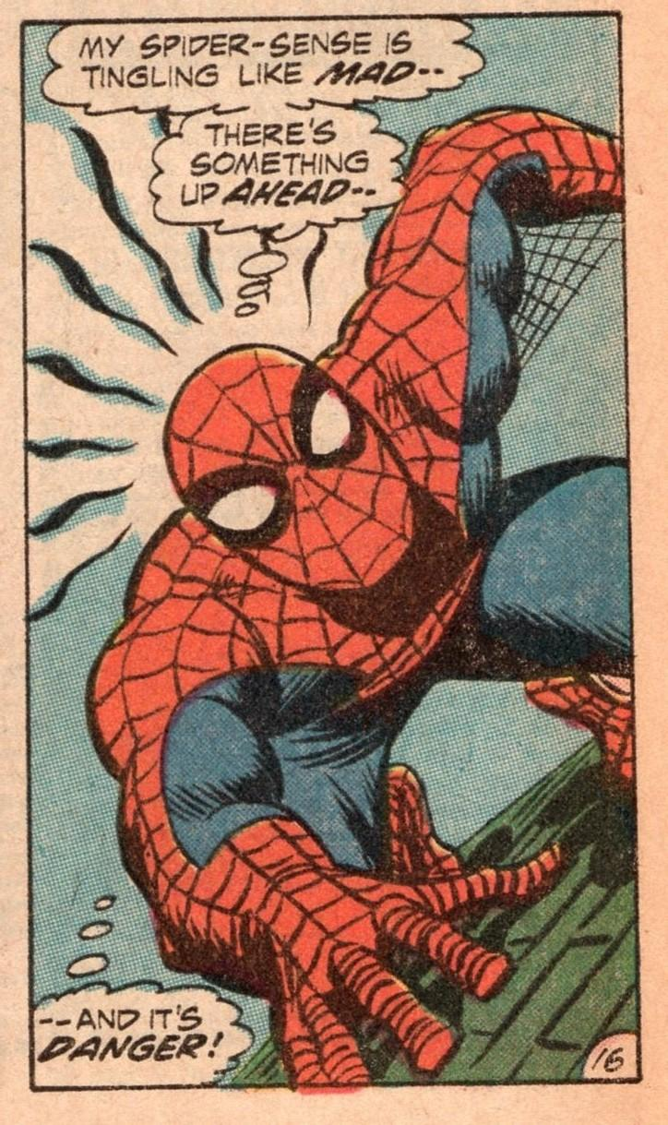
Danger?
Utseende
Vitalparametrar
Skademekanism

Slide 4
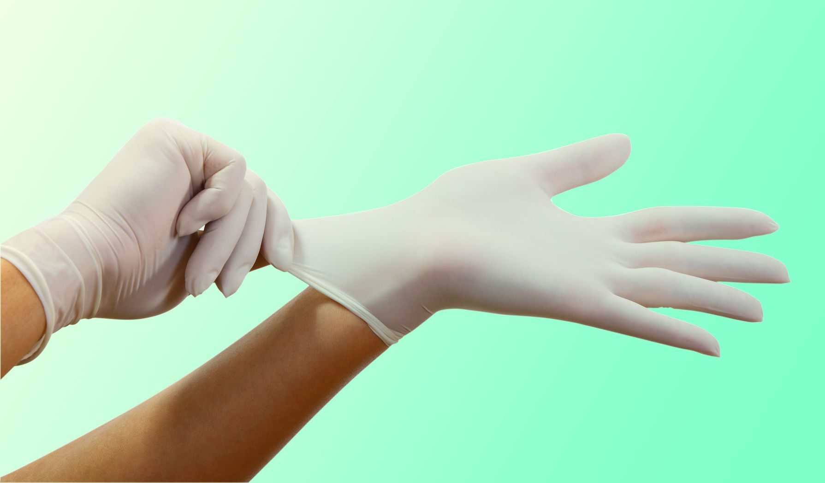
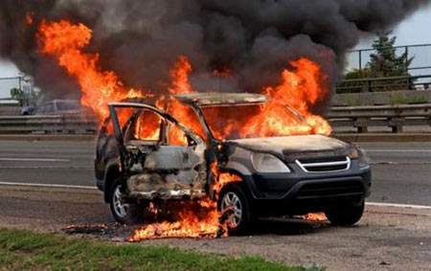
Säkerhet

Slide 5
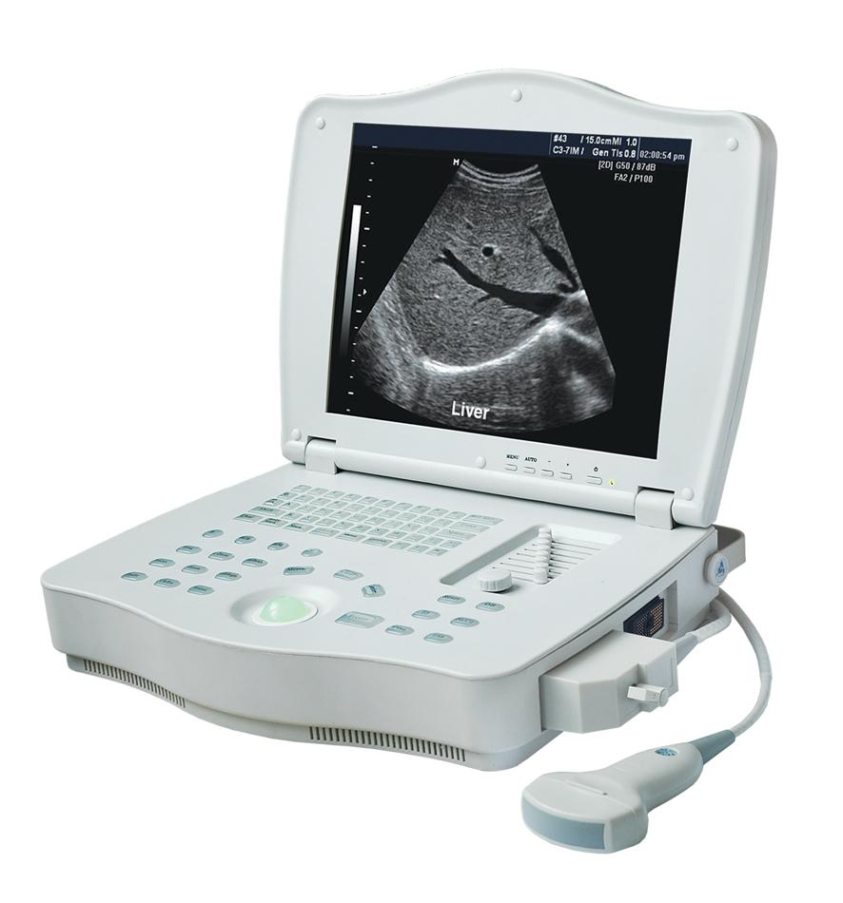

Support

Slide 6


Team: varför?

Slide 7

Crew Resourse Management
Individer gör misstag
Teamet räddar
Införa rutiner och verktyg som främjar teamet

Slide 8


Team: utmaningar?

Slide 9
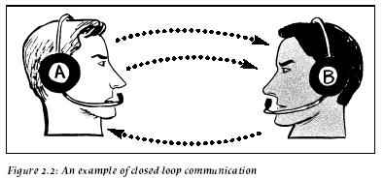
Två format för kommunikation
S | Situation
B | Background
A | Assessment
R | Recommendation

Slide 10
Sign-In
Situation | Team Patient
Background | Bakgrund Aktuellt
Assessment | Potentiella diagnoser? Potentiella åtgärder?
Recommendation | Roller—extra personal? Åsikter-förslag?

Slide 11
Vikt
< 1 år | (må / 2) + 4
1-4 år | (år x 2) + 10
5-14 år | år x 4

Slide 12
Closed-loop
A: “B, tacksam räkna andningfrekvens”
B: “Jag räknar andningsfrekvens”
A: “Tack”

Slide 13
Stabilisering
Syfte
Minska morbiditet genom tidiga åtgärder
Hur behandar man när man inte känner Dx?
Metod
Hitta problem som kan åtgärdas direkt
Känna igen syndrom som kan åtgärdas tidigt

Slide 14
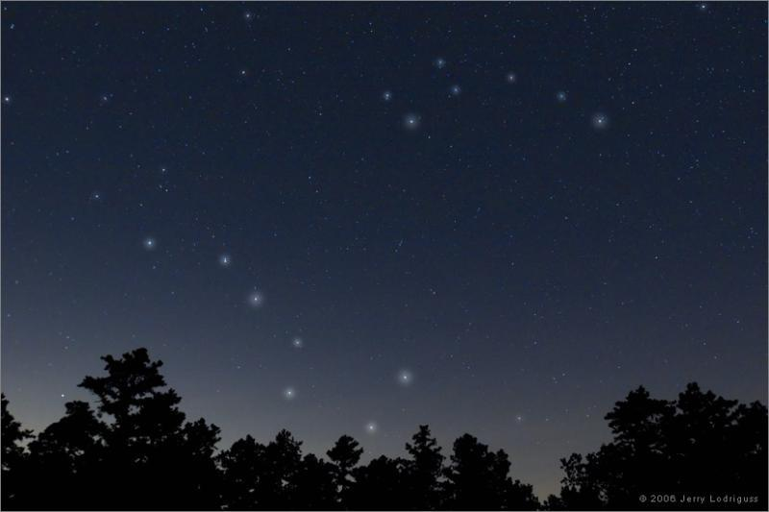
Syndrom
Anafylaxi
Sepsis
Opioid toxidrom

Slide 15
Generisk ABCDE
C | Pulser, blodtryck? Hjärtfrekvens? Rytm? (3 avl EKG)
D | AVPU Ögon Hand/fot Glukos
E | Framsida Baksida Temperatur?
Ö | Hjärtstopp?
A | Trauma till huvudet? Luftvägsljud? Munhålan?
B | Syresaturation? Andningsfrekvens? Lungauskultation? Bröstkorgen?

Slide 16
 | Bedömning | Åtgärd
O | Säkerhet? Support? Speciell situation? | Handskar, förkläder, flytta Begära personal/utrustning HLR, tryck mot katastrofal blödning
A | Trauma till huvudet? Luftvägsljud? Munhålan? | Manuell immob. av halsryggen Övre luftvägsåtgärd Sug, sidoläge, MaGill tång
A¹ | Trauma till huvudet? EtCO2? Tub? | Manuell immob. av halsryggen Extubera om ingen EtCO2 Sug
1: Redan intuberad
Notes:
So let’s now go through a proposed generic ABCDE.
There is a step before A. This is the O step on this slide, where O stands for Overview. The purpose of O is to prevent an escalation of acuity.
During the Overview step, there are three assessments:
First assessment: Safety? The potential interventions to consider are what PPE to done and whether the working environment is safe for patient and personnel
Second assessemnt: Support? The potential interventions to consider are requesting additional personnel and requesting additional equipment
Third assessment: Special Situation? Cardiac arrest should be identified during the overview, and advanced cardiopulmonary resuscitation initiated. Catastrophic bleeding should be stopped using pressure or tourniquet before proceeding to the next step.
The next step is A for Airway. The purpose of A is to stabilize the cervical spine if it is potentially unstable, and to ensure patency between the pharynx and carina.
During A, there are three assessments:
First assessment: Head trauma? The potential intervention to consider is manual stabilization of the cervical spine.
Second assessment: listen to the airway sounds. The potential interventions to consider are airway interventions which are covered in the next slide.
Third assessment: inspect the oral cavity. The potential interventions are suction, lateral decubitus and the use of forceps to remove liquids or loose solids from the oral cavity
If the patient is already intubated, there are still three assessments during A:
First assessment: Head trauma? The potential intervention to consider is manual stabilization of the cervical spine.
Second assessment: Measuring the End-tidal CO2. If there is no end-tidal CO2, the assumption should be that the tube is not in the right place and the patient should be extubated.
Third assessment: Inspecting the tube. If it contains liquid, the tube should be suctioned

Slide 17
 | Bedömning | Åtgärd
B | SpO2%? Andningsfrekvens? Lungauskultation? Bröstkorg? | ≥ 10 L O₂ via mask Ventilera via mask Täck håll i bröstkorgen
C | Pulser, blodtryck? Hjärtfrekvens? Rytm? (2-avl EKG) | Krystalloid 10 ml/kg IV/IO Adrenalin IM Externpacing
Notes:
The next step is B which stands for Breathing. The purpose of B is to ensure oxygen delivery to the blood and removal of CO2 from the blood.
During B, there are four assessments:
First assessment: what is the SpO2? The potential intervention to consider is the administration of supplemental oxygen via mask
Second assessment: what is the respiratory rate? The potential intervention to consider is ventilating the patient via mask, either with a one-person or two-person technique
Third assessment: lung auscultation. There is no directly linked potential intervention. Wheezing can be caused by an asthma or COPD exacerbation, but also by heart failure. The information acquired during auscultation provides data to recognize certain poisoned arrow patterns.
Fourth assessment: chest wall inspection. If there is a hole in the chest wall, the intervention is to seal the hole
The next step is C for Circulation. The purpose of C is to ensure brain perfusion so that oxygen and glucose can be delivered to the neurons.
During C, there are three assessments
First assessment: presence of the radial or femoral pulse and ideally obtaining a blood pressure. If the pulse is thready or absent or the blood pressure is low, the intervention consists in obtaining intravenous or intraosseous access and administering a bolus of crystalloid, 500 ml for an adult and 10 ml/kg for a child. Once more information is obtained, it will be clearer whether the patient in is shock, and what the cause of the shock is. Then interventions targeted to the cause can be implemented, e.g. giving blood for hemorrhagic shock, given thrombolysis for massive pulmonary embolism. But giving an initial bolus of fluid can be justified.
Second assessment: measuring the heart rate. If the heart rate is really low, it is reasonable to give adrenalin intramuscular instead of atropine, and if the heart rate is really-really low, then the acute initial intervention is external pacing.
Third assessment: heart rhythm. Here, all you need is a two-lead EKG to determine whether the heart rate is regular or not, and whether the QRS complexes are wide or narrow. This information allows you to categorize tachycardias.

Slide 18
 | Bedömning | Åtgärd
D | Ögonundersökning AVPU, svår agitation Motorik händer/fötter Glukos | Diazepam 5 mg IV Midazolam 5 mg IM Glukose 30 ml 300 mg/ml IV Glukagon IM 1 mg IM
E | Kroppens framsida¹ Kroppens baksida¹ Temperatur? | Bäckengördel, skena Stockvänd, immob ryggrad Beh/förebygga hypo/hyper
1-Beroende på omständigheterna
Notes:
The next step is D which stands for Disability. The purpose of D is to rule out hypoglycemia and detect focal neurological deficits.
During D, there are four assessments:
First assessment: degree of alertness according to AVPU. AVPU stands for Alert-Verbal-Pain-Unconscious.
Second assessment: looking at the eyes for pupillary size and asymmetry, conjugated eye deviation, abnormal movements such as nystagmus or roving eye movements.
Third assessment: examining the gross motor function in the hands and feet. If the patient is not moving these spontaneously, ask the patient to move them. If the patient is unconscious, apply a painful stimulus to the nailbeds and observe the response. This allows for the detection of focal neurological deficits.
Fourth assessment: measuring capillary or plasma glucose.
In terms of interventions during D, they mainly boil down to giving benzodiazepines in the presence of seizure or severe agitation that hampers assessment and treatment, and given glucose or glucagon in the setting of hypoglycemia.
The final step of the ABCE is E for Exposure. The purpose of E is to detect infection/trauma and to detect or prevent hypo and hyperthermia.
During E, there are three assessments
First assessment: inspecting the body’s front side, looking at the skin, looking for signs of trauma or inflammation. What is appropriate under E will depend on the circumstances. For example, it is appropriate to look for petechiae and sources of infection in the setting of suspected sepsis; it is appropriate to assess pelvic ring stability and the femurs in trauma, to perform a peripheral neurovascular examination in limb trauma. Assessing the stability of the pelvic ring in an elderly patient presenting with dyspnea in the absence of known trauma is of dubious value.
Second assessment: inspecting the body’s back side. If spinal injury is suspected, this is done by log-rolling the patient. Palpating the spine is of dubious value in unconscious patients.
Third assessment: checking the patient’s temperature.
The associated interventions will depend on the findings.

Slide 19

“ABCDE-34343”

Slide 20
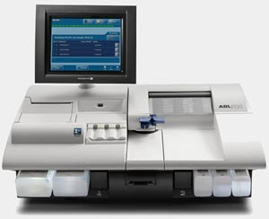
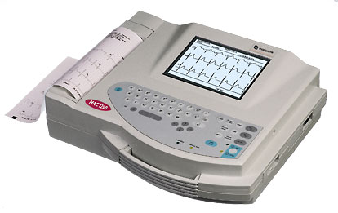
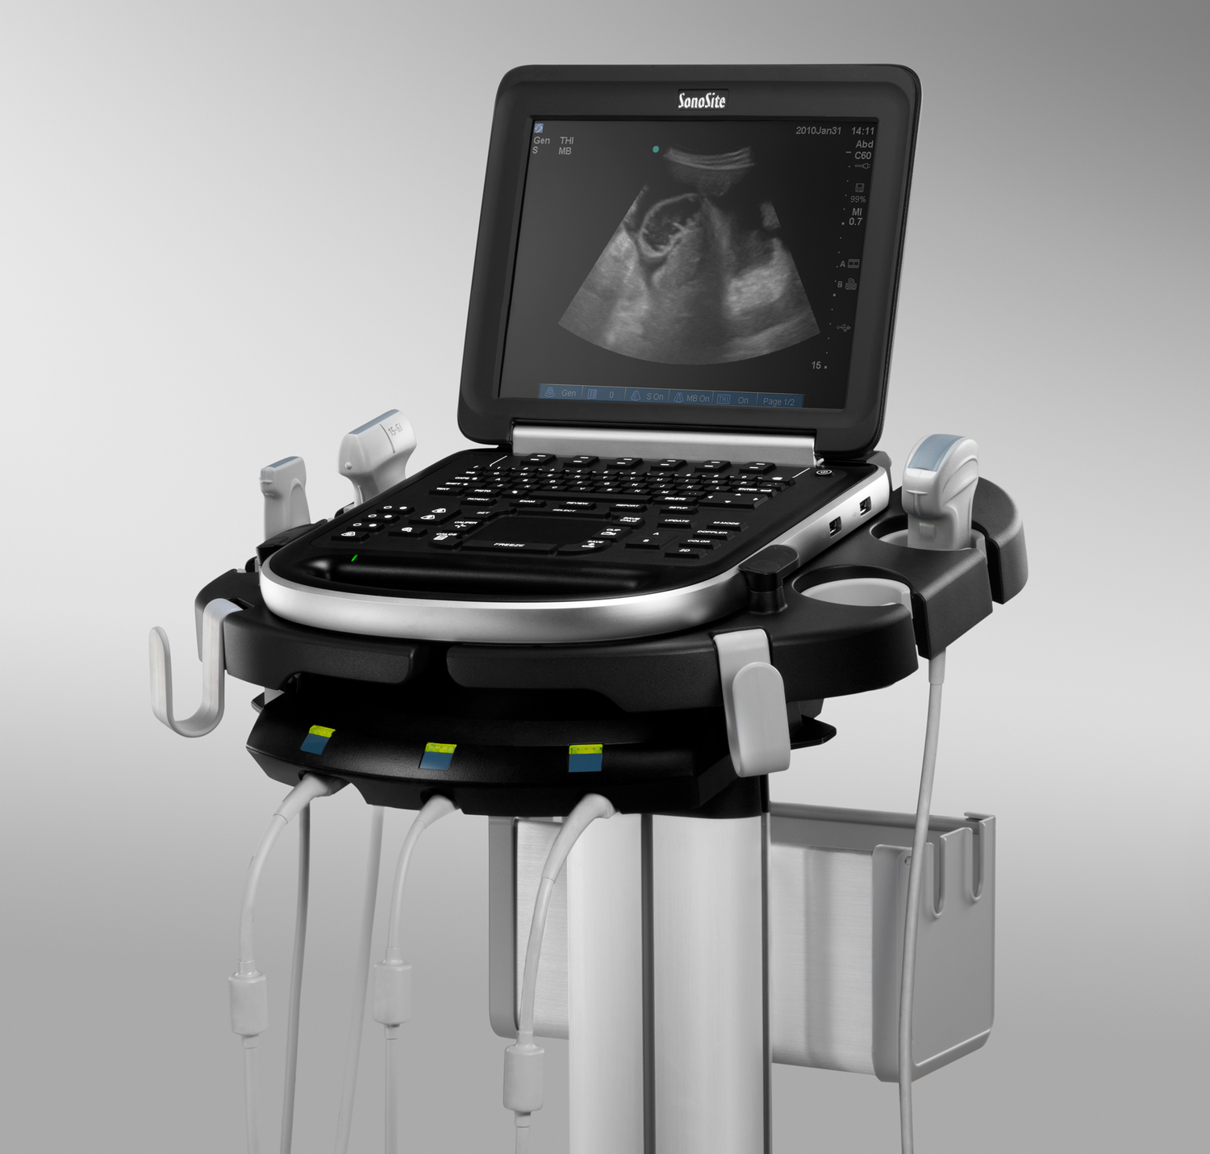
ABCDE+

Slide 21
Blodgas Värden pH 7,40 pCO₂ 5,3 kPa pO₂ 12,3 kPa cBase(Ecf)c -1,2 mmol/L cHCO3⁻(P,st)c 25,1 mmol/L Oximeter Värden sO₂ 98,0 % cHb 135 g/L FMetHb 1,7 % FCOHb -0,7 % Elektrolyt Värden cNa⁺ 142 mmol/L cK⁺ 4,0 mmol/L cCa²⁺ 1,2 mmol/L cCl⁻ 105 mmol/L Metabolit Värden cGlu 5,0 mmol/L cLac 1,0 mmol/L cCrea 85 μmol/L Beräknade Värden Anjongap 12 mmol/L
Läst högt genom de viktiga värdena
Ytlig syra-bastolkning:
Dominant rubbning?
Föreligger kompensation?
Är AG högt?
Ytlig differential

Slide 22
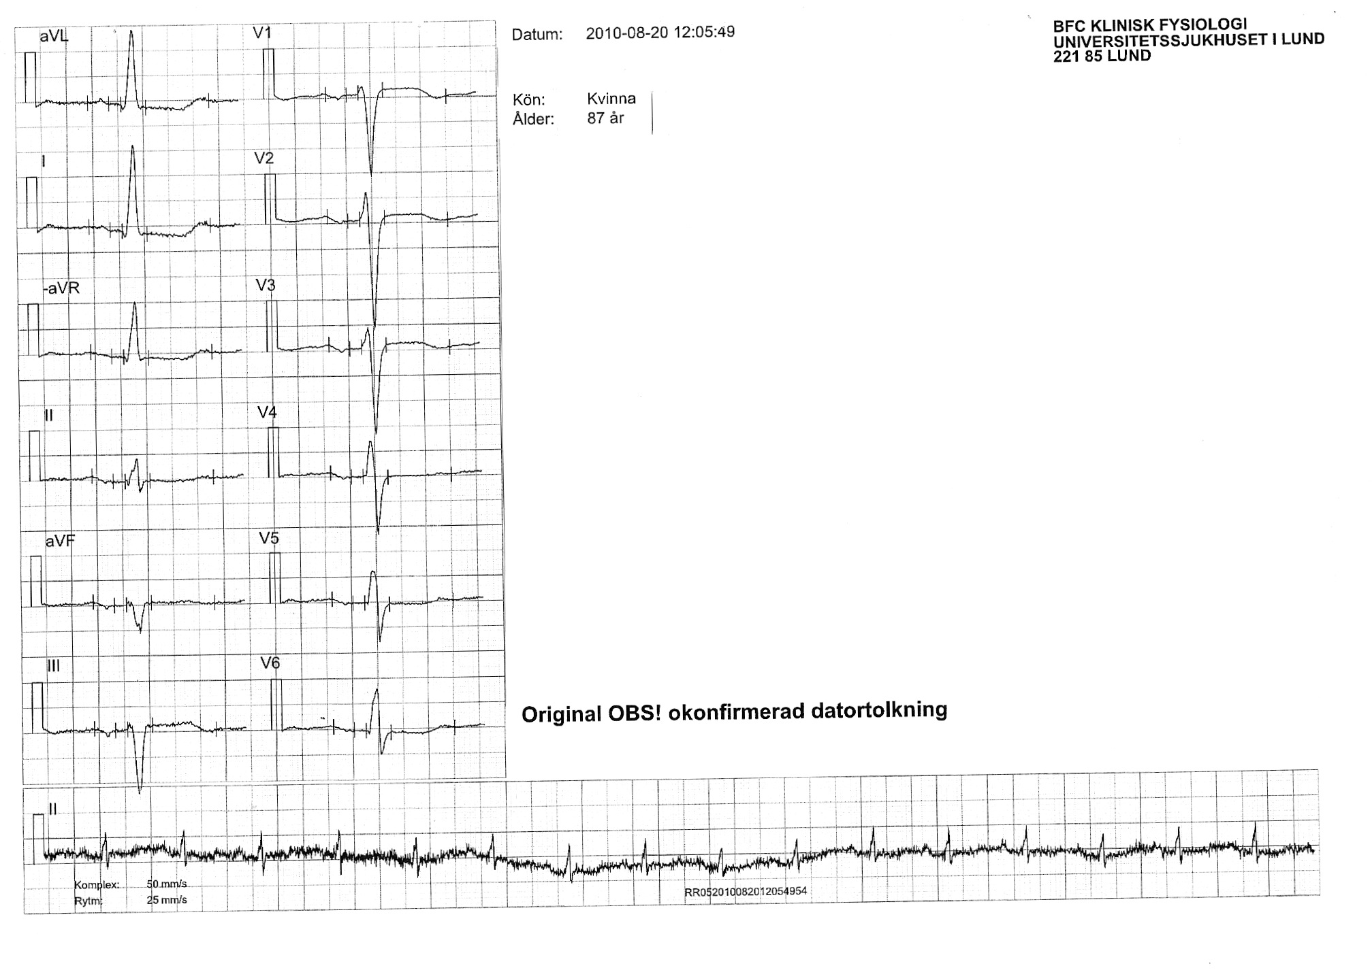
Ytlig EKG-tolkning:
Regelbundenhet?
QRS-komplex: smala/breda?
ST-sträckor: höjda/sänkta?
T-vågor: stora/inverterade?
Tolkning: rytm +/- övrigt

Slide 23
Regelbunden
Smala QRS-komplex
ST↓ lateralt, ST↑ III + V1-3
Negativa T-vågor V1-V3 + III
Sinus rytm + ischemi eller belastning

Slide 24
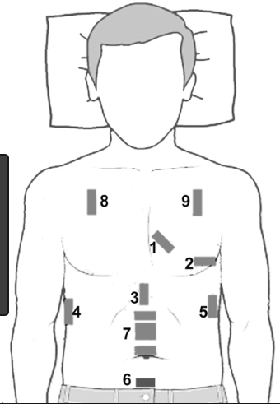
Riktade undersökningar
Kort screen:
Hjärta subkostalt
IVC eller IJV
Juice: R1 + R4 + L1 + L4

Slide 25
Syndrom handläggning
Handläggs när syndromet identifieras
Syndrom 1
Synkope
Svullen tunga
Expiratoriska sibilanta andningsljud
Syndrom 2
Trauma
Ensidiga nedsatta andningsljud
Ingen radialispuls

Slide 26
Sign-Out
– | Huvudtillstånd
Vad? | Fortsatt vård
Var? | Avdelning, röntgen, Op
Vem? | PAL
Hur? | Transport: personal/utrustning
+ | Åsikter-förslag?

Slide 27
Sign-Over
S | Misstänkt diagnos/nyckelfynd
b | beroende på vad PAL vill veta
a | beroende på vad PAL vill veta
r | beroende på vad PAL vill veta

Slide 28
Sekventiellt
Simultant
A
A
B
C
D
E
B
C
D
E
Blandning

Slide 29
4 nyckelroller
Leader
Fluids
Vitals
Scribe

Slide 30
Sign-In
ABCDE
Ultraljud? Ingrepp?
Syndrom behandling
Sign-Out
Leader
Ultra-
ljud

Slide 31
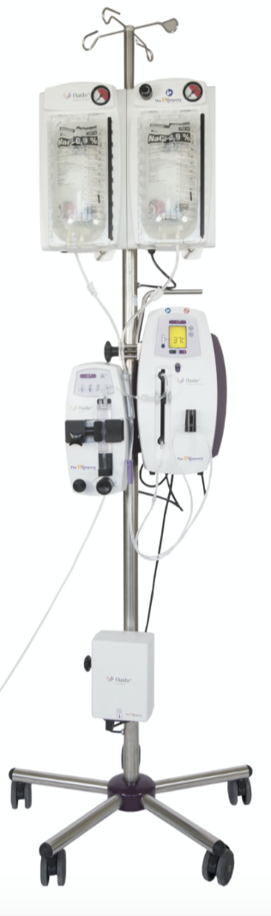
PVK? IO?
Blodprov
Krystalloid? Blod?
Läkemedel?
Fluido
Stick-vagn
Fluids

Slide 32
SpO₂, AF, BT, Temp
EKG (3 +/- 12 lead)
Följa VP, medvetande, smärta
NIV? KAD? Gips?
Monitors
Vitals

Slide 33
Dokumenterar
Checklistor
Telefonsamtal
Koll på tid
Scribe

Slide 34
Sign-Over
Konsult

Slide 35
Teamarbete
Ledare
Strukturerar arbete
Skapar samsyn
Lyhörd till förslag
Vågar fatta beslut
Medlem
Gör sina uppgifter
Öva closed-loop
Rapporterar problem
Bidrar med förslag
Ta inte över ledarskap

Slide 36
Team-Leader Nivå 2
1-Sign-in | Förbereder teamet
2-ABCDE | Letar efter och åtgärdar problem
3-Syndrom | Åtgärdar syndrom när det känns igen
4-Sign-out | Planerar för fortsatt vård

Slide 37
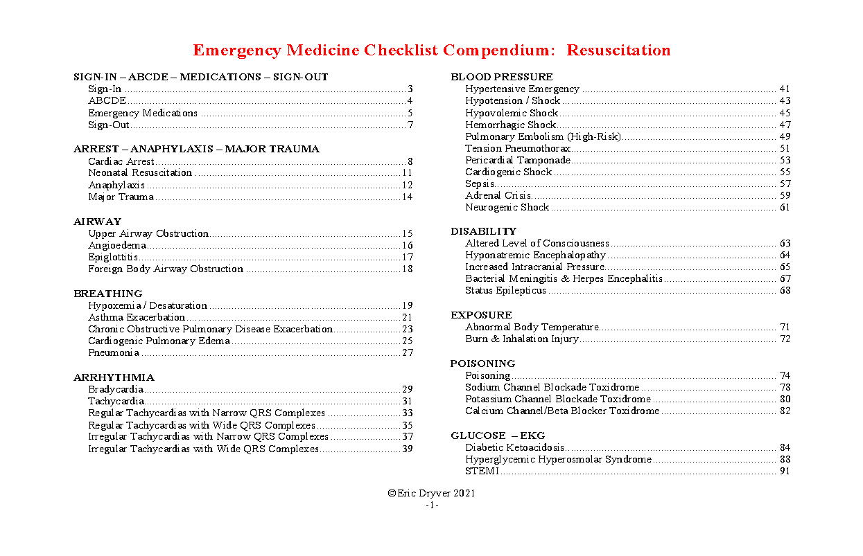

Slide 38
Vårdpersonal
Multikompetent
Hands on!
Stödjer teamleadern
Closed-loop

Slide 39
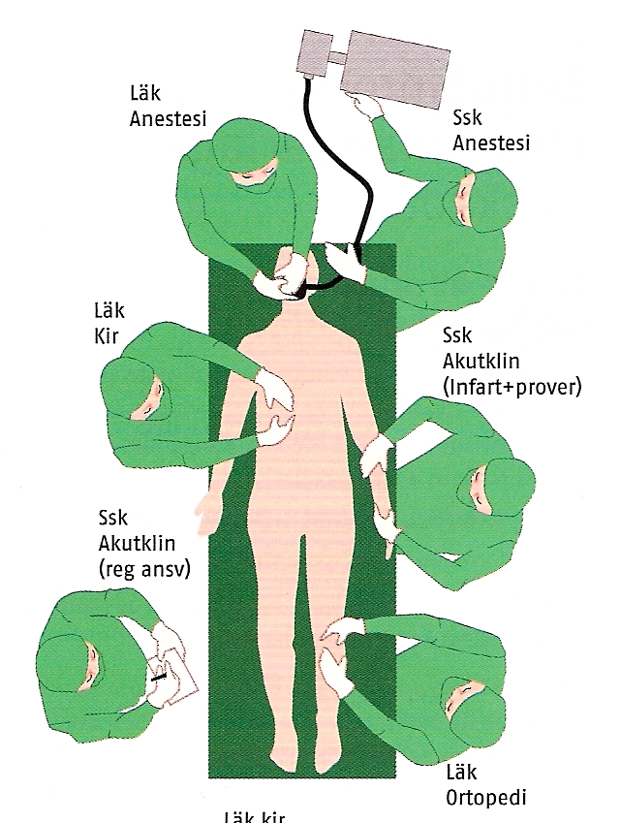
Dokumentationsansvarig
Fyller i checklistan
Antecknar det som är gjort
Kan söka övriga personal

