Slide 1
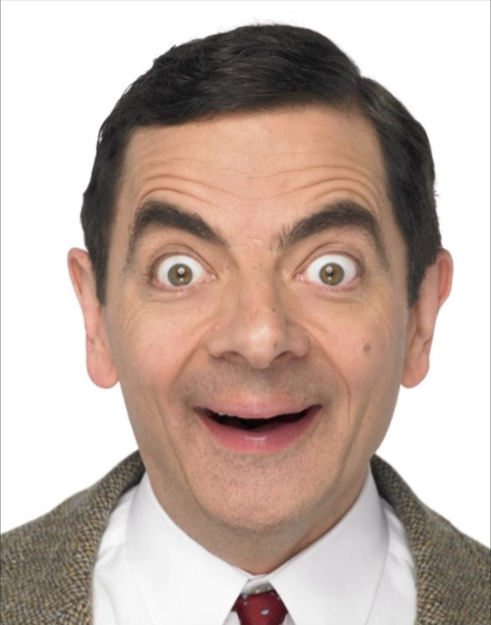
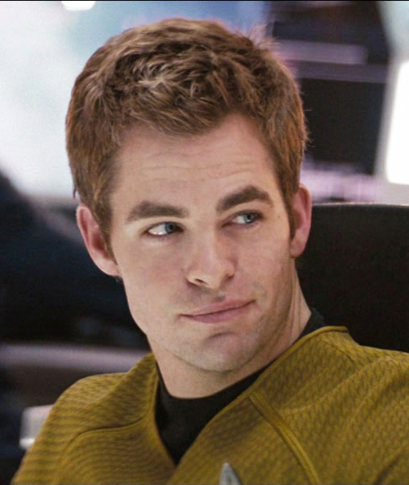

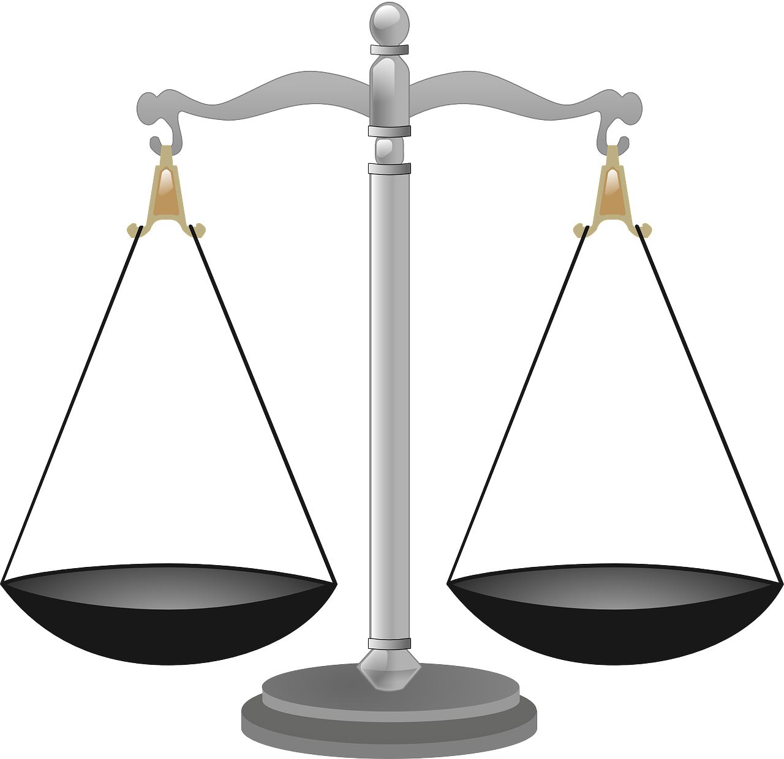

Diagnostik
& beslutsfattande

Slide 2

“diagnostic errors have represented a blind spot in the delivery of quality health care”
“continue to harm an unacceptable number of patients”
Notes:
In 2015, the Institute of Medicine published ”Improving Diagnosis in Health Care” to emphasize the importance of getting the diagnosis right and the impact of diagnostic errors.
They argue that diagnostic errors have represented a “blind spot in the delivery of quality health care” and “continue to harm an unacceptable number of patients”

Slide 3
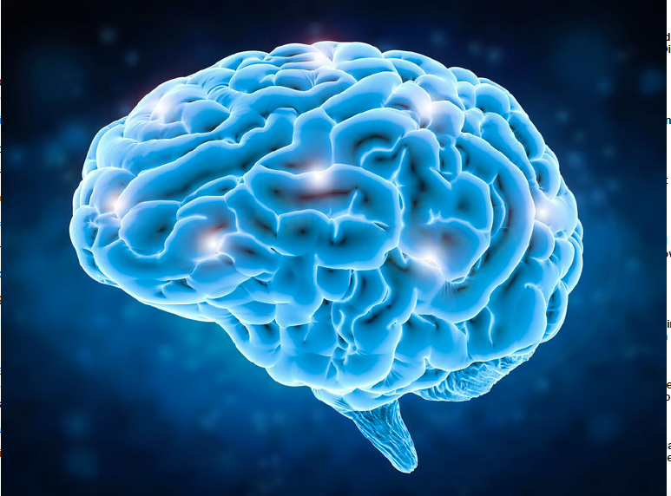
Diagnostic Errors: Causes
System-Related Errors
Limited time/data
Multitasking
Interruptions
Equipment failure
No-Fault Errors
Uncooperative patient
Cognitive Errors
Notes:
“the majority of errors that do occur result, at least in part, from the individual doctor’s cognitive processes" {Norman, 2010 #2502}, citing {Graber, 2005 #90}.
Photo: Brain concept (stock illustration) Credit: pholamaiphoto / Fotolia

Slide 4

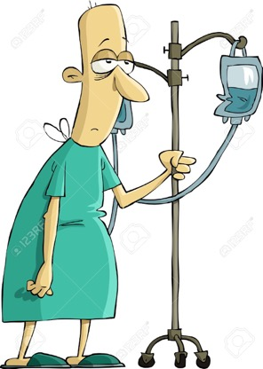

Tänka på rätt diagnos
Problem
Bröstsmärta
Takykardi
Förhöjt CRP
Diagnos
AKS?
Ångest?
Pneumoni?
Notes:
Patienten söker med olika problem
Läkaren träffar patienten, samlar data och börjar överväga olika diagnoser

Slide 5

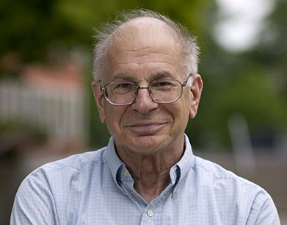
Daniel Kahneman
Notes:
So how does diagnostic reasoning work? How does thinking work in general?
Daniel Kahnemanan Israeli-American psychologist and winner of the 2002 Nobel Memorial Prize in Economic Sciences. He is notable for his work on the psychology of judgment and decision-making, behavioral economics and hedonic psychology.
With Amos Tversky and others, Kahneman established a cognitive basis for common human errors which arise from heuristics and biases (Kahneman & Tversky, 1973; Kahneman, Slovic & Tversky, 1982; Tversky & Kahneman, 1974), and developed prospect theory (Kahneman & Tversky, 1979). He was awarded the 2002 Nobel Memorial Prize in Economics for his work in prospect theory.

Slide 6
System 1
Omedveten
Mönster igenkännande
Hoppar till slutsatser
Ej ansträngande
Notes:
2017 Norman: ”automatic, unconscious, seemingly effortless, intuitive, heuristic”

Slide 7
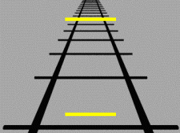
Notes:
Coherence.
And for the most part, this is a great feature. We do need to interprete information within its context

Slide 8
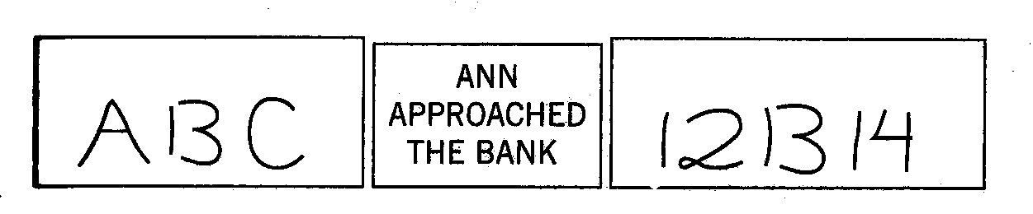

Slide 9
System 2
Medveten
Analytisk
Regel-baserad
Ansträngande
Notes:
2017 Norman: ”controlled, conscious, effortful, reflective, analytic

Slide 10
System 2 är ansträngande
”The defining feature of System 2 . . . is that its operations are effortful”

Slide 11
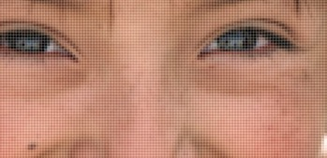
Bristfällig information
Notes:
One source of diagnostic errors is insufficent data. Here, it is obvious that we lack information to recognize the person. But our System-1 is designed to jump to conclusions and can construe a very good story based on insufficient information. Our system-1 is not designed to pick up that too little information is available.
The acronym Kahneman uses is What You See Is All There Is (WYSIATI)

Slide 12
Ung man
Smärta höger fossa
Kräkning
Vilken diagnos tänker man på?
Smärtan nådde max intensitet inom minuter
Inga peritonitretning
Urinstick 4+ röda
Vilken diagnos tänker man på?

Slide 13
Att hoppa till slutsatser
”System 1 is designed to jump to conclusions from little evidence—and it is not designed to know the size of its jumps.”

Slide 14
Att hoppa till slutsatser
”System 1 is designed to jump to conclusions from little evidence—and it is not designed to know the size of its jumps.”
”The amount of evidence and its quality do not count for much, because poor evidence can make a very good story.”

Slide 15
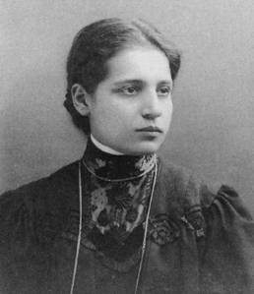
Bristfällig kunskap
Lise Meitner
Notes:
Another source of diagnostic error is insufficient or faulty knowledge. Does anyone recognize this person? This is Lise Meitner, whom many historian think should have been awarded the nobel prize for understanding nuclear fission.
With pictures of people, we either recognize the person or not. But with clinical data, it is more complex.

Slide 16
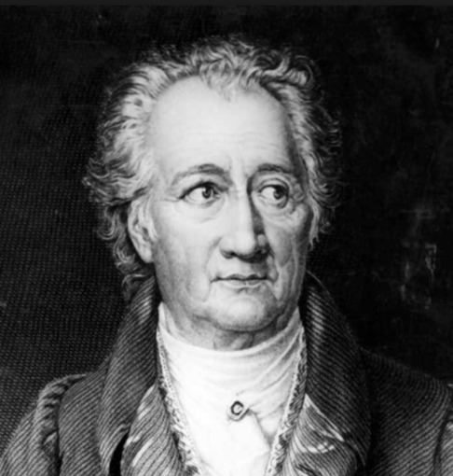
“Man sieht nur, was man weiß”
Johann Wolfgang von Goethe
Notes:
We are likely to see what we know. So if we don’t know what a zebra looks like, we might not see the stripes and we recognize a horse instead.

Slide 17

Notes:
So this is a short lecture about diagnosis and diagnostic errors.
When we talk about zebras versus horses, we are talking mainly about an uncommon condition, a zebra, that is misakenly diagnosed as a more common condition, a horse.
The focus of the analogy is on the false positive.

Slide 18

Bristfällig tolkning
Notes:
The third source of diagnostic error is faulty or insufficient data interpretation. Here in this pictures, there is a lot of data. The picture can be interpreted as that of a young woman or that of an old woman. The problem is that we can only see one interpretation at a time.

Slide 19
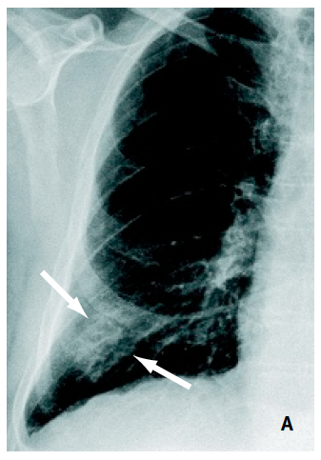
Premature Closure
Feber
Dyspné
Hosta
Pleuritisk bröstsmärta
Förhöjda vita & CRP

Slide 20
Diagnostic Error: Definition Institute of Medicine
Failure to
establish accurate and timely explanation of the patient’s health problem(s)
Failure to
Communicate that explanation to the patient
This is a problem with communication, not a problem with diagnosis
This definition does not make sense within the realm of Emergency Medicine
Notes:
So: what is a diagnostic error? The Institute of Medicine defines a diagnostic error as ” ”.
I don’t feel that this definition is applicable within the context of Emergency Medicine.
First of all, we are a the forefront of the diagnostic process. We have limited time to work-up the patient
We also have limited information.
And then there is a hindsight bias issue. For example, let’s say I suspect that a patient might have sepsis. I ordered blood cultures, administer antibiotics and fluids and admit the patient. 5 days later, the treating physicians conclude that the patient has some obscure vasculitis. Did I commit a diagnostic error?
It could even be that the physician suspected pneumonia for the wrong reasons, and that pneumonia ended up being the correct diagnosis. Was the physician’s diagnostic process then correct?

Slide 21
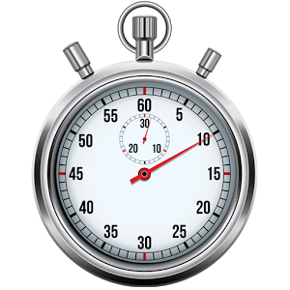
Tidskänsliga diagnoser
Där behandling inom minuter-dagar påverkar morbiditet & mortalitet

Slide 22

Tidskänsliga diagnoser
Lungemboli
Stroke
Aktiv GI blödning
Sepsis
Lungcancer
MS
Järnbrist anemi
RA

Slide 23
ALLVARLIG ≠ AKUT

Slide 24
För varje symtom
Fåtal tidskänsliga diagnoser

Slide 25
Bröstsmärta
Akut koronart syndrom
Lungemboli
Aortadissektion
Mediastinit
Pneumothorax
Perikardit
Notes:
Det finns visst övriga allvarliga diagnoser som kan orsaka bröstsmärta, t ex övertrycks pneumothorax, esofagusruptur, ventrikeltakykardi. Men man upptäcker oftast dessa diagnoser när man inhämtar sin data (t ex VT på EKG är ganska uppenbart). Det finns åt andra sidan diagnoser som kan presenteras på ett mer subtilt sätt och där det finns en risk för att missa diagnosen pga ”premature closure.” Det är dessa som man bör överväga på ett medvetet sätt och som ingår i listan som finns på checklistkompendium.

Slide 26
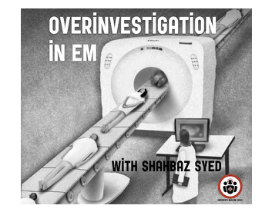
Over-Investigation
Notes:
Finally, all of us in medicine ought to be concerned about the risks of over-investigation and over-treatment.
Over-investigations harm patients and waste valuable health care resources.
The Institute of Medicine definition of diagnostic error does not address over-investigation, which is the flip-side of the diagnostic error coin.

Slide 27

MISSED DIAGNOSIS
”Type 1 Error”
OVERINVESTIGATION
”Type 2 Error”

Slide 28
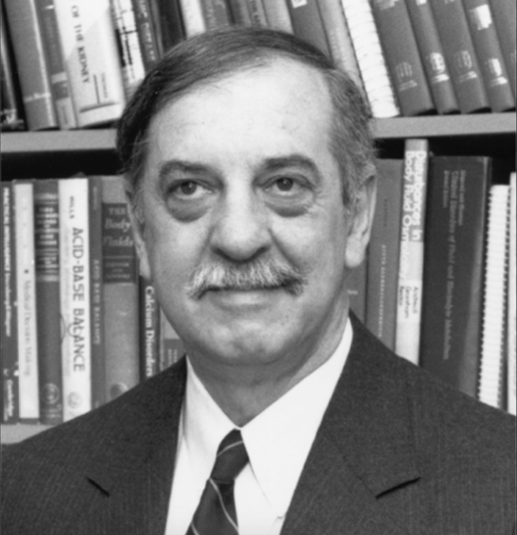
“Absolute certainty in diagnosis is unattainable, no matter how much information we gather ”
Jerome Kassirer
Notes:
Photo: Massachusetts Medical Society

Slide 29
Diagnostiskt misstag i akutsjukvård
Bristfällig sannolikhetsbedömning för tidskänsliga tillstånd utifrån tillgänglig patientnära information

Slide 30
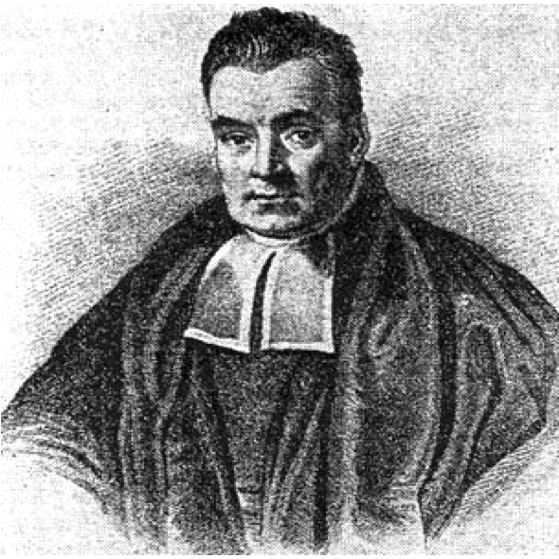
Bayes teorem
Thomas Bayes
1702-1761
Sannolikhet
Före prov
Efter prov

Slide 31

Bayes teorem

Slide 32
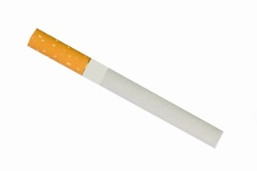
Före-prov sannolikhet
Notes:
We derive our pre-test probability by knowing the prevalence of a condition in our patient population.
If I meet an elderly smoker who presents coughing blood, I think lung cancer.
If I’m working in Pakistan and meet a young patient coughing blood, I think Tuberculosis.
We also take into consideration risk factors. The COVID pandemic is an on-going exercise in Bayesian reasoning. There was a brief period when a travel history to Italy or China was relevant when determining the likelihood of COVID.

Slide 33

MAPLES
Medications
Allergies
Past medical history
Life circumstances
Ethanol
Smoking

Slide 34
Bayes teorem

Slide 35
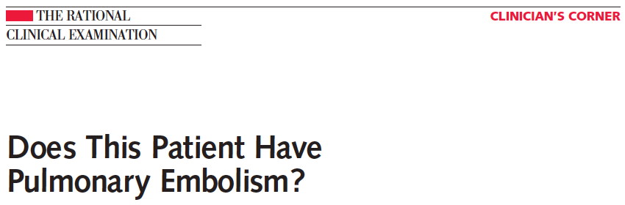
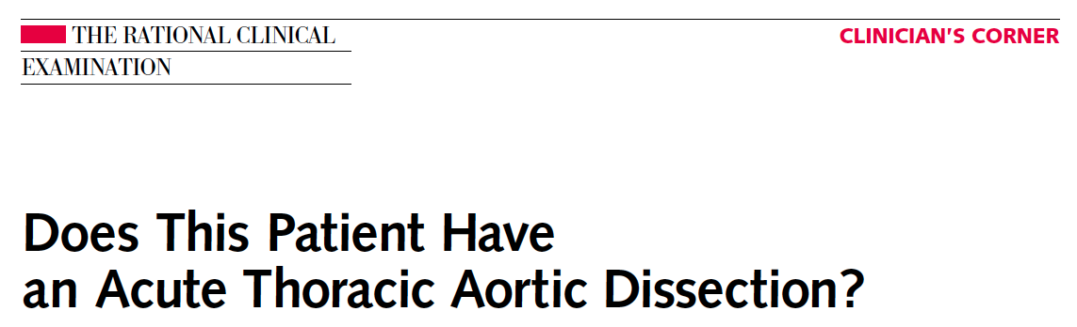
JAMA 2003;290
JAMA 2002;287

Slide 36
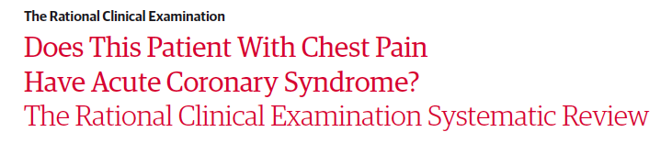
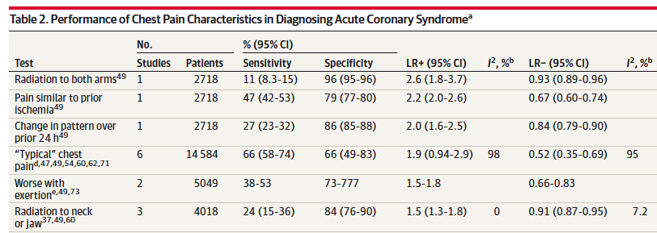
JAMA 2015;314

Slide 37

Sannolikhetskvot
Ideal vid Bayesianskt tänkande

Slide 38
Bröstsmärta
Onset
Position
Quality
Relieving / aggravating
Severity
Time
+ − bensmärta?
dyspné?
feber?
Vitalparametrar
Cor + bröstkorg
Lung
Övre buk
Ben
CRP
EKG

Slide 39
Clinical Decision Rules
Wells Score
Aortic Dissection Detection Score
Canadian C-Spine Rule
Ottawa Ankles Rule
Ottawa Subarchnoid Hemorrhage Rule

Slide 41
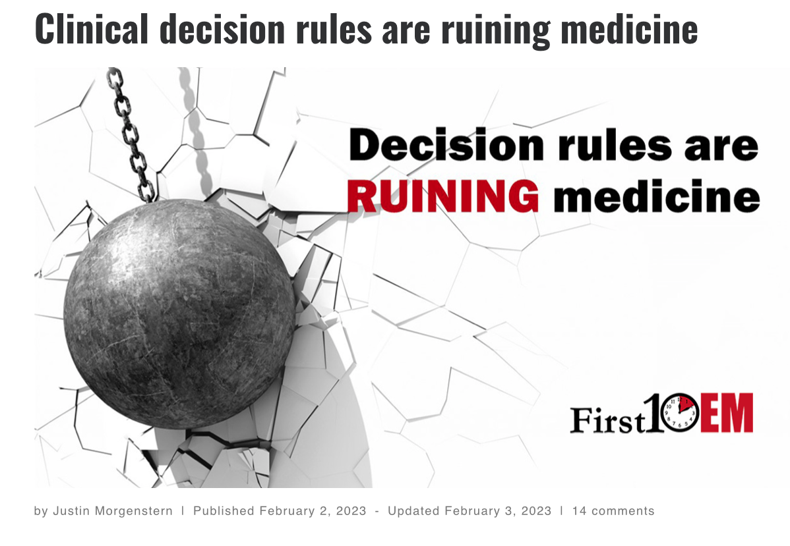

Slide 42
Sannolikheter påverkar varandra
Akut problem = 1 diagnos
Summa av sannolikheter = 1
Diagnos 1 ↑ Diagnos 2 ↓
Notes:
Sedan påverkas sannolikheten för olika diagnoser av varandra.
Det är så eftersom en patient med ett akutpåkommet symptom troligen lider bara av en diagnos.
Summan av sannolikheterna för potentiella diagnoser är 1 (100%)
Om sannolikheten för en potentiell diagnos ökar påverkar det sannolikheterna av övriga potentiella diagnoser.

Slide 43
50-årig med bröstsmärta
Summan av sannolikheterna: 100%
Notes:
En 50-årig patient söker till akuten med bröstsmärta.
Utifrån data från tidigare 50-åriga patienter som har sökt till akuten med bröstsmärta kan man uppskatta att patienten har en 10% sannolikhet för AKS, 0.1% sannolikhet för aortadissektion, enstaka procent sannolikhet för lungemboli, och resten är muskuloskelettalt och övriga diagnoser.
Nu träffar man patienten och frågar: ”Är din bröstsmärta värre när du ta ett djupt andetag?” Om patienten svarar ”Ja!”, vad har hänt med sannolikheterna för dessa diagnoser?

Slide 44
Smärta värre med inandning
Summan av sannolikheterna: 100%
Notes:
En 50-årig patient söker till akuten med bröstsmärta.
Utifrån data från tidigare 50-åriga patienter som har sökt till akuten med bröstsmärta kan man uppskatta att patienten har en 10% sannolikhet för AKS, 0.1% sannolikhet för aortadissektion, enstaka procent sannolikhet för lungemboli, och resten är muskuloskelettalt och övriga diagnoser.
Nu träffar man patienten och frågar: ”Är din bröstsmärta värre när du ta ett djupt andetag?” Om patienten svarar ”Ja!”, vad har hänt med sannolikheterna för dessa diagnoser?

Slide 45
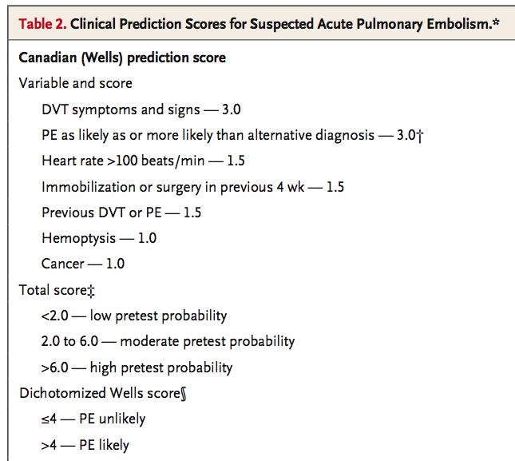
Wells score
Notes:
Återkoppling:
1-Team-leader: vad gjorde du bra?
2-Team-leader: vad skulle du göra annorlunda?
3-Observatör teamarbete: hur var det?
4-Checklista: återkoppling

Slide 46
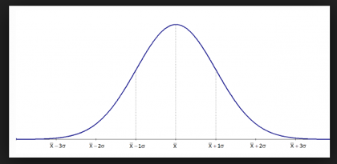
Gestalt
Illness Script = mental bild av hur tillståndet beter sig

Slide 47
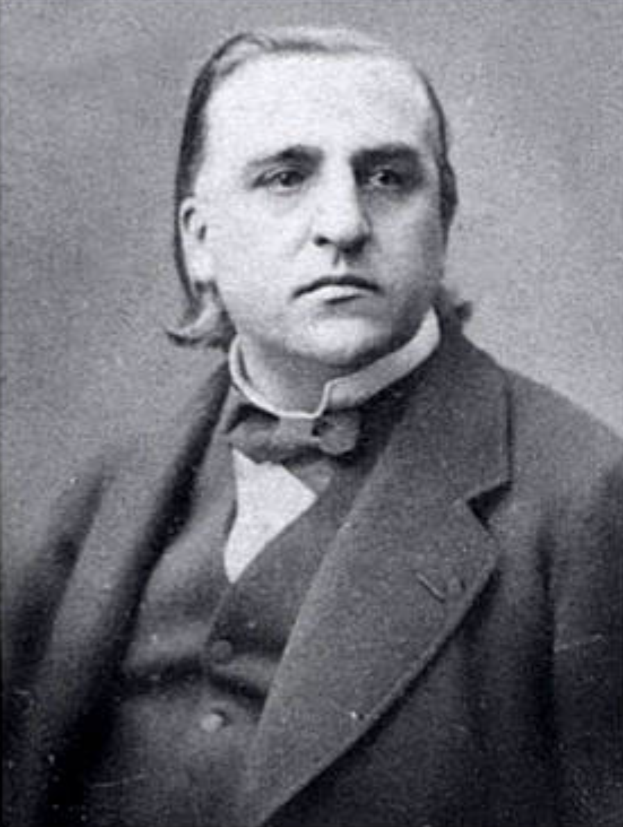
“La théorie c’est bon; mais ça n’empêche pas d’exister”
Jean-Martin Charcot
Notes:
We are likely to see what we know. So if we don’t know what a zebra looks like, we might not see the stripes and we recognize a horse instead.

Slide 49
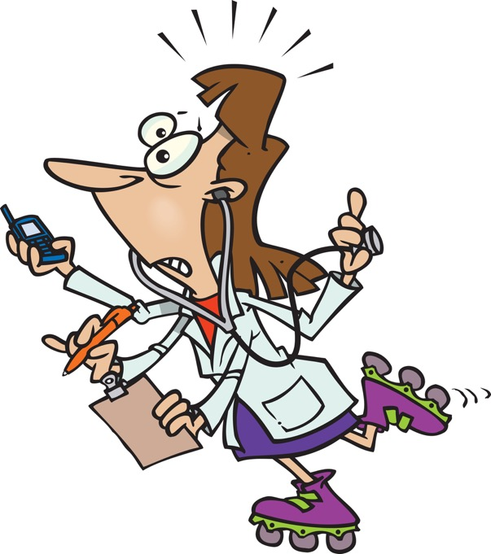
Notes:
Finally, this is how it feel during my shifts. I have very little control over how much time I can spend on various tasks. I spend most of my time reacting to events around me. If I have time for metacognition, it is after my shift, not during the shift.
So I need a strategy that is simple to use, robust (resistent to all this interruptions) and concrete. And a tool that helps me work with junior residents.

Slide 50
0 - 1 - 2
Notes:
Here’s the strategy that we advocate in our residency program: the 0-1-2 method.
Step 0 is symbolized here by Mr Bean. It is not cognitively challenging. It has to do with data acquisition, using a checklist.
During that time, System-1, Kirk, will spontaneously kick in and suggest diagnoses
Finally, it is time to activate System-2, Spock, but only for key diagnoses because Spock is tedious.

Slide 51
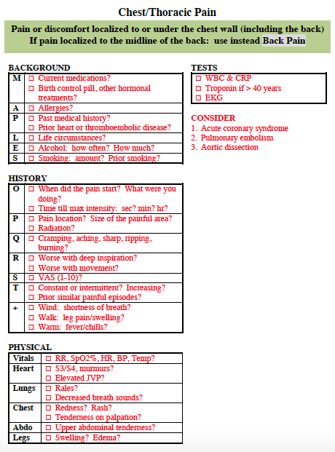
Notes:
Här finns information som påverkar ”före-prov” sannolikhet för olika diagnoser.

Slide 52
Perikardit?
Tietze?
Ångest?
Notes:
Här finns information som påverkar ”före-prov” sannolikhet för olika diagnoser.

Slide 53
Notes:
Till slut finns här viktiga ”don’t miss” diagnoser att överväga på ett medvetande sätt.

Slide 54
Notes:
Checklistcompendium, grön (symptoms) sida, sida 8.
Först handlar det om att hamna på rätt checklista. Notera specifikt att nomenklatur ”bröst/thorax/flank/buk/rygg” smärta kan vara oklart. Med ”Bröst/Thorax” smärta menas här smärta under bröstkorgen (inklusive ryggen) förutom i mittlinjen av ryggen.
Poängen är: viktigt att läsa noggrant texten med grön bakgrund.

Slide 55
Diagnostiskt misstag i akutsjukvård
Bristfällig sannolikhetsbedömning för tidskänsliga tillstånd utifrån tillgänglig patientnära information

Slide 56
Beslutsfattande
Fler prov?
behandling?
inläggning?

Slide 57
“Our task is . . . to reduce the level of diagnostic uncertainty enough to make optimal therapeutic decisions”
Jerome Kassirer
Notes:
Photo: Massachusetts Medical Society

Slide 58
Test/Treat Thresholds
Test / Treatment Threshold
Diagnostic Likelihood
No Treatment / Test Threshold
Notes:
The test and treat thresholds are not fixed in stone. They depend on the patient’s prognosis with and without investigation / treatment.
They are linked: if there is no treatment (i.e.no treat threshold), then testing for the condition is moot.

Slide 60
Disposition Thresholds
Admit
Discharge
Notes:
The test and treat thresholds are not fixed in stone. They depend on the patient’s prognosis with and without investigation / treatment.
They are linked: if there is no treatment (i.e.no treat threshold), then testing for the condition is moot.

Slide 61
Faktorer som påverkar
Utredningar:
Risker
Nytta
Behandlingar:
Risker
Nytta
Inläggning:
Risker
Nytta
Patientens värderingar
Anhörigas åsikter
Tillgängliga resurser
Notes:
When it comes to the final step of decision-making, I believe that Big Data will help us better estimate the risks/benefits of various investigations and treatments. Yet, decision-making also needs to take into account patient wishes and values, those of the patient’s relatives, and the availability of health care resources. I believe that decision-making will remain challenging regardless of how much support we get from artificial intelligence.

Slide 62
Diffall
Data
MAPLES
Anamnes
Status
Patientnära prov
Diskussion
Sannolikhetsbedömning för tidskänsliga tillstånd
Beslutsfattande

