Slide 1
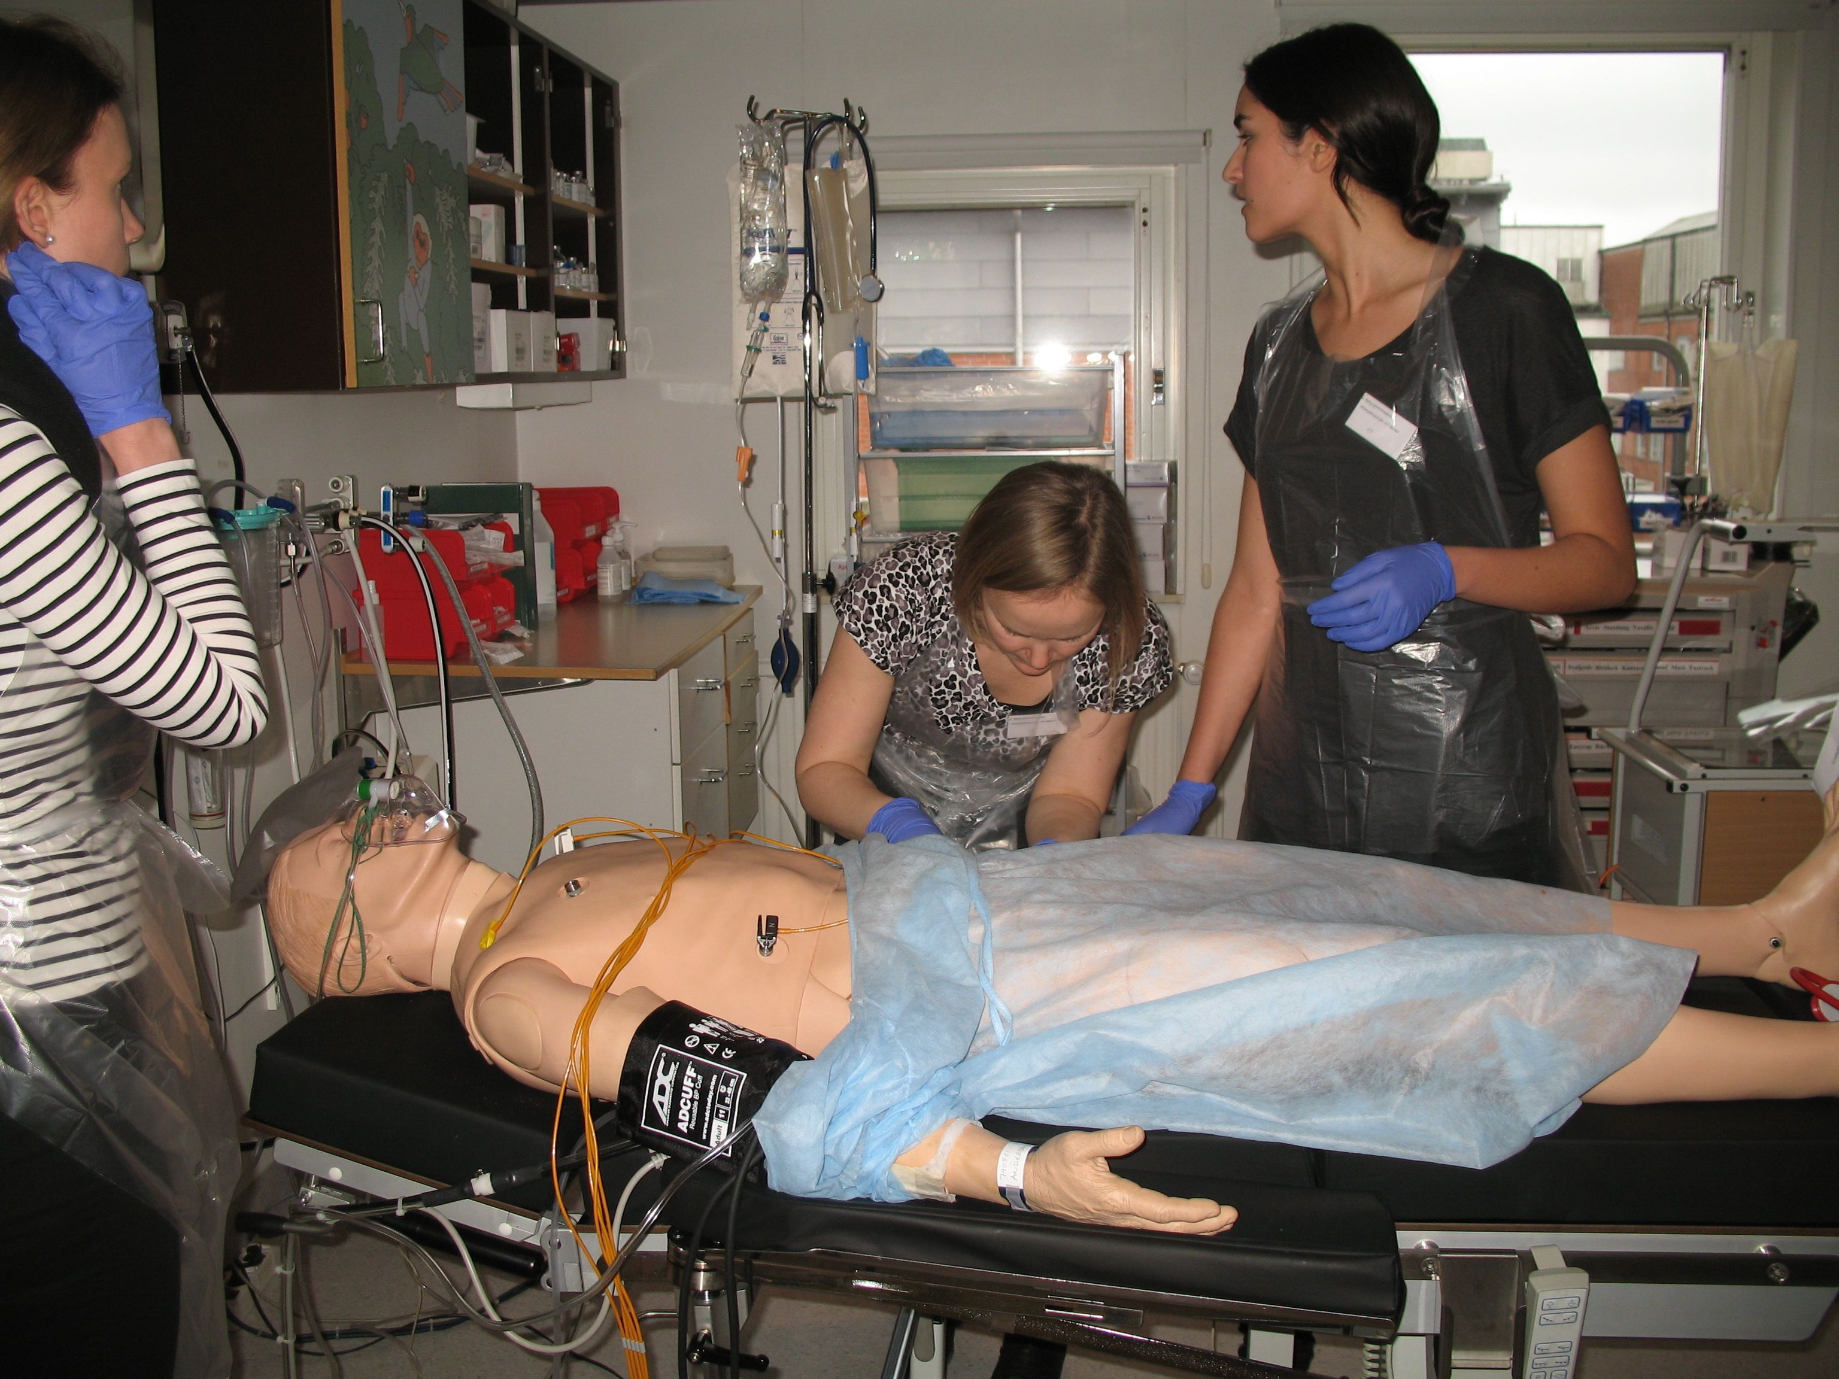
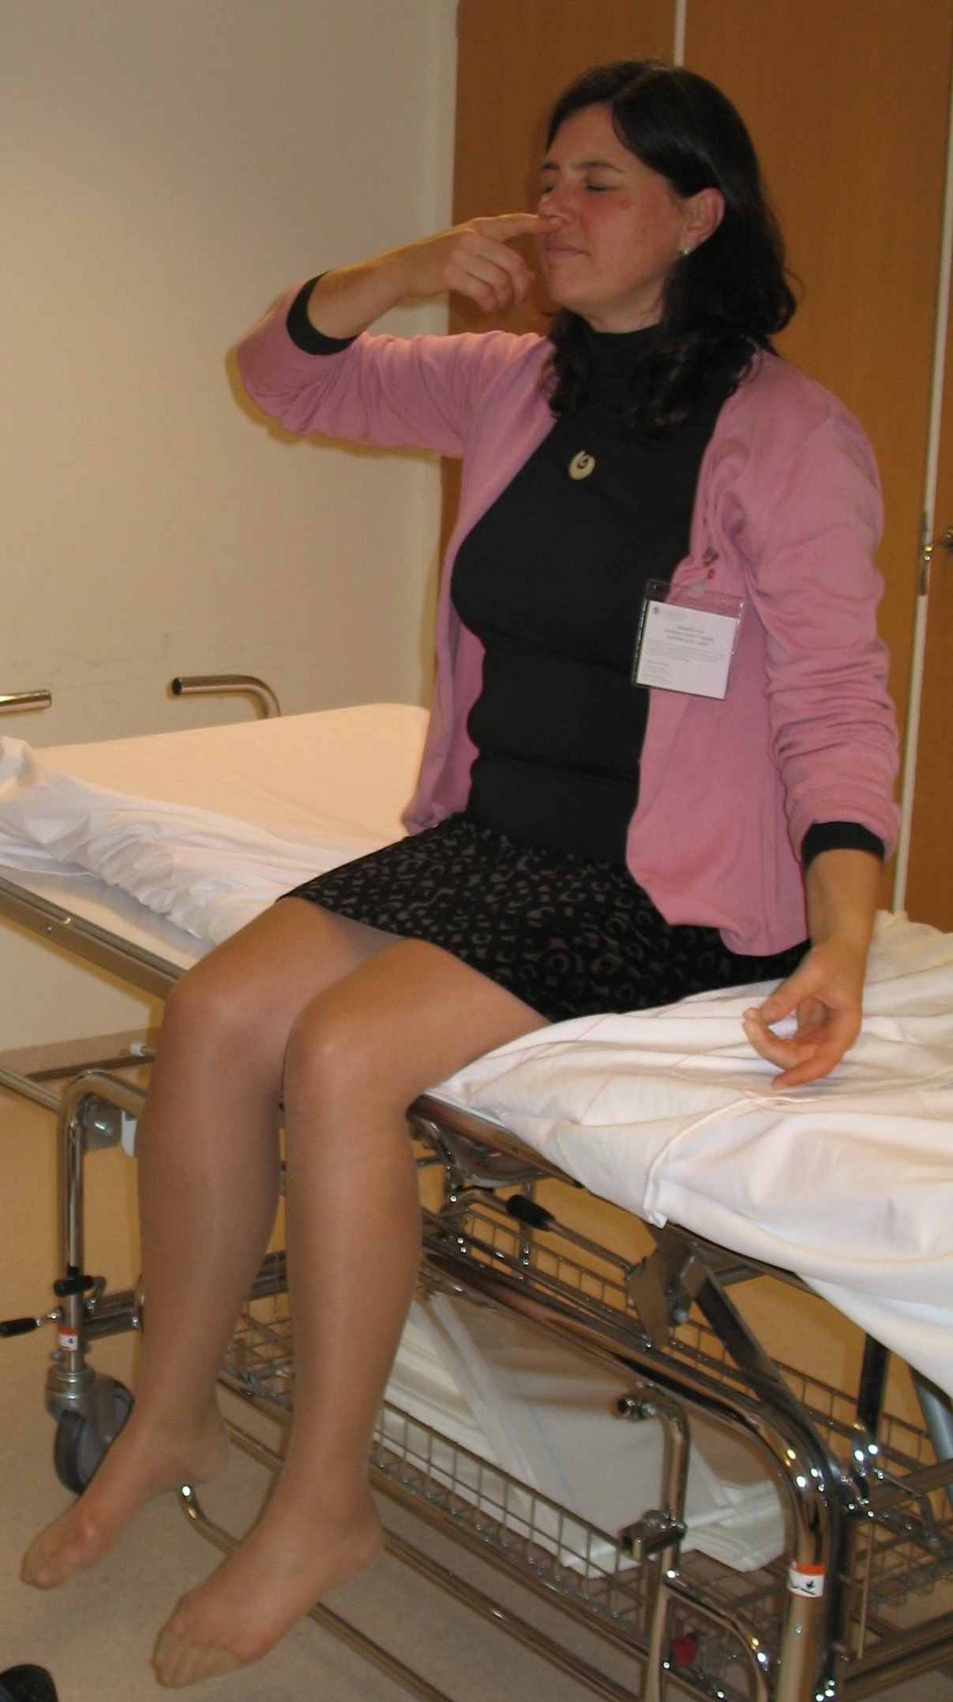
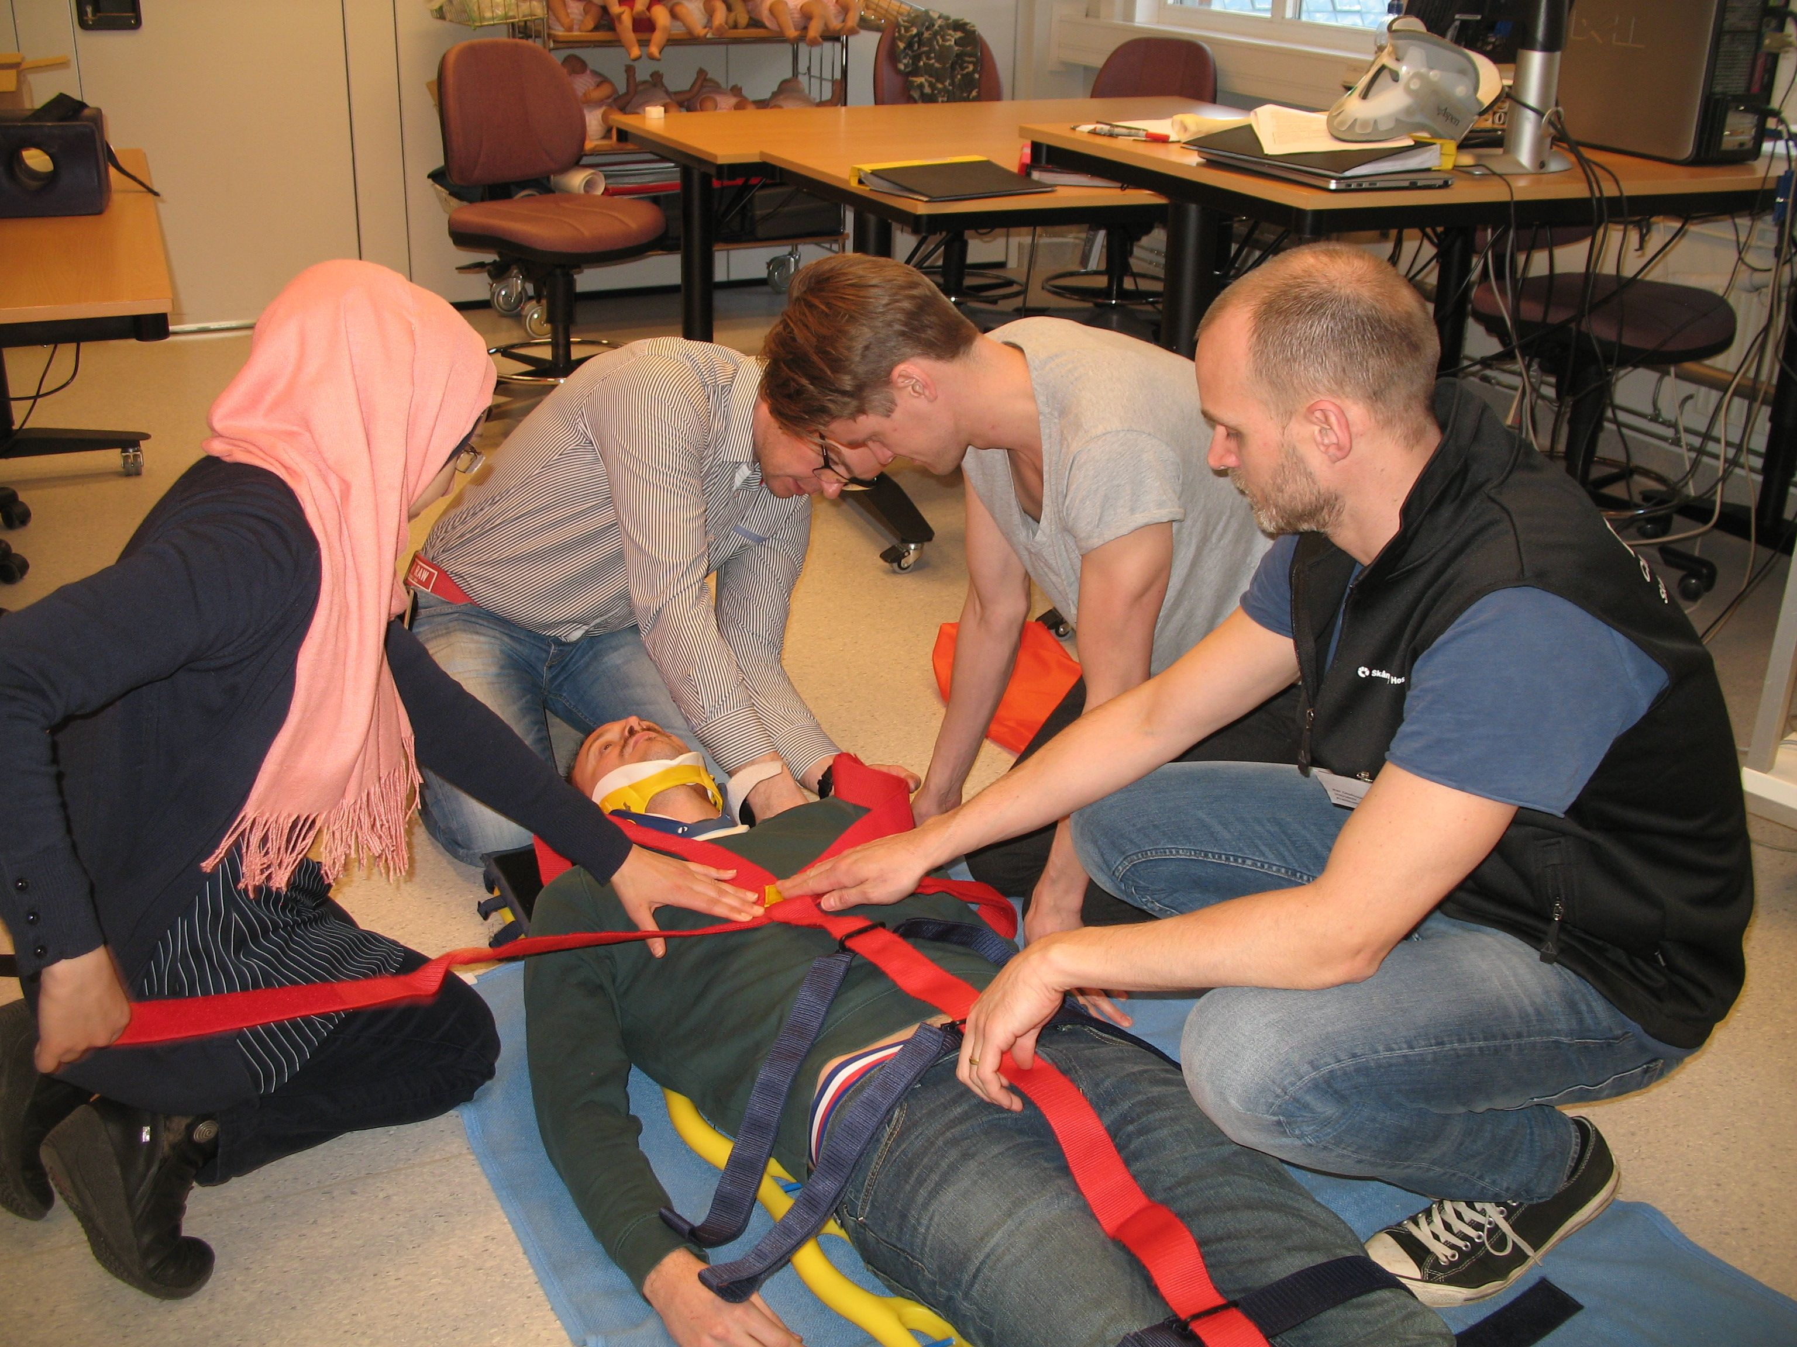
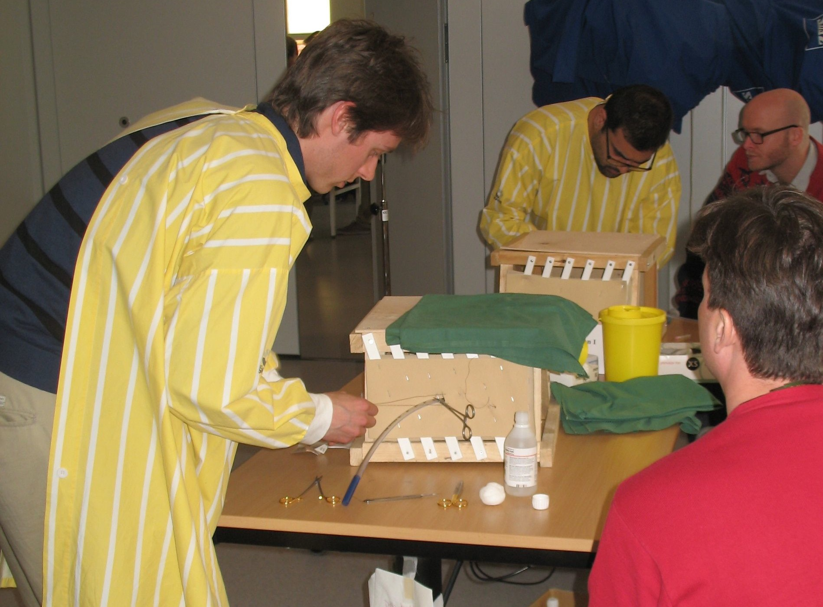
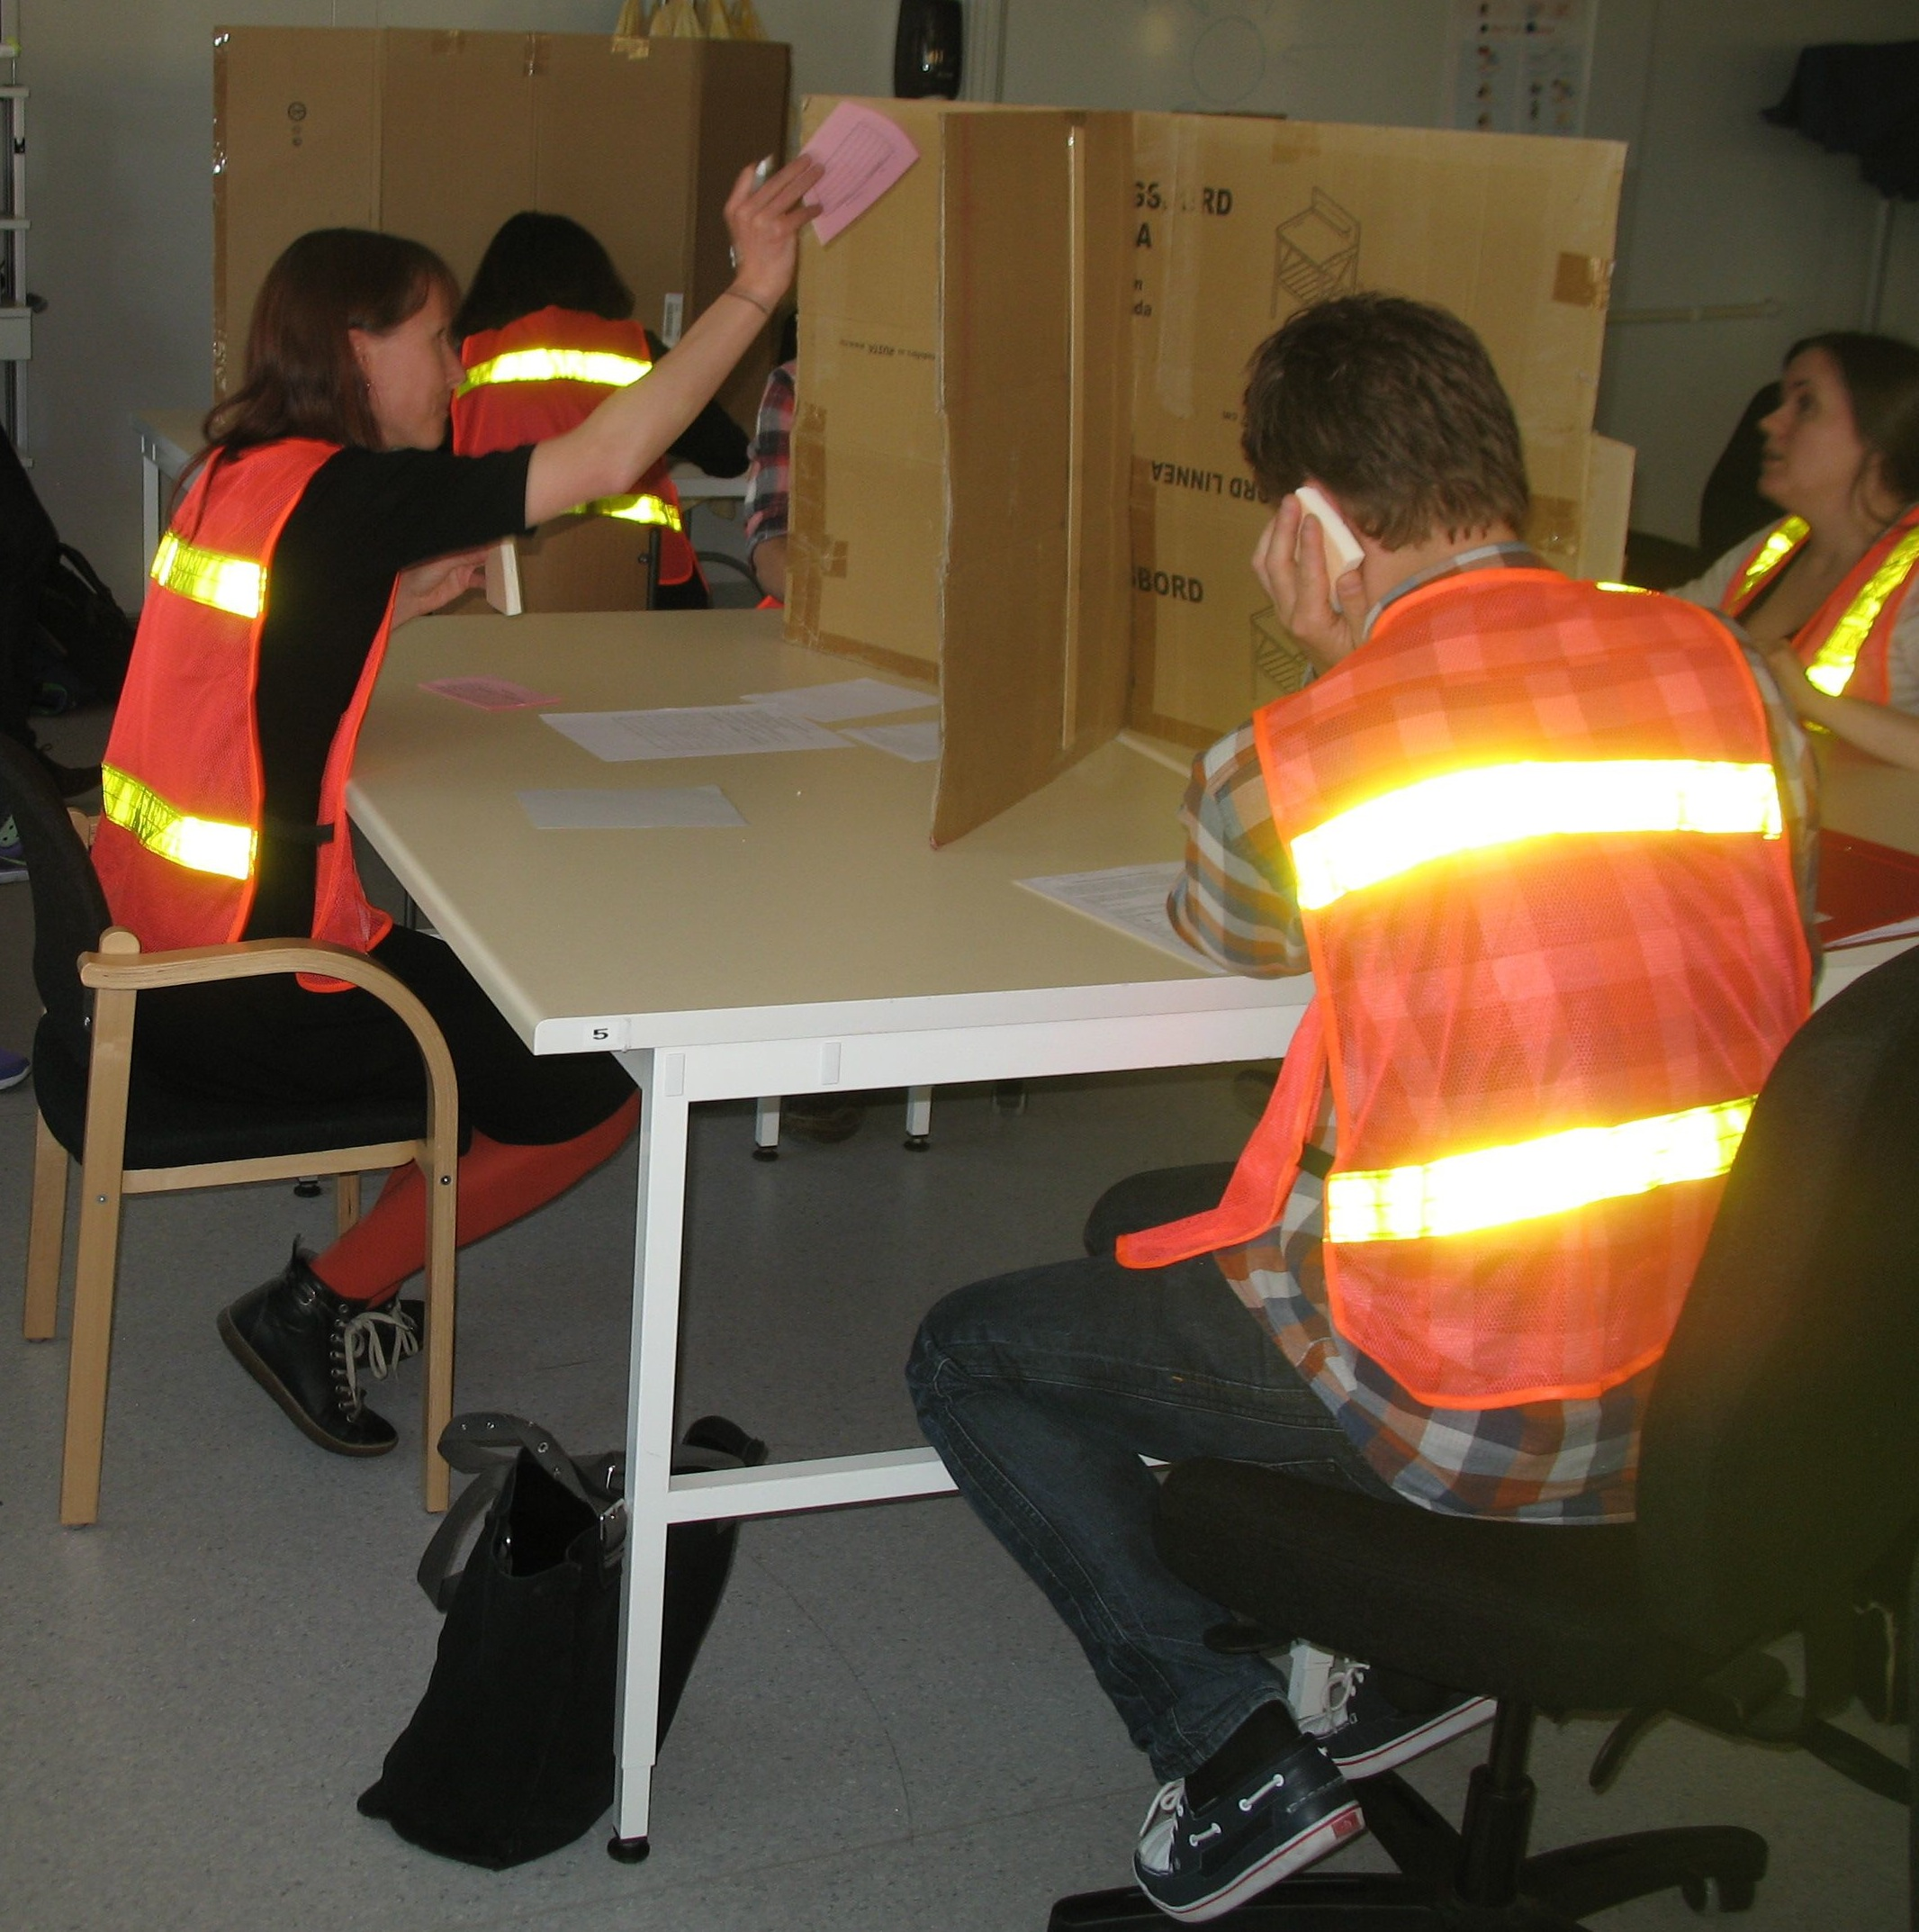
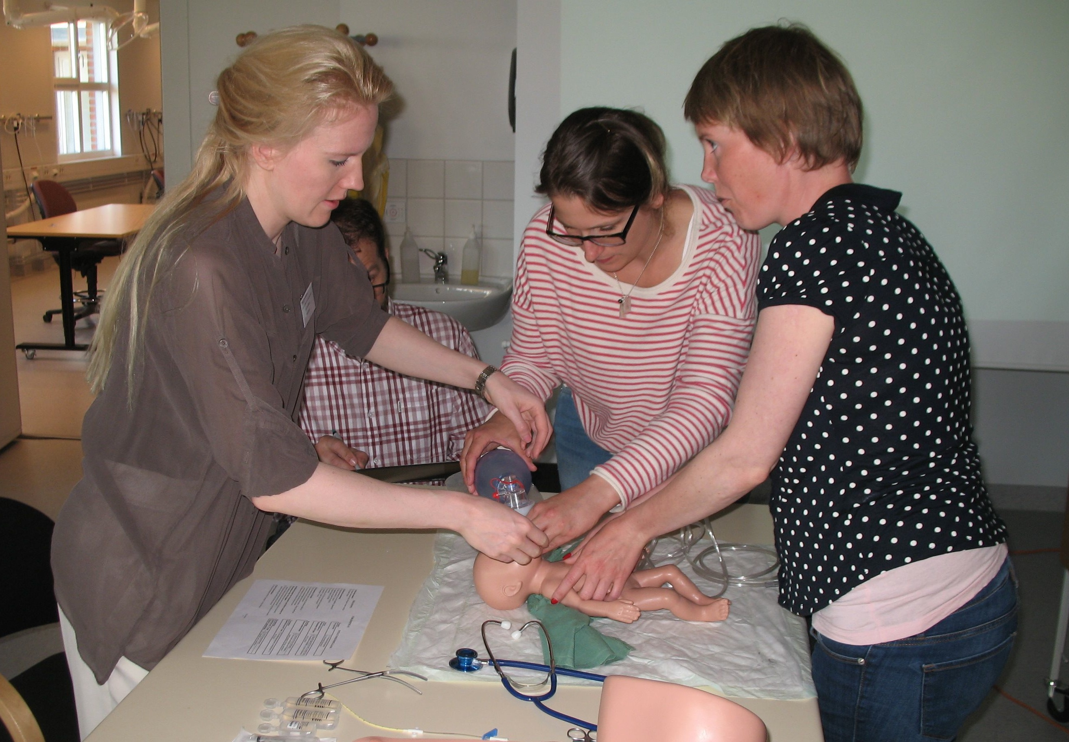
Akutsjukvård

Slide 2


Slide 3


Slide 4
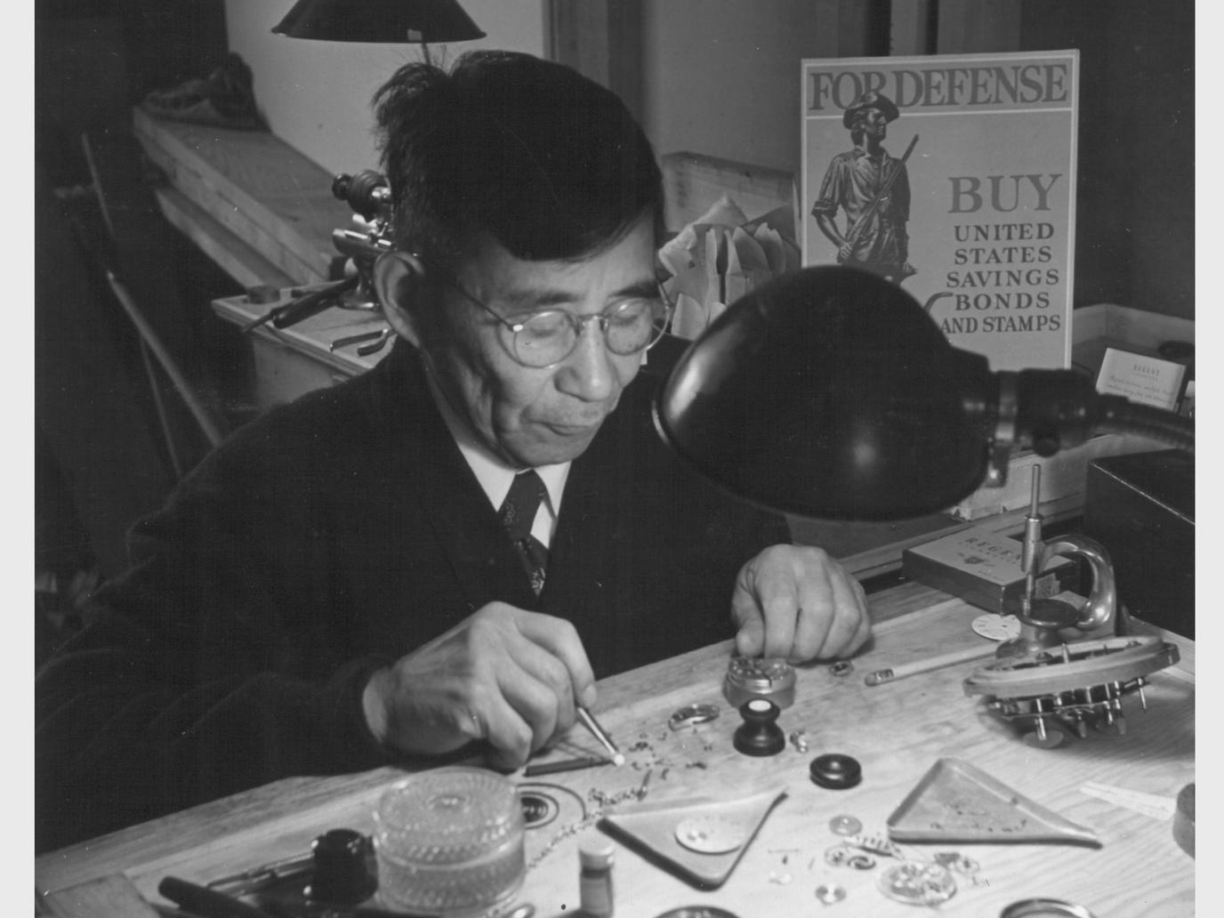

Slide 5


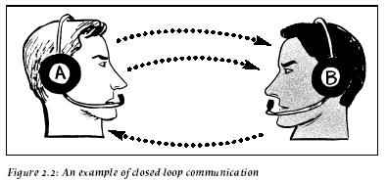

Slide 6


Slide 7
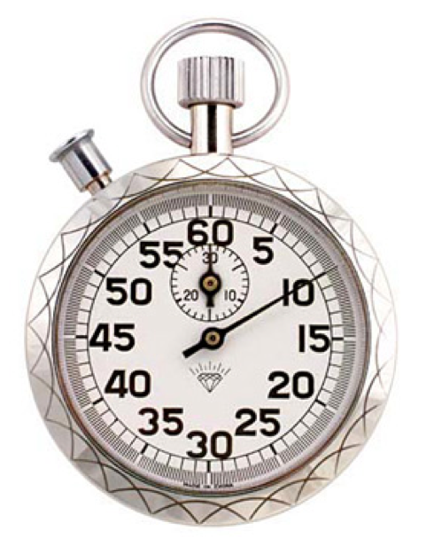

=

Slide 8
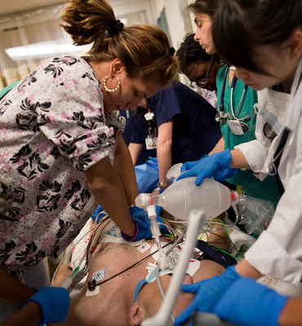
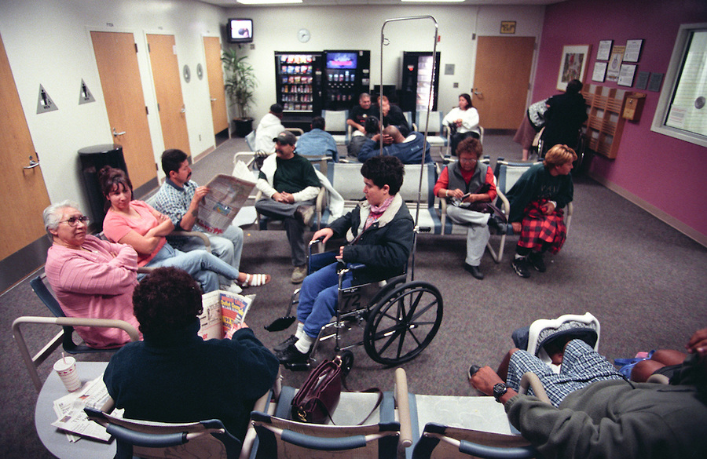
=

Slide 9
Mål
Svårt sjuka patienter
Diagnostik & beslut
Utvalda färdigheter
Organisation
Kommunikation
Effektivitet

Slide 10
Average Retention Rate
5%
Lecture
10%
Reading
20%
Audio-Visual
30%
Demonstration
50%
Discussion Group
75%
Practice by Doing
90%
Teach Others / Immediate Use
E. Dale, Audio-visual methods in Teaching. New York Dryden Press, 1954

Slide 11
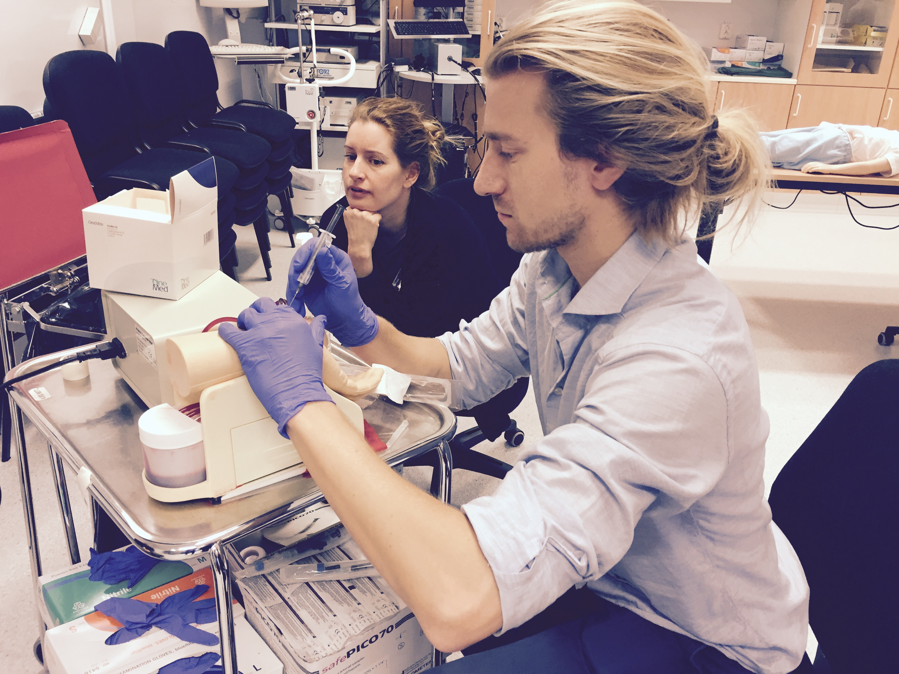
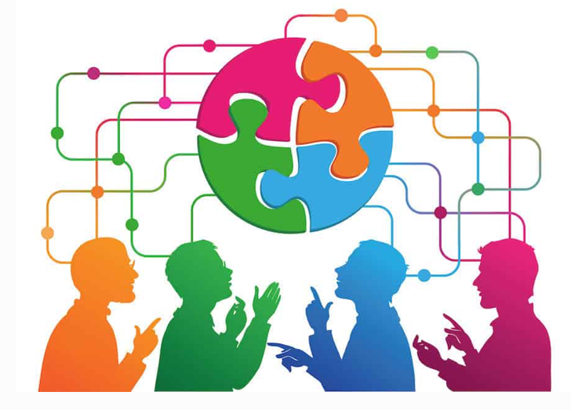
Metod
Öva!
Lära från varandra
”What the student does is actually more important in determining what is learned than what the teacher does.” T J Shuell

Slide 12

Ofarligt tillstånd………………………………….Livshotande
Vanligt tillstånd………………………………………Ovanligt
Typisk presentation…………………………………...Atypisk

Slide 13


Scenarioövningar
. . . med fokus på
livsthotande
ovanliga
atypiska

Slide 14


Slide 15

Notes:
Detta är en snäll hund!
Detta är en snäl kurs! Vi har alla styrkort och brister.

Slide 16
Psychological safety
Civility matters

Slide 17
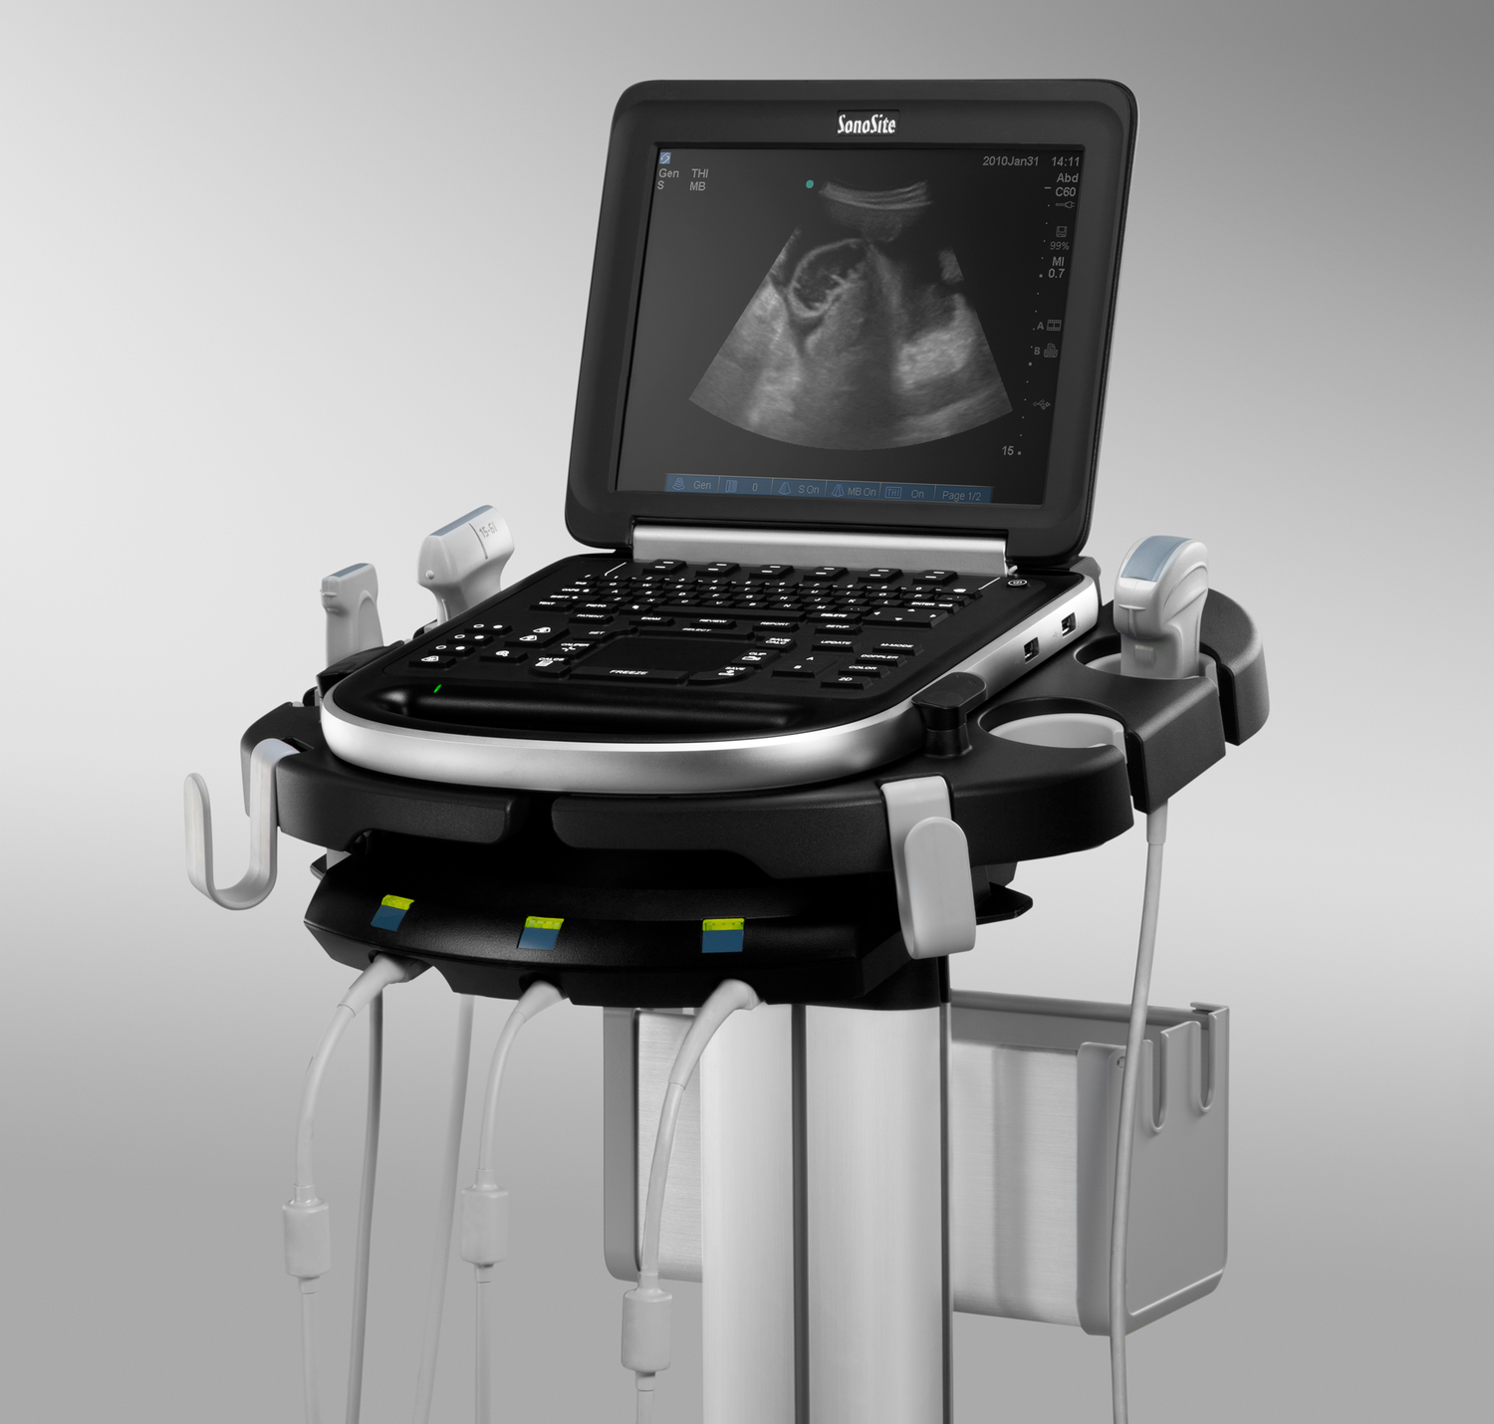
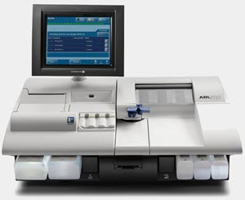
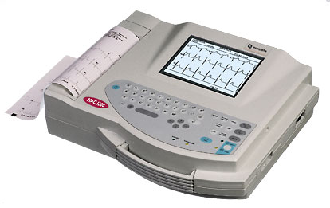
Patientnära information

Slide 18
Checklistor
Fokus – bättre diagnostik?
Fakta – bättre behandling?

Slide 19

Notes:
What the EMCC is about is teaching a systemic structure for:
1-Data acquisition
2-Directing focus on specific data
3-Diagnostic consideration
There are fairly short checklists for different processes:
1-ABCDE as generic initial management of priority one patients
2-ACID for acid-base
3-OPQRST for EKG assessment
4-HIJKL for a generic PoCUS exam
5-MAPLES for background information
6-OPQRST+ for history of present illness (or before-during-after for T-LOC)
7-C-543 for a generic neurological exam
8-Local-Distal-Function for limb examination
9-MNOP for major events
Then we have checklists for differential diagnoses:
1-KULT for HAGMA
2-CRAP for NAGMA
3-LACTATES for lactic acidosis
4-LIMBS for low anion gap
5-CONFUSED for altered level of consciousness
6-TIPPED for conditions that secondary causes of arrhythmias
7-5Is for conditions that trigger DKA/HHS
8-5M 3P for stroke mimics
These are like lego pieces that can be combined in different ways depending on the circumstances.
The advantage of having same small modular processes that one can get good at.
https://www.mentalfloss.com/article/92127/how-many-combinations-are-possible-using-6-lego-bricks
Mathematician Søren Eilers was intrigued by a LEGO-related math problem. Let's say you have six "standard LEGO bricks" (the rectangular 4x2 bricks seen in the original LEGO patent). If you fit them together, how many possible structures can you make?
This question was first officially "answered" in 1974, and LEGO mathematicians arrived at the number 102,981,500. Eilers was curious about the mathematical methodology behind that number, and soon discovered that it only covered one kind of stacking—thus, it was dramatically low. So he wrote a computer program that modeled all the possible brick combinations. After running the program for a week, he ended up with a massive number: 915,103,765 combinations.

Slide 20
Grupper & Schema

Slide 21
Frågor till gruppdiskussion
Läkare högst upp på listan i varje grupp
Ansvar att skriva ner frågor som uppstår
Notes:
Börja introducera pärmen
Alla introducerar sig

Slide 22
Lunch
Patienthotellet

Slide 23
Kursmiddag Torsdag 19:00 O’Learys

Slide 24
Checklistkompendium
Prio 1
Problem
Read-Do
Do-Confirm
Granskning / Cross-Checking
Skriv gärna namn + telnummer

Slide 25

Frågor?

