Slide 1
Diagnosis & Decision-Making

Slide 2

“diagnostic errors have represented a blind spot in the delivery of quality health care”
“continue to harm an unacceptable number of patients”
Notes:
In 2015, the Institute of Medicine published ”Improving Diagnosis in Health Care” to emphasize the importance of getting the diagnosis right and the impact of diagnostic errors.
They argue that diagnostic errors have represented a “blind spot in the delivery of quality health care” and “continue to harm an unacceptable number of patients”

Slide 3
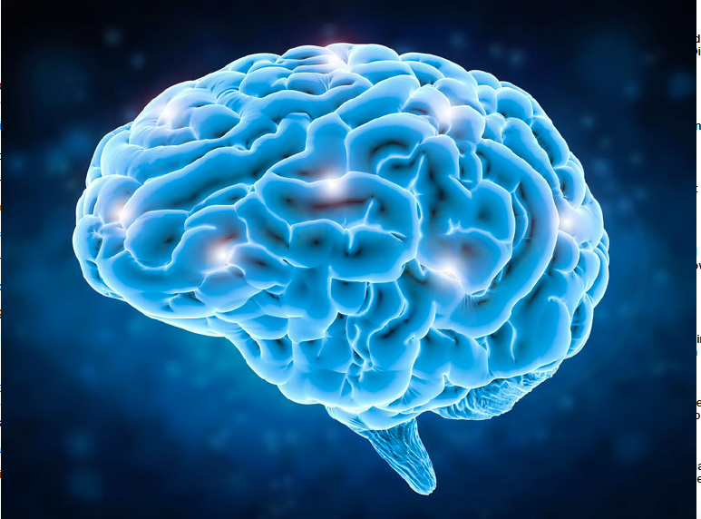
Diagnostic Errors
System-Related Errors
Limited time/data
Multitasking
Interruptions
Equipment failure
No-Fault Errors
Uncooperative patient
Cognitive Errors
Notes:
“the majority of errors that do occur result, at least in part, from the individual doctor’s cognitive processes" {Norman, 2010 #2502}, citing {Graber, 2005 #90}.
Photo: Brain concept (stock illustration) Credit: pholamaiphoto / Fotolia

Slide 4

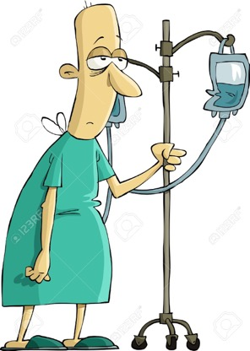
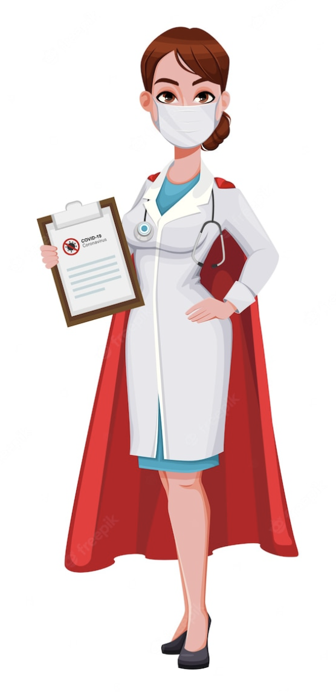
Think of Correct Diagnosis
Symptom
Chest pain
Tachycardia
Elevated CRP
Diagnosis
Acute coronary syndrome?
Anxiety?
Pneumonia?
Notes:
Patienten söker med olika problem
Läkaren träffar patienten, samlar data och börjar överväga olika diagnoser

Slide 5
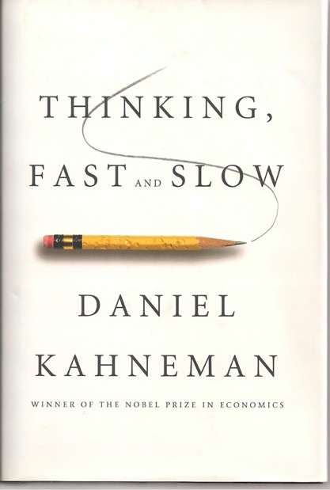
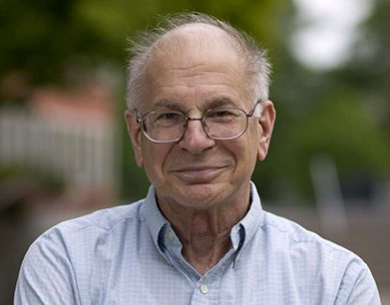
Daniel Kahneman
Notes:
So how does diagnostic reasoning work? How does thinking work in general?
Daniel Kahnemanan Israeli-American psychologist and winner of the 2002 Nobel Memorial Prize in Economic Sciences. He is notable for his work on the psychology of judgment and decision-making, behavioral economics and hedonic psychology.
With Amos Tversky and others, Kahneman established a cognitive basis for common human errors which arise from heuristics and biases (Kahneman & Tversky, 1973; Kahneman, Slovic & Tversky, 1982; Tversky & Kahneman, 1974), and developed prospect theory (Kahneman & Tversky, 1979). He was awarded the 2002 Nobel Memorial Prize in Economics for his work in prospect theory.

Slide 6
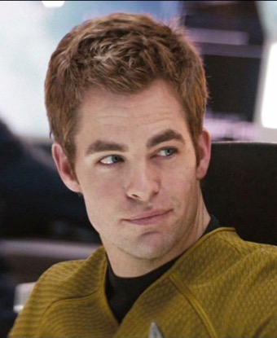
System 1
Unconscious
Pattern recognition
Jumps to conclusions
Effortless/Emotional
Notes:
Pattern recognition, striving for coherence.
2017 Norman: ”automatic, unconscious, seemingly effortless, intuitive, heuristic”

Slide 7
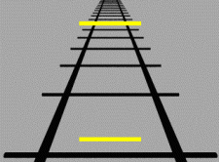
Notes:
Coherence.
And for the most part, this is a great feature. We do need to interprete information within its context

Slide 8
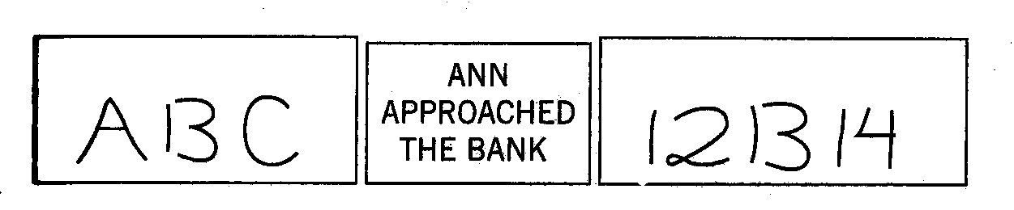

Slide 9

System 2
Conscious
Analytical
Rule-based
Tedious
Notes:
2017 Norman: ”controlled, conscious, effortful, reflective, analytic

Slide 10
System 2 needs energy
”The defining feature of System 2 . . . is that its operations are effortful”

Slide 11
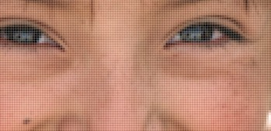
Deficient Data
Notes:
One source of diagnostic errors is insufficent data. Here, it is obvious that we lack information to recognize the person. But our System-1 is designed to jump to conclusions and can construe a very good story based on insufficient information. Our system-1 is not designed to pick up that too little information is available.

Slide 12
Young man
Pain right lower quadrant
Vomiting
What diagnosis comes to mind?
Pain reached max intensity within minutes
No peritoneal irritation
Urinalysis 4+ red cells
What diagnosis do you now suspect?

Slide 13
Jumping to conclusions
”System 1 is designed to jump to conclusions from little evidence—and it is not designed to know the size of its jumps.”

Slide 14
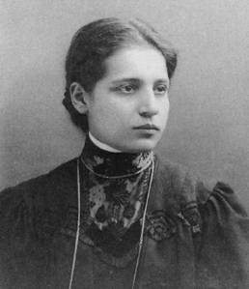
Faulty Knowledge
Lise Meitner
Notes:
Another source of diagnostic error is insufficient or faulty knowledge. Does anyone recognize this person? This is Lise Meitner, whom many historian think should have been awarded the nobel prize for understanding nuclear fission.
With pictures of people, we either recognize the person or not. But with clinical data, it is more complex.

Slide 15
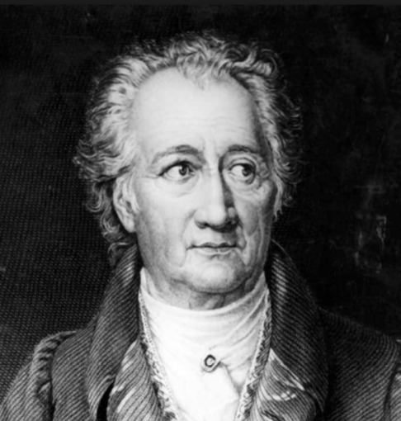
“Man sieht nur, was man weiß”
Johann Wolfgang von Goethe
Notes:
“The eyes do not see what the mind does not know”. So if we don’t know what a zebra looks like, we might not see the stripes and we recognize a horse instead.

Slide 16

Notes:
So this is a short lecture about diagnosis and diagnostic errors.
When we talk about zebras versus horses, we are talking mainly about an uncommon condition, a zebra, that is misakenly diagnosed as a more common condition, a horse.
The focus of the analogy is on the false positive.

Slide 17

Deficient Interpretation
Notes:
The third source of diagnostic error is faulty or insufficient data interpretation. Here in this pictures, there is a lot of data. The picture can be interpreted as that of a young woman or that of an old woman. The problem is that we can only see one interpretation at a time.

Slide 18
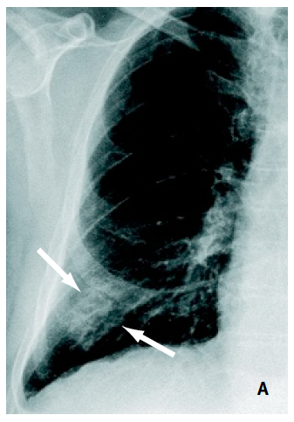
Premature Closure
Fever
Dyspnea
Cough
Pleuritic chest pain
Elevated WBC & CRP

Slide 19
Diagnostic Error: Definition
Institute of Medicine
Failure to
establish accurate and timely explanation of the patient’s health problem(s)
Failure to
Communicate that explanation to the patient
This is a problem with communication, not a problem with diagnosis
This definition does not make sense within the realm of Emergency Medicine
Notes:
So: what is a diagnostic error? The Institute of Medicine defines a diagnostic error as ” ”.
I don’t feel that this definition is applicable within the context of Emergency Medicine.
First of all, we are a the forefront of the diagnostic process. We have limited time to work-up the patient
We also have limited information.
And then there is a hindsight bias issue. For example, let’s say I suspect that a patient might have sepsis. I ordered blood cultures, administer antibiotics and fluids and admit the patient. 5 days later, the treating physicians conclude that the patient has some obscure vasculitis. Did I commit a diagnostic error?
It could even be that the physician suspected pneumonia for the wrong reasons, and that pneumonia ended up being the correct diagnosis. Was the physician’s diagnostic process then correct?

Slide 20
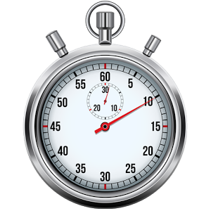
Time-Sensitive Diagnoses
Treatment within minutes-days impacts on morbidity
Notes:
The diagnoses of interest in Emergency Medicine are ”timely diagnoses”, namely diagnoses whereby treatment within seconds to days impacts on morbidity and mortality

Slide 21

Time-Sensitive Diagnoses
Pulmonary embolism
Stroke
Active GI bleed
Lung cancer
Multiple sclerosis
Chronic iron deficiency
Notes:
For example, pulmonary embolism, stroke, active gastrointestinal bleed and sepsis are timely diagnoses.
Lung cancer, multiple sclerosis, chronic iron deficiency anemia and rheumatoid arthritis are not timely diagnoses.

Slide 22
Symptom
Time-sensitive diagnoses

Slide 23
Chest Pain
Acute coronary syndrome
Pulmonary embolism
Aortic dissection
Mediastinitis
Pneumothorax
Pericarditis
Notes:
Det finns visst övriga allvarliga diagnoser som kan orsaka bröstsmärta, t ex övertrycks pneumothorax, esofagusruptur, ventrikeltakykardi. Men man upptäcker oftast dessa diagnoser när man inhämtar sin data (t ex VT på EKG är ganska uppenbart). Det finns åt andra sidan diagnoser som kan presenteras på ett mer subtilt sätt och där det finns en risk för att missa diagnosen pga ”premature closure.” Det är dessa som man bör överväga på ett medvetet sätt och som ingår i listan som finns på checklistkompendium.

Slide 24
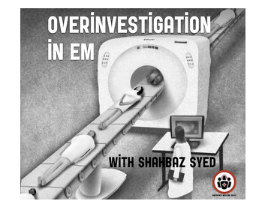
Notes:
Finally, all of us in medicine ought to be concerned about the risks of over-investigation and over-treatment.
Over-investigations harm patients and waste valuable health care resources.
The Institute of Medicine definition of diagnostic error does not address over-investigation, which is the flip-side of the diagnostic error coin.

Slide 25
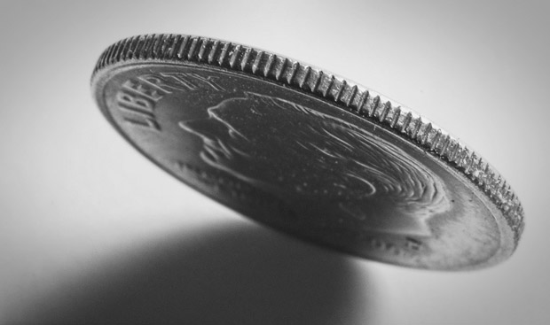
MISSED DIAGNOSIS
OVER-INVESTIGATION

Slide 26
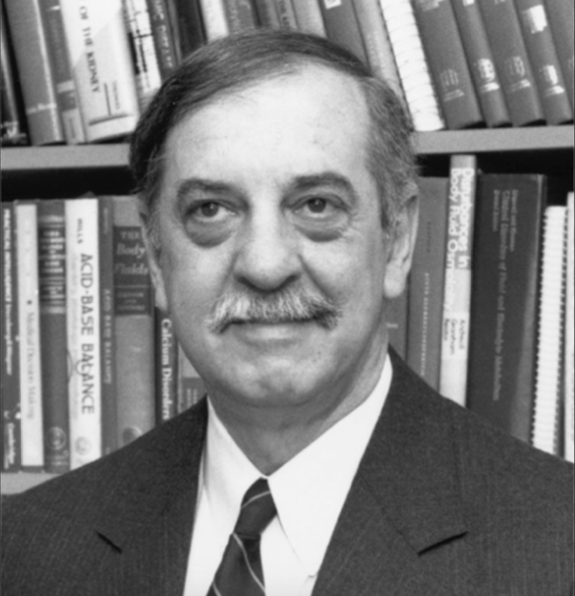
“Absolute certainty in diagnosis is unattainable, no matter how much information we gather ”
Jerome Kassirer
Notes:
Photo: Massachusetts Medical Society

Slide 27
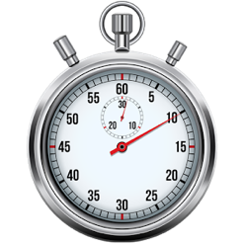
Diagnostic Error in EM
Failure to approximate the likelihoods of time-sensitive conditions based on available point-of-care information
Notes:
I think a more suitable definition of diagnostic error in Emergency Medicine would be: ” ”

Slide 28
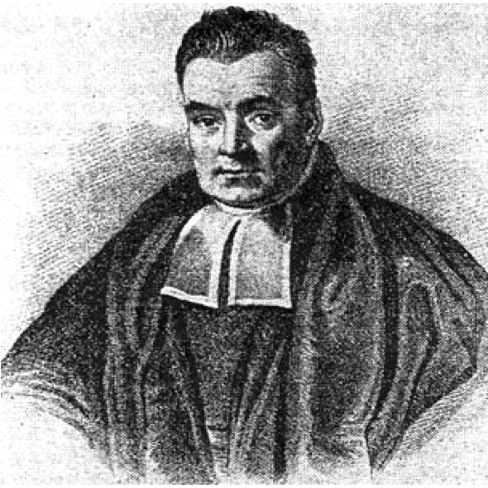
Bayes’ Theorem
Thomas Bayes
1702-1761
Likelihood
Pre-Test
Post-Test

Slide 29

Bayes’ Theorem

Slide 30
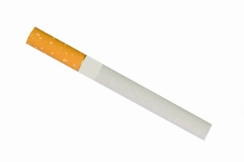
Pre-Test Probability
Notes:
We derive our pre-test probability by knowing the prevalence of a condition in our patient population.
If I meet an elderly smoker who presents coughing blood, I think lung cancer.
If I’m working in Pakistan and meet a young patient coughing blood, I think Tuberculosis.
We also take into consideration risk factors. The COVID pandemic is an on-going exercise in Bayesian reasoning. There was a brief period when a travel history to Italy or China was relevant when determining the likelihood of COVID.

Slide 31

MAPLES
Medications
Allergies
Past medical history
Life circumstances
Ethanol
Smoking

Slide 32
Bayes’ Theorem

Slide 33
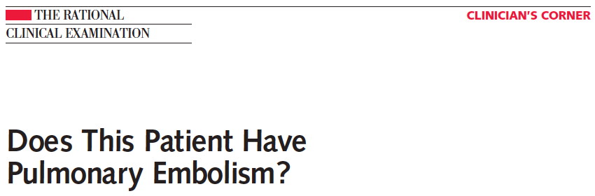
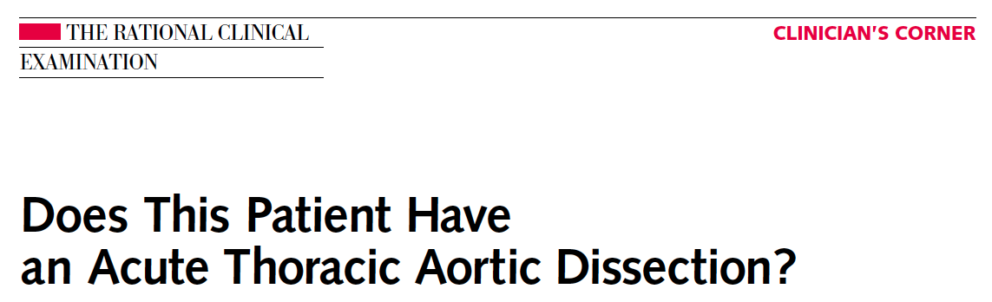
JAMA 2003;290
JAMA 2002;287
Notes:
Det finns många artiklar som redovisar för hur anamnes, status och övriga prov påverkar diagnosens sannolikhet, bland annat en artikelserie i JAMA som heter ”The Rational Clinical Examination.” Det finns artiklar om lungemboli, aortadissektion . . .

Slide 34
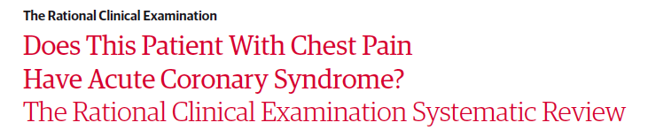
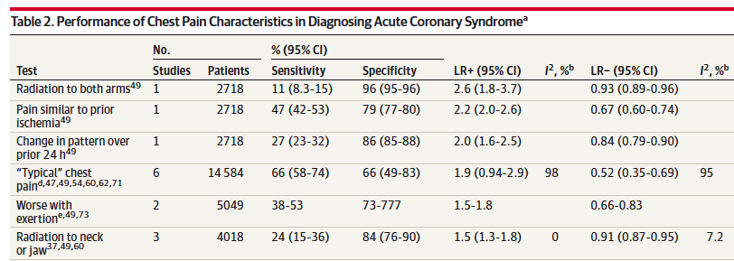

Slide 35
Likelihood Ratios
Pre-Test Odds x LR = Post-Test Odds

Slide 36

Likelihood Ratios
Ideal for Bayesian thinking

Slide 37
Chest Pain
Onset
Position
Quality
Relieving / aggravating
Severity
Time
+ − Walk (leg pain/swelling)?
  Wind (dyspnea)?
  Warm (fever/chills)?
Vitals
Heart
Lungs
Upper abdomen
Legs
CRP
EKG

Slide 39
Interrelated Likelihoods
Acute problem = one diagnosis
Hypothesis #1 ↑ Hypothesis #2 ↓
Notes:
Sedan påverkas sannolikheten för olika diagnoser av varandra.
Det är så eftersom en patient med ett akutpåkommet symptom troligen lider bara av en diagnos.
Summan av sannolikheterna för potentiella diagnoser är 1 (100%)
Om sannolikheten för en potentiell diagnos ökar påverkar det sannolikheterna av övriga potentiella diagnoser.

Slide 40
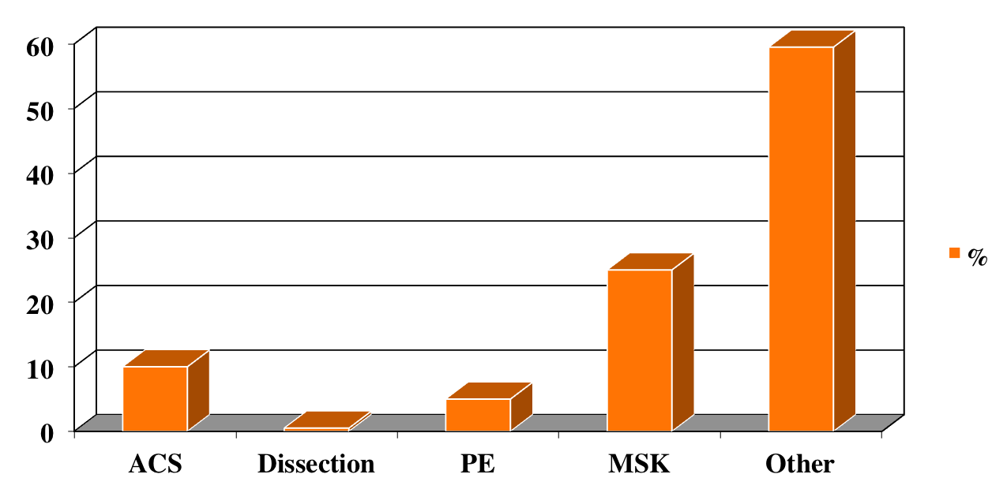
50-year-old with chest pain

Slide 41
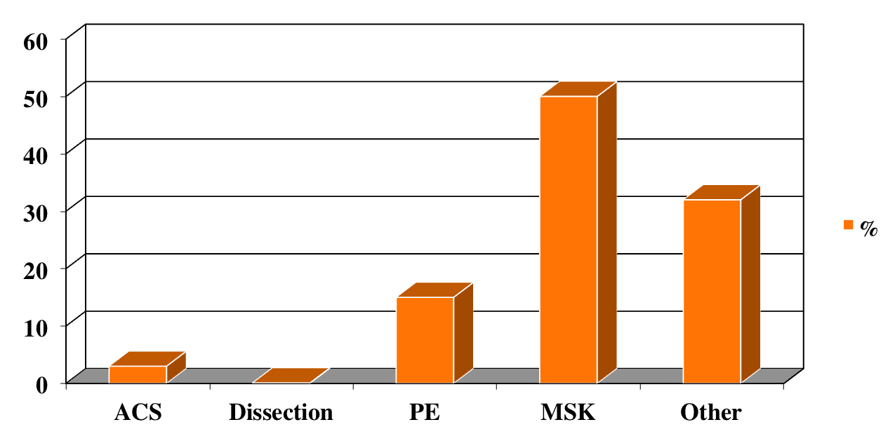
Pain worse with inspiration

Slide 42
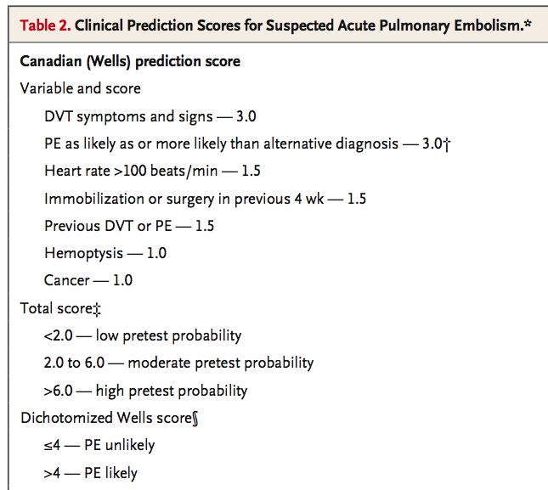
Wells score
Notes:
Återkoppling:
1-Team-leader: vad gjorde du bra?
2-Team-leader: vad skulle du göra annorlunda?
3-Observatör teamarbete: hur var det?
4-Checklista: återkoppling

Slide 43
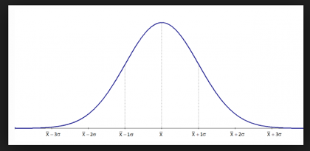
Illness Script
Mental representation of how conditions present

Slide 44
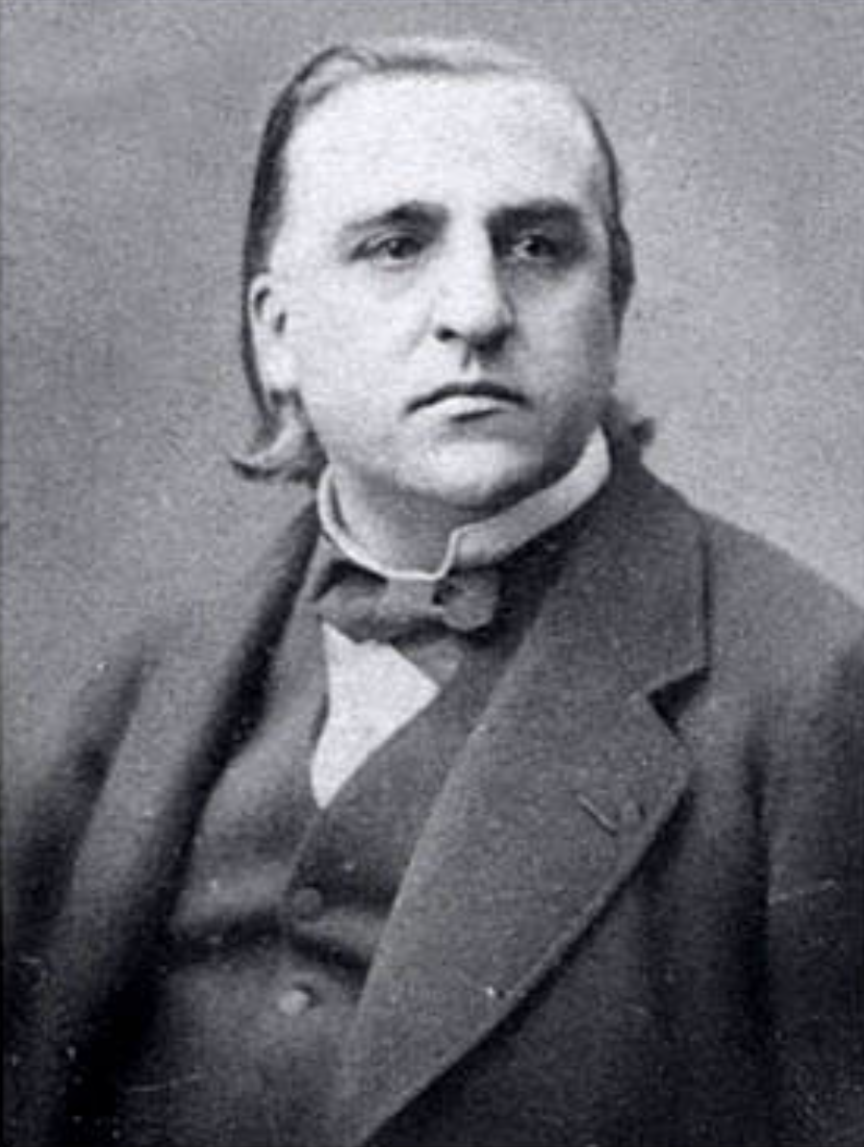
“La théorie c’est bon; mais ça n’empêche pas d’exister”
Jean-Martin Charcot
Notes:
We are likely to see what we know. So if we don’t know what a zebra looks like, we might not see the stripes and we recognize a horse instead.

Slide 46
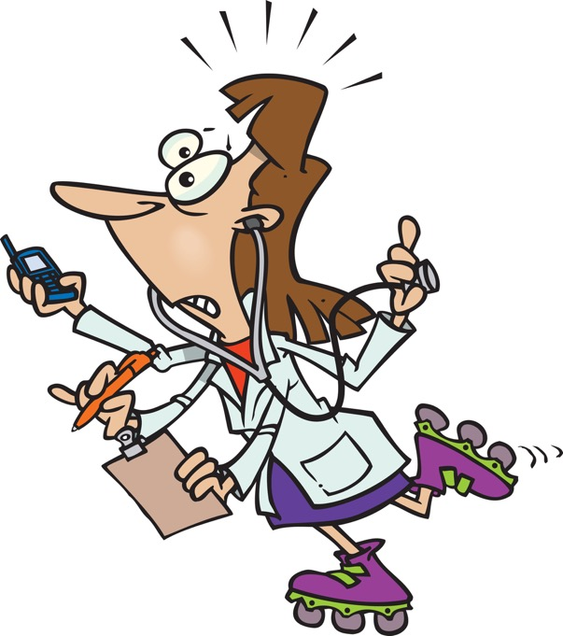
Notes:
Finally, this is how it feel during my shifts. I have very little control over how much time I can spend on various tasks. I spend most of my time reacting to events around me. If I have time for metacognition, it is after my shift, not during the shift.
So I need a strategy that is simple to use, robust (resistent to all this interruptions) and concrete. And a tool that helps me work with junior residents.

Slide 47
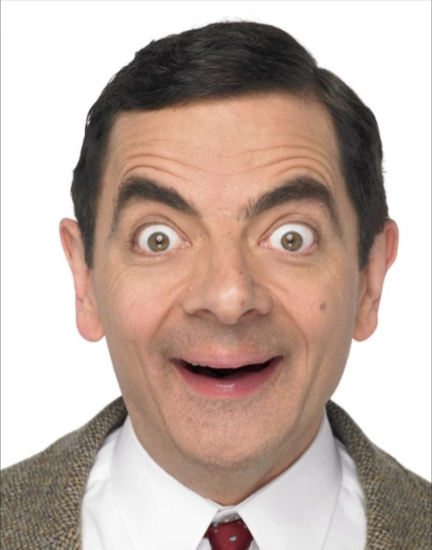


0 - 1 - 2
Notes:
Here’s the strategy that we advocate in our residency program: the 0-1-2 method.
Step 0 is symbolized here by Mr Bean. It is not cognitively challenging. It has to do with data acquisition, using a checklist.
During that time, System-1, Kirk, will spontaneously kick in and suggest diagnoses
Finally, it is time to activate System-2, Spock, but only for key diagnoses because Spock is tedious.

Slide 48
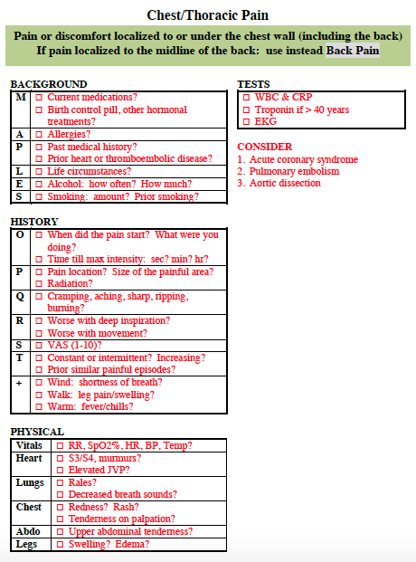
Don’t think!
Focus on getting the data
Notes:
Här finns information som påverkar ”före-prov” sannolikhet för olika diagnoser.

Slide 49
Notes:
Checklistcompendium, grön (symptoms) sida, sida 8.
Först handlar det om att hamna på rätt checklista. Notera specifikt att nomenklatur ”bröst/thorax/flank/buk/rygg” smärta kan vara oklart. Med ”Bröst/Thorax” smärta menas här smärta under bröstkorgen (inklusive ryggen) förutom i mittlinjen av ryggen.
Poängen är: viktigt att läsa noggrant texten med grön bakgrund.

Slide 50
Pericarditis?
Costochondritis?
Anxiety?
Notes:
Här finns information som påverkar ”före-prov” sannolikhet för olika diagnoser.

Slide 51
Consider
time-sensitive
conditions
Notes:
Till slut finns här viktiga ”don’t miss” diagnoser att överväga på ett medvetande sätt.

Slide 52
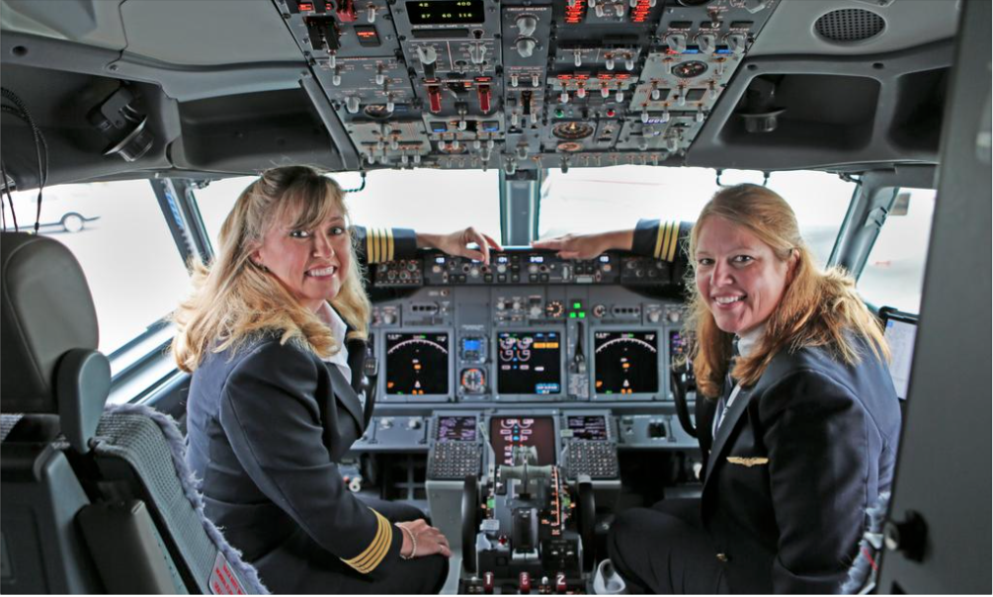
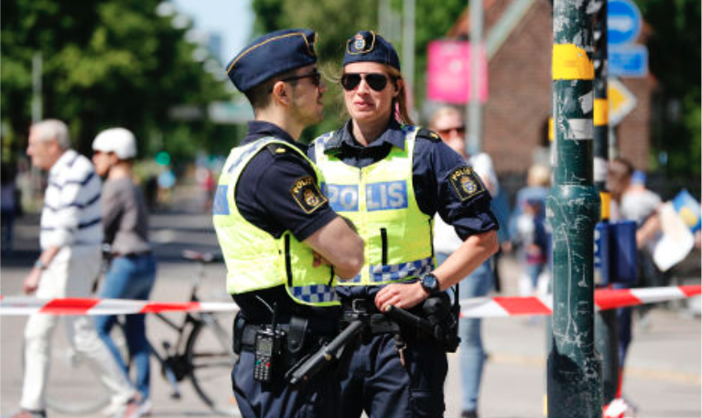
Notes:
And in both of these situations, checklists are used by a team. It could be that when we work as a team, we need to activate our System-2 more often when we are communicating.
It could also be that you are forced to be more aware of what one is doing, more conscious, more system-2, when you know that you are being observed.
For example, when policemen and policewomen work in pairs, they are not simply policing other people, they are also policing each other.
Not just policing others, but also policing themselve. Using checklists as a tool for cross-checking
Photo police: Christine Olsson, TT
Photo pilots: Lazare L. Bizjournals.com

Slide 53
Decision-Making
More tests?
Treatment?
Admission?

Slide 54
Decision-Making
More tests?
Treatments?
Admission?

Slide 55
“Our task is . . . to reduce the level of diagnostic uncertainty enough to make optimal therapeutic decisions”
Jerome Kassirer
Notes:
Photo: Massachusetts Medical Society

Slide 56
Test/Treat Thresholds
Treat
Likelihood
Test
Don’t treat
Notes:
The test and treat thresholds are not fixed in stone. They depend on the patient’s prognosis with and without investigation / treatment.
They are linked: if there is no treatment (i.e.no treat threshold), then testing for the condition is moot.

Slide 57
Test/Treat Thresholds
Test / Treatment Threshold
Diagnostic Likelihood
No Treatment / Test Threshold
Notes:
The test and treat thresholds are not fixed in stone. They depend on the patient’s prognosis with and without investigation / treatment.
They are linked: if there is no treatment (i.e.no treat threshold), then testing for the condition is moot.

Slide 58


Slide 59
Disposition Thresholds
Admit
Discharge
Notes:
The test and treat thresholds are not fixed in stone. They depend on the patient’s prognosis with and without investigation / treatment.
They are linked: if there is no treatment (i.e.no treat threshold), then testing for the condition is moot.

Slide 60
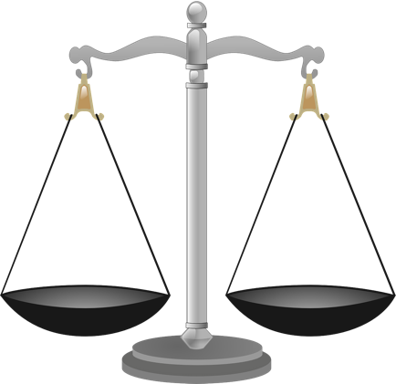
Factors Determining Thresholds
Tests:
  Risks
  Benefits
Treatments:
  Risks
  Benefits
Admission:
  Risks
  Benefits
Patient’s values
Input from relatives
Available resources
Notes:
When it comes to the final step of decision-making, I believe that Big Data will help us better estimate the risks/benefits of various investigations and treatments. Yet, decision-making also needs to take into account patient wishes and values, those of the patient’s relatives, and the availability of health care resources. I believe that decision-making will remain challenging regardless of how much support we get from artificial intelligence.

Slide 61
Diagnosis & Decision Scenarios
Data
MAPLES
History
Physical
Bedside Tests
Discussion
Likelihoods of time-sensitive diagnoses
Decision-making

